Slide 1

Predicting MBTI Personalities using NLP
Sumanth Nallamotu

Slide 2
What is MBTI?
MBTI: Myers-Briggs Personality Type Indicator
Designed to identify a person's personality type based on answers to questions
Your result is a combination of 4 different variables, each variable with 2 possibilities
Extraversion (E) or Introversion (I)
Sensing (S) or Intuition (N)
Thinking (T) or Feeling (F)
Judging (J) or Perceiving (P)
Example: I am an ENFP

Slide 3
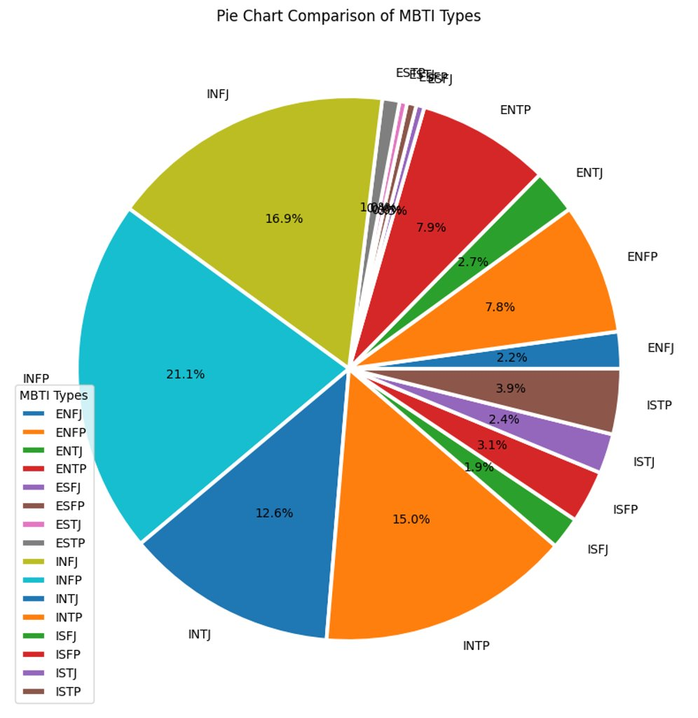
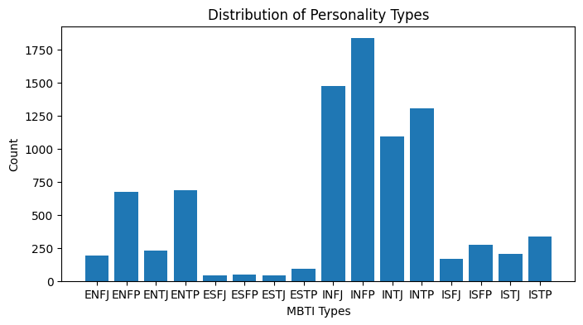
What does our data look like?

Slide 4
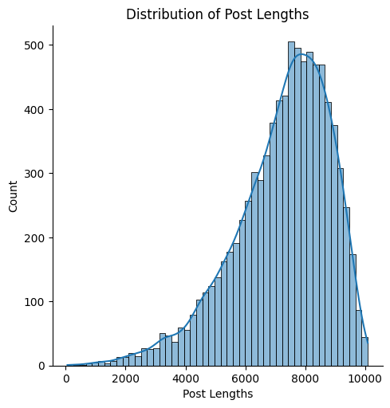
What does our data look like?

Slide 5
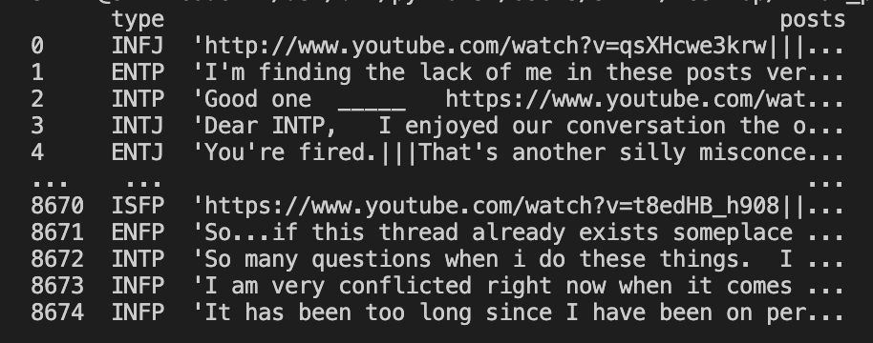
What does our data look like?

Slide 6
Data Processing
Removed extraneous information/noise with regex
URL's, symbols, HTML tags, digits
Handled stop words
Stratified when splitting the data
Vectorized the text into numeric columns
Encoded the label

Slide 7
Baseline Results
 | Logistic Regression | Multinomial Naïve Bayes | XGBoost
Precision | 0.5785 | 0.2954 | 0.6507
Recall | 0.5834 | 0.3607 | 0.6583
F1 | 0.5411 | 0.275 | 0.6480

Slide 8
Challenges
Computing limits when trying to implement LSTM
Lack of understanding for how to address particular errors + sparse findings on the Internet

Slide 9
Down the Road
Full integration with LSTM or Transformers to provide context-based conclusions to MBTI based tests
Prediction capabilities on non-test statements
Can your MBTI be accurately predicted based on how you respond to different events throughout the day rather than just MBTI questions?

