Slide 1

Group 8 ADTA 5940 - Analytics Capstone Experience
Analysis of Crime Patterns in Los
Angeles
Team Members:
Gowtham Kavvadi (ID: 11573885)
Sree Shanth Reddy Bheem Reddy (ID: 11691040)
Giridhar Reddy Bayyapu( ID: 11614290)
Sumanth Chakra Dhar Palla (ID: 11611985)
Tharuni Dusakanti
Instructor: Dr. Anthony Fantasia, PhD

Slide 2
Introduction:
The study focuses on analyzing crime patterns by location, time, weapon use, reporting delays, and victim demographics. These insights can help law enforcement better anticipate high-risk locations, modify preventive measures, and address reporting delays, ultimately improving public safety and resource allocation. . It aims to analyze crime patterns across Los Angeles, focusing on identifying geographic crime concentrations, temporal trends in crime occurrences. The study looks at these aspects in an effort to identify underlying causes of particular crime types and reporting patterns. The research problem centers on the need for more targeted and data-driven approaches to allocate law enforcement resources effectively. With insights into crime distribution by area, weapon use, and crime type, this study endeavors to support the development of location-specific and crime-type-specific strategies. Law enforcement will be able to better anticipate high-risk locations and insights, modify preventive measures, and solve reporting delays that prevent prompt crime response. This project is of considerable importance as it highlights the value of data analytics in transforming unstructured crime data into actionable intelligence.

Slide 3

Dataset Overview:
Data Source: City of Los Angeles Crime Data from 2020 to Present (Data.gov).
Collected crime incidents in Los Angeles from 2020 to the present.
It Includes 970,759 records with variables like time, location, victim information, and weapon use.

Slide 4

Hypothesis Statement
Temporal Patterns of Crime: Crime rates are higher during the end of the week and late at night, for which an LSTM model reduced training loss from 0.0117 to 0.0036.
Victim age Demographics: Older populations fall victim to fraud and similar low-violence crimes. Younger populations are more victimized in areas of high violence.
Statistical Analysis: F-statistic: 600.70, P-value: 0.0, which implies there are significant differences between the groups. The null hypothesis rejected here ensures that place, demographics, and past crime records influence high- and low-crime area classification.
Key Implication: To effectively prevent crime and allocate resources, geography, demographics, and response prioritization play an important role.

Slide 5
Methodology
Data Cleaning
Missing values such as Vict Age, Vict Sex, Vict Descent, DATE OCC, and Date Rptd were either by filling it with values or by removing missing data. Removing duplicate values to avoid repeated counting. Age outliers are deleted to maintain logical data.
Columns like DATE OCC and Date Rptd were put in the right format to datetime types for accurate calculations.
Dataset was gathered to calculate for each region and provide age distribution by crime types. Specific days like holidays were highlighted within the data and especially, on those days crime rates were compared with average daily rates.
The ANOVA approach was used to analyze variations in reporting delays among crime types.
Software Tools Used:

Slide 6
Exploratory Data Analysis:
Categorial variables are changed to more readable forms such as crime descriptions. The victim descent column was a single-letter code for ethnic groups that was connected to full descriptions. Later, weapon types were gathered into larger categories.
The criminology day was rescheduled to begin at 5 AM and close at 4:59 AM. According to standard criminology patterns, this modification enables incidences recorded throughout the late hours (the early hours to five in the morning.) to be classified as belonging to the preceding day.
To examine patterns at night, incidents that happened between 10:00 PM to 5 AM were filtered.
For time series analysis, crimes were combined into a daily count, which made it possible to apply temporal prediction models such as LSTM.
Used various visualizations like bar charts, scatter plots, and violin plots to analyze crime trends and distribution.
One-way ANOVA revealed significant differences in mean reporting delays across various crime types, highlighting the influence of crime type on reporting urgency (F-statistic: 600.70, p-value < 0.05).

Slide 7
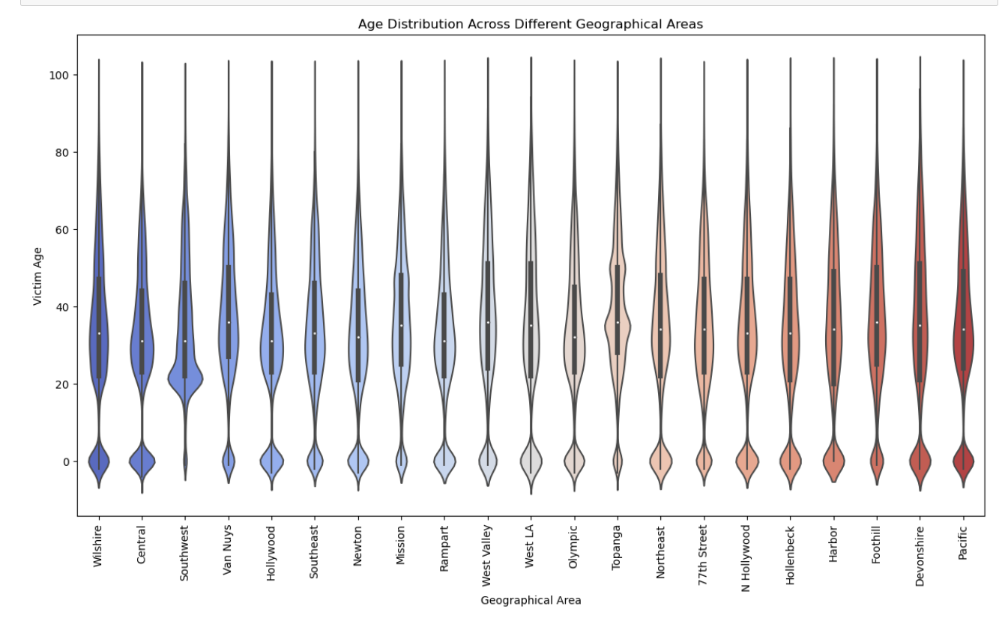
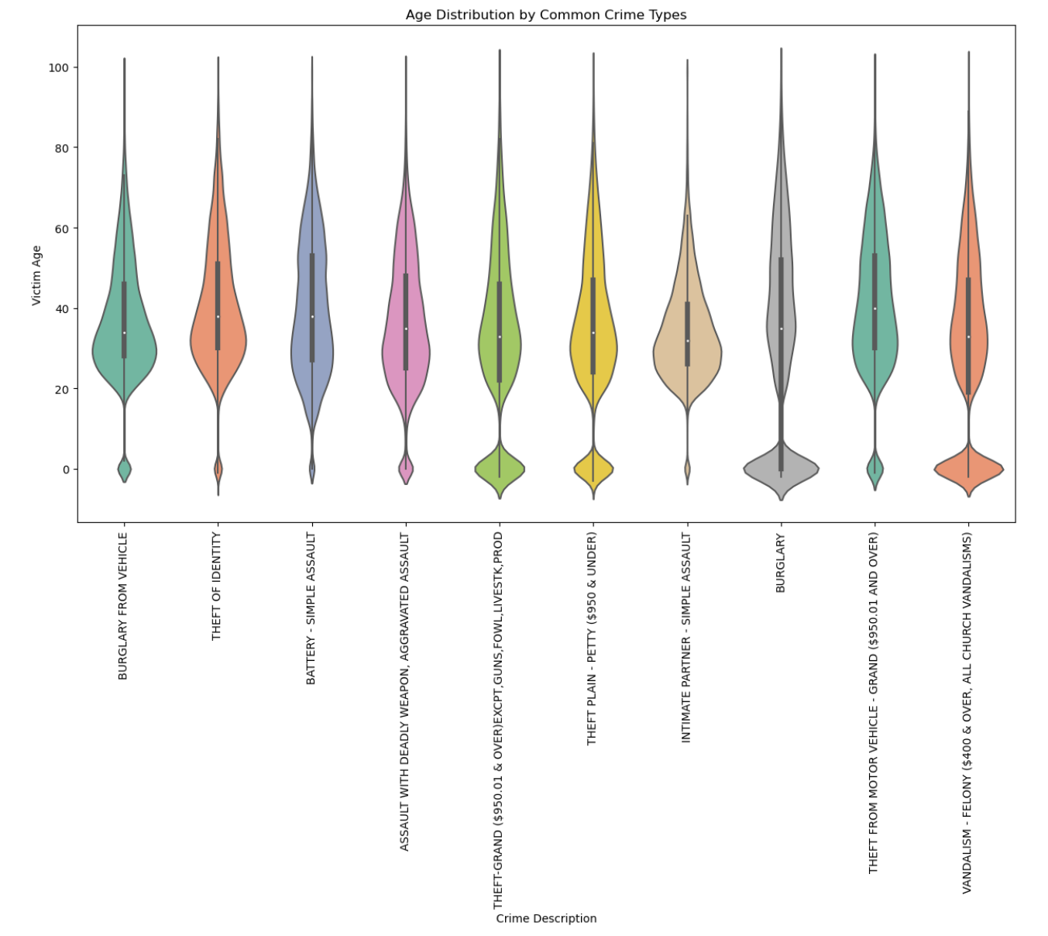
Impact of Age Demographics on Crime Rates Across Geographical Areas:
Visualization
Violin plots used to show the age distribution of victims across areas and crime types.
Width of the violin indicates the prevalence of victim age in each area or crime type.
Rejected the null hypothesis.
Geographical Distribution
Different areas show distinct age patterns.
Some areas have predominantly younger victims; others show
a broader age range.
Crime Type and Victim Age
Certain crimes target younger individuals more (e.g., robbery).
Crimes like theft or burglary involve victims across a wider age range.
Insights
Helps understand crime demographics across city regions.
Aids in developing age-specific crime prevention strategies.

Slide 8
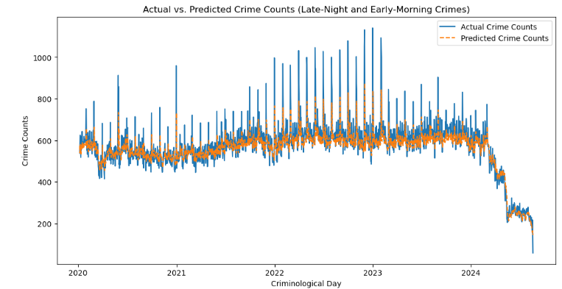
Time-Based Crime Analysis Approach
Defined 'Criminological Day’ starting from 5 AM to group incidents.
Focused on late-night (10 PM to 5 AM) high-risk hours.
LSTM neural network used for time-series forecasting.
Supports the alternative Hypothesis.
Interpretation
Training loss reduced from 0.0117 to 0.0036 across 10 epochs.
Successfully captured day-by-day variations.
Graph shows close match between actual and predicted crime counts.
Recommendations
Targeted patrols during high-risk times (e.g., late-night weekends).
Enhanced resource allocation to high-crime areas.

Slide 9
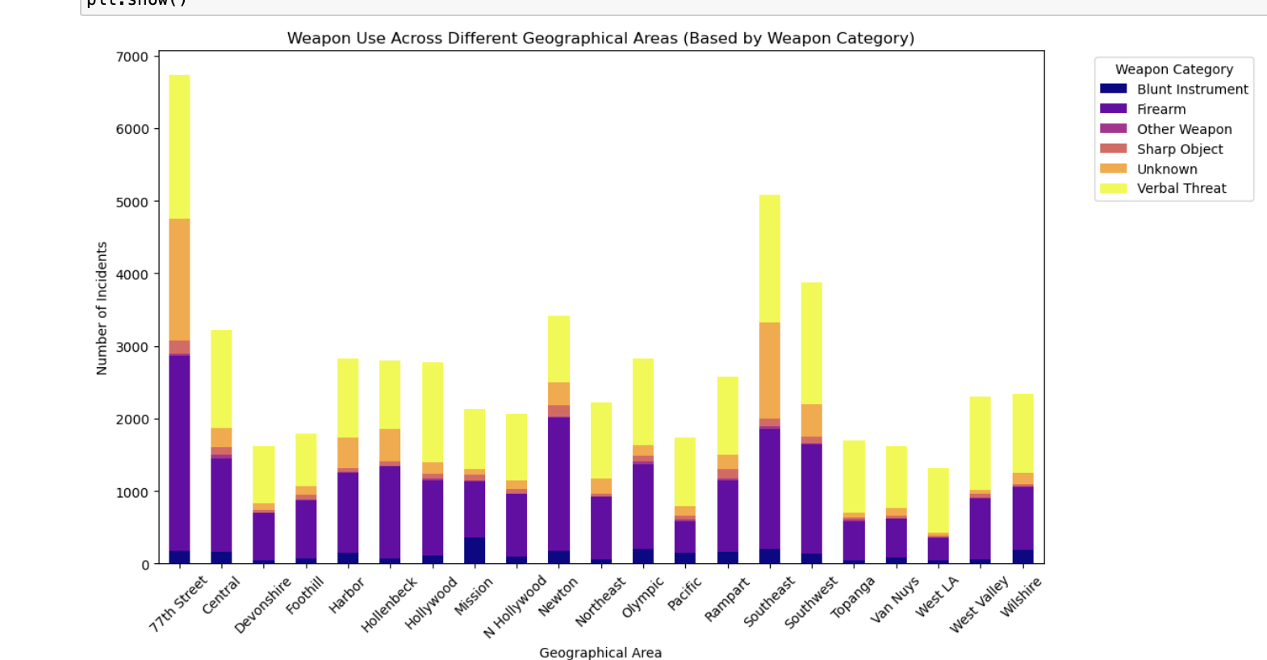
Variation in Weapon Use Across Crime Types and Geographical Areas:
Weapons grouped into categories: Firearms, Blunt Instruments, Sharp Objects, Verbal Threats, Unknown.
Columnar bar charts used to visualize weapon types by area.
Sections inside bars represent event counts per weapon type.
Regional variations:
Firearms more prevalent in dense areas (e.g., 77th Street, Southeast).
Blunt instruments and verbal threats dominate less populated areas.
Interpretation :
Insights from descriptive analysis improve predictive crime models:
Identify high-risk areas prone to gun-related crimes (e.g., Central, Mission).
Geo-targeted approaches enhance forecasting and resource allocation.
Supports proactive strategies to deploy law enforcement resources effectively.

Slide 10
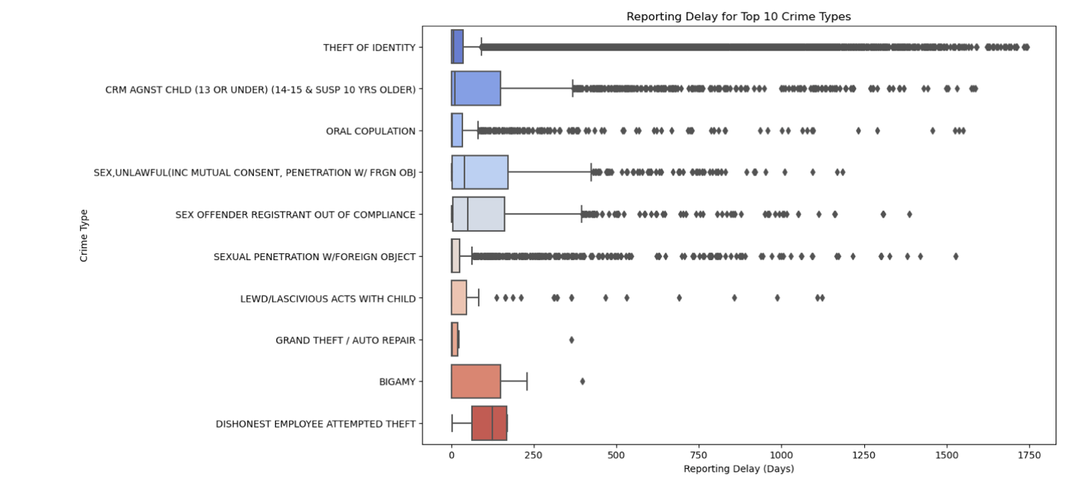
Relationship Between Crime Type and Reporting Time:
Visualizations: Box plots for crime categories and top 10 crime types with the longest delays.
Statistical Test: One-Way ANOVA for significance in reporting delays.
Serious offenses (e.g., assault) are reported faster than nonviolent crimes (e.g., fraud, identity theft).
Nonviolent crimes involving personal data (e.g., fraud) often face significant delays.
ANOVA Results:
F-statistic: 600.70, p-value < 0.05.
Insights:
Earlier reporting facilitates faster law enforcement responses and prevents future crimes.
Longer delays for specific crimes (e.g., fraud, identity theft) highlight the need for monitoring systems.

Slide 11
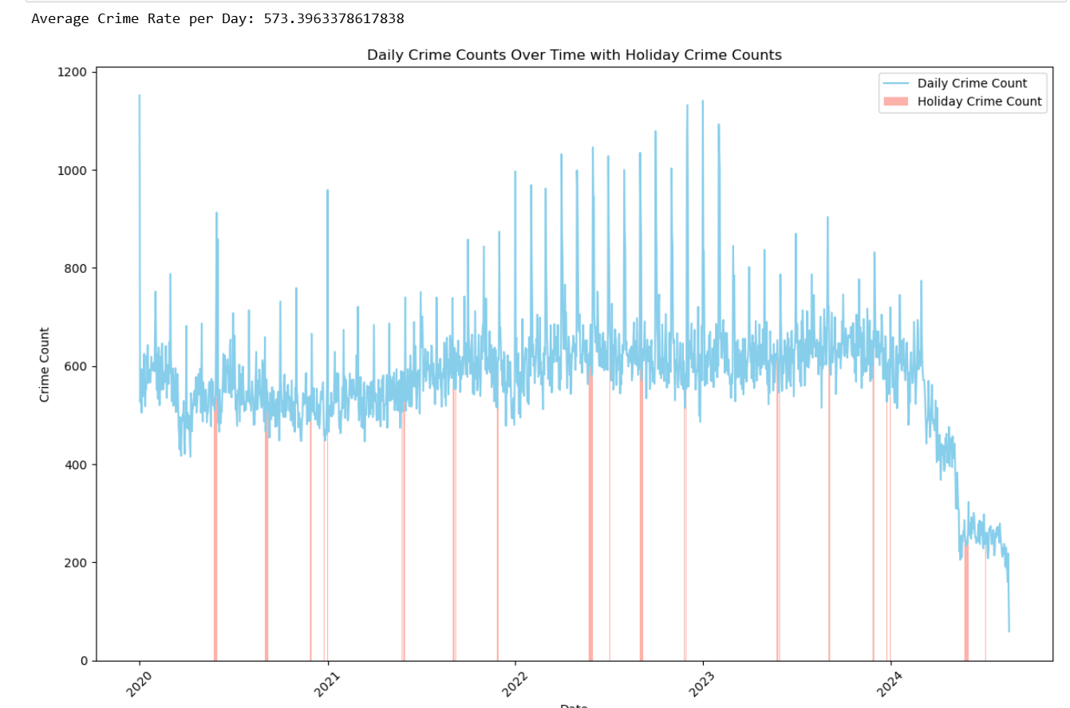
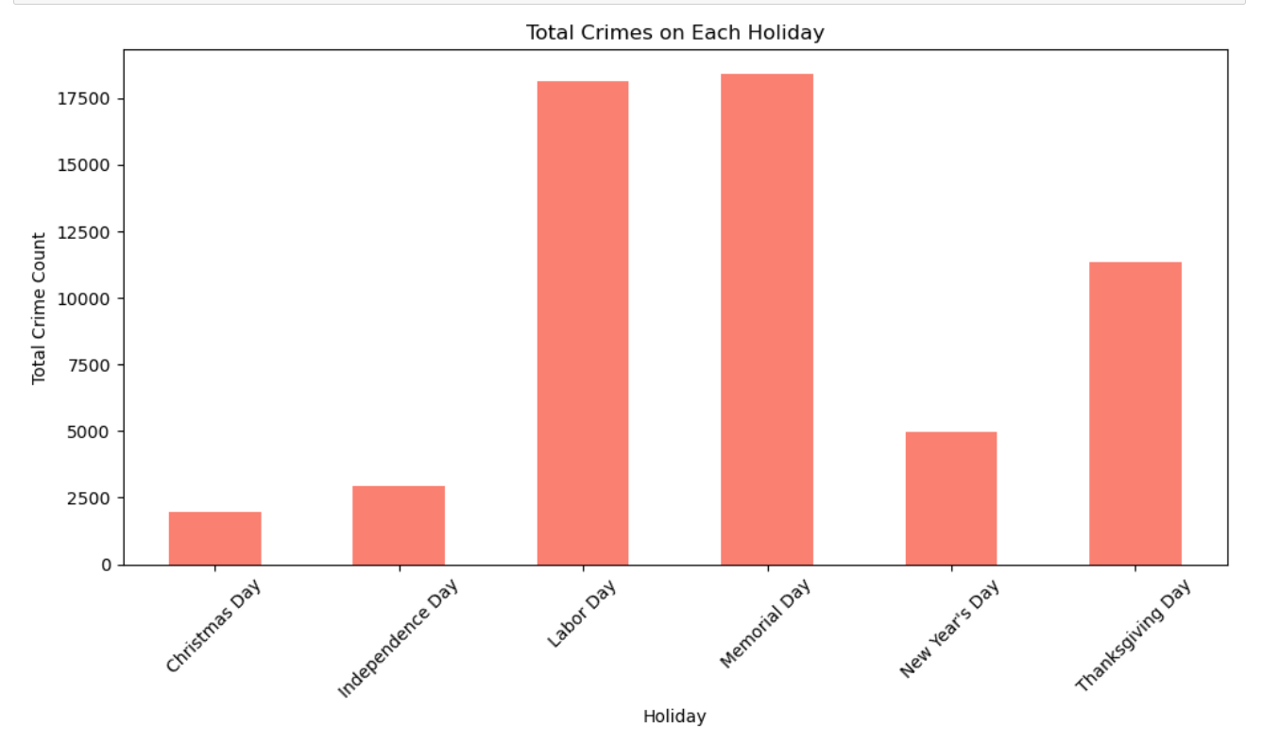
Comparison of Crime Rates During Holidays and Regular Days
Total crimes on holidays are not much higher than average daily crime rates on regular days.
While holidays as high-risk for certain crimes, overall crime levels during these times remain similar to regular days.
Line graph: Daily crime counts with holiday crime counts highlighted.
Bar chart: Total crimes on each holiday.
Insights support resource allocation for policing during high-risk holidays with public events.
Daily Crime Patterns:
Crimes do not consistently spike on holidays.
Occasional increases observed during holidays with large public events (e.g., Labor Day, Memorial Day).
Holiday Crime Insights:
Holidays like Labor Day and Memorial Day see more crimes.
Public celebrations lead to higher crime rates compared to calmer holiday settings.

Slide 12
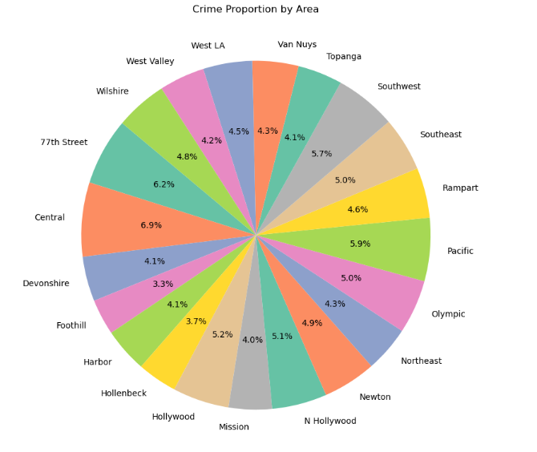
Spatial Crime Classification Approach Using XGBoost
XGBoost model used to classify areas as high-crime or low-crime.
Features: Location, demographics, past crime records.
Model trained to identify crime-prone neighborhoods.
Achieved 99.15% accuracy on the test set and rejected the null hypothesis.
Crime Distribution
Central: Highest crime rate (6.9%), followed by 77th Street (6.2%) and Pacific (5.9%).
Foothill: Lowest crime rate (3.3%).
Recommendations
Increase patrols in high-crime areas.
Conduct targeted interventions during high-risk periods.
Focus on late-night and weekend patrols for better community safety.

Slide 13
Conclusion:
Our study examined the crime patterns of Los Angeles from a number of perspectives, including geographic distribution, time series analysis, weapons usage, victimology, and lags in reporting.
Key Results:
Geographic Profiling: Identification of high-crime areas for resource allocation and proactive intervention.
Temporal Patterns: Identification of late-night criminal activities for targeting patrols.
Demographics: Identification of age and type of crime for age-specific strategies.
Weapon Usage: Identification of regional variations to tailor enforcement.
Reporting Delays: Faster reporting is associated with effective responses.
Impact: Insights into data-driven strategies for law enforcement include improving public safety and resource efficiency.

Slide 14
Further Improvements:
Including demographic data such as income, education, employment status, etc.
Calculating response time in minutes or hours to analyze the efficiency of the response time of police.

Slide 15
Reference:
Chatzisymeonidis, S., & Pina, A. (2024). Exploring police attitudes on victims’ delayed reporting and victim blame in technology-facilitated IPV. Crime Science, 13, 12. https://doi.org/10.1186/s40163-024-00213-x
Lam, W. (2020). Christmas criminals: A routine activity approach to crime on U.S. holidays. James Madison Undergraduate Research Journal, 7(1). Retrieved [Month Day, Year], from http://commons.lib.jmu.edu/jmurj/vol7/iss1/5
Mitra, R., Abedin, M. T., & Sen, K. K. (2023). Does an ageing population affect crime rates in the United States? Social Indicators Research, 170(3), 825–845. https://doi.org/10.1007/s11205-023-03223-5
Pizarro, J. M., Zgoba, K. M., & Pelletier, K. R. (2021). Firearm use in violent crime: Examining the role of premeditation and motivation in weapon choice. Journal of Primary Prevention, 42(1), 77–91. https://doi.org/10.1007/s10935-020-00595-z
Prieto Curiel, R. Weekly Crime Concentration. J Quant Criminol 39, 97–124 (2023). https://doi.org/10.1007/s10940-021-09533-6
Sharma, H. K., Choudhury, T., & Kandwal, A. (2023). Machine learning based analytical approach for geographical analysis and prediction of Boston City crime using geospatial dataset. GeoJournal, 88(Suppl 1), 15 27. https://doi.org/10.1007/s10708-021-10485-4

Slide 16
THANKYOU

