Slide 1
Multi MAILBOX
Manisha & Sumanth Reddy

Slide 2
Description
Problem Statement:
Checking emails regularly during the day in different tabs can be a time consuming way to
keep inbox at manageable levels. So, the effective approach is to easily access multiple Inbox
concurrently.
Solution:
This Project deals with managing of multiple Email Inbox view in a very creative and user
Friendly manner.

Slide 3
UML Diagram
Gmail Account
View Multiple Mail Services
User
Mail Box view
Outlook
Account

Slide 4
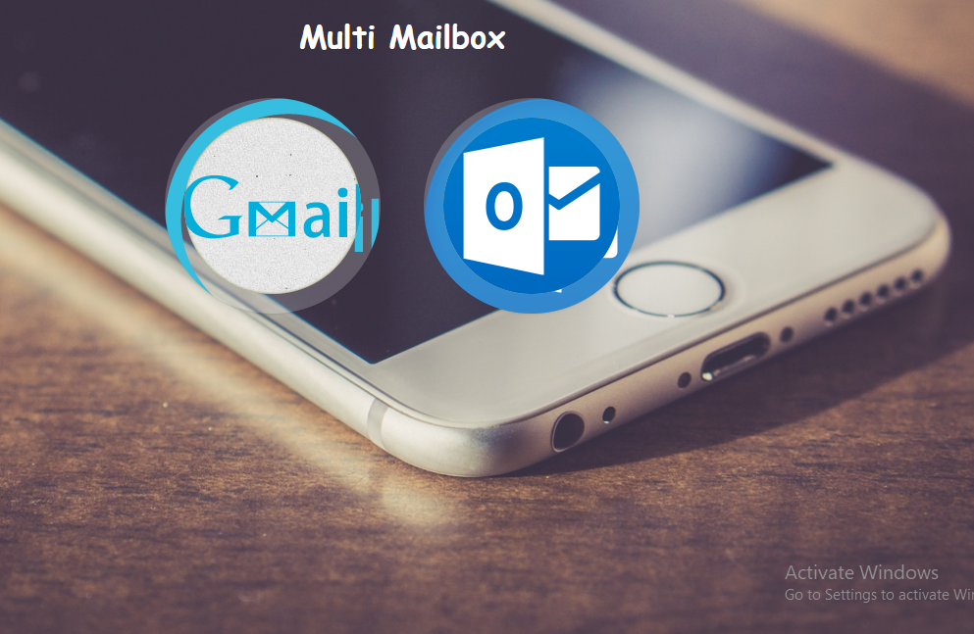
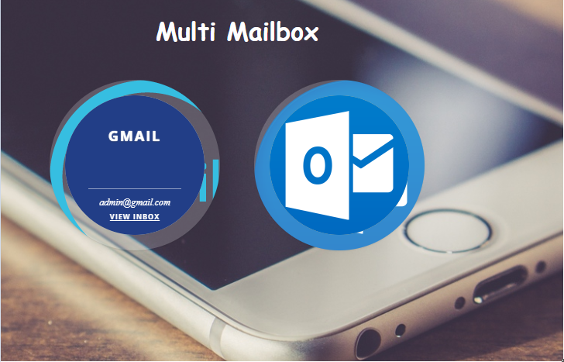
Home PAGE – UI

Slide 5
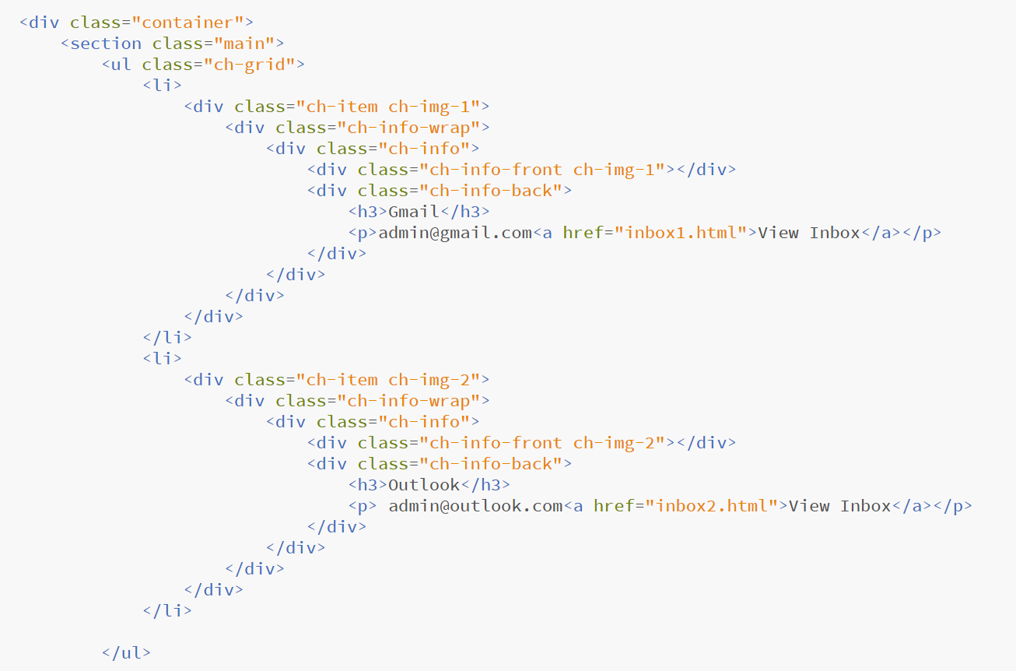
HTML code

Slide 6
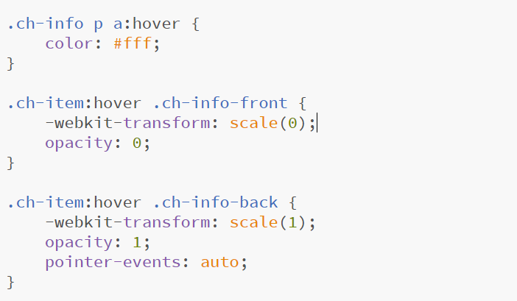
Image hover code

Slide 7
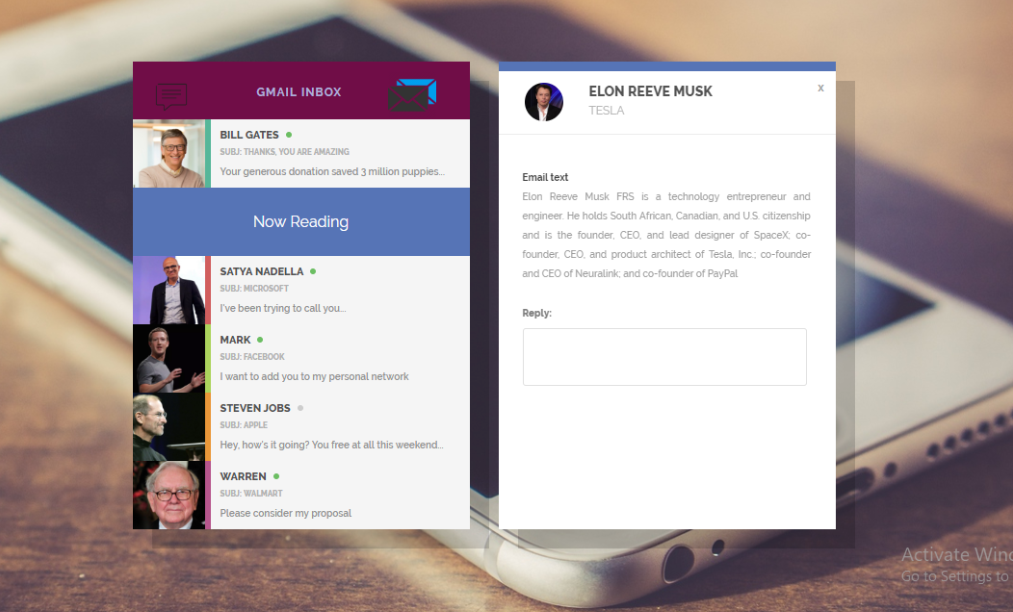
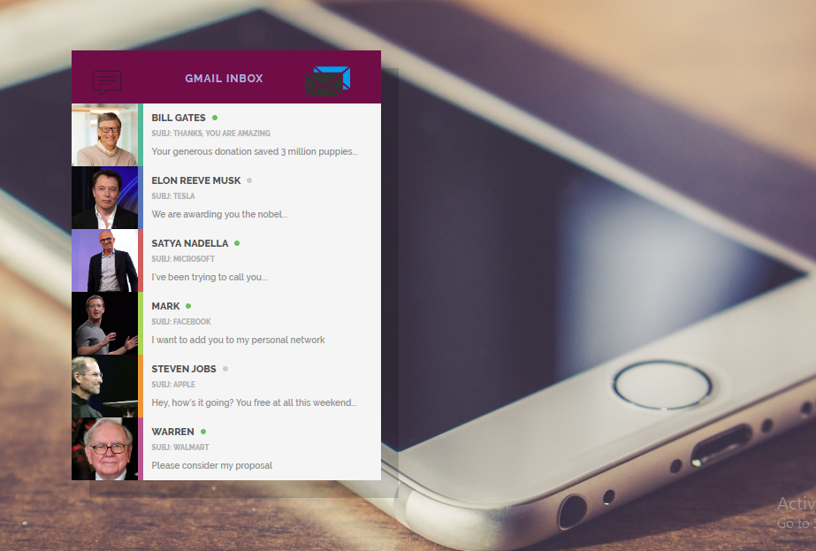
INBOX UI

Slide 8
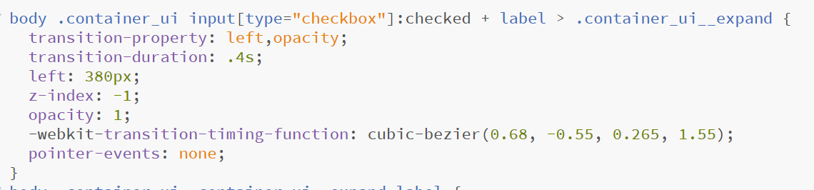
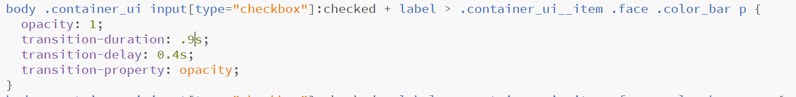
INBOX VIEW – ON checked HOVER CHANGE code

Slide 9
Testing
HTML Validator
CSS Validator
Safari
chrome
Mozilla

Slide 10

DEMO

