Slide 1


Yahoo Financial Application Using Streamlit
Prof.Minh Phan
Sai Sumanth Sripada

Slide 2
OUTLINE
To Build a Financial Dashboard Using Streamlit by Fetching the below stock data from the Yahoo finance
Stock Summary
Chart
Statistics
Financials
Stock Analysis
Monte Carlo Simulation to predict the future Prices.

Slide 3
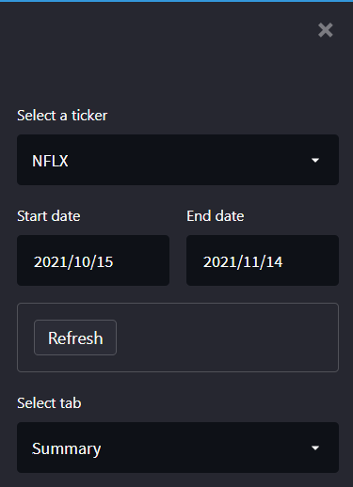
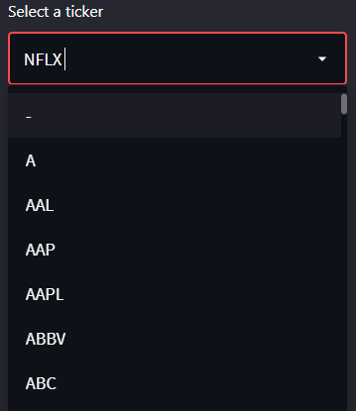
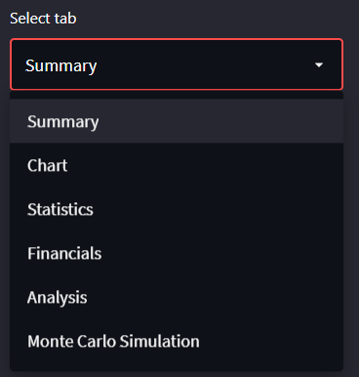
Streamlit Overview
Streamlit Sidebar acts as a navigator to toggle between tabs and to select the common parameters for all the tabs
Dropdown to Select Ticker and to switch between multiple tabs
Update Button Refreshes the page.

Slide 4
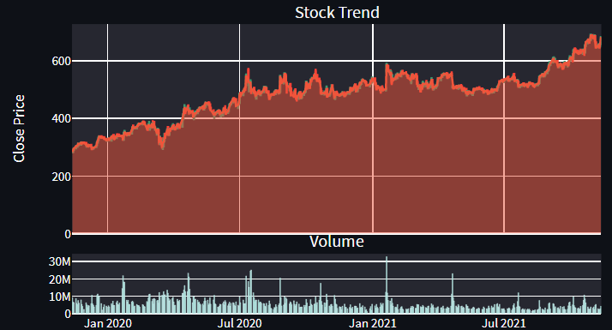
Stock Summary
Stock Summary Gives us the details about the details like opening and closing price of the stock over the selected period.
Function to get the Stock Summary : get_quote_table & get_data
Netflix Stock Summary Example

Slide 5
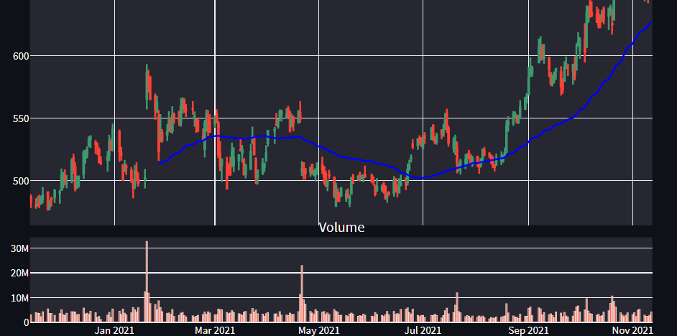
Chart
Chart displays the visual representation of stock trend over the period.
To Fetch the data, get_data Function is used.
Example Plot for the Netflix Sock for the period of 1 Year
Volume, Moving Average and the trend can be observed from the chart.

Slide 6
Stock Statistics
To get the Stats like valuation Measures, History, Profitability of the required stocks
get_stats_valuation & get_stats are the functions used to fetch the stats data.

Slide 7
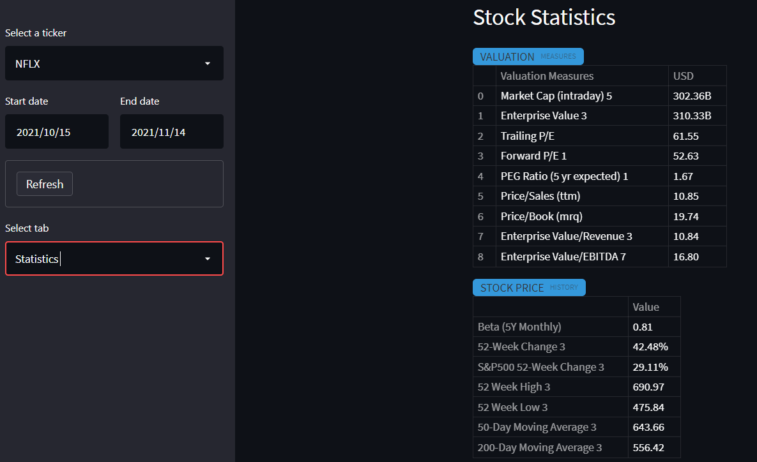
Statistics Streamlit Dashboard
For the Selected Stock and the duration, We can see the statistics of that stock

Slide 8
Financials
Financials gives us the insight on the Annual and Quarterly Revenues of the company and the worth.
Income Statement , Balance Sheet & Cash Flow data can be fetched using functions get_income_statement , get_balance_sheet & get_cash_flow

Slide 9
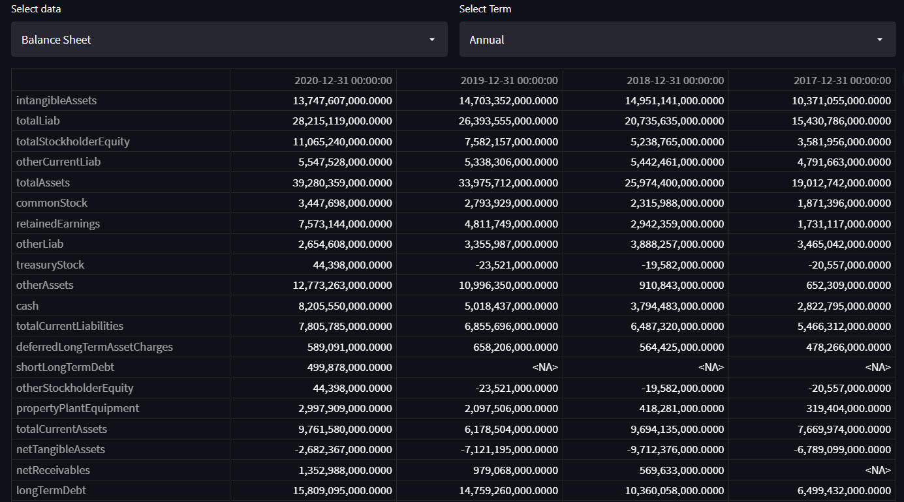
Financials Streamlit Snippet
Income Statement, Balance Sheet & Cash Flow Can be Fetched Both Annually and Quarterly

Slide 10
Analysis
Stock Analysis is to fetch the stock history and the analysis based on the data and future estimates like Earnings and Revenue estimates for the next few quarters.
Function get_analysts_info is used to fetch the analysis of stocks

Slide 11
Monte Carlo Simulation
Monte Carlo Simulations helps to find the probability of uncertain outcome and associated risks. We are using this method to predict the future stock price and the Value at Risk based on the historical data.
With pandas_datareader we can scrape the required data for the simulation

Slide 12
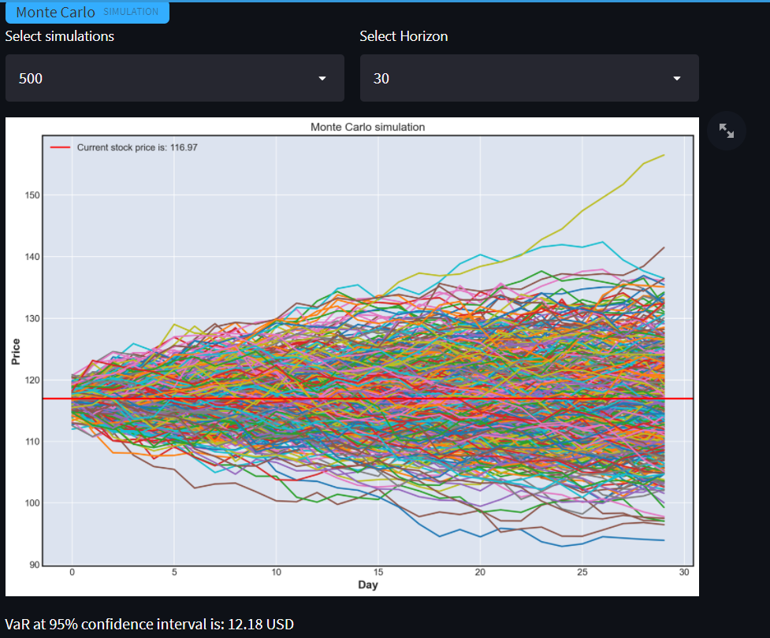
Mont Carlo Streamlit Snippet
With the selected number of simulations and the time horizon, we can see the plot of the simulated results.

Slide 13
References
Annotated Text - https://discuss.streamlit.io/t/annotated-text-in-streamlit/9260
Navigation Bar - https://youtu.be/hoPvOIJvrb8
Volume in Plotly - https://stackoverflow.com/questions/64689342/plotly-how-to-add-volume-to-a-candlestick-chart
Monte Carlo Simulation – Based on what was learnt in the session
Streamlit Related - Official Streamlit docs/ Community threads - https://docs.streamlit.io/library/api-reference

