Slide 1

$ git status
Agentic Development
for Java Teams
From Specs to Production with AI Agents
from vibes to context
Sumanth KS Giridhar Gopal
Java Meetup · illustrated with one Interview Buddy app

Slide 2

WHERE WE ALL START
Vibe coding: prompt, accept, repeat
You describe what you want in a chat, the AI writes something plausible, you eyeball it and move on. Fast and fun for a weekend hack — you’re coding on vibes, not on a shared understanding of the project.
“Add an endpoint to schedule a mock interview for a candidate.”
What it never asked
you
Sure! Here’s a InterviewController with a POST mapping, a new service method, and a JPA save. ✅
Which layer pattern do we use?
Can a candidate double-book a slot?
How do we validate & audit?
What do our tests look like?
AI
“Looks right — ship it.” 😎
you
It guessed. On a weekend project that’s fine. In a real codebase, guesses compound.
02

Slide 3




WHY IT BREAKS DOWN
The problems with coding on vibes
Hallucinated APIs
Convention drift
Broken contracts
Re-explaining forever
Invents methods, beans and config that don’t exist in your project.
Field injection here, constructor there — every file its own style.
Ignores the rules that matter: validation, auditing, no double-booked slots.
Every new chat starts from zero; you paste the same context again and again.
The root cause: the model has no durable knowledge of your project. Each prompt is a fresh stranger doing their first day — with no onboarding.
03

Slide 4


THE FAILURE YOU ACTUALLY FEEL
An unfinished task, with no context to fall back on
Halfway through the scheduling feature the session ends — context window fills, you close the laptop, a new chat begins. Without written context, the agent can’t resume; it restarts.
›
›
›
Started well
Mid-task
Session ends
New chat
Wrote InterviewController + service
Tests half-written, DTO not mapped
Context lost — nothing written down
“What were we building?” — starts over
No memory, no map. The work that was already done isn’t lost in the repo — it’s lost in the agent’s head. Re-discovering “how this project does things” every single time is the tax you pay for having no written context.
05

Slide 5




WHAT “AGENTIC” ACTUALLY MEANS
An agent is a loop, not a one-shot answer
Vibe coding is one prompt, one reply. An agent keeps going on its own — it plans, edits files, runs the build, reads the result and corrects course. That autonomy is exactly why missing context hurts: it compounds across the loop.
1. Perceive
Reads the goal + repo: “add a daily session limit”
You stay in the loop
2. Plan
Update InterviewService, entity, add tests
Agents propose; humans approve the gates that matter.
Tools are sandboxed — tests, linters, build; not prod creds.
Publishing a candidate’s score stays a human decision.
Autonomy is a dial, not a switch — turn it up as trust grows.
3. Act
Writes code, runs mvn test & the build
4. Reflect
Year-end test fails → fixes & repeats
↻ repeats until the task is done
06

Slide 6



THE FIX
Write the context down, once, in the repo
Instruction files are plain markdown that lives beside your code. The agent reads them on every run — so the onboarding happens once, not every prompt. Three names you’ll meet, same core idea:
copilot-
instructions.md
CLAUDE.md
AGENTS.md
GITHUB COPILOT
CLAUDE / CLAUDE CODE
OPEN STANDARD
Repo-wide rules Copilot applies to every suggestion & chat.
Project memory Claude loads automatically each session.
Vendor-neutral file many agents read — one file, many tools.
Different ecosystems, same job: give the agent a briefing it can actually read.
07

Slide 7

INSTRUCTION FILES · 1 OF 3
copilot-instructions.md
GitHub Copilot’s repo-wide briefing — lives in .github/ and applies to every suggestion.
What is it
.github/copilot-instructions.md
A markdown file Copilot auto-loads for the whole repo. No need to repeat rules in each prompt.
# Interview Buddy — Copilot
## Stack
Spring Boot 3, JDK 21, Postgres
## Always
- Constructor injection
- DTOs at the web layer
## Never
- Expose entities in the API
- Allow double-booked slots
What it does
Steers inline completions and Copilot Chat toward your stack, patterns and guardrails.
What it contains
Tech stack, architectural patterns, coding standards, and project-specific do’s & don’ts.
08

Slide 8
INSTRUCTION FILES · 2 OF 3
CLAUDE.md
Claude Code’s project memory — loaded automatically at the start of every session.
What is it
CLAUDE.md
A memory file Claude reads on launch. Can sit at repo root, in subfolders, or your home dir.
# CLAUDE.md
## Commands
build: mvn clean verify
test: mvn test
run: mvn spring-boot:run
## Conventions
- Tests: JUnit 5 + Testcontainers
- No overlapping interview slots
- Mask candidate PII in logs
What it does
Gives Claude standing context + the exact commands to build, test and run before it acts.
What it contains
Project overview, key commands, conventions, and links to deeper docs or sub-module files.
09

Slide 9
INSTRUCTION FILES · 3 OF 3
AGENTS.md
An open, vendor-neutral standard — one file that many different agents agree to read.
What is it
AGENTS.md
A shared convention adopted across tools, so you don’t maintain a separate file per vendor.
# AGENTS.md
## Setup
JDK 21 + Docker for Postgres
## Testing
- Run: mvn test
- New logic needs a unit test
## Pull requests
- Conventional commits
- Green build before review
What it does
Acts as the single source of truth; tool-specific files can point back to it.
What it contains
Setup, build & test steps, code style, PR/commit rules — the same briefing, tool-agnostic.
10

Slide 10



AN ANALOGY
Think of it as the new hire’s onboarding binder
A brilliant contractor joins every morning with total amnesia. Without an onboarding binder, you brief them from scratch daily. Instruction files are that binder — written once, read every day.
The amnesiac contractor
= the AI assistant
Sharp and fast, but remembers nothing once the session ends.
The onboarding binder
= CLAUDE.md / AGENTS.md
House rules, stack, conventions — the briefing they read first.
“How we do things here”
= coding standards & guardrails
Constructor injection, mask candidate PII, never double-book a slot.
Updating the binder
= evolving the file
Each time they trip on something new, you write it down for next time.
Persistent, project-specific context — so the agent starts every session already onboarded.
11

Slide 11




KEEP THEM ALIVE
These files grow with the codebase
Don’t try to write the perfect file on day one. Start tiny, then promote a rule every time you catch the agent guessing wrong. Code first — distil the lessons back into the file.
1
2
3
4
›
›
›
Write code
Spot a gap
Promote a rule
Next time it’s right
Build the scheduling feature with the agent
It used field injection — against our style
Add “constructor injection only” to the file
Agent follows it without being told
↺ repeat as the codebase grows
Coding guidelines
Unit-test standards
Hard-won gotchas
Naming, layering, error handling — added as patterns settle.
“Every service method needs a test” — once your test style exists.
The edge cases that bit you, written down so they never repeat.
12

Slide 12
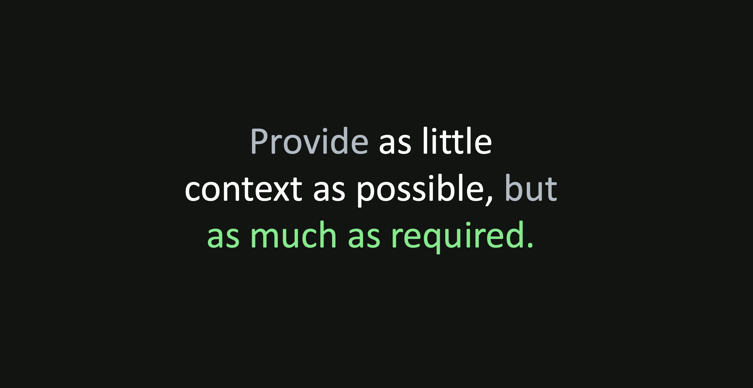

Slide 13



WHERE AI PLUGS INTO YOUR SDLC
Spec-Driven Development across the lifecycle
Instruction files say how we build. A spec says what we’re building this time — and it maps onto the lifecycle phases you already use. AI helps you research, plan and implement; the spec is the source of truth that carries context between them.
RESEARCH
PLAN
IMPLEMENT
VERIFY
›
›
›
›
Specify
Design
Tasks
Build
Verify
Behaviour, edge cases, acceptance — in plain markdown
Technical approach & integration points
Small, reviewable, testable units
Agent writes the Java against the spec
Checked against the spec, not vibes
How to adopt: no big rewrite — add a spec for the next change, keep your instruction files, and let AI carry research → plan → implement with the spec as the thread between them.
13

Slide 14
A TOOL FOR SDD
OpenSpec: a lightweight spec layer in your repo
Open-source, no API keys, works with 20+ assistants via slash commands. It keeps specs beside your code so context survives when the chat ends — and it’s brownfield-first, built for existing codebases.
1. Propose
$ openspec init
✓ added slash commands
$ /openspec:propose \
add-session-limit
openspec/
specs/ # source of truth
changes/ # proposals
add-session-limit/
proposal.md
design.md
tasks.md
specs/ # the delta
Describe the change — AI drafts proposal.md, specs/, design.md, tasks.md
2. Apply
Implement the tasks against the agreed spec, step by step
3. Archive
Merge the delta into the living specs/ source of truth
14

Slide 15

REUSE WHAT WORKS
Reusable prompts & skills
Instruction files and specs are passive context the agent reads. Prompts and skills are active building blocks you invoke — packaged know-how you don’t want to retype.
Reusable prompts
Skills
Saved, parameterised instructions for recurring tasks.
e.g. “New REST endpoint for <Interview resource>” scaffolds controller + DTO + test.
Invoked on demand — often as slash commands.
Folders of procedural know-how the agent loads when relevant.
e.g. a “score-rubric” skill: how we grade and store interview results.
Bundle instructions + scripts + examples, reused across projects.
Where they fit: instruction files set the ground rules · specs define this change · prompts & skills are the power tools the agent reaches for to do the work consistently.
15

Slide 16

THE MECHANIC BEHIND THE DRIFT
Tokens & the context window: the agent’s short-term memory
An LLM reads and writes in tokens (≈ ¾ of a word). Everything it can “see” at once — your prompt, the files, its own replies — must fit in a fixed context window. It has no memory beyond it.
What fills the window
Fill it up and it forgets
When the window is full, the oldest context falls out — the agent literally loses the early part of the task.
Every token is paid for
Cost & latency scale with tokens. Re-pasting the whole project each prompt is slow and expensive.
System + instruction files
The code & files in play
Conversation so far
Room left to think
Written context is the fix
Files, specs and graphs load just what’s needed — so the window holds signal, not noise.
This is why vibe coding drifts and unfinished tasks get abandoned — and why everything that follows is about feeding the window well.
04

Slide 17
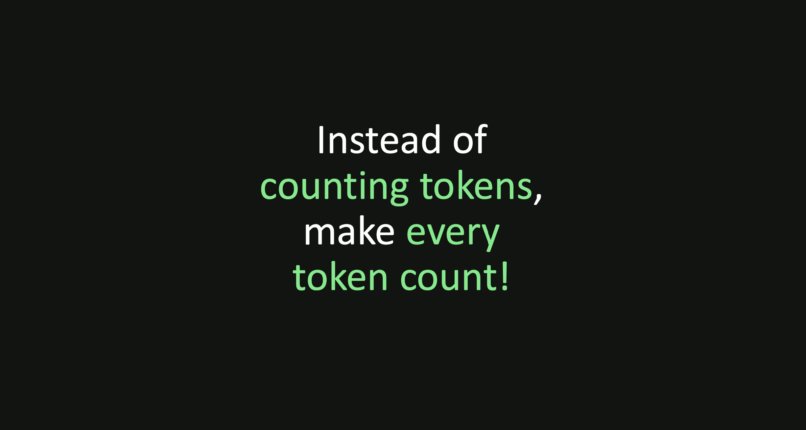

Slide 18



REASON ACROSS THE WHOLE SYSTEM
Knowledge graph: linking it all together
Files give context one document at a time. A knowledge graph maps how everything relates — so an agent can reason across the system instead of re-reading files one by one.
Everything connects
InterviewService
REST API
Spec → service → test → candidate, as queryable relationships.
Reason, don’t guess
Session
spec
“If I change session booking, what else breaks?” — answerable.
Fewer tokens, less drift
Tests
Candidate
Ride the map to the right files instead of re-scanning the repo.
16

Slide 19


KNOWLEDGE GRAPH IN PRACTICE
Graphify: a graph for a large Java codebase
On a 500-file Interview Buddy monolith, re-reading files every query burns tokens and misses links. Graphify (an open-source agent skill) builds the graph once, up front, so the agent rides the map instead of re-scanning.
1 · Parse locally
2 · Build the graph
3 · Agent queries it
›
›
Tree-sitter reads every Java file, SQL schema & doc — no code leaves your machine.
Typed edges (imports, calls, contains) + community clustering across the repo.
“What depends on InterviewService?” answered from the graph, not a full scan.
up to 70×
Why teams like it
Runs local / private (no API calls) · saves to files the whole team queries · edges tagged EXTRACTED / INFERRED so you know what was found vs. guessed.
fewer tokens querying a 500+ file project vs. re-reading files
17

Slide 20



THE LAST MILE
From a verified change to production
Context, specs and graphs get the agent to good code. Shipping it safely is the rest of the title — the same guardrails you already trust, with the agent doing the heavy lifting and you holding the gate.
›
›
›
›
Verify
Review
Human gate
CI/CD
Production
Tests & build run green against the spec
Reviewer sub-agent flags a PII-in-log case
You approve the PR — the call stays yours
Pipeline builds, scans and deploys
Change is live; webhook pings the team
The whole pipeline: spec → agent loop → verify → review → your approval → ship. The agent moves fast; the gates keep it safe. That’s “from specs to production with AI agents.”
18

Slide 21

Sumanth Srivarma

Slide 22

Giridhar Gopal

