Slide 1


Parsing PCAP File and uploading to HDFS.
Done by: Sumanth Uppala,
Instructor: Dr. Feng Yu.

Slide 2
Out line
Setting up the login server on VM.
Parsing PCAP file.
Uploading parsed PCAP file into HDFS

Slide 3
Requirements
Spark (Hadoop).
HDFS.
JAVA.
SSH (Putty).

Slide 4
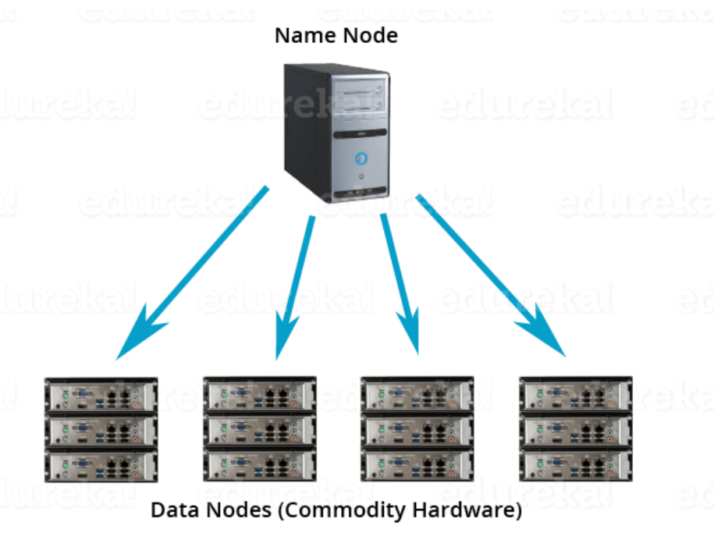
HDFS
It is a Block file system where file is divided into blocks with pre-determined size.
All these blocks will be stored over a group of one or more machines.
It follows master slave architecture.
One node acts as a master and rest of the nodes in a cluster acts as Data nodes (Slaves).

Slide 5
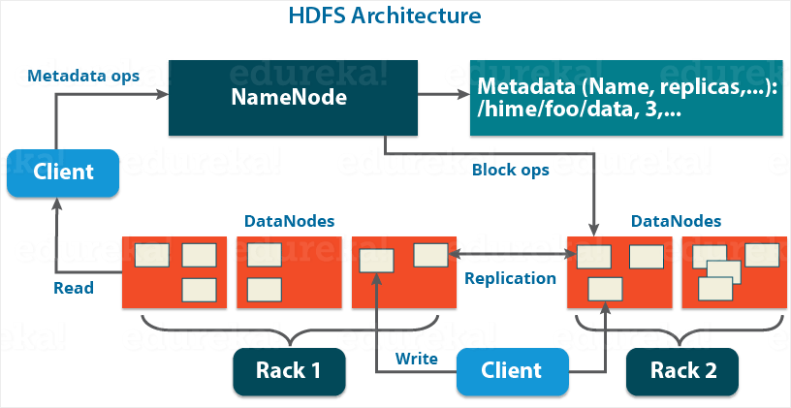
HDFS Architecture
Name Node - Records metadata of all the files Stored in the Cluster.
Data Node - server thst stores data into a local file ext3 or ext4. It reports the performance of HDFS with a default frequency of 3 sec.
Secondary Name Node - reads data from file system and writes into hard disk or file system. Also combines Edit logs with Fsl Image.

Slide 6
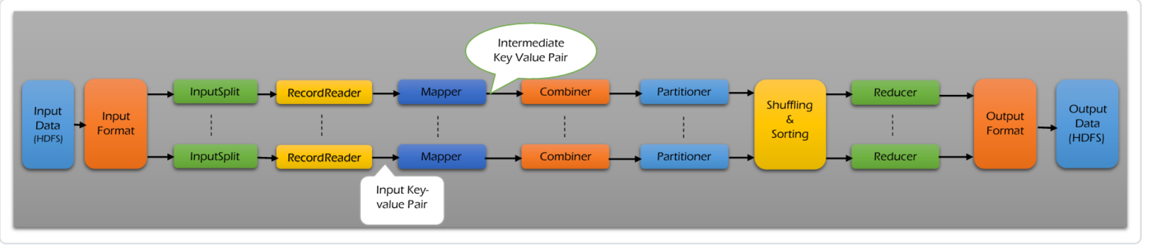
Map Reduce
Input Files
Input Format
Input Split
Partitioner
Shuffling and Sorting
Reducer
Output Format
Map Reduce → Core component of Hadoop which provides data processing.
Map Reduce:
Map → packet → csv
Reduce → sorting according to timestamp

Slide 7
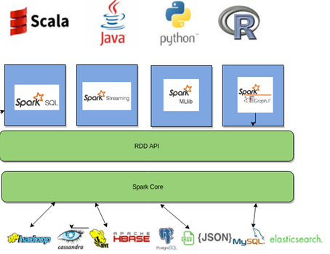
Spark
Spark is a open source and Cluster-computing framework. It has an interface with fault tolerance and implicit parallelism.
Spark → Map reduce
1. Processing very big sets
2. Processing time gets decreases

Slide 8
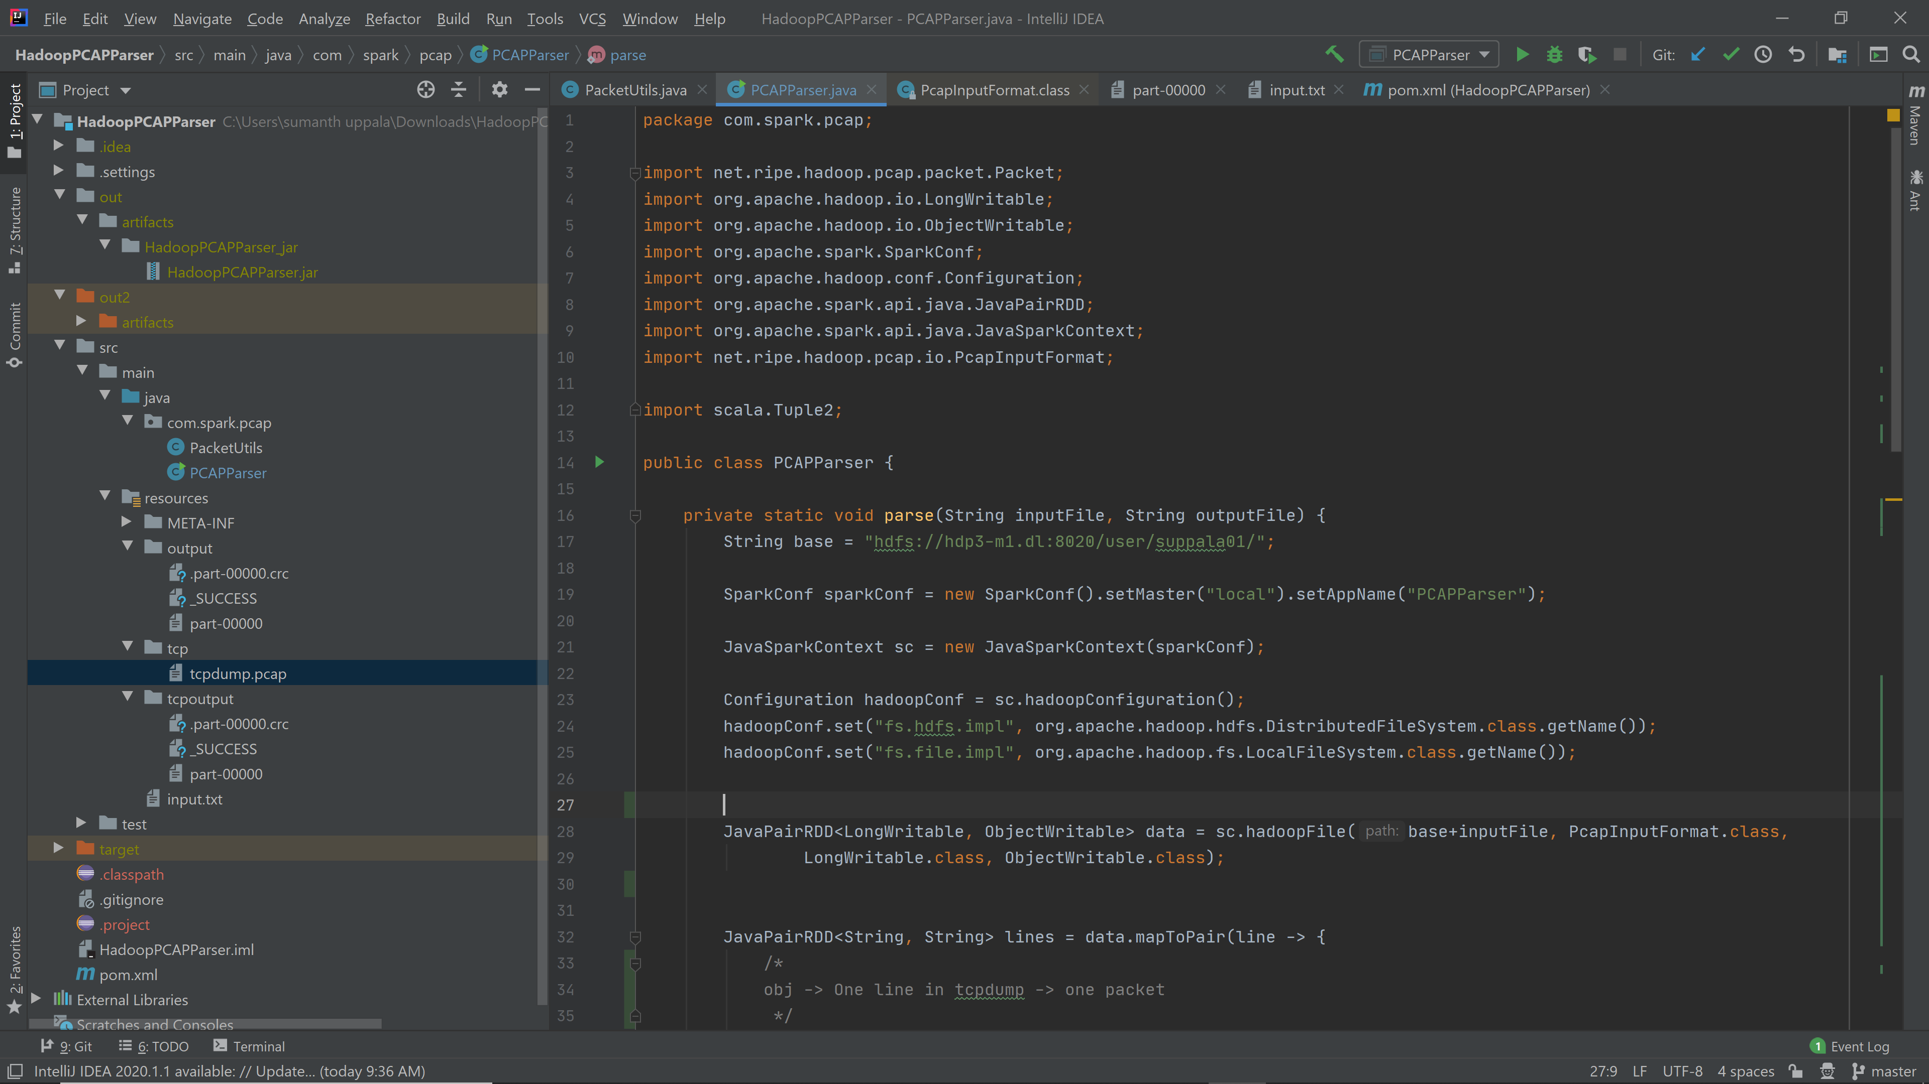
PCAP Parser code

Slide 9
Input format
PCAPinputformat decodes to LongWritable, ObjectWritable
ObjectWritable → contains the Packet
PCAP line → Key, Value
Key → Timestamp
Value → Line

Slide 10
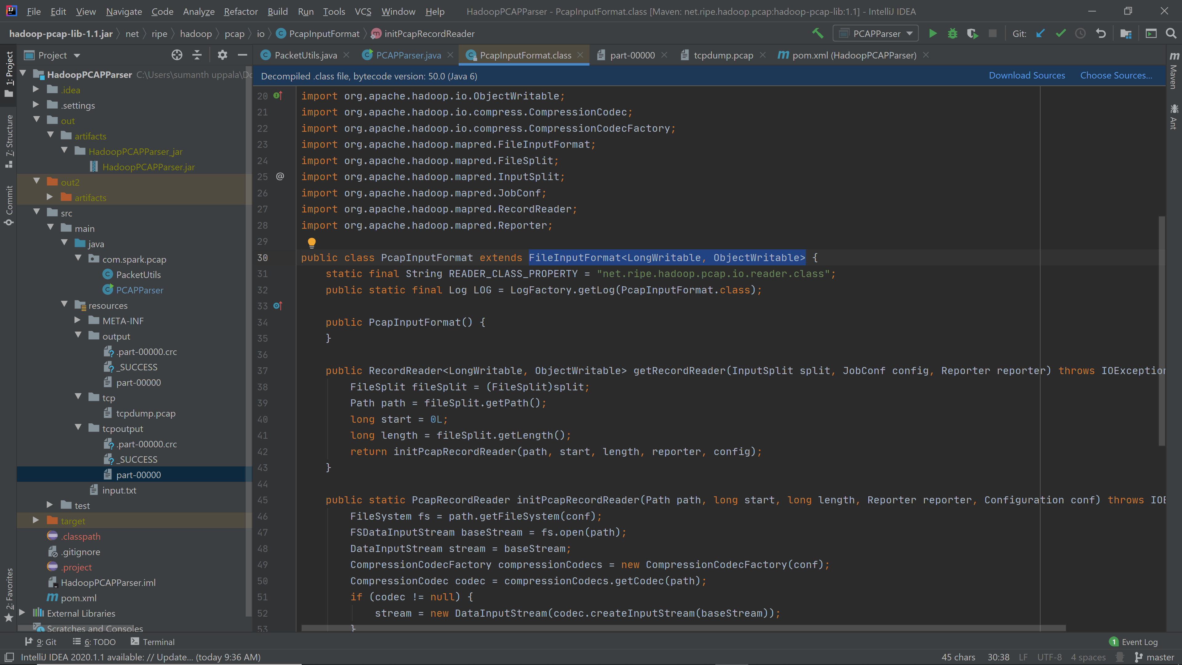
Input format class

Slide 11
TCP Dump Parsing
1. JNetPCAP library in java. Lib files are needed for parsing tcp dump files
2. Hadoop-PCAP-lib. It doesn't need any additional libraries.
Java level parsing
Translates packet from tcp dump to a java understandable Packet class

Slide 12
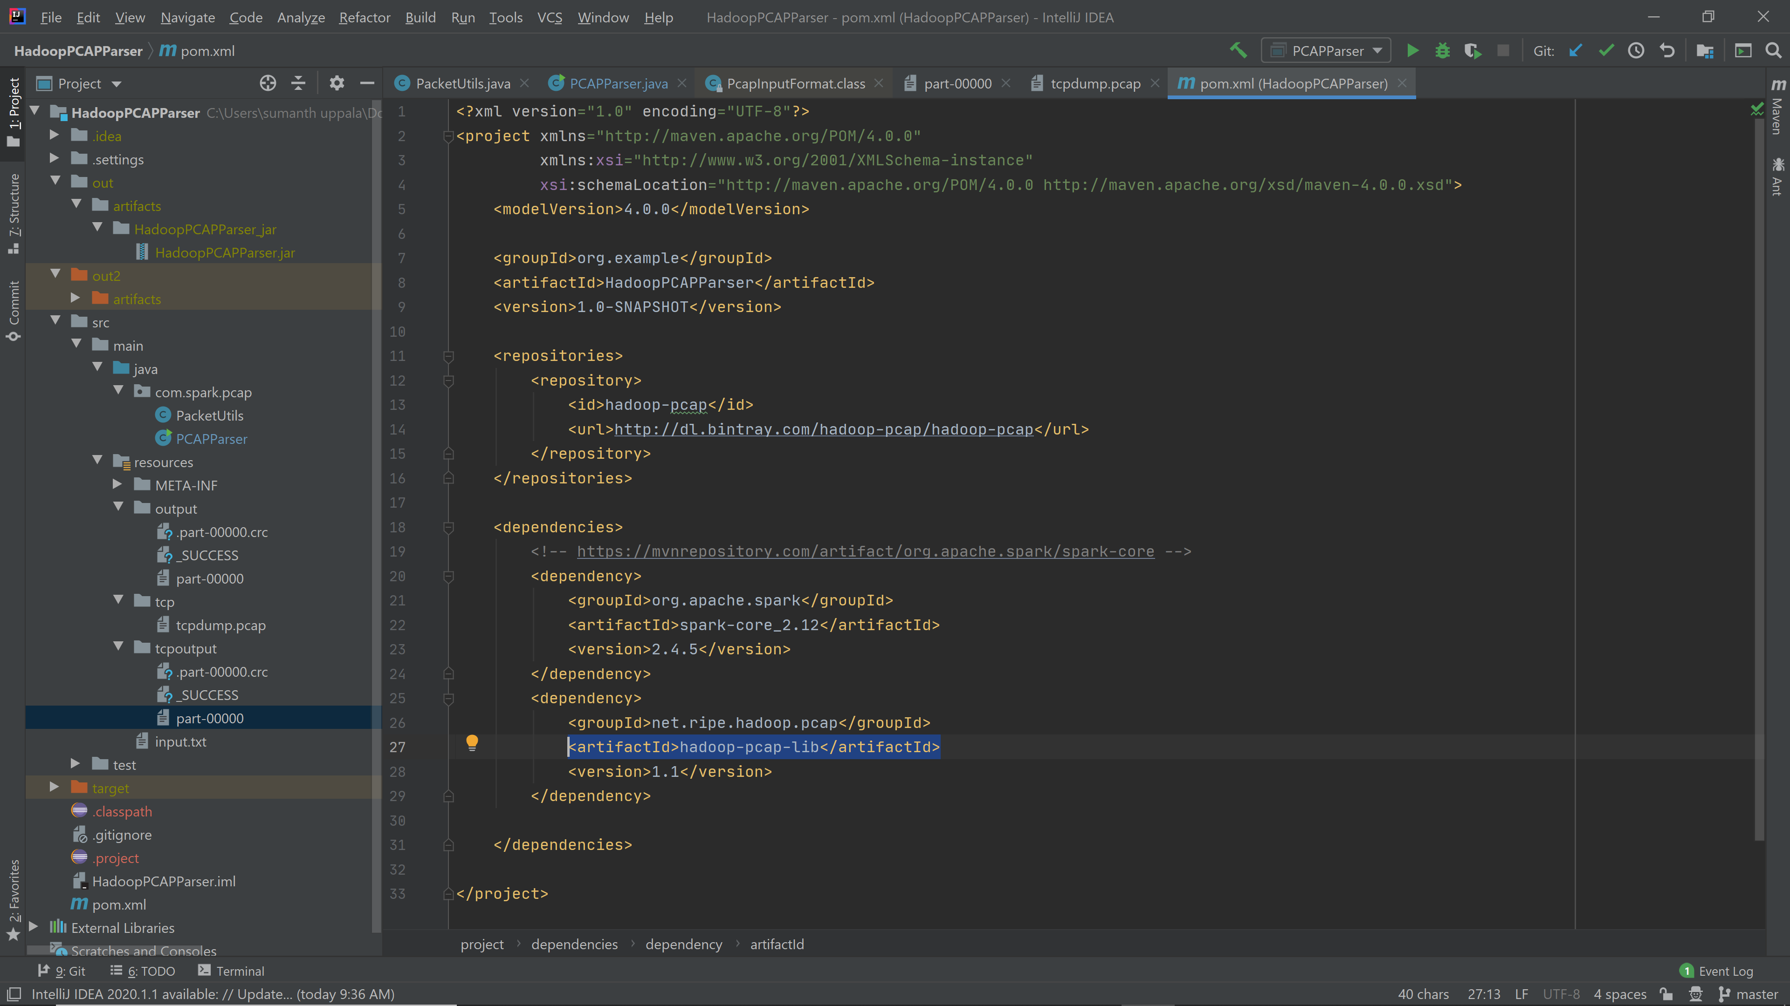
Hadoop PCAP Parser

Slide 13
Key, Value
1.PCAP line → Key, Value
Key → Timestamp
Value → Line
2.Packet → key, value
key → timestamp
value → output csv

Slide 14
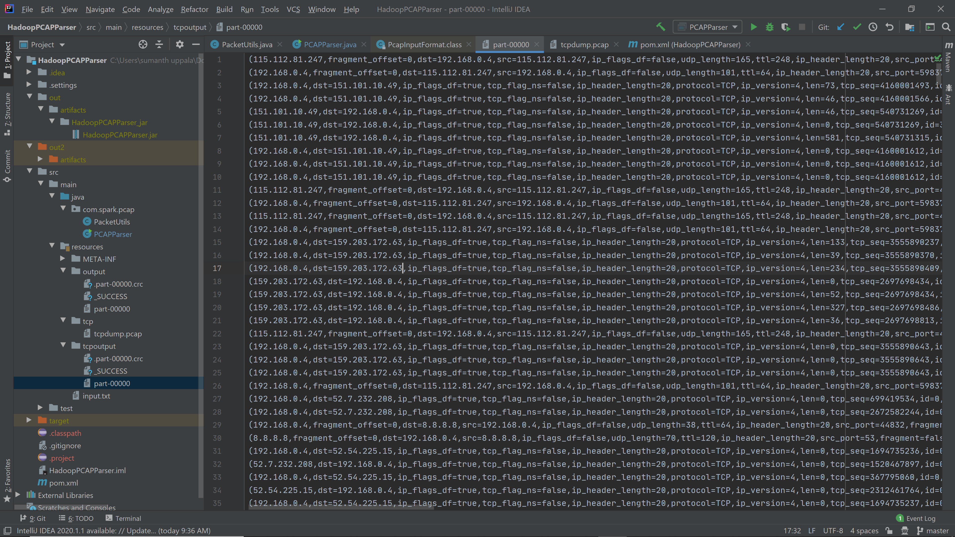
Output (CSV format)

Slide 15

Mail ID: suppala01@student.ysu.edu
GitHub Repo: https://github.com/sumanthuppala/HadoopPCAPParser
Thank you

