Slide 1
Welcome & Overview
Course theme: R as a tool for solving real-world problems.
Today's agenda:
- Course objectives & mechanics.
- What is R? Why R?
- Workflow in R projects.
- Running examples preview.

Slide 2
Course Objectives
Develop fluency in R programming.
Learn data wrangling, visualization, modeling.
Practice reproducible workflows.
Apply R to real-world problems across disciplines.
Build transferable data analysis skills.

Slide 3
Course Mechanics
20% of student grade will come from the group assignment
30% of student grade will come from a written mid-term examination
50% of the student grade will come from a written final examination
AI use is strongly encouraged in class. No AI support during written examinations.

Slide 4
What is R?
Language & environment for data analysis.
Originated in 1990s. Ross Ikha and Robert Gentleman
https://en.wikipedia.org/wiki/R_(programming_language)
Strengths:
- Statistical modeling.
- Visualization (ggplot2, plotly).
- Huge package ecosystem.
- Free: Open source & community-driven.
Integrates with Python, SQL, ML frameworks.

Slide 5
Why Use R?
Designed for statistics & data analysis.
Widely used in academia & industry.
Strong visualization tools.
Excellent for reproducible research.
Free, open-source, large community support.

Slide 6
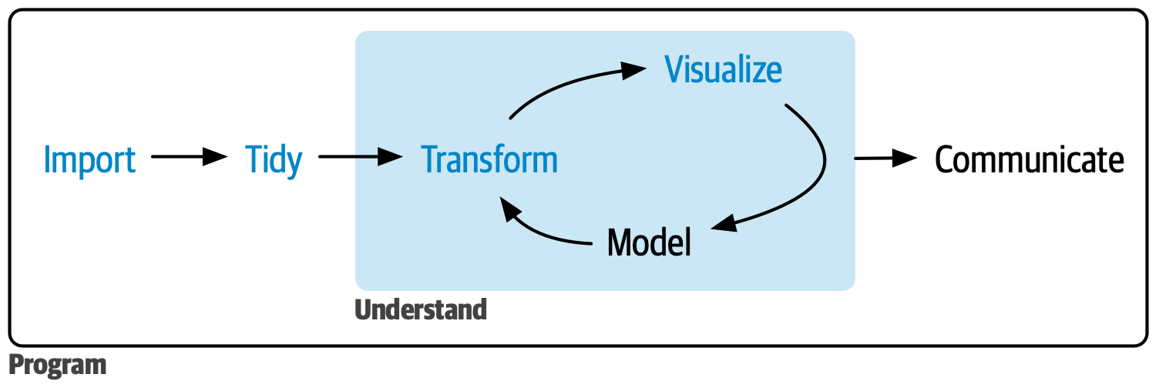
Workflow in R Projects
Use RStudio Projects for organization.
Recommended structure:
- Data (raw vs processed).
- Scripts.
- Results & reports.
Source: Wickham et. Al. R for Data Science
Workflow:
1. Import data.
2. Clean & transform.
3. Visualize
4. Model.
5. Validate & interpret.
6. Communicate findings.

Slide 7
Running Examples – Overview
Real-world case studies throughout the course:
1. Microeconomics: Demand Elasticity.
2. Macroeconomics: GDP Growth Forecasting.
3. Finance (Derivatives): Black–Scholes Pricing.
4. Finance (Insurance): Ruin Simulation.
5. Digital Marketing: A/B Testing.
6. IT: Code Quality Analysis.
7. AI/ML: Image Classification (CNNs).

Slide 8
Example 1 – Microeconomics
Question: How does demand respond to price changes?
Elasticity formula: %ΔQ / %ΔP.
Model: Log–log regression.
R Code: lm(log(Quantity) ~ log(Price) + Advertising, data=demand)
Takeaway: R quantifies economic behavior with real data.

Slide 9
Example 2 – Macroeconomics
Question: How to forecast GDP growth?
Method: ARIMA/SARIMA time series.
R Code: auto.arima(gdp), forecast(model, h=8)
Takeaway: R makes forecasting systematic & visual.

Slide 10
Example 3 – Finance (Derivatives)
Question: How to price options?
Method: Black–Scholes formula.
R Code: GBSOption('c', S=100, X=105, Time=1, r=0.05, sigma=0.2)
Takeaway: Finance theory → computational tools in R.

Slide 11
Example 4 – Finance (Insurance)
Question: What is probability of insurer ruin?
Method: Simulation of claims & premiums.
R Code: mean(replicate(1000, simulate_ruin()))
Takeaway: R handles stochastic simulation of risk.

Slide 12
Example 5 – Digital Marketing
Question: Does new design increase conversions?
Method: A/B test, 2-proportion z-test.
R Code: prop.test(x=c(50,70), n=c(1000,1000))
Takeaway: R applies statistical rigor to business experiments.

Slide 13
Example 6 – IT (Code Quality)
Question: How to measure software complexity?
Method: Analyze source files.
R Code: line_counts <- sapply(files, function(f) length(readLines(f))); hist(line_counts)
Takeaway: Code is data → analyze it in R.

Slide 14
Example 7 – AI/ML
Question: Can R do deep learning?
Method: CNN with keras.
R Code: keras_model_sequential() %>% layer_conv_2d(...) %>% ...
Takeaway: R supports modern ML workflows.

Slide 15
Wrap-up
R is a powerful, open-source language for data analysis.
Course emphasizes:
- Real-world examples.
- Reproducible workflows.
- Skill-building for multiple domains.
Next step: Install R + RStudio, test basic commands.

Slide 16
Q/A
Open floor for questions.
Encourage students to try R setup before next session.

Slide 17
References
James, G., Witten, D., Hastie, T. and Tibshirani, R. (2023) An Introduction to Statistical Learning: With Applications in R. 3rd edn. Berlin/Heidelberg: Springer Nature. R Core Team (2025) An Introduction to R. R version 4.5.1 (2025-06-13). The R Project for Statistical Computing. Available at: https://cran.r-project.org/doc/manuals/r-release/R-intro.html (Accessed: 8 September 2025).
Wickham, H., Çetinkaya-Rundel, M. and Grolemund, G. (2023) R for Data Science, 2nd edn. Sebastopol, CA: O'Reilly Media, Inc. Available at: [https://r4ds.hadley.nz/]
Chollet, F. and Allaire, J.J. (2018) Deep Learning with R. Manning Publications Co. Available at: [https://www.manning.com/books/deep-learning-with-r]
Hair, J.F., Babin, B.J., Anderson, R.E., and Black, W.C. (2018) Multivariate Data Analysis. 8th edn. NOIDA, India: Cengage (India) Pvt. Ltd. Available at: [https://www.amazon.in/Multivariate-Analysis-Joseph-Anderson-William/dp/9353501350/]

