Slide 1
Project-1 Airbnb Booking Analysis (Host - Guest Matching)

Slide 2
Introduction
Purpose: Gain insights into the NYC Airbnb market and explore factors influencing host-guest matching.
Significance: Provide valuable information to hosts, guests, and stakeholders in the hospitality industry.

Slide 3
Dataset and Scope
Dataset: NYC Airbnb dataset containing property listings, prices, groups, guest reviews and other thing.
Scope: Focus on the NYC Airbnb market, examining host behaviors, guest preferences, and competitive landscape.

Slide 4
Overview of NYC Airbnb Dataset
The dataset has around 49,000 observations in it with 16 columns and it is a mix between categorical and numeric values but there are some null values and missing data we clean those and then make our analysis.
There are 3 different room types (Entire home/apt, Private room, Shared room)
.
We have 5 five neighborhood group (Manhattan, Brooklyn, Queens, Bronx, Staten Island).

Slide 5

Process
DATA Understanding
DATA Cleaning
DATA Modelling(If required)
DATA Analysis
Uncover Insights
For detailed code and analysis, you can access the Notebook https://colab.research.google.com/drive/1kohIUlT6oOSdu80DNjDHVhscxYIN4Nvo?usp=sharing

Slide 6
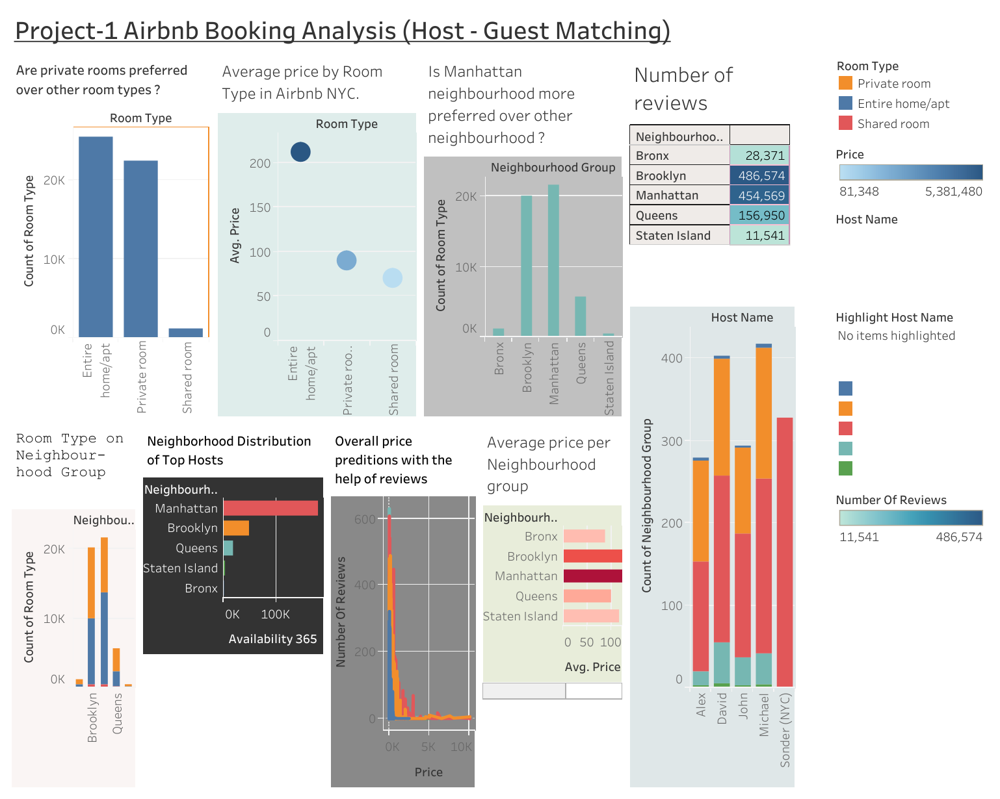
Process

Slide 7
INSIGHTS
Expensive Neighborhoods: Manhattan, Brooklyn, and Queens are the most expensive neighborhoods for Airbnb listings in NYC.
Popular Room Types: Entire home/apt and private room are the most popular room types for Airbnb listings in NYC.
Average Price: The average price of an Airbnb listing in NYC is $150 per night.
Impact of Neighborhood: The neighborhood significantly influences the price of the listing.
Stay Duration: Guests staying in entire homes or apartments tend to stay longer in specific neighborhoods.

Slide 8
INSIGHTS
6.Private Room Stay: Guests preferring private rooms have shorter stays compared to entire homes or apartments.
7.Price Preference: Most guests prefer listings with lower prices.
8.Reviews and Tourism: Neighborhoods with more reviews indicate popular tourist destinations with excellent service.
9.Travelers' Stay: Guests staying for one night are likely travelers.
10.Multiple Areas: The dataset includes 221 different areas, with "Williamsburg" having the highest number of listings.

Slide 9
11.Crowded Manhattan: Manhattan is the most crowded location, accounting for 44.3% of listings.
12.Top Hosts: The top five busiest hosts are Dona, Jj, Maya, Carol, and Danielle.
13.Sonder's Listings: Host "Sonder" has the most listings in Manhattan.
14.Hosts as Businesses: Many hosts treat Airbnb as a business, with "Michael" having the most listings across multiple groups.

Slide 10
Conclusion to the Stakeholders:
NYC Airbnb Market: The NYC Airbnb market is highly competitive, with prices varying significantly based on the neighborhood and room type.
Multiple Listings Benefit: Hosts owning multiple listings can command higher prices for their properties.
Importance of Reviews: Listings with more reviews attract more guests. Hosts should actively engage with guests, respond promptly and positively to reviews, and provide excellent customer service to enhance the overall guest experience.

Slide 11
4.Location Impact: Listings near popular tourist destinations tend to be more expensive. Hosts should consider choosing a central location like Manhattan to attract more guests.
5.Key Aspects: In conclusion, stakeholders should consider important factors like neighborhood group, room type, price, and number of reviews to optimize their listings and succeed in the competitive NYC Airbnb market.

Slide 12
Future Work
If needed, we can develop a predictive model that correlates price with neighborhood group and room type, enabling better pricing strategies for maximizing listing revenue.

Slide 13
THANK YOU
By
Sumant kale
sumantkale1999@gmail.com

