Slide 1
Unleashing the Power of Data: Predicting Sales in the Offline Drug Sector

Slide 2
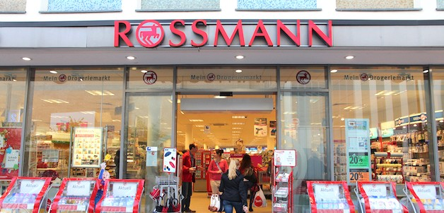
Overview
This project focuses on predicting sales for a major o ine drug store using machine learning techniques. We explore di erent regression algorithms, preprocess the data, train models, and evaluate their performance to make accurate sales predictions.

Slide 3
Table of Contents
Project Description Data
EDA
Models Conclusion Summary

Slide 4

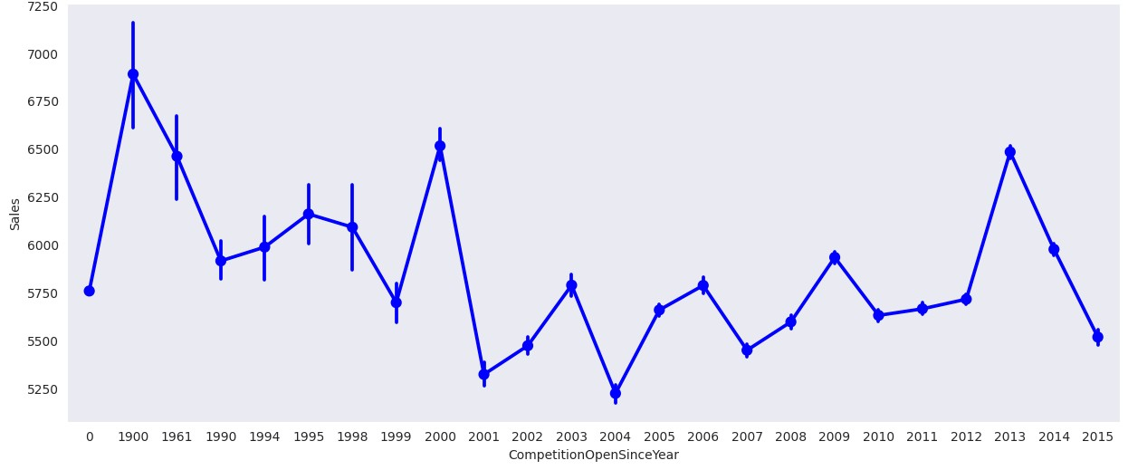
Project Description
There are several advantages of using the XGBoost algorithm for sales predictions in the o ine drug sector. Firstly, it can handle large datasets
e ciently, making it suitable for analyzing extensive sales data. Secondly, it has the capability to handle missing values, ensuring accurate predictions even with incomplete data. Lastly, the XGBoost algorithm can capture complex relationships within the data, enabling it to make highly accurate sales predictions with a remarkable 98% accuracy rate.

Slide 5
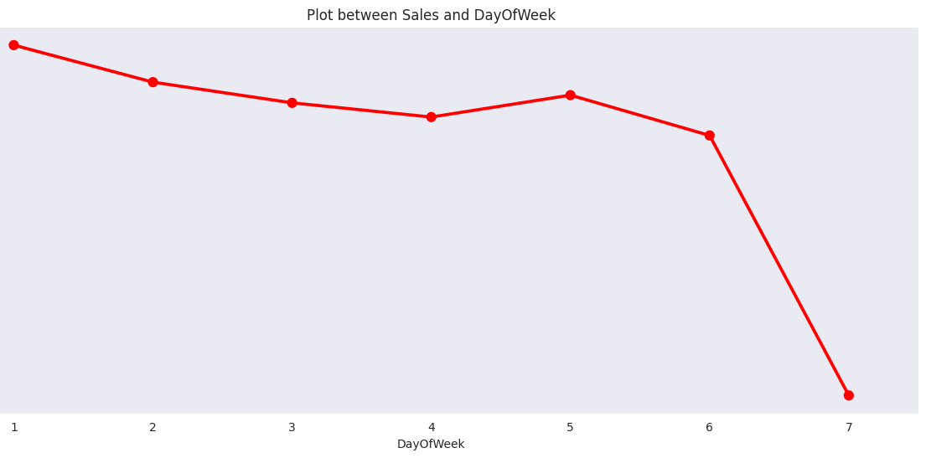
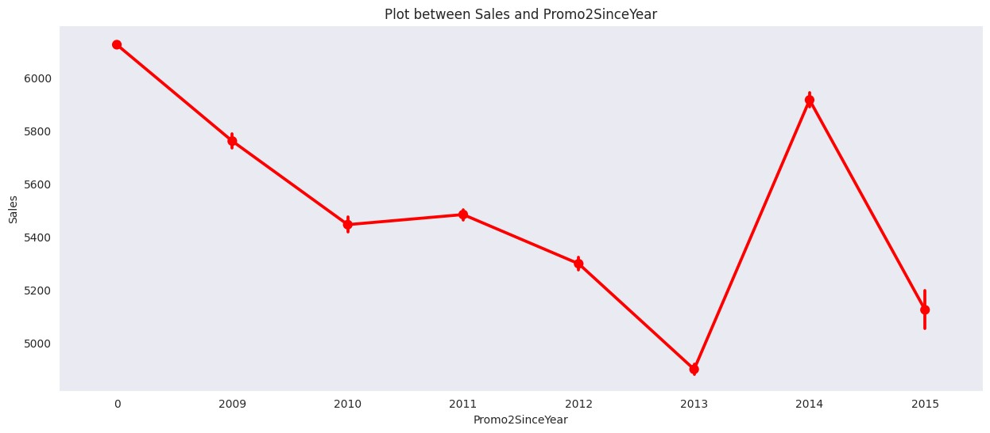
Data
The dataset used in this project contains information about the drug store, including sales, features, and other relevant variables. The data was preprocessed to handle zero sales entries e ectively.

Slide 6
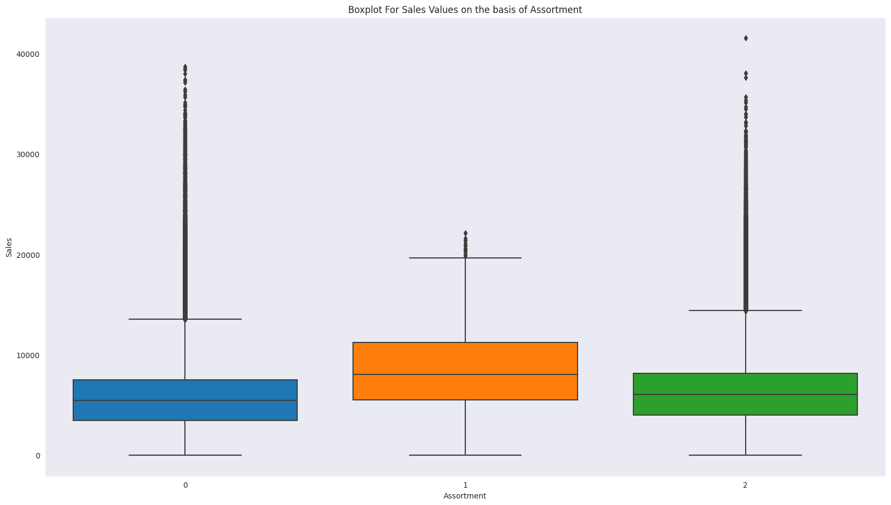
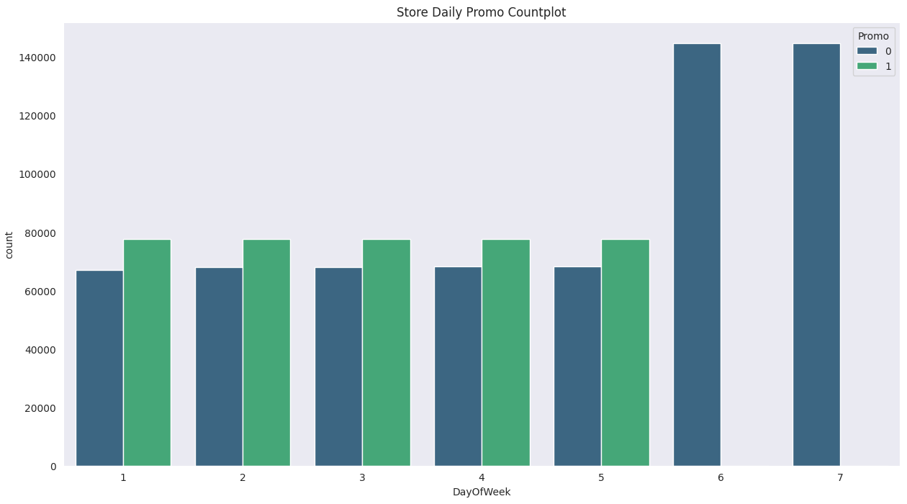
Model
We used the following machine learning models for sales prediction:
Linear Regression
Random Forest Regressor
AdaBoost Regressor
XGBoost Regressor
Each model's hyperparameters were tuned to achieve the best possible performance.

Slide 7
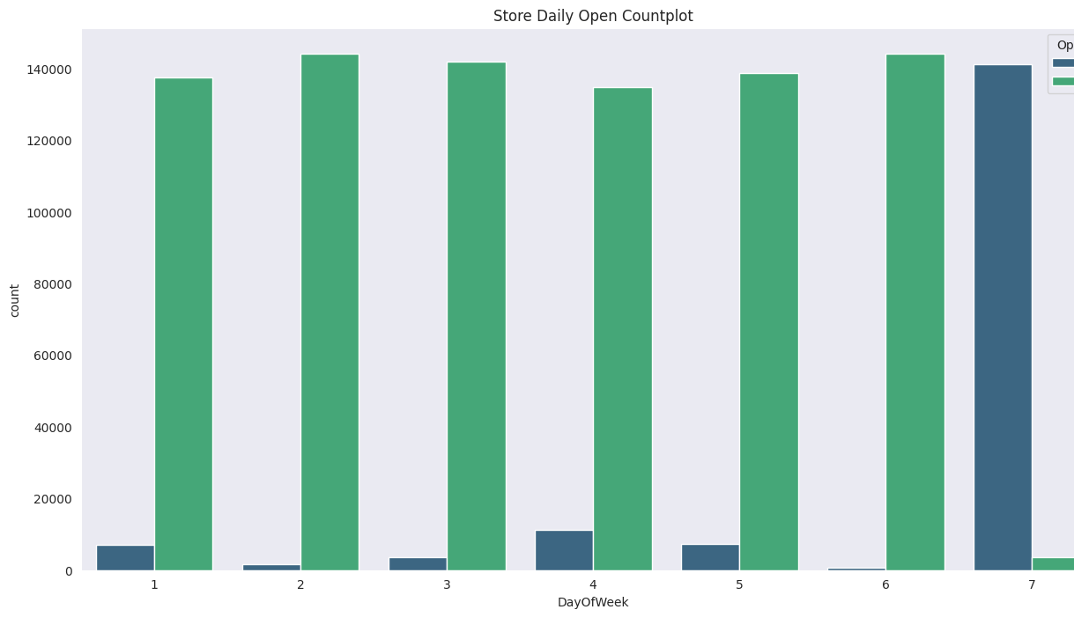
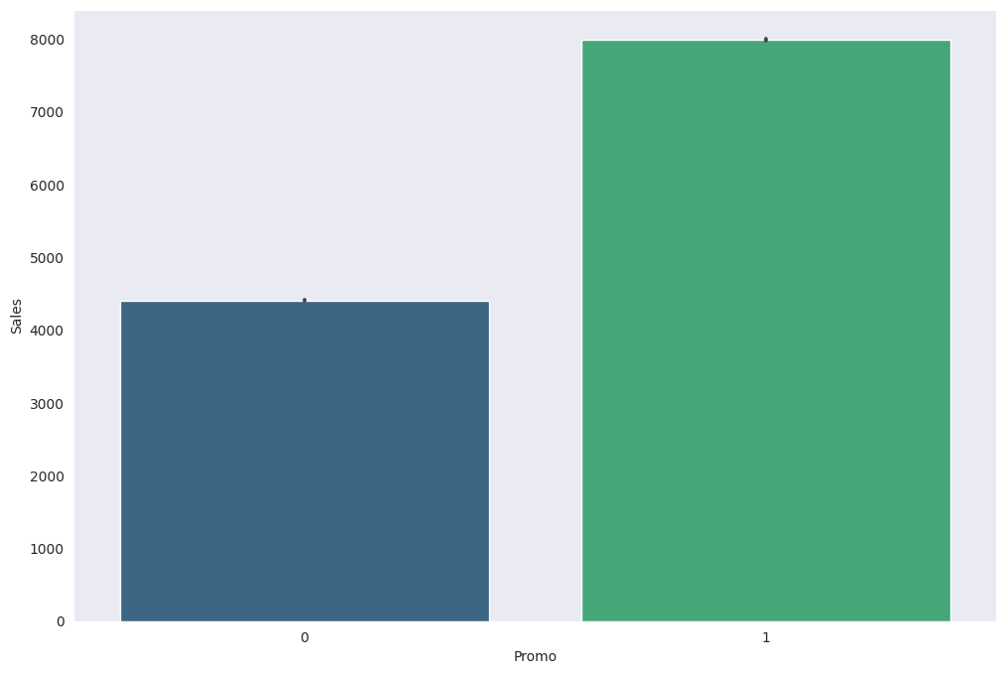
Conclusion
From plot sales and competition Open Since Month shows sales go increasing from November and highest in month December.
From plot Sales and day of week, Sales highest on Monday and start declining from Tuesday to Saturday and on Sunday Sales almost near to Zero.
Plot between Promotion and Sales shows that promotion helps in increasing Sales.
Type of Store plays an important role in opening pattern of stores.
All Type ‘b’ stores never closed except for refurbishment or other reason.
All Type ‘b’ stores have comparatively higher sales and it mostly constant with peaks appears on weekends.
Assortment Level ‘b’ is only o ered at Store Type ‘b’.
We can observe that most of the stores remain closed during State Holidays. But it is interesting to note that the number of stores opened during School Holidays were more than that were opened during State Holidays.

Slide 8
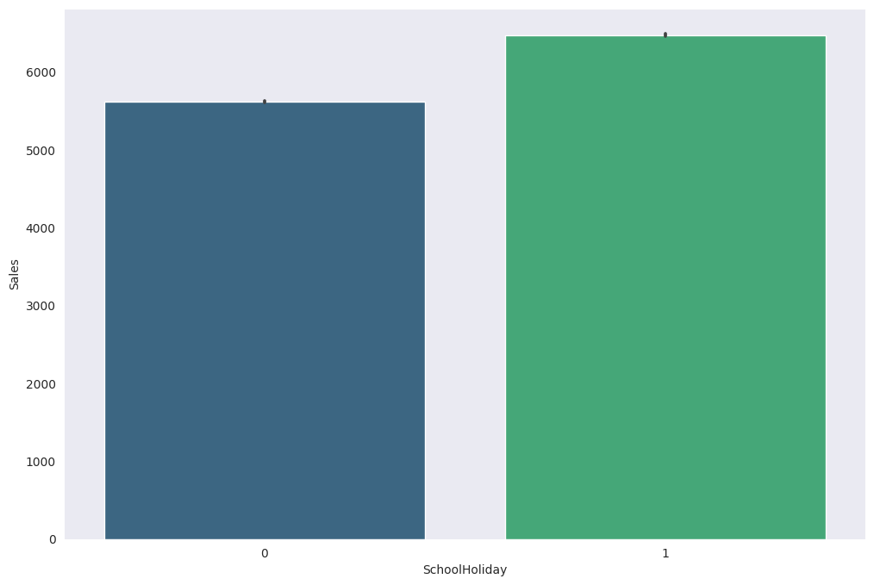
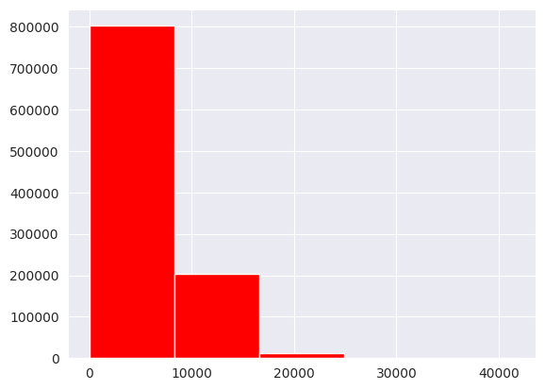
Model Conclusion
We saw that Sales column contains 172817 rows with 0 sale. So we created a new dataframe in which we removed 0 sales rows and tried to train our model. We used various algorithms and got accuracy score around **74%.**
We were also curious about the total dataset(including Sales = 0 rows). So we trained another model using various algorithms and we got accuracy near about **98%** which is far better than previous model.
we came to conclusion that removing sales=0 rows actually removes lot of information from dataset as it has **172817** rows which is quite large and therefore we decided not to remove those values.We got our best rmpse score from **Random Forest model,Graident boosting technique like adaboost ,Xgboost**,we tried taking an optimum parameter so that our model doesnt over t.

Slide 9
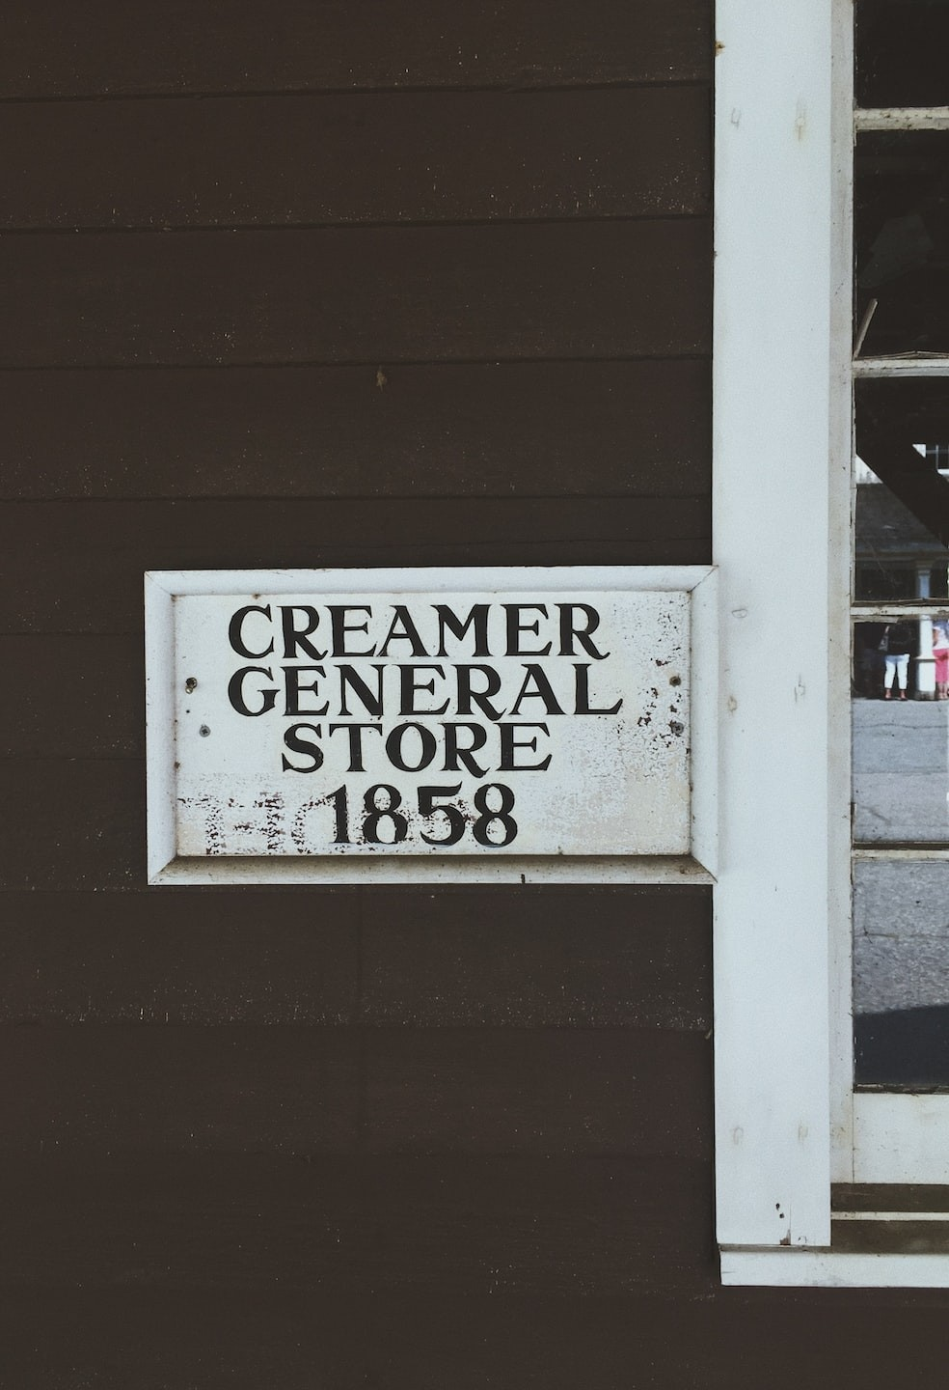
Summary
This dataset is a live dataset of Rossmann Stores. On analsysing this problem we observe that Rossmann problem is a regression problem and our primarily goal is to predict the sales gures of Rossmann problem. In this Notebook we work on following topics
Analysing the Dataset by using Exploratory Data Analysis. Using Exponential Moving Averages analyse Trends and Seasonality in Roseman dataset.
Analyse Regression analysis using following prediction analysis, A. Linear Regression Analysis B. Elastic Regression ( Lasso and Ridge Regression). C. Random Forest Regression. d.adaboost and Xgboost).
By applying above algorthim we nd accuracy of 98% by Xgboost.

Slide 10
Thank You Any Questions

