Slide 1
Day 4
Xamarin.Android
Presented By : Anand Dubey

Slide 2
Contents
Handling Rotation
User Interface

Slide 3
Handling Rotation
Android, a mature mobile OS, provides a sophisticated framework for dealing with rotation within applications, whether the user interface is created declaratively in XML or programmatically in code
Two ways to handle rotation
Declarative Layout Rotation
Programmatic Layout Rotation

Slide 4
Declarative Layout Rotation
By including files in folders that follow naming conventions, Android automatically loads the appropriate files when the orientation changes
This includes support for:
Layout Resources
Drawable Resources

Slide 5
Layout Resources
By default, Android XML (AXML) files included in the Resources/layout folder are used for rendering views for an Activity
This folder's resources are used for both portrait and landscape orientation if no additional layout resources are provided specifically for landscape
In addition to the layout folder (which defaults to portrait and can also be explicitly named layout-port by including a folder named layout-land), an application can define the views it needs when in landscape without any code changes

Slide 6
<?xml version="1.0" encoding="utf-8"?>
<RelativeLayout xmlns:android="http://schemas.android.com/apk/res/android"
android:layout_width="fill_parent"
android:layout_height="fill_parent">
<TextView
android:text="This is portrait"
android:layout_height="wrap_content"
android:layout_width="fill_parent" />
</RelativeLayout>
<?xml version="1.0" encoding="utf-8"?>
<RelativeLayout xmlns:android="http://schemas.android.com/apk/res/android"
android:layout_width="fill_parent"
android:layout_height="fill_parent">
<TextView
android:text="This is landscape"
android:layout_height="wrap_content"
android:layout_width="fill_parent" />
</RelativeLayout>

Slide 7
Drawable Resources
During rotation, Android treats drawable resources similarly to layout resources. In this case, the system gets the drawables from the Resources/drawable and Resources/drawable-land folders, respectively
For example, say the project includes an image named Monkey.png in the Resources/drawable folder, where the drawable is referenced from an ImageView in XML like this
<ImageView
android:layout_height="wrap_content"
android:layout_width="wrap_content"
android:src="@drawable/monkey"
android:layout_centerVertical="true"
android:layout_centerHorizontal="true" />

Slide 8
Handling Rotation Programmatically
To add controls programmatically perform following steps:
Create layout
Set layout parameters
Create controls
Set control layout parameters
Add controls to the layout
Set the layout as the content view

Slide 9
protected override void OnCreate (Bundle bundle)
{
base.OnCreate (bundle);
var rl = new RelativeLayout (this);
var layoutParams = new RelativeLayout.LayoutParams (ViewGroup.LayoutParams.FillParent, ViewGroup.LayoutParams.FillParent);
rl.LayoutParameters = layoutParams;
var tv = new TextView (this);
tv.LayoutParameters = layoutParams;
tv.Text = "Programmatic layout";
rl.AddView (tv);
SetContentView (rl);
}

Slide 10
Detecting Orientation
If an application tries to load a different user interface for each orientation when OnCreate is called (this will happen each time a device is rotated), it must detect the orientation, and then load the desired user interface code. Android has a class called the WindowManager, which can be used to determine the current device rotation via the WindowManager.DefaultDisplay.Rotation property
if (surfaceOrientation == SurfaceOrientation.Rotation0 || surfaceOrientation == SurfaceOrientation.Rotation180) {
tvLayoutParams = new RelativeLayout.LayoutParams (ViewGroup.LayoutParams.FillParent, ViewGroup.LayoutParams.WrapContent);
} else {
tvLayoutParams = new RelativeLayout.LayoutParams (ViewGroup.LayoutParams.FillParent, ViewGroup.LayoutParams.WrapContent);
tvLayoutParams.LeftMargin = 100;
tvLayoutParams.TopMargin = 100;
}

Slide 11
User Interface
Android Designer
Splash Screen
Layout
Controls

Slide 12
Android Designer
The Designer is launched automatically when a layout is created, or it can be launched by double-clicking an existing .axml file
you can add a new layout by right-clicking the layout folder in the Solution Explorer and selecting Add > New Item... > Android Layout

Slide 13
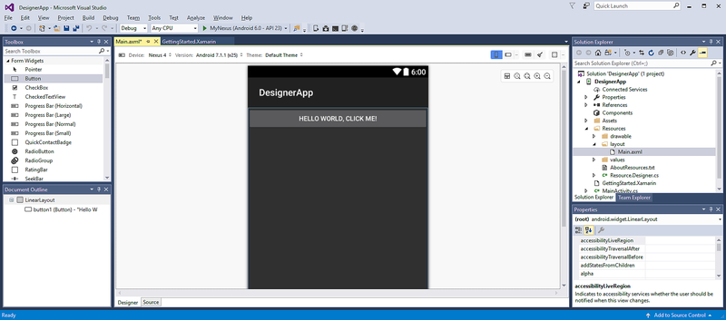

Slide 14
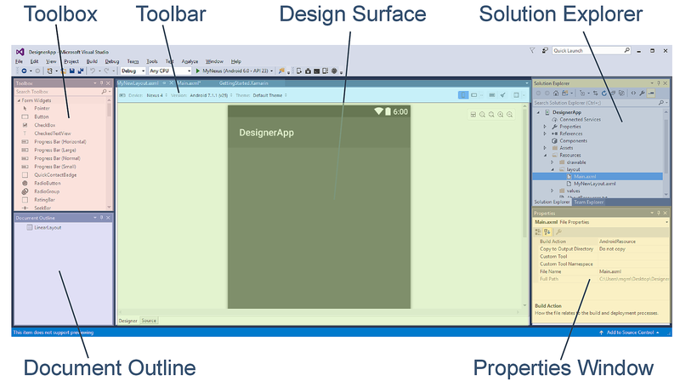

Slide 15
Splash Screen
A splash screen may display start up progress to the user or to indicate branding
Steps to create splash screen
Creating a drawable resource for the splash screen
Defining a new theme that will display the drawable resource
Adding a new activity to the application that will be used as the splash screen

Slide 16
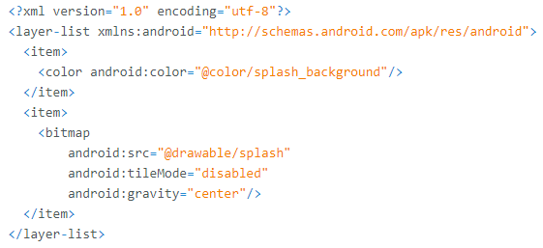
Step 1-Creating a drawable for the splash screen
Splash screen will display an XML drawable in the background of the splash screen Activity
It is necessary to use a bitmapped image (such as a PNG or JPG) for the image to display

Slide 17
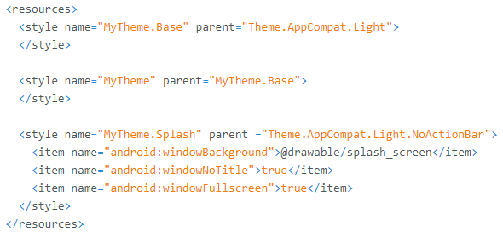
Step 2-Implementing a theme
To create a custom theme for the splash screen Activity, edit (or add) the file values/styles.xml and create a new stylelement for the splash screen

Slide 18
Step 3- Create a splash Activity
Now we need a new Activity for Android to launch that has our splash image and performs any startup tasks

Slide 19
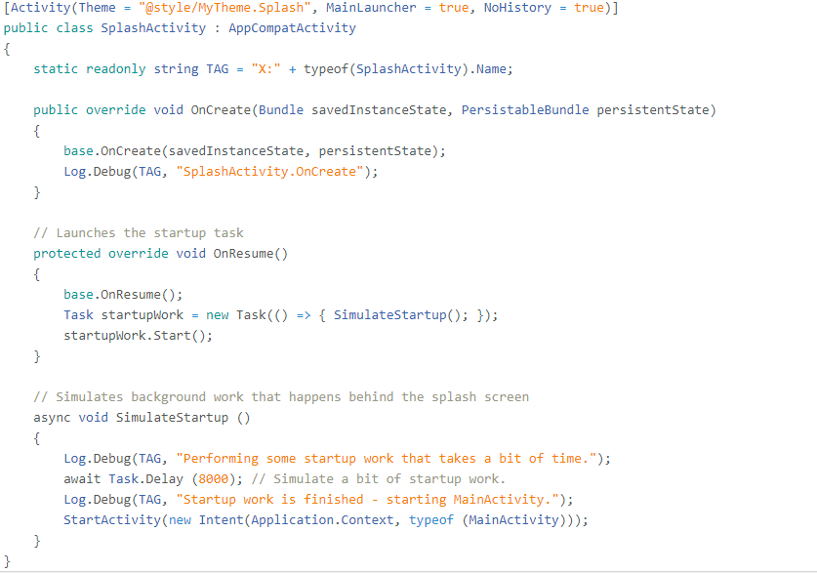

Slide 20
Layouts
Linear Layout
Relative Layout
Table Layout
Recycler View
List View
Grid View
Grid Layout
Tabbed Layout

Slide 21

Linear Layout
It is a ViewGroup that displays child View elements in a linear direction, either vertically or horizontally
https://developer.xamarin.com/guides/android/user_interface/layouts/linear-layout/

Slide 22
Relative Layout
It is a ViewGroup that displays child View elements in relative positions
The position of a View can be specified as relative to sibling elements
Instead of using several nested LinearLayout groups, you may be able to replace them with a single RelativeLayout
https://developer.xamarin.com/guides/android/user_interface/layouts/relative-layout/

Slide 23
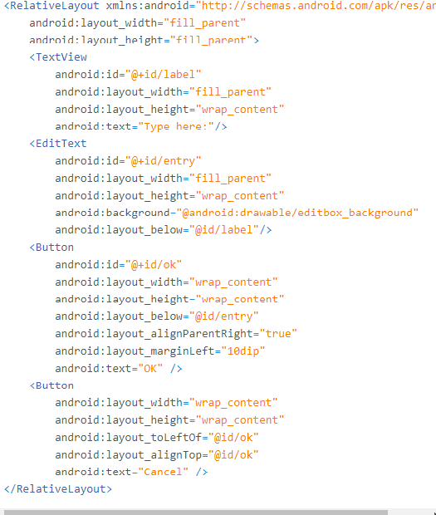

Slide 24
Table Layout
TableLayout is a ViewGroup that displays child View elements in rows and columns
https://developer.xamarin.com/guides/android/user_interface/layouts/table-layout/

Slide 25
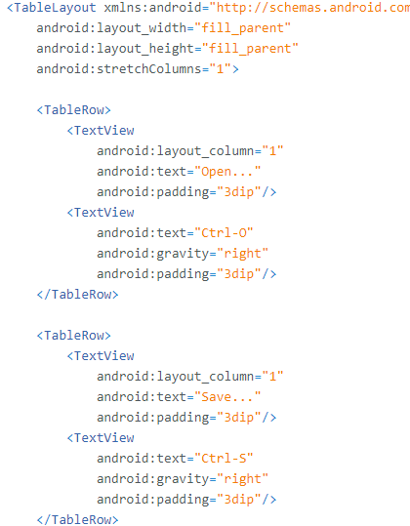

Slide 26
Recycler View
RecyclerView is a view group for displaying collections
it is designed to be a more flexible replacement for older view groups such as ListView and GridView
RecyclerView is an Android widget that displays a collection of items in a list or a grid, enabling the user to scroll through the collection
Requirement:
Xamarin.Android 4.20 or later must be installed and configured withVisual Studio
app project must include the Xamarin.Android.Support.v7.RecyclerView package

Slide 27
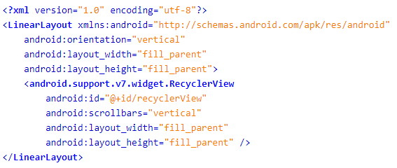
https://developer.xamarin.com/guides/android/user_interface/layouts/recycler-view/

Slide 28
Listview
It is used everywhere from short lists of menu options to long lists of contacts
The RecyclerView widget is a more advanced and flexible version of ListView. Because RecyclerView is designed to be the successor to ListView (and GridView)
https://developer.xamarin.com/guides/android/user_interface/layouts/list-view/

Slide 29
Gridview
GridView is a ViewGroup that displays items in a two-dimensional, scrollable grid
https://developer.xamarin.com/guides/android/user_interface/layouts/grid-view/

Slide 30
Grid Layout
The GridLayout is a new ViewGroup subclass that supports laying out views in a 2D grid, similar to an HTML table

Slide 31
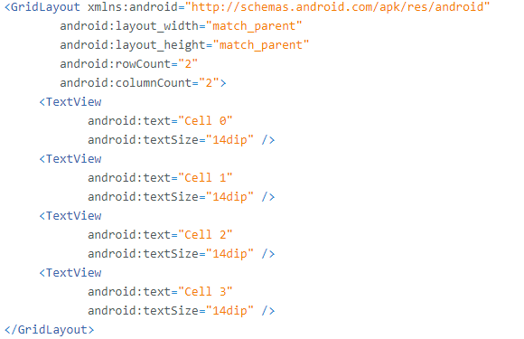

Slide 32
Tabbed Layout
Tabs are a popular user interface pattern in mobile applications because of their simplicity and usability
They provide a consistent, easy way to navigate between various screens in an application
There are 4 tabbed interface:
TabHost
ActionBar
PageTabStrip
Toolb ar : Android 5.0 and later
https://developer.xamarin.com/guides/android/user_interface/layouts/tab-layout/

Slide 33
Thanks

