Slide 1
Day 1
Xamarin.Forms
Presented By : Anand Dubey

Slide 2
Contents
Introduction
Xamarin Studio vs Visual Studio
Approach
Architecture
User Interface
Pages
Layouts

Slide 3
Introduction
Xamarin offers C# to develop Android, Iphone and windows phone
There are 3 ways to develop apps in xamarin
Xamarin.Forms
Xamarin.Android
Xamarin.IOS

Slide 4
Xamarin.Forms
Allows developers to create User interface that can be shared between Android, IOS and windows
User Interface renders using native controls of the target platform
Two techniques to create User interface:
C#
XAML
Can use native features also if required

Slide 5
Visual Studio vs Xamarin Studio
Visual Studio
Available on windows machine
Supports for Xamarin.ios, xamarin.android and windows
Xamarin Studio
Supports only Xamarin.android on windows
Supports xamarin.android and xamarin.ios on mac machine

Slide 6
Approach
We follow MVVM pattern to manage the code in shared folder
There are two ways to create apps in Xamarin.Forms
Shared
PCL

Slide 7
Shared Approach
Can write all the common code in shared folder
While compiling the code it compiles all the code as part of target platform
Normally used for small projects and POC
Can use compiler directive to write platform specific code
#if __ANDROID__
target= "android";
#if __IOS__
target= "iOS“;

Slide 8
PCL Approach
Can write all common code in common/shared folder
While compiling the code, it compiles the shared code separately and add it as dll in target platform
Can’t use compiler directive to switch between platforms

Slide 9
Architecture
Common/Shared folder
Xamarin.Android
Xamarin.IOS
Xamarin.WindowsPhone
Xamarin.UWP

Slide 10
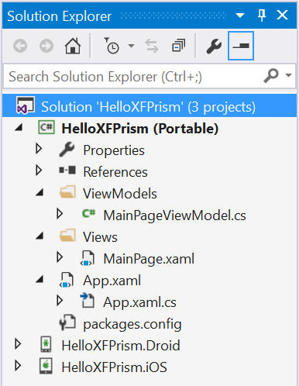

Slide 11
User Interface - Pages
Represents screens of mobile app
Types of pages
Content page
Master Detail Page
Navigation Page
Tabbed Page
Carousal Page

Slide 12
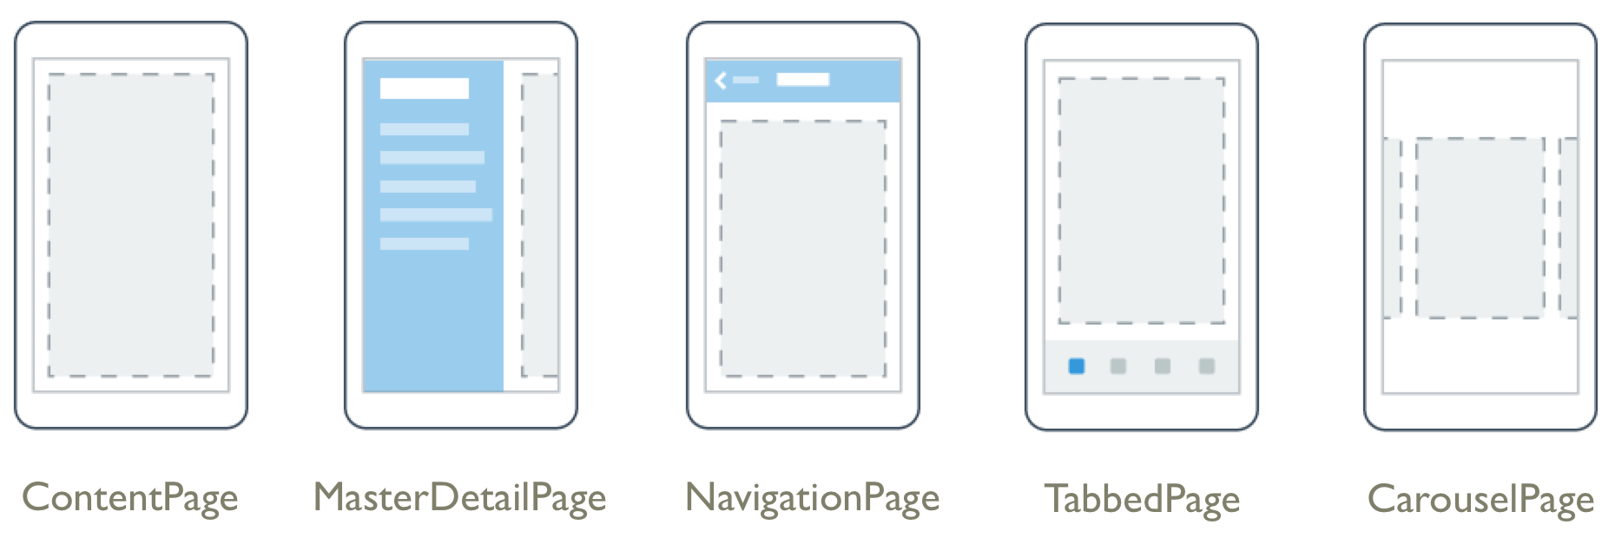



UIViewController
Activity
Page

Slide 13

Content Page
Display a single view
new ContentPage { Content = new Label
{ Text = "Hello, Forms!",
VerticalOptions = LayoutOptions.CenterAndExpand,
HorizontalOptions = LayoutOptions.CenterAndExpand,
},
}

Slide 14

Master Detail Page
Manages two panes of information: Master Page and detail page

Slide 15

Navigation Page
Manage navigation between pages and create stack of pages

Slide 16

Tabbed Page
Display an array of tabs
On ios list of tabs appear at bottom while in andorid and windo phone it appears at top

Slide 17

Carousal Page
Pages that user can swipe from side to side to display pages of content like gallery

Slide 18
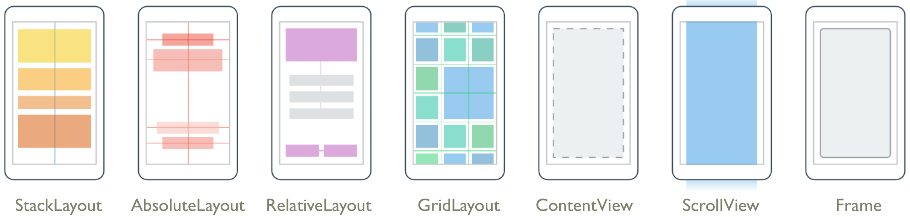
Layouts

Slide 19
Stack Layout
A layout that positions child elements into single line either horizontally or vertically
<StackLayout Orientation=“Vertical”>
<StackLayout.Children>
<Label x:Name="valueLabel"
Text="A simple Label"
FontSize="Large"
HorizontalOptions="Center"
VerticalOptions="CenterAndExpand" />
<Button Text="Click Me!"
HorizontalOptions="Center"
VerticalOptions="CenterAndExpand"
Clicked="OnButtonClicked" />
</StackLayout.Children>
</StackLayout

Slide 20
Grid
Layout that arranges views rows and columns
<Grid> <Grid.ColumnDefinitions> <ColumnDefinition Width="2*" /> <ColumnDefinition Width="1*" /> <ColumnDefinition Width="1*" /> </Grid.ColumnDefinitions> <Grid.RowDefinitions> <RowDefinition Height="2*" /> <RowDefinition Height="1*" /> <RowDefinition Height="1*" /> </Grid.RowDefinitions> <Button>Button 1</Button> <Button Grid.Column="1">Button 2</Button> <Button Grid.Column="2">Button 3</Button> <Button Grid.Row="1">Button 4</Button> <Button Grid.Column="1" Grid.Row="1">Button 5</Button> <Button Grid.Column="2" Grid.Row="1">Button 6</Button> <Button Grid.Row="2">Button 7</Button> <Button Grid.Column="1" Grid.Row="2">Button 8</Button> <Button Grid.Column="2" Grid.Row="2">Button 9</Button> </Grid>

Slide 21
Absolute Layout
Positions child elements at absolute positions
Can control the placement of child elements by providing proportional coordinates or a combination of both

Slide 22
Relative layout
Layout that uses constraints to layout its children

Slide 23
Content View
An element that contains a single child element
MainPage = new ContentPage () {
Padding = new Thickness(10, Device.OnPlatform(20, 0, 0), 10, 5),
Content = new ContentView {
Content = new Label { Text = "I'm Content!" },
}
};

Slide 24
Scroll View
An element capable of scrolling of its content requires
var stack = new StackLayout();
for (int i = 0; i < 100; i++)
{
stack.Children.Add(new Button { Text = "Button " + i });
}
MainPage = new ContentPage
{
Content = new ScrollView { Content = stack }
};

Slide 25
Frame
An element containing single child, with some framing options
MainPage = new ContentPage () {
Content = new Frame {
Content = new Label { Text = "I'm Framous!" },
OutlineColor = Color.Silver,
VerticalOptions = LayoutOptions.CenterAndExpand,
HorizontalOptions = LayoutOptions.Center
}
};

Slide 26
Thanks

