Slide 1
Day 3
Xamarin.Android
Presented By : Anand Dubey

Slide 2
Contents
Introduction
Android API levels
SDK manager
Resources
Activity Lifecycle
Handling Rotation

Slide 3
Introduction
Xamarin.Android makes it possible for you to create native Android applications using the same UI controls as you would in Java, but with the flexibility and elegance of a modern language (C#), the power of the .NET Base Class Library (BCL), and a first-class IDE (Visual Studio) at your fingertips

Slide 4
Android API
Xamarin.Android has several Android API level settings that determine your app's compatibility with multiple versions of Android
Xamarin.Android exposes three Android API level project settings:
Target Framework - Specifies which framework to use in building your application. This API level is used at compiletime by Xamarin.Android.
Minimum Android Version - Specifies the oldest Android version that you want your app to support. This API level is used at run time by Android.
Target Android Version - Specifies the version of Android that your app is intended to run on. This API level is used at run time by Android.
Before you can configure an API level for your project, you must install the SDK platform components for that API level
Normally, all three Xamarin.Android API levels are set to the same value. On the Application page, set Compile using Android version (Target Framework) to the latest stable API version (or, at a minimum, to the Android version that has all of the features you need)

Slide 5
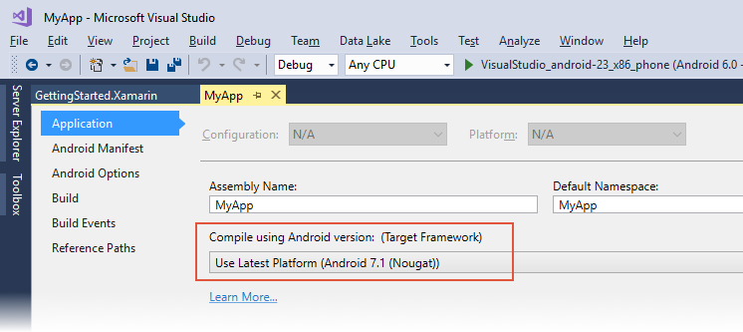

Slide 6
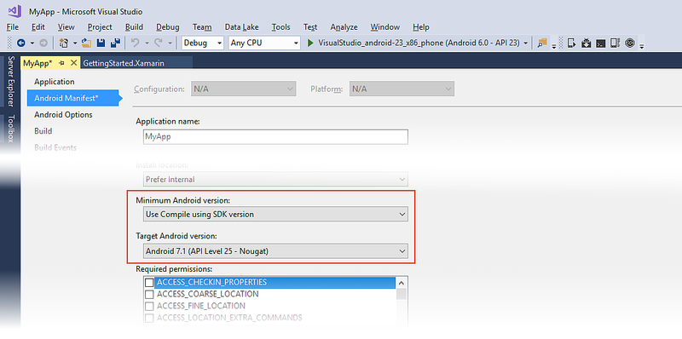

Slide 7
Android version and API level
As the Android platform evolves and new Android versions are released, each Android version is assigned a unique integer identifier, called the API Level. Therefore, each Android version corresponds to a single Android API Level. Because users install apps on older as well as the most recent versions of Android, real-world Android apps must be designed to work with multiple Android API levels.
Each release of Android goes by multiple names:
The Android version, such as Android 7.1
A code name, such as Nougat
A corresponding API level, such as API level 25
An Android code name may correspond to multiple versions and API levels (as seen in the list below), but each Android version corresponds to exactly one API level.

Slide 8
Cont…
Each Android device runs at exactly one API level – this API level is guaranteed to be unique per Android platform version
Android's system of API levels helps Android determine whether an application is compatible with an Android system image prior to installing the application on a device.
An app contains two info:
Target API
Minimum Android API
These settings are used to ensure that the functionality needed to run the app correctly is available on the Android device at installation time. If not, the app is blocked from running on that device. For example, if the API level of an Android device is lower than the minimum API level that you specify for your app, the Android device will prevent the user from installing your app.

Slide 9
Android SDK manager
The Xamarin Android SDK Manager helps you download the latest Android components that you need for developing your Xamarin.Android app
When you click Tools > Android > Android SDK Manager , the Xamarin Android SDK Manager will be launched instead of the Google Android SDK Manager. If you are using an earlier version of the Android SDK that supports Google's standalone Android SDK Manager, installing the Xamarin Android SDK Manager will not create a conflict – you can still launch the standalone Google SDK Manager from outside of Visual Studio to manage the Android SDK.

Slide 10
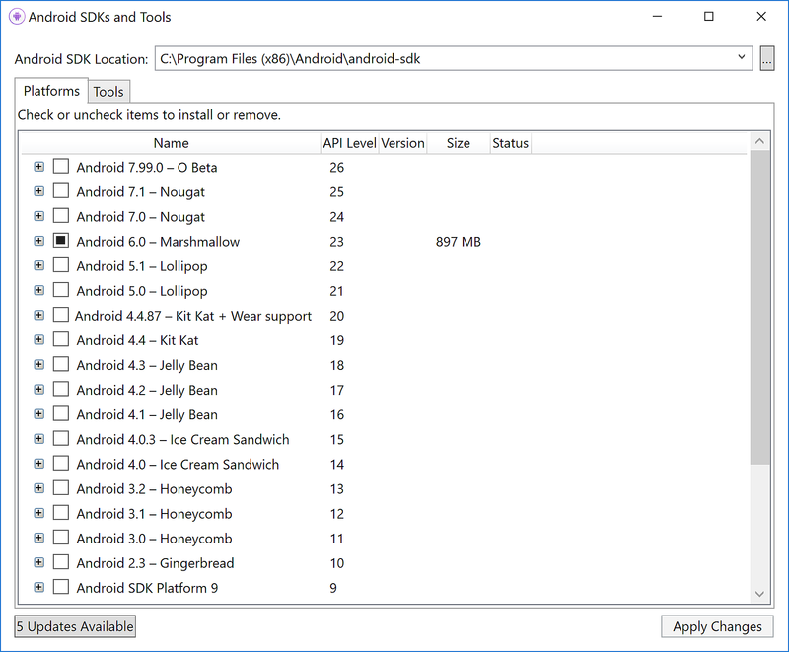

Slide 11
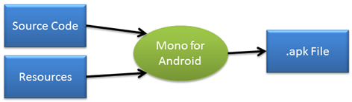
Resources
An Android application is seldom just source code. There are often many other files that make up an application: video, images, fonts, and audio files just to name a few. Collectively, these non-source code files are referred to as resources and are compiled (along with the source code) during the build process and packaged as an APK for distribution and installation onto devices:

Slide 12
Cont…
When a new Xamarin.Android project is started, a special directory called Resources is created, along with some subdirectories
images will go in the drawable directory; views go
in the layout subdirectory, etc.
These resources are called Default Resources and
are used by all devices unless a more specific
match is specified
every type of resource may optionally have
Alternate Resources that Android may use to
target specific devices

Slide 13
Cont…
Alternate resources are specified by adding a short string, called a qualifier, to the end of the directory holding a given type of resources.
For example, resources/drawable-de will specify the images for devices that are set to a German locale, while resources/drawable-fr would hold images for devices set to a French locale

Slide 14
Cont…
Basic structure
Icon.png
Main.axml
Strings.xml
AboutResources.txt
Resource.Designer.cs
Creating resources is as simple as adding files
to the directory for the resource type
The screen shot below shows string resources
for German locales were added to a project.
When Strings.xml was added to the file, the
Build Action was automatically set to
AndroidResource by the Xamarin.Android
tools

Slide 15
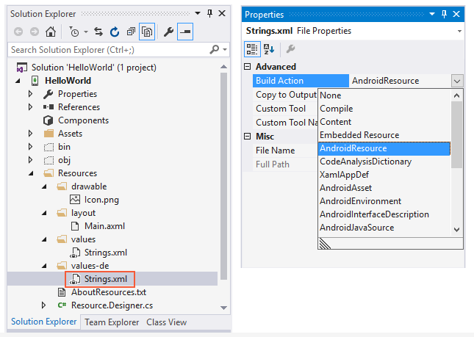

Slide 16
Activity Lifecylce
Activities are a fundamental building block of Android applications and they can exist in a number of different states.
The activity lifecycle begins with instantiation and ends with destruction, and includes many states in between
When an activity changes state, the appropriate lifecycle event method is called, notifying the activity of the impending state change and allowing it to execute code in order to adapt to that change
Android applications can be launched via any registered activity within an application, In practice, most applications will only have a specific activity that is specified as the application entry point
The activity lifecycle is implemented as a collection of methods the OS calls throughout the lifecycle of an activity

Slide 17
Activity State
The Android activity lifecycle comprises a collection of methods exposed within the Activity class that provide the developer with a resource management framework
This framework allows developers to meet the unique state management requirements of each activity within an application and properly handle resource management
The Android OS arbitrates Activities based on their state. This helps Android identify activities that are no longer in use, allowing the OS to reclaim memory and resources. The following diagram illustrates the states an Activity can go through during its lifetime

Slide 18
Cont…
Active or Running
Activities are considered active or running if they are in the foreground, also known as the top of the activity stack
This is considered the highest priority activity in Android, and as such will only be killed by the OS in extreme situations, such as if the activity tries to use more memory than is available on the device as this could cause the UI to become unresponsive.
Paused
When the device goes to sleep, or an activity is still visible but partially hidden by a new, non-full-sized or transparent activity
Paused activities are still alive, that is, they maintain all state and member information, and remain attached to the window manager
This is considered to be the second highest priority activity in Android and, as such, will only be killed by the OS if killing this activity will satisfy the resource requirements needed to keep the Active/Running Activity stable and responsive

Slide 19
Cont…
Stopped/Backgrounded
Activities that are completely obscured by another activity are considered stopped or in the background
Stopped activities still try to retain their state and member information for as long as possible, but stopped activities are considered to be the lowest priority of the three states and, as such, the OS will kill activities in this state first to satisfy the resource requirements of higher priority activities
Restarted
It is possible for an activity that is anywhere from paused to stopped in the lifecycle to be removed from memory by Android
If the user navigates back to the activity it must be restarted, restored to its previously saved state, and then displayed to the user

Slide 20
Activity Lifecycle Methods
The Android SDK and, by extension, the Xamarin.Android framework provide a powerful model for managing the state of activities within an application. When an activity's state is changing, the activity is notified by the OS, which calls specific methods on that activity
you can handle state changes by overriding these methods within an activity
all lifecycle methods are called on the UI thread and will block the OS from performing the next piece of UI work, such as hiding the current activity, displaying a new activity, etc

Slide 21
On Create
OnCreate is the first method to be called when an activity is created. OnCreate is always overridden to perform any startup initializations that may be required by an Activity such as:
Creating Views
Initializing Variables
Binding Static data to list
OnCreate takes a Bundle parameter, which is a dictionary for storing and passing state information and objects between activities If the bundle is not null, this indicates the activity is restarting and it should restore its state from the previous instance
Once OnCreate has finished, Android will call OnStart

Slide 22
On Start
OnStart is always called by the system after OnCreate is finished
Activities may override this method if they need to perform any specific tasks right before an activity becomes visible such as refreshing current values of views within the activity
Android will call OnResume immediately after this method.

Slide 23
On Resume
The system calls OnResume when the Activity is ready to start interacting with the user
Activities should override this method to perform tasks such as
Starting Animation
GPS updates
Display any relevant alerts or dialogs
OnResume is important because any operation that is done in OnPause should be un-done in OnResume, since it's the only lifecycle method that is guaranteed to execute after OnPause when bringing the activity back to life

Slide 24
OnPause
OnPause is called when the system is about to put the activity into the background or when the activity becomes partially obscured
Activities should override this method if they need to:
Commit unsaved changes to persistent data
Destroy or clean up other objects consuming resources
Unregister external event handlers or notification handlers
if the Activity has displayed any dialogs or alerts, they must be cleaned up with the .Dismiss() method
There are two possible lifecycle methods that will be called after OnPause
OnResume
OnStop

Slide 25
OnStop
OnStop is called when the activity is no longer visible to the user
This happens when one of the following occurs
A new activity is being started and is covering up this activity
An existing activity is being brought to the foreground
The activity is being destroyed
The next lifecycle methods that may be called after this one will be OnDestroy if the Activity is going away, or OnRestart if the Activity is coming back to interact with the user

Slide 26
OnDestroy
OnDestroy is the final method that is called on an Activity instance before it's destroyed and completely removed from memory
In extreme situations Android may kill the application process that is hosting the Activity, which will result in OnDestroy not being invoked
Most Activities will not implement this method because most clean up and shut down has been done in the OnPause and OnStop methods
The OnDestroy method is typically overridden to clean up long running resources that might leak resources

Slide 27
OnRestart
OnRestart is called after your activity has been stopped, prior to it being started again
A good example of this would be when the user presses the home button while on an activity in the application. When this happens OnPause and then OnStopmethods are called, and the Activity is moved to the background but is not destroyed. If the user were then to restore the application by using the task manager or a similar application, Android will call the OnRestart method of the activity
The next lifecycle method called after OnRestart will be OnStart

Slide 28
Back VS Home
There is a subtle difference between the two buttons, even though they appear to have the same effect of putting an application in the background. When a user clicks the Back button, they are telling Android that they are done with the activity. Android will destroy the Activity. In contrast, when the user clicks the Home button the activity is merely placed into the background – Android will not kill the activity.

Slide 29
Thanks

