Slide 1
Auto Theft Case Study
Data Description:
In this case study, the data provided is about the automobiles theft cases registered in all the states of the country. The cases which are registered are from 2001 to 2010. All the varieties of automobiles starting from two wheelers to multi axel vehicles being stolen away are considered.
This data also tells us about number of thefts being caught and how many automobiles are stolen and recovered.
Problem Statement:
We are supposed to perform the analysis of number of autos theft and their recovery over the years.

Slide 2
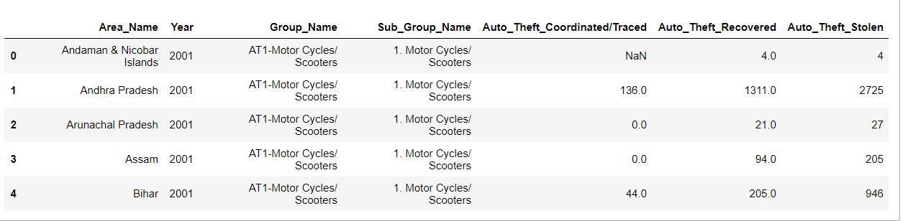
Data Dictionary:
Area_Name : States of the country
Year: Years ranging from 2001 to 2010
Group_Name: Autos category
Sub_Gtroup_Name: Autos theft sub category
Auto_Theft_Traced: Number of theft traced
Auto_theft_recoverd: Number of automobiles recovered
Auto_theft_stolen: Number of automobiles stolen
This is how the data looks like……

Slide 3
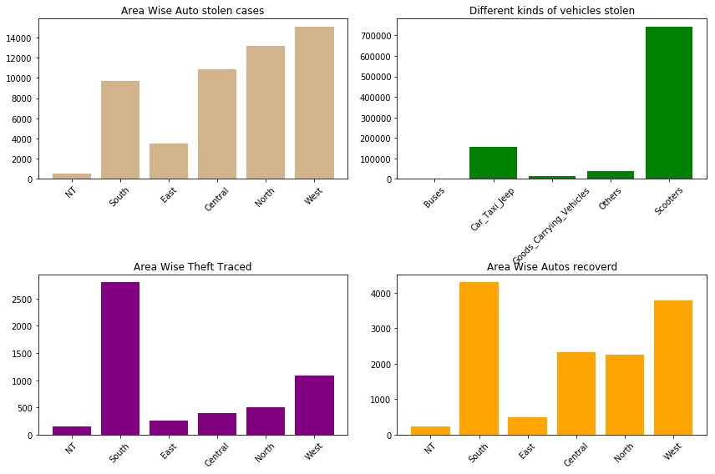

Slide 4
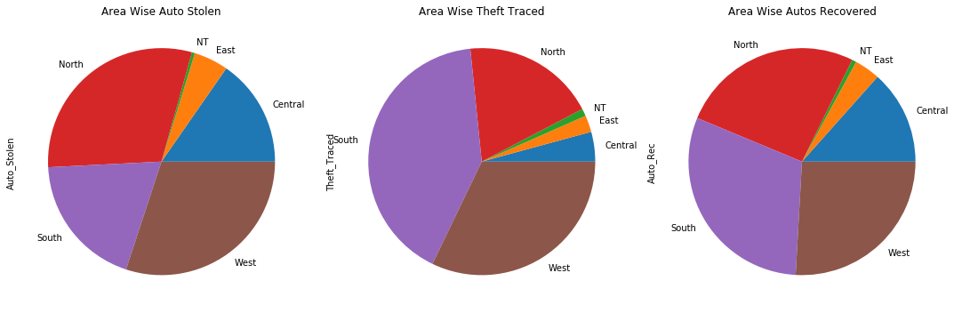
Northern and Western region of India have registered more cases of automobiles theft than the rest part of the country.
Southern region being the ace in catching the theft.
Since theft being highly traced, more is the chance of getting automobiles recovered. Hence, South region again tops the ranking in auto recovery.

Slide 5
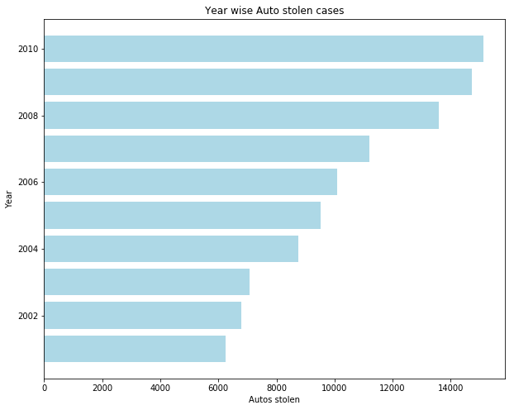

Slide 6
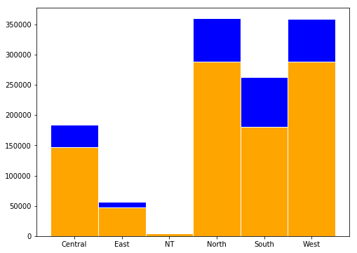
Region Wise Analysis

Slide 7
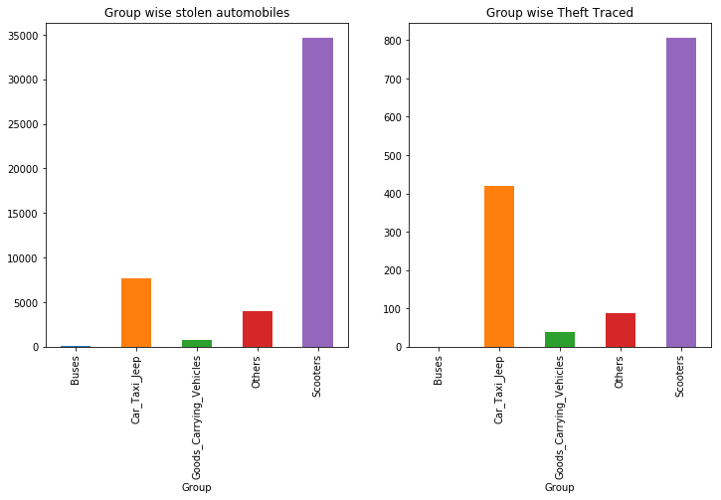
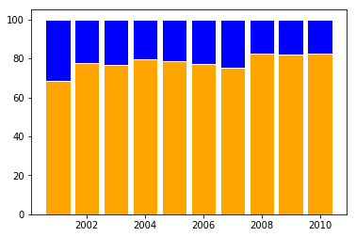
East Zone

Slide 8
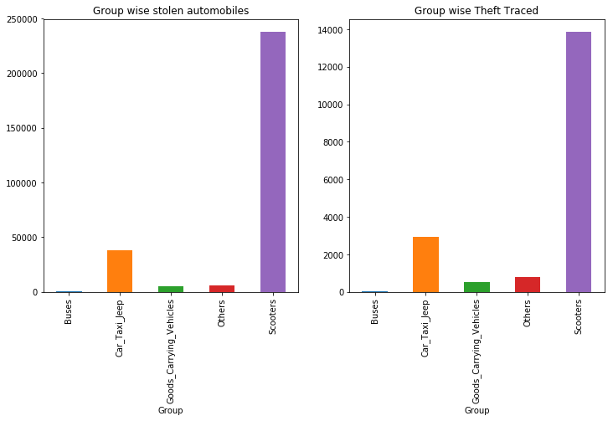
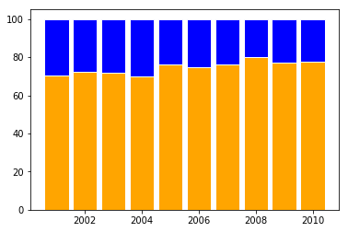
West Zone

Slide 9
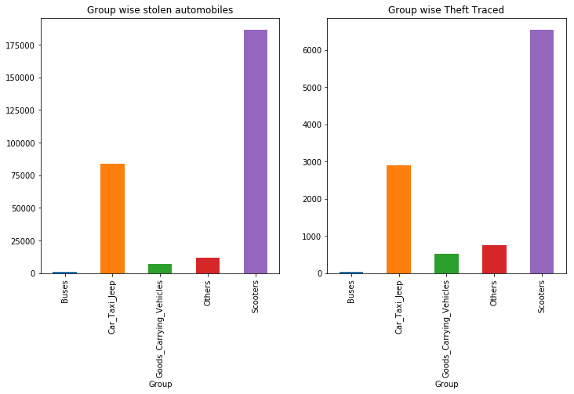
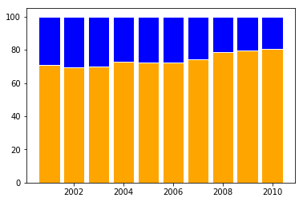
North Zone

Slide 10
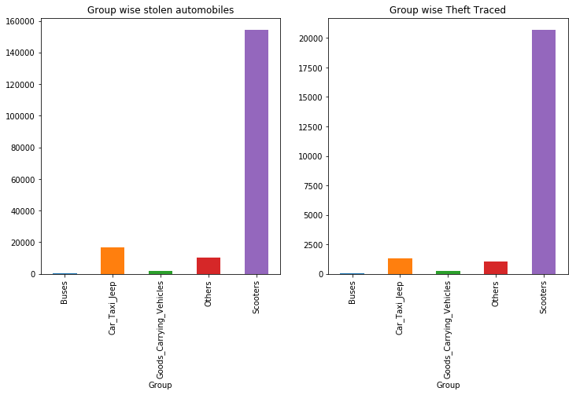
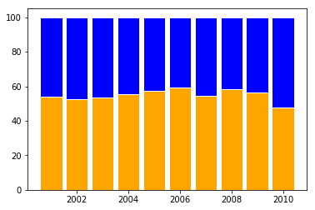
South Zone

Slide 11
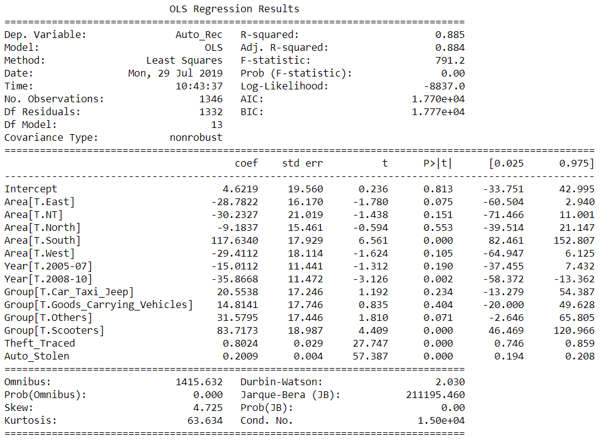
Mean_Squared_Error : 28054.9215
r_square_value : 0.8774

Slide 12
Regression Result:
Model | MSE | R2_Score
Multiple Linear Regression | 28454.7852 | 0.8756
Multiple Linear Regression(After Stats model analysis) | 28054.9215 | 0.8775
DecisionTreeRegressor | 22746.6509 | 0.9006
RandomForestRegressor | 18837.4478 | 0.9178
BaggingRegressor | 16958.2972 | 0.9259
AdaBoostRegressor | 22604.0644 | 0.9012
GradientBoostingRegressor | 19970.7166 | 0.9127

Slide 13
Observations:
Scooters have been stolen the most as compared to the other types of automobiles. Cars and jeep being the second in the list to get stolen away.
Northern and Western region of India have registered more cases of automobiles theft than the rest part of the country.
Eastern part and the national territories have lesser population hence the registered cases of automobiles theft are less in number as compared to other regions.
Southern region being the ace in catching the theft.
Since theft being highly traced, more is the chance of getting automobiles recovered. Hence, South region again tops the ranking in auto recovery.
The theft cases are increasing year by year in all states of the country being the serious issue.
Link to see the code:
https://github.com/sumantn16/Exploratory_Data_Analysis/blob/master/Auto_theft.ipynb

