Slide 1
Object Oriented Programming using C++
Handout1
Kayalvizhi Jayavel

Slide 2
UNIT I
FUNDAMENTALS OF C++
Programming paradigms – Procedure Oriented Programming and Object Oriented Programming systems (OOPS)
History of C++
Characteristics of OOPS- ANSI/ISO standard; C++ Tokens - Data Types, keywords;
Operators, Arrays, Branching and iterations;
Introduction to Standard Library-namespaces- Strings-Vectors

Slide 3
About the slides
All details in forthcoming slides are an attempt to introduce the basic concepts of OOPS and C++
All topics will be discussed in detail with appropriate examples in future classes

Slide 4
Semester Planner
1. Lab exercises: Solved (Manual) and To Solve (By Students) type of exercises
2. Multiple Choice Questions: (Students need to prepare in this direction too..)
3. Random Surprise Tests (2 to 3), Quizzes, Puzzles etc…
4. Project Module towards the end of the course (Time limit 2 weeks)

Slide 5
History Of Programming Languages

Slide 6
Programming language
It is a language that is used to control the behavior of a machine particularly computer.
It is used to facilitate communication about task of organizing and manipulating information
It is used to express algorithms precisely

Slide 7
Why programming is important??
Critical reading :Understanding + analysis
Analytical reading: Step-by-Step procedures to break complex problem into small steps
Creative synthesis: Think about all the possibilities

Slide 8
Pay attention to details
Pay attention to all the aspects
Pay attention to all the calculations involved in program, their flow, and most importantly the logic of program
Understand the fact the computers are useless
Don’t assume that reader is intelligent
Comment your code

Slide 9
Model of a complex system
Model: Simplified representation of salient features of something, either tangible or abstract
System: Collection of components that work closely together
Syntax: Grammatical rules for forming instructions
Semantics: Meaning/ interpretation of instructions.

Slide 10
Instruction written by programmer
Coded in a specific programming language
Programming language allow you to express yourself more precisely than natural language
Source code:: All instructions that compute a program is called source code
e.g. library catalog, ATM, video game.

Slide 11
Algorithm
Set of instructions used to specify how to solve a problem

Slide 12
Syntax
Set of rules that govern the structure of sentences, instructions

Slide 13
Types of languages
Typed language: If operation defined for one data type can’t be performed on another data type
Un-typed language: Allow any operation to be performed on any data type e.g. assembly language.

Slide 14
Introduction
C++ is General purpose programming language
Mid level language: Combination of both high level language and low level language

Slide 15
High level language
It is a programming language that in comparison to high level language is more compact, abstract, easier to use and portable to most platforms
They normally abstract away cpu operations like memory access models and measurement of scope
It can easily implement algorithms
High level language is converted to assembly by compiler

Slide 16
Low level language
It does not provide any sort of abstraction from a computer’s microprocessor
First generation low level language: It was only understood by microprocessor; it requires numerous numeric codes for writing a single instruction
Second generation low level language :e.g. Assembly language. It is not a microprocessor’s native language.But programmer still need to understand internal architecture of microprocessor such as registers and instructions e.g. cmp edx,3

Slide 17
Why functions?
It is a way to make programs more comprehensive
Each function has a clearly defined purpose and a clearly defined interface to other parts of program
Module: Grouping of a number of functions together

Slide 18
Structured programming
Division of a program into functions and reconstruction in the form of modules is structured programming

Slide 19
Data
In procedural language data is given second class status But in object oriented programming data is given first class status
Global data: The one that is acessible to all the functions
Local Data: the one that is accessible only to its own confined block

Slide 20
Object oriented programming
Combine data and functions into a single unit that operate on that data; such a unit is called an object
Object functions: Provide only way to access its data; if you want to read a data item you only need to access its function;
C++ typically consists of a number of objects which communicate with each other through its functions

Slide 21
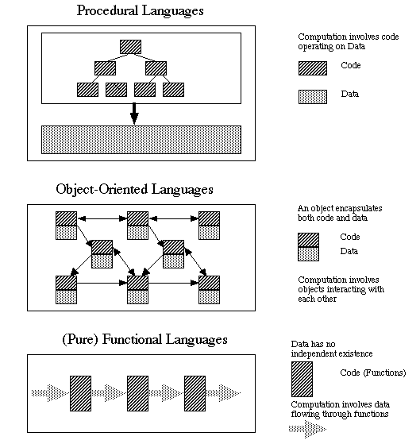
Procedural versus OOPS

Slide 22
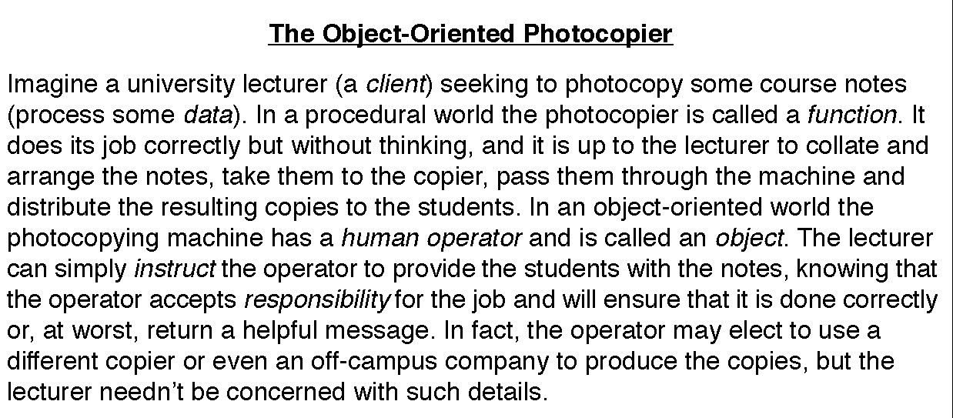
Scenario demonstrates
OOPS versus Procedural

Slide 23
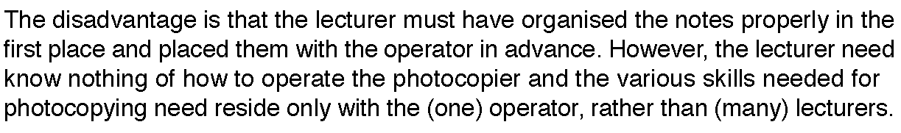

Slide 24
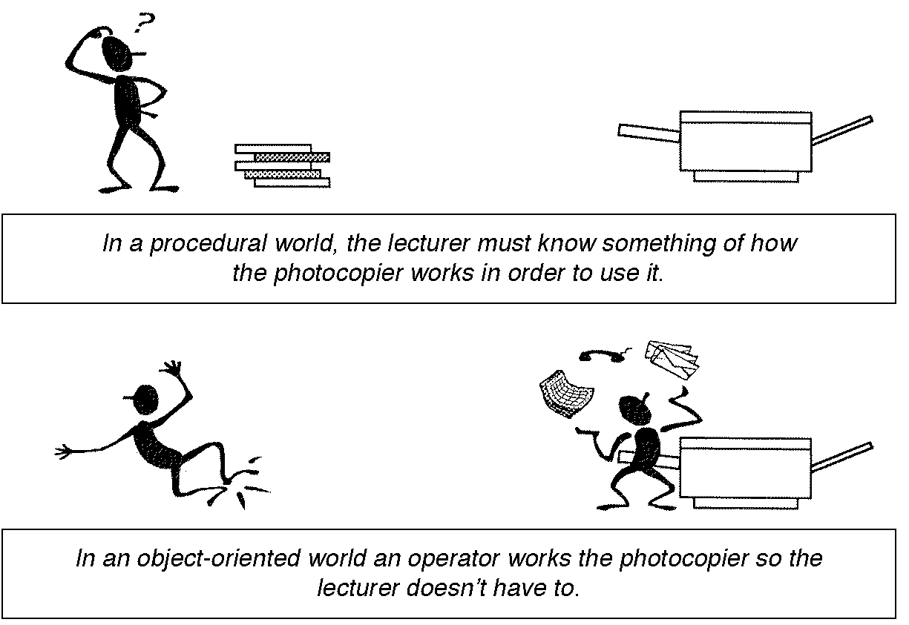
Procedural versus OOPS

Slide 25
History of C and C++
C is a programming language developed in the 1970's alongside the UNIX operating system.
C provides a comprehensive set of features for handling a wide variety of applications, such as systems development and scientific computation.
C++ is an “extension” of the C language, in that most C programs are also C++ programs.
C++, as opposed to C, supports “object-oriented programming.”

Slide 26
History of C and C++
History of C
  Evolved from two other programming languages
    BCPL and B
      “Typeless” languages
  Dennis Ritchie (Bell Laboratories)
    Added data typing, other features
  Development language of UNIX
  Hardware independent
    Portable programs
  1989: ANSI standard
  1990: ANSI and ISO standard published
    ANSI/ISO 9899: 1990

Slide 27
History of C and C++
History of C++
  Extension of C
  Early 1980s: Bjarne Stroustrup (Bell Laboratories)
  “Spruces up” C
  Provides capabilities for object-oriented programming
    Objects: reusable software components
      Model items in real world
    Object-oriented programs
      Easy to understand, correct and modify
  Hybrid language
    C-like style
    Object-oriented style
    Both

Slide 28
C++ Standard Library
C++ programs
  Built from pieces called classes and functions
C++ standard library
  Rich collections of existing classes and functions
“Building block approach” to creating programs
  “Software reuse”

Slide 29
Object Technology
Objects
  Reusable software components that model real world items
  Meaningful software units
    Date objects, time objects, paycheck objects, invoice objects, audio objects, video objects, file objects, record objects, etc.
    Any noun can be represented as an object
  More understandable, better organized and easier to maintain than procedural programming
  Favor modularity
    Software reuse
      Libraries
        MFC (Microsoft Foundation Classes)
        Rogue Wave

Slide 30
Basics of a Typical C++ Environment
C++ systems
  Program-development environment
  Language
  C++ Standard Library

Slide 31
Basics of a Typical C++ Environment
Phases of C++ Programs:
  Edit
  Preprocess
  Compile
  Link
  Load
  Execute
Program is created in
the editor and stored
on disk.
Editor
Disk
Preprocessor
Disk
Preprocessor program
processes the code.
Compiler creates
object code and stores
it on disk.
Compiler
Disk
Linker links the object
code with the libraries,
creates a.out and
stores it on disk
Linker
Disk
Primary
Memory
Loader
Loader puts program
in memory.
Disk
.
.
.
.
.
.
Primary
Memory
CPU
CPU takes each
instruction and
executes it, possibly
storing new data
values as the program
executes.
.
.
.
.
.
.

Slide 32
Compilers
To list a few:
Borland C++
Turbo C++
GCC
CC
For complete list refer:
http://en.wikipedia.org/wiki/List_of_compilers#C.2B.2B_compilers

Slide 33
Integrated development environment
Put all the tools that you need to develop program into a single unit

Slide 34
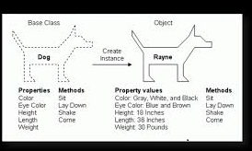
Properties of OOPS

Slide 35
Properties of OOPS

Slide 36
Properties of object oriented programming
Abstraction
Inheritence
Encapsulation
polymorphism

Slide 37
Inheritence
Each subclass share a common set of characteristics from its parent class. In addition to common characteristics they have their own characteristics as well
OOP class can be divided into subclasses. Original class is called parent class and those that share common characteristics are called subclass.

Slide 38
Class
Serve as template of a new data type .
It specifies what data and functions will be included in objects of that class.
Defining class don’t create any object .
Similar to integer don’t create any integer variable.

Slide 39
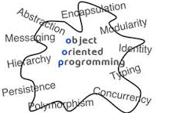
In Nutshell: Properties of OOPS

Slide 40
General form of C++ Program
// Program description
#include directives
int main()
{
constant declarations
variable declarations
executable statements
return 0;
}

Slide 41
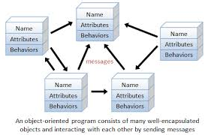
In Nutshell: OOPS

Slide 42
Keywords
Each keyword has a predefined purpose in the language.
Do not use keywords as variable and constant names!!
The complete list of keywords refer http://en.cppreference.com/w/cpp/keyword
Following are few keywords:
bool, break, case, char, const, continue, do, default, double, else, extern, false, float, for, if, int, long, namespace, return, short, static, struct, switch, typedef, true, unsigned, void, while

Slide 43
Example Scenario-1
Peter: Hey Frank, I just learned how to add two numbers together.
Frank: Cool!
Peter : Give me the first number.
Frank: 2.
Peter : Ok, and give me the second number.
Frank: 5.
Peter : Ok, here's the answer: 2 + 5 = 7.
Frank: Wow! You are amazing!

Slide 44
after Frank says “2”, Peter has to keep this number in his mind.
after Frank says “5”, Peter also needs to keep this number in his mind.
First number:
2
Second number:
5
Sum:
7

Slide 45
Corresponding C++ Program
The Corresponding C++ Program
#include <iostream>
using namespace std;
int main()
{
int first, second, sum;
cout << "Peter: Hey Frank, I just learned how to add”
<< “ two numbers together."<< endl;
cout << "Frank: Cool!" <<endl;
cout << "Peter: Give me the first number."<< endl;
cout << "Frank: ";
cin >> first;
cout << "Peter: Give me the second number."<< endl;
cout << "Frank: ";
cin >> second;
sum = first + second;
cout << "Peter: OK, here is the answer:";
cout << sum << endl;
cout << "Frank: Wow! You are amazing!" << endl;
return 0;
}

Slide 46
Identifiers
  An identifier is a name for a variable, constant, function, etc.
  It consists of a letter followed by any sequence of letters, digits, and underscores.
  Examples of valid identifiers: First_name, age, y2000, y2k
  Examples of invalid identifiers: 2000y
  Identifiers cannot have special characters in them. For example: X=Y, J-20, ~Ricky,*Michael are invalid identifiers.
  Identifiers are case-sensitive. For example: Hello, hello, WHOAMI, WhoAmI, whoami are unique identifiers.

Slide 47
Comments
Comments appear in green in Visual C++.
Comments are explanatory notes; they are ignored by the compiler.
There are two ways to include comments in a program:
  // A double slash marks the start of a //single line comment.
  /* A slash followed by an asterisk marks the start of a multiple line comment. It ends with an asterisk followed by a slash. */

Slide 48
Compiler Directives
Compiler directives appear in blue in Visual C++.
The #include directive tells the compiler to include some already existing C++ code in your program.
The included file is then linked with the program.
There are two forms of #include statements:
#include <iostream> //for pre-defined files
#include "my_lib.h" //for user-defined files

Slide 49
Programming Style
C++ is a free-format language, which means that:
Extra blanks (spaces) or tabs before or after identifiers/operators are ignored.
Blank lines are ignored by the compiler just like comments.
Code can be indented in any way.
There can be more than one statement on a single line.
A single statement can continue over several lines.

Slide 50
Programming Style
In order to improve the readability of your program, use the following conventions:
Start the program with a header that tells what the program does.
Use meaningful variable names.
Document each variable declaration with a comment telling what the variable is used for.
Place each executable statement on a single line.
A segment of code is a sequence of executable statements that belong together.
  Use blank lines to separate different segments of code.
  Document each segment of code with a comment telling what the segment does.

Slide 51
Never Do these….
Writing Code without detailed analysis and design
Repeating trial and error without understanding the problem
Debugging the program line by line, statement by statement
Writing tricky and dirty programs

Slide 52
References and Further Reading
COMP102 Programming Fundamentals : Introduction to C++
Thanks to Mariam Shafqat

