Slide 1
Description
Our website is freelancing Website In this developer can register themselves and create their profile and clients can visit our website and find developers and see developers profile and their skills and many more and if client interested can contact via Email.

Slide 2
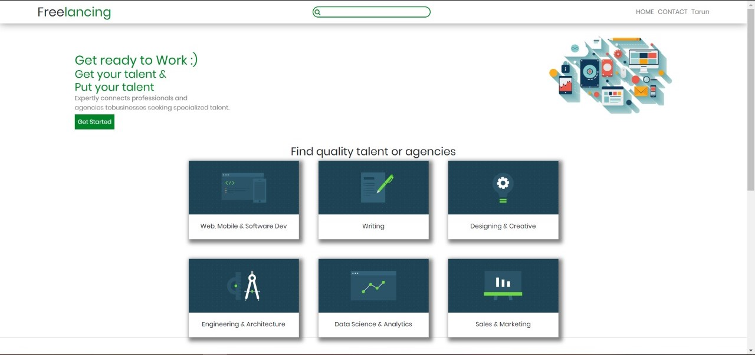
Screenshots

Slide 3
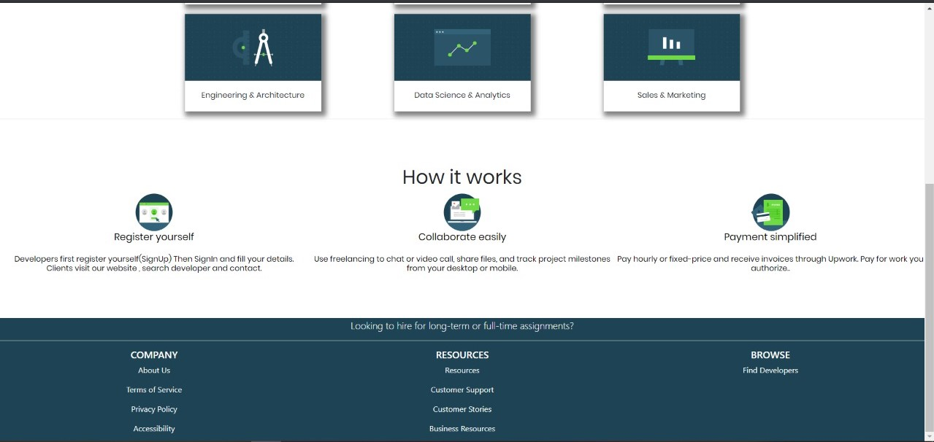

Slide 4
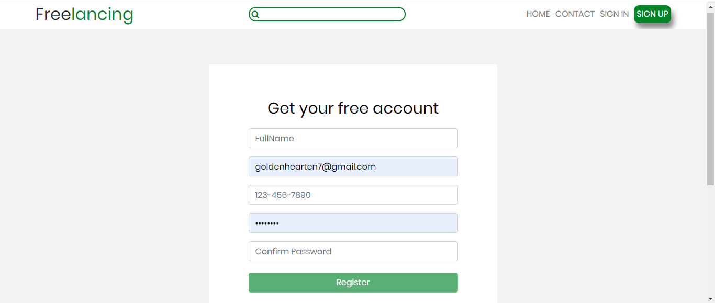

Slide 5
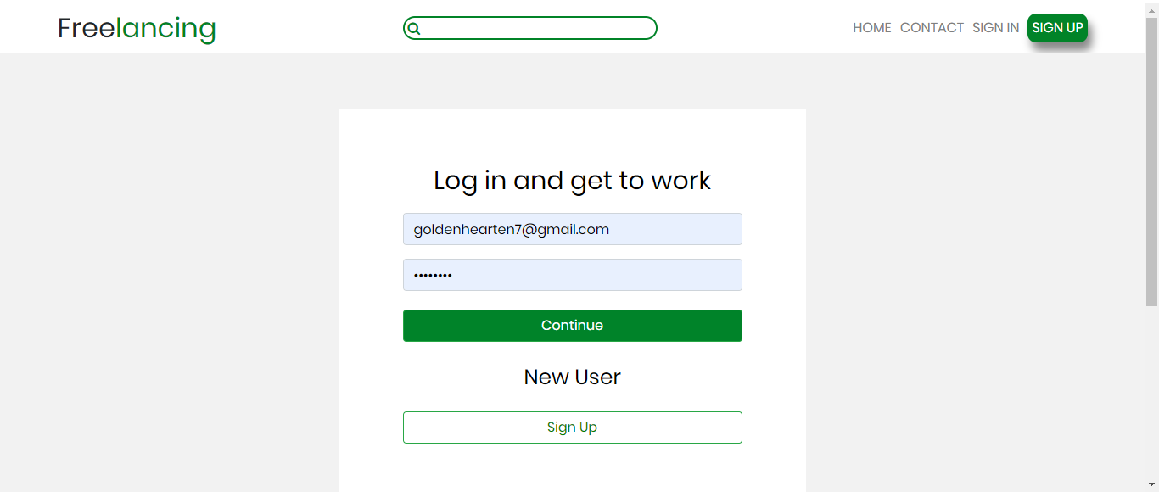

Slide 6
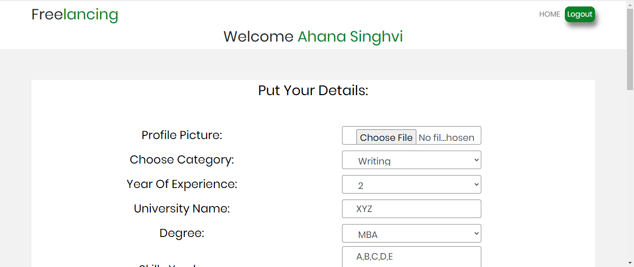
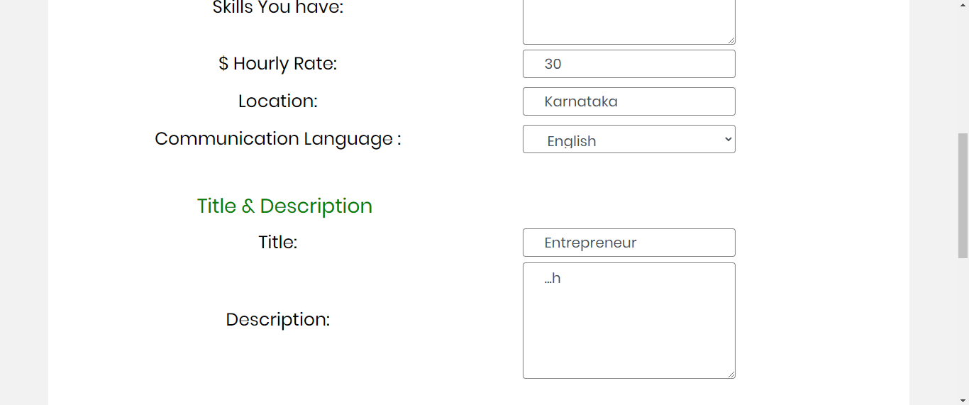

Slide 7
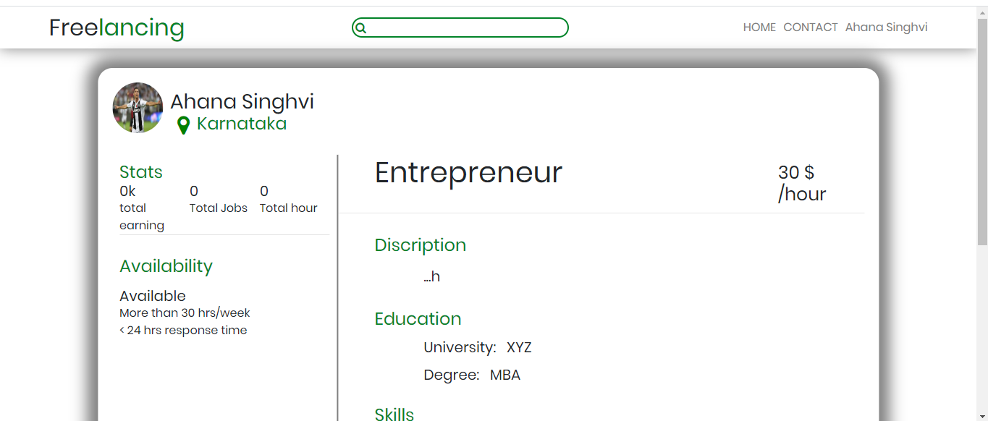


Slide 8
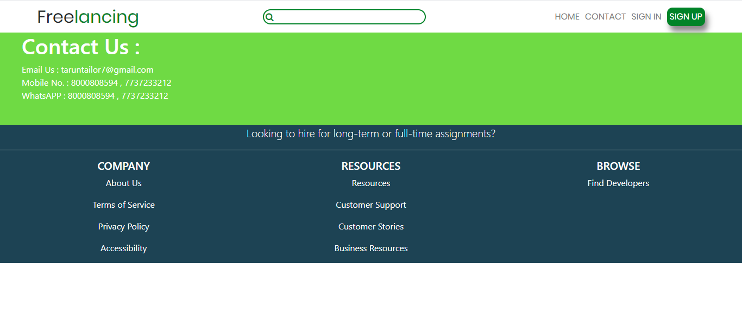

Slide 9
Thank You

