Slide 1


Grass solutions PVT. LTD.
A Power Point Presentation Submitted in complete fulfilment of the requirements for the training
Of
3rd Year
Bachelor of Technology
In
Computer Science and Engineering
Dept. of Computer Science
Techno India NJR Institute of Technology
Udaipur(313001), Rajasthan
(Affiliated to Rajasthan Technical University (RTU), Kota)

Slide 2
Summer training- Full stack development May- June(2020) Project Title Freelancing Website “an online Freelancing platform”
Under the guidance of:
Mr. Sanjay Rathore

Slide 3
Table of Contents
Topic | Slide No.
Collaborators | 4
Introduction | 5
Aim and Objectives | 6
Scope & Motive | 7
Basic Block Diagram | 8
Entities Supported | 9-11
Technologies involved | 12
Procedure | 13
Functionality | 14-16
Pros | 17
E-R Diagrams | 18
Use case Diagram | 19
Website-snapshots & Conclusion | 20-24

Slide 4
Collaborators
Sumant Vyas
(Student- 3rd Year B.Tech Computer Science Engineering)
Tarun Tailor
(Student- 3rd Year B.Tech Computer Science Engineering)
Nitin Bagdi
(Student- 3rd Year B.Tech Computer Science Engineering)
Geetesh Kashyap
(Student- 3rd Year B.Tech Computer Science Engineering)

Slide 5
Introduction
This project is a real world application involving skills and knowledge that we have acquired from our internship in MEAN stack development.
Since we all are amidst a global pandemic, it is our duty, as students, to come up with something innovative that would connect skilled and passionate entities together to fulfill development requirements of companies and individuals across the world.
Keeping the above motive in mind we’ve come up with our “freelancing” website developed via skills and knowledge acquired in our Summer internship.
Freelance websites are platforms, where both people looking for work and employers post their offers.
It is a freelance service marketplace designed to help individuals get started with freelance work.

Slide 6
Aim & objectives
As quoted previously also our aim is to provide a freelance service marketplace designed to help individuals get started with freelance work.
Geared towards lean entrepreneurs who are looking to hire talent for short-term projects, Freelancing is a good place for freelancers searching for interesting work with fair compensation.
Our website accommodates different types of professionals, including writers, programmers, and graphic artists, to name a few.
Once accepted on the platform, freelancers can post their services along with their fees, sample work, testimonials, and client requirements.
Prospective clients then view the various freelance offerings and select the one that best suits their needs.
Right after the acceptance from developer’s end, client can track the development progress of the project and view the completed project before deadline.

Slide 7
Scope and purpose
In the coming 10 years we can see lot of improvement & growth in Freelancing.
The process is quite simple and efficient. What we have to do is to just gain a very good knowledge on technologies and start working on freelancing sites.
It will fetch you lot of knowledge technically and personally.
We get to know how to manage people, how to make deals, how to deliver the quality work which is more important in Freelancing.
Freelancing purely depends on the field in which you want it and the skills you have for it.
For every different field there is a different scope. Not like that there will be no scope for a specific thing or skill, but that it will be low or high.

Slide 8
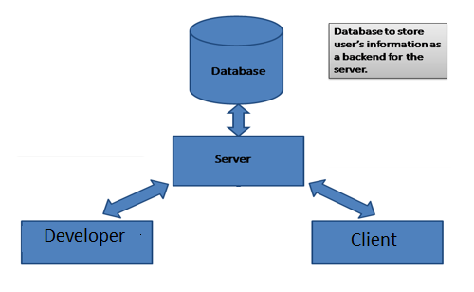
Basic Block Diagram

Slide 9
Users
Administrators
Sign up
Login
Password
Taking backup of the database.
Modify other details.
Edit or create the database

Slide 10
Developers
Sign up
Login
Complete your profile
Sample Work
View matching jobs and opportunities

Slide 11
Clients
Explore Website
Sign up if found your desired field.
Update profile info
Chat
Track progress
Help
Contact Admins

Slide 12
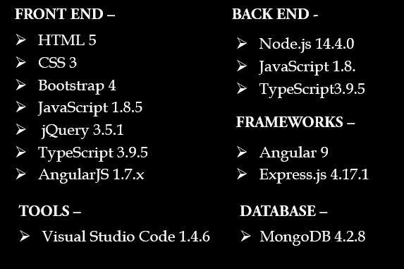
Languages & Applications used

Slide 13
PROCEDURE
Start by posting a job. Tell us about your project and the specific skills required.
Freelancing analyzes your needs. Our search functionality uses data science to highlight the best freelancers and agencies based on their skills, helping you find talent that’s a good match.
We send you a shortlist of likely candidates. You can also search our site for specialized freelancers and professional agencies who can view your job and submit proposals too.

Slide 14
FUNCTIONALITY
Clients-
View and explore website without registration.
Find your needs and developers.
View developer’s profile.
Register to post a requirement.
Chat with developer after initial acceptance.
Select project deadline and payment options.
Track progress and get the work done.
Contact admins for help regarding any critical issues.

Slide 15
Developers-
View and explore website without registration.
Find jobs based on your interests and specialization.
Perform registration as a developer.
Update profile details.
Select the task and read terms and conditions before confirmation.
Get started with the work and update progress.
Submit the work and finally get paid off for your first project.
Update work experience and accomplishments in profile section.

Slide 16
Administrators-
Taking backup of the database.
Editing/ Deleting/ Creating the database.
Changing passwords.
Logging into the system.
Monitoring registrations of clients and developers.
Managing the overall web application and troubleshooting.

Slide 17
Advantages
Flexible Hours – The first advantage of becoming a freelancer is that you can work whenever you want. You get to choose your own hours.
Control over Jobs and Clients – When you work for someone else, you don’t get a choice of who you work with. You can become stuck with unprofessional or rude clients. But, when you’re a freelancer, you can choose with whom you work.
Work Wherever You Want – Whether you prefer consistency or shaking things up when it comes to your work environment, you can choose to work wherever you want: Find a place in which you work best.
You’re the Boss – You no longer have to answer to anyone but your clients and yourself. No one is hanging over you or micromanaging you. Making all the tough decisions just became your responsibility; you have all the control.
You Keep All the Profits -No longer do you have to work for a flat rate, no matter how large the projects are that you complete. Now, you get to allocate or keep all the profits from your large and small projects and clients.

Slide 18
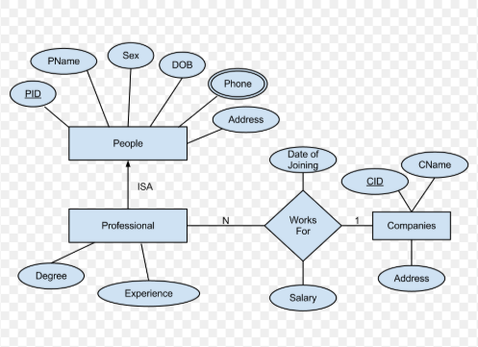
E-r Diagram

Slide 19
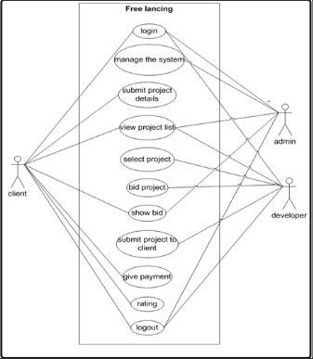
USE CASE DIAGRAM

Slide 20
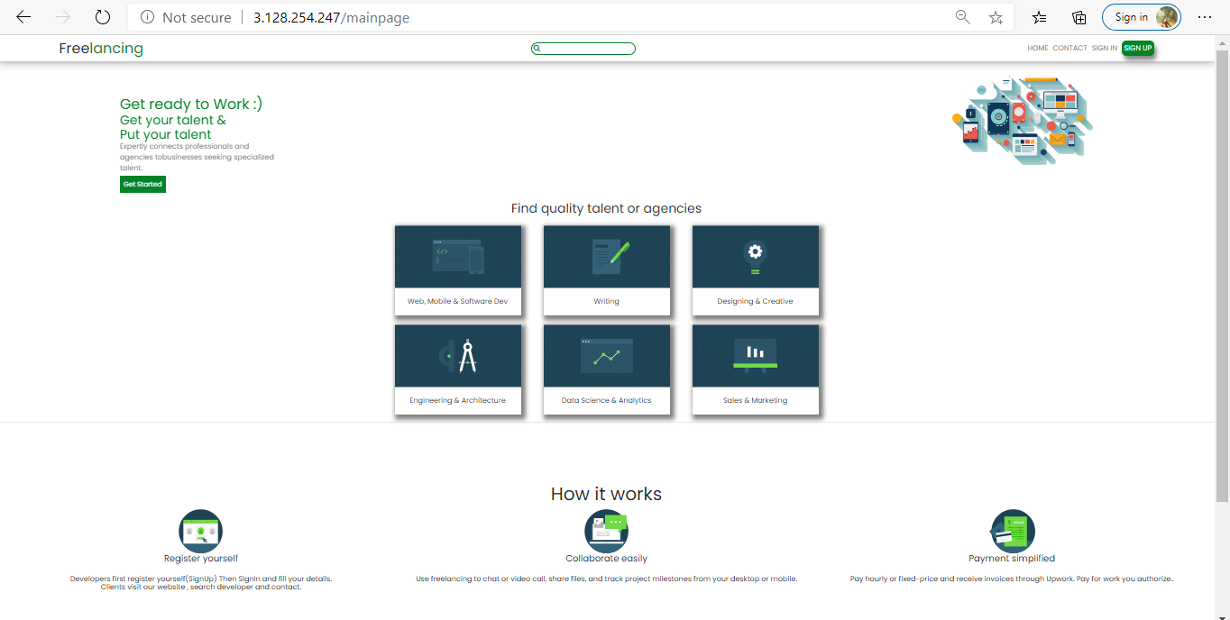
Website snapshots
Home page

Slide 21
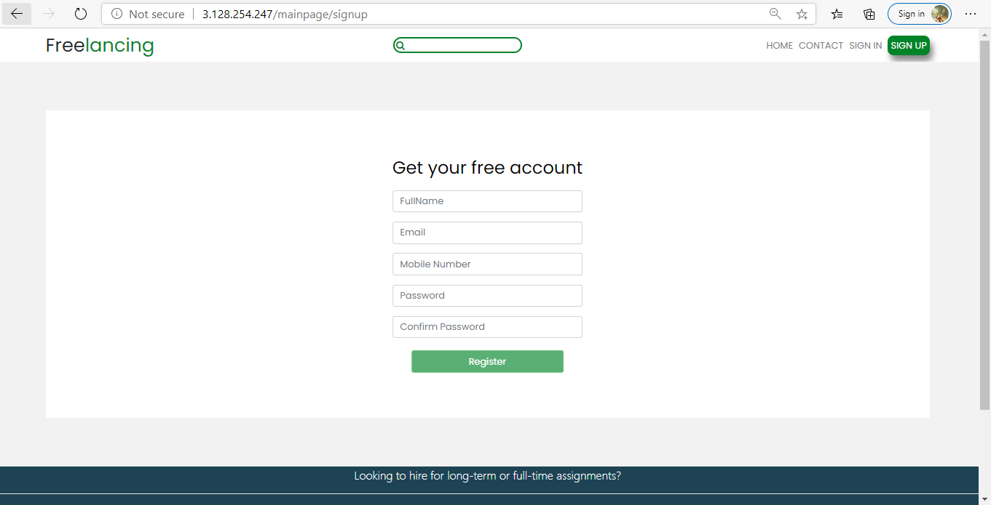
Sign UP

Slide 22
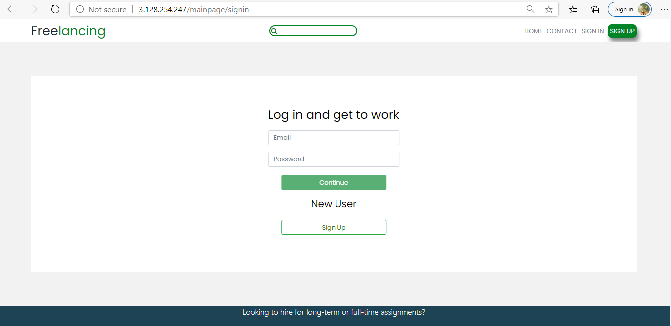
Sign In

Slide 23
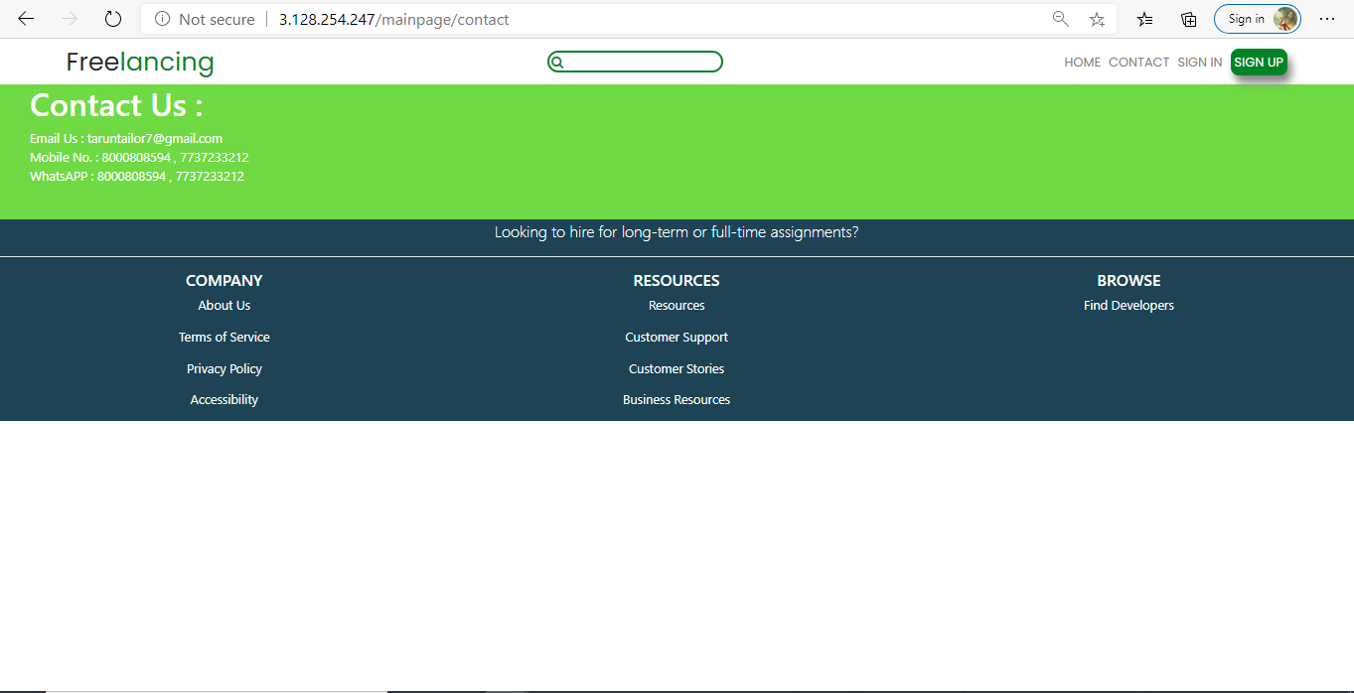
Contact

Slide 24
CONCLUSION
Freelancing has become incredibly popular in recent years, with some people using it to supplement their monthly income and others pursuing it full-time for the freedom it accords them. This surge in popularity is understandable seeing that freelancers get to choose the projects they work on, schedule their own hours, work from new locations each day, and charge their own fees. Freelancers today need to build a solid reputation and portfolio if they want to receive steady work. Since hiring freelancers on a need-basis is more cost-effective as compared to hiring full-time talent, companies and entrepreneurs can also makes use of these sites to get their work done on a budget.
Thus, it can be concluded for now that freelancing is certainly the latest career opportunity on the block and will continue to dominate the Indian job market in the future.

Slide 25
THANK YOU

