Slide 1
Data discovery
The dataset gives several variables (screening information related to patients) along with a condition classified into “Normal”, “MCI”, “Dementia”
Dataset contain 46 attributes, "Label” (dependent variable) is the class variable which is determined depending on some of the given attribute's information.
Started with data exploration where checked about missing data, removed insignificant features, removed X variables which are in correlation (there Must NOT be Any relationship between the X variables) and learned which features are important.
During the data preprocessing, categorical variables are converted to dummy variables and changed data types.
Analyzed cleaned data using Pandas-profiling for better understanding of data
Seaborn and matplotlib to do the visualizations

Slide 2
Research questions
To determine whether age and gender have any significant role in classifying the disease condition
Whether patient health history and lifestyle has any role in progression/presence of MCI/Dementia
To identify the diagnostic test/screening test that are significant in classifying the disease condition
Selection of appropriate screening questions and tests to better diagnoses and classification of the disease
To develop a better method for prediction in future using machine learning models to save time and resources.

Slide 3
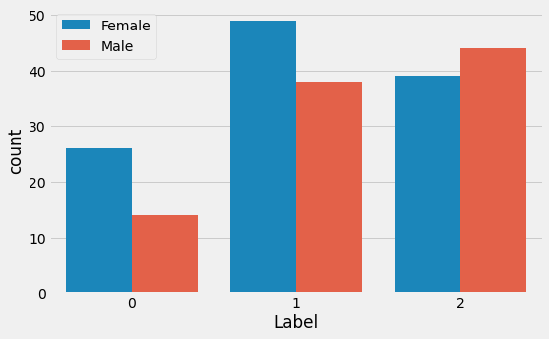
Analysis
In the given data 41.4% were diagnosed as MCI patients and 19% were diagnosed with Dementia, more than 50% patients were diagnosed with MCI/Dementia in the given data set.
Patients diagnosed with MCI/Dementia in the given data set are in the age range of 50-95
As it is known that Dementia is an age-related progressive disorder, the average age of people diagnosed with Dementia is 75 in the given data.
MCI is risk factor for Dementia, the average is 72 for the people with MCI in the given data set. So, these people have high chance of progression to Dementia, so available treatments should be highly targeted to these patients.
More number of females are diagnosed with Dementia and MCI in the given population which in relation to the studies showing women are at higher risk of developing dementia than men
Diagnosis/screening parameters NPI, IADL have negative correlation with target variable
MoCAB, MMSE, C1 HVLT(immediate memory), C5 HVLT (delayed recall 5min) ,C8 HVLT (delayed recall 20min), C4 logical memory(WMS), C6 Boston Naming Test, C3 articulateness and verbal fluencey-vegetable(BNT), C2 CFT Rey-o (imitation), C9 CFT Rey-o (recall) have high positive correlation in diagnosing MCI and Dementia. So, in future the screening can done focusing these test for better diagnosis and it can reduce time of screening
Lastly diagnosis doesn’t have any dependence on patient health history

Slide 4
Predictive modelling
As outcome/target variable is categorical, I used classification models for future predictions using this clinical data
Naive Bayes, Random Forest Classifier, K-Nearest Neighbour, Decision Tree, Support Vector Machine, Multinominal Logistic Regression, Extreme Gradient Boost, Artificial Neural Network(ANN)
Using machine learning models trained tested data set and validation is done on test data.
Lastly, obtained confusion matrix and computed the model’s quality
Of course, there is still room for improvement, like doing a more extensive feature engineering, by comparing and plotting the features against each other and identifying and removing the noisy features.
The models present different patterns of average precision and recall, which allows for flexibility depending on the task in which the model will be deployed to help.
One such example would be to use the recall model as a screening aid and the precision model for resource allocation.It is also worth noting that the we should not exclude the possibility of a selection bias in the dataset composition, as specific clinics may target to specific patients as well.

Slide 5
Conclusions
While training the Naive Bayes model in the dataset, we achieved an accuracy rate of 78%, which is more than the baseline accuracy. For classifying class “0” (i.e. Dementia) the algorithm achieved a recall value of 1 and an F1 score of 0.73 and for class "1"(MCI) the recall value of 0.6 and F1 score of 0.67
The Random Forest model attained an accuracy rate of 89%, which is more than the Naive Bayes model. Moreover, the precision for identifying Dementia is 1 with an F1 score of 0.78.
The KNN model achieved an accuracy rate of 83%, which is slightly less than the Random Forest model. The model has precision of 1 and f1-scores of 0.78 for identifying the class “0” (Dementia)
The Decision Tree model achieved an accuracy rate of 83%, which is slightly less than the Random Forest model.
Support Vector Classifier and Extreme Gradient Boost shows lower accuracy than random forest model, which is 86%.
Random Forest gives the best accuracy of 89% compared to other models and least.
Most of this classification models have high precision value “1” in predicting Dementia.
Predicting disease condition associated with a group of screening tests is primarily a special type of Machine Learning problem. The performance of the model is measured by evaluating it for predicting a True positive. In this way, the K-NN,SVM,MLR and random forest models’ performance better in comparison with the rest of the models. This models can be used to ensemble methods since these models can classify the nonlinearly separable dataset.
Proposed next steps
As the given data set is small, we can use a technique called cross-validation methods like K-fold validation and the Leave-One-Out cross validation
In order to increase the accuracy of the model we can use ensemble methods like stacking technique.

