Slide 1
Comcast Telecom Consumer Complaints_case study using python_jupyter notebook

Slide 2
Steps involved in data handling
importing all required python libraries
import numpy as np
import pandas as pd
import seaborn as sns
import matplotlib.pyplot as plt
%matplotlib inline
Loading dataset using read_csv function
Checking shape of dataset(function-df.shape), column names for duplicates(df.columns)
Checking for datatypes and any null values(df.info())-no null values in the given dataset
Convert Date, Date_month_year to datatime datatype creating trend analysis based on daily and monthly complaints

Slide 3
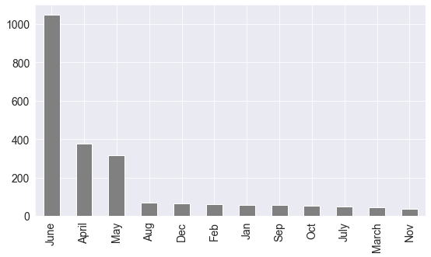
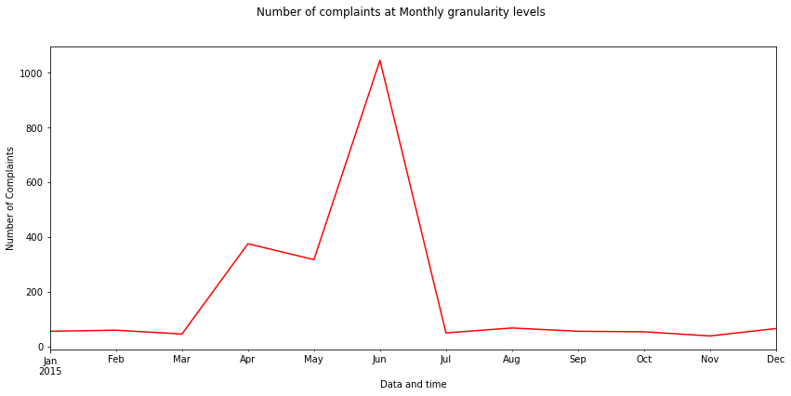
Q1- Provide the “trend chart” for the number of complaints at “monthly” and “daily” granularity levels
#Let's extract month from date_month_year column
Comcast_comp["month"]=Comcast_comp.Date_month_year.dt.month
Comcast_comp['month’]=Comcast_comp['month'].replace([1,2,3,4,5,6,7,8,9,10,11,12],['Jan','Feb','March','April','May','June','July','Aug','Sep','Oct','Nov','Dec'])
# Provide the trend chart for the number of complaints at monthly granularity levels.
plt.figure(figsize=(14,6))
plt.suptitle('Number of complaints at Monthly granularity levels’)
plt.ylabel('Number of Complaints’)
Comcast_comp['month'].groupby(pd.Grouper(freq="M")).size().plot(color='red')
#### Monthly Granularity ####
Comcast_comp['month'].value_counts().plot(kind='bar',color='grey')
Highest complaints received in the month of June and more complaints are reported in months of April, May and June

Slide 4
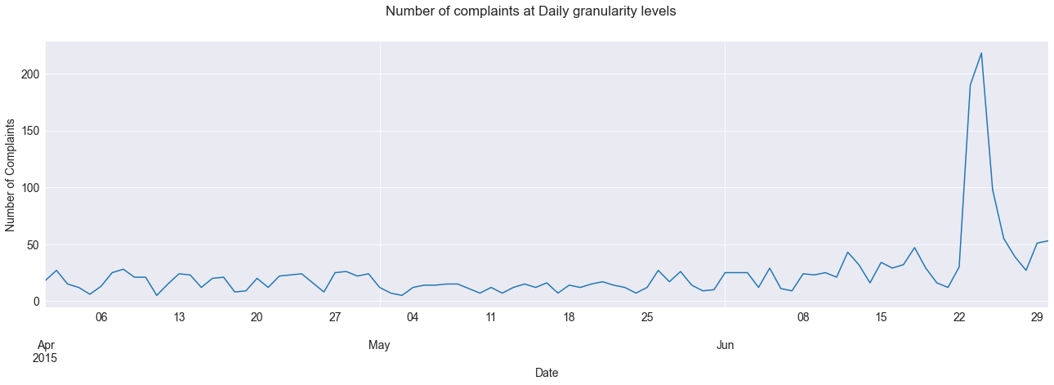
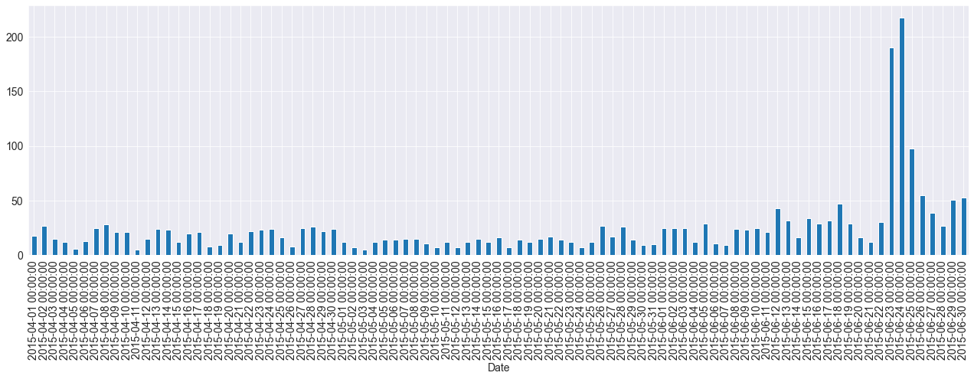
Q1- Provide the “trend chart” for the number of complaints at “monthly” and “daily” granularity levels
# Provide the trend chart for the number of complaints at daily granularity levels.
plt.figure(figsize=(14,6))
plt.suptitle('Number of complaints at Daily granularity levels’)
plt.ylabel('Number of Complaints’)
Comcast_comp['Customer Complaint'].groupby(Comcast_comp.Date).count().plot(kind='line',figsize=(22,6))
#### Daily Granularity #### Comcast_comp['Customer Complaint'].groupby(Comcast_comp.Date).count().plot(kind='bar',figsize=(22,6))
Highest complaints (more than 200) received on Date 24.06.2015

Slide 5
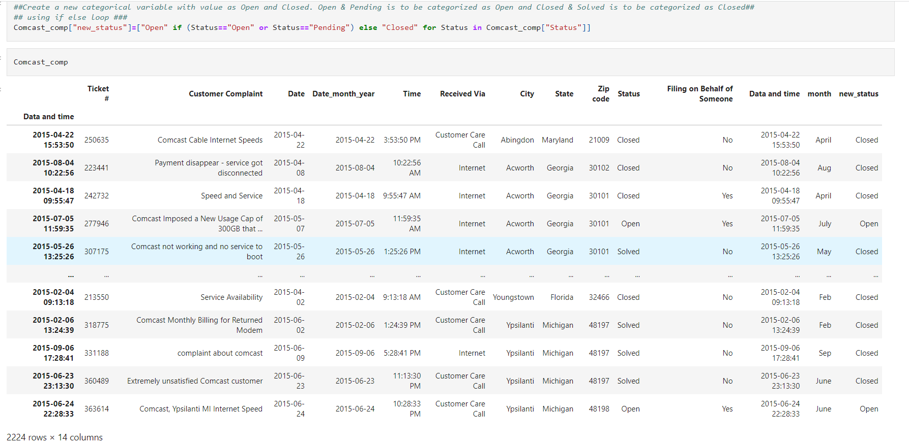
Q2- Create a new categorical variable with value as Open and Closed. “Open & Pending” is to be categorized as “Open” and “Closed & Solved” is to be categorized as “Closed
##Create a new categorical variable with value as Open and Closed. Open & Pending is to be categorized as Open and Closed & Solved is to be categorized as Closed
## ## using if else loop ###
Comcast_comp["new_status"]=["Open" if (Status=="Open" or Status=="Pending") else "Closed" for Status in Comcast_comp["Status"]]

Slide 6
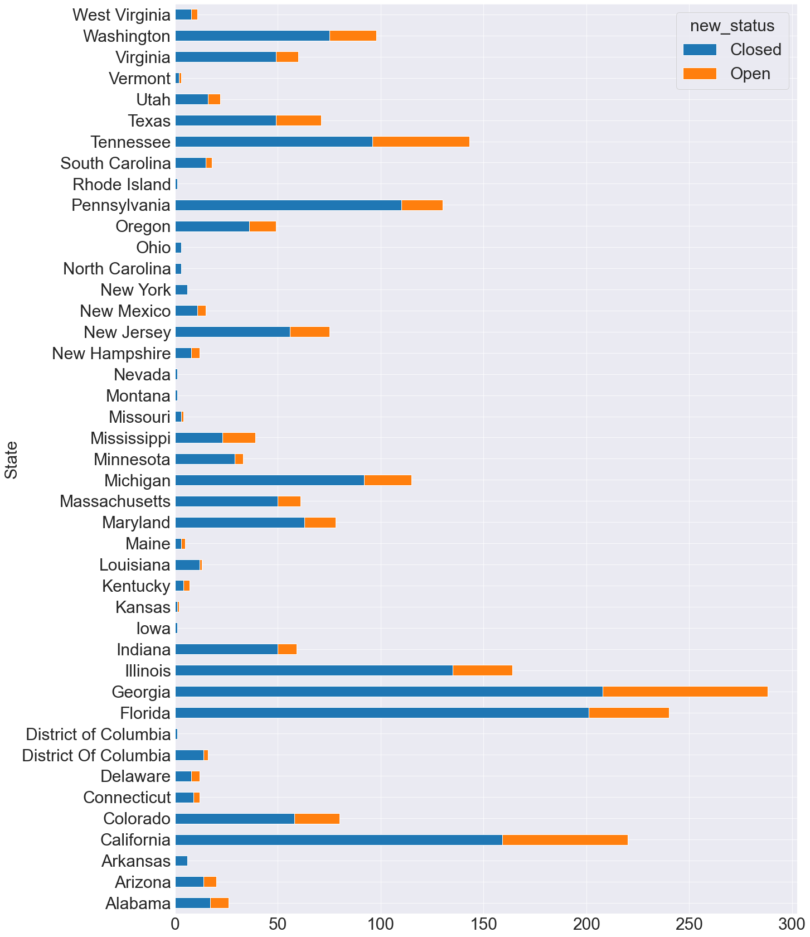
Q3- Provide state wise status of complaints in a stacked bar chart.
state_complaints=Comcast_comp.groupby(["State","new_status"]).size().unstack().fillna(0)
state_complaints
state_complaints.plot(kind="barh",figsize=(20,30),stacked=True)
plt.rcParams.update({"font.size":30})
Georgia has maximum number of complaints

Slide 7
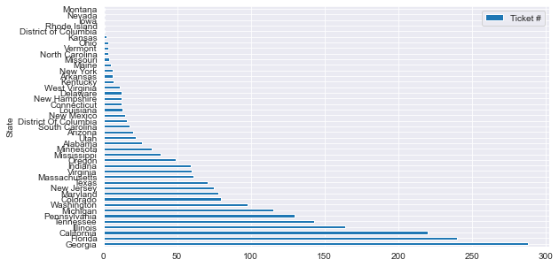
Use the categorized variable from Q2.
Provide insights on:
Which state has the maximum complaints
statewise_max=Comcast_comp[['Ticket #', 'State']].groupby('State').count().sort_values(by='Ticket #',ascending=False)
statewise_max.head()
statewise_max.plot(kind='barh') plt.rcParams.update({"font.size":5})
Georgia state has received maximum customer complaints we have to give special attention to that state Georgia,Florida and california are three states from where maximum complaints were received

Slide 8
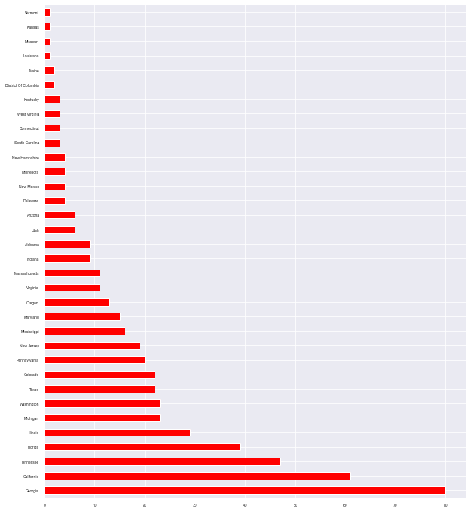
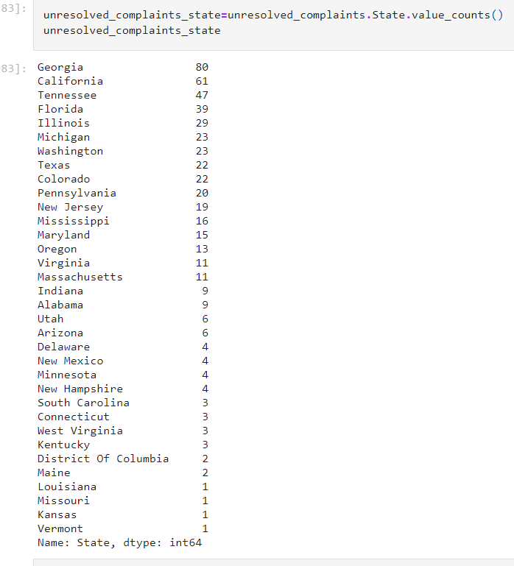
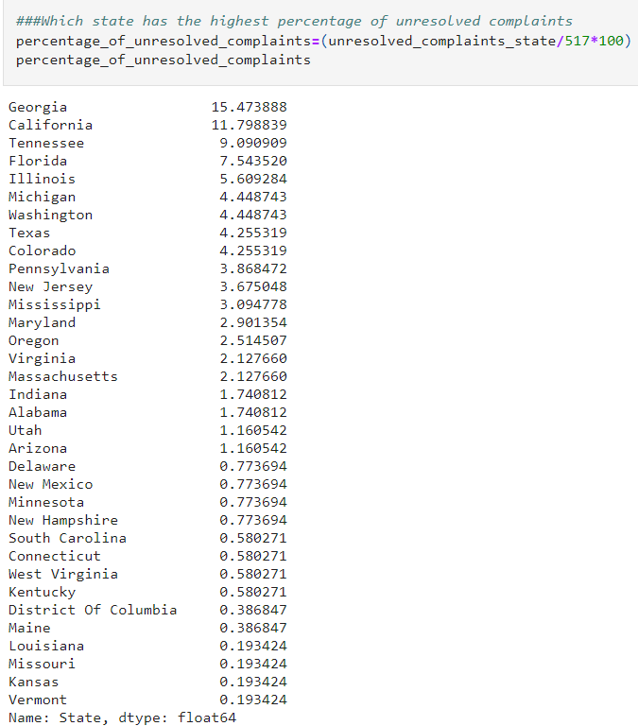
Which state has the highest unresolved complaints
##Which state has the highest percentage of unresolved complaints
unresolved_complaints = Comcast_comp[Comcast_comp['new_status']=='Open']
unresolved_complaints.State.value_counts().plot(kind='barh',figsize=(10,12),color="red")
###Which state has the highest percentage of unresolved complaints
percentage_of_unresolved_complaints=(unresolved_complaints_state/517*100)
percentage_of_unresolved_complaints
Georgia state has highest percentage of unresolved customer complaints

Slide 9
Q4- Provide the percentage of complaints resolved till date, which were received through the “Internet” and “customer care calls”.
###Provide the percentage of complaints resolved till date, which were received through the Internet and customer care calls.
Code: Comcast_comp['Received Via'].unique()
Output: array(['Customer Care Call', 'Internet'], dtype=object)
Code: compl=Comcast_comp.groupby(['Received Via','new_status'])['Received Via'].count().unstack()
compl
Output: new_status | Closed | Open
Received Via
Customer Care Call | 864 | 255
Internet | 843 | 262
Code: totcompl=len(Comcast_comp)
totcompl
Output: 2224
Code: for x in compl.values:
l=(x/totcompl*100)
print(l)
percentage of complaints resolved till date received through customer care call is 39%, percentage of complaints resolved till date received through Internet is 38%
Output:[38.84892086 11.46582734]
[37.90467626 11.78057554]

Slide 10
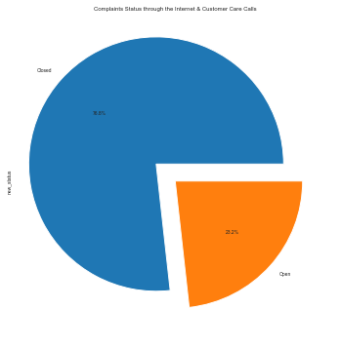
Q4- Provide the percentage of complaints resolved till date, which were received through the “Internet” and “customer care calls”.
# Used autopct='%1.1f%%' to show percentage under the pie chart
myexplode = [0.2, 0]
plt.title('Complaints Status through the Internet & Customer Care Calls\n’)
Comcast_comp.new_status.value_counts().plot(kind='pie',explode = myexplode,autopct='%1.1f%%’,
figsize = (10,6))
We have seen that total complaint resolved rate is 76.7% to improve this we have to lookout the state of Georgia, Florida and california from where maximum complaints received and the month of June as maximum complaints received in this month. We should look out the reason behind this.

Slide 11
Q5:Provide a table with the frequency of complaint types
# To get the frequency of complaint types first we must see all complaint types and check for duplicate, case sensitive
# Incomplete data so that we can make analytics better
# Better to convert all data into uper case or sentence case so duplicate value will shorted
complaint_type=Comcast_comp["Customer Complaint"].str.upper().value_counts() complaint_type.head(25)
complaint_type = Comcast_comp["Customer Complaint"].value_counts()
complaint_type
COMCAST 102
COMCAST DATA CAP 30
COMCAST INTERNET 29
COMCAST DATA CAPS 21
COMCAST BILLING 18
INTERNET SPEED 15
COMCAST SERVICE 15
DATA CAPS 13
UNFAIR BILLING PRACTICES 13
DATA CAP 12
COMCAST COMPLAINT 11
COMCAST/XFINITY 11
COMCAST INTERNET SERVICE 10
BILLING 9
BILLING ISSUES 8
COMCAST CABLE 5
SLOW INTERNET 5
COMPLAINT AGAINST COMCAST 5
COMCAST BILLING PRACTICES 5
SERVICE ISSUES 5
INTERNET SERVICE 5
COMCAST ISSUES 5
INTERNET 5
COMCAST BILLING COMPLAINT 5
NO INTERNET SERVICE 4
Name: Customer Complaint, dtype: int64
Comcast 83
Comcast Internet 18
Comcast Data Cap 17
comcast 13
Comcast Data Caps 11 ..
Customer Service & Billing 1
Throttled connection at peak time 1
Concern about Comcast Internet Modem Billing Practices 1
Comcast in violation of merger terms 1
COMCAST SERVICE COMPLAINT 1
Name: Customer Complaint, Length: 1841, dtype: int64
We can show clearly in this table that COMCAST, COMCAST DATA CAP, COMCAST INTERNET are the Highest top 3 complaint types

