Slide 1
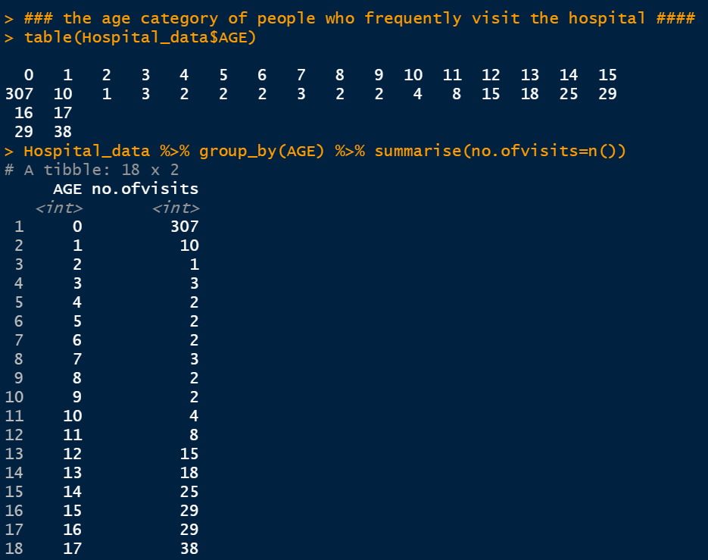
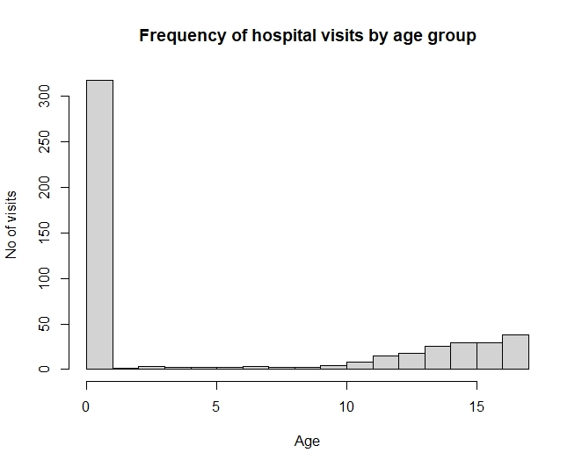
To record the patient statistics, the agency wants to find the age category of people who frequent the hospital
There are various ways to find the most frequently visited age group to the hospital
Code:
Hospital_data <- read.csv("HospitalCosts.csv") #### loading dataset ####
print(Hospital_data)
### the age category of people who frequently visited hospital ####
#### method 1 #####
table(Hospital_data$AGE)
#### method 2 #####
Hospital_data%>% group_by(AGE) %>% summarise(n())
#### method 3 #####
hist(Hospital_data$AGE,xlab = "Age",ylab = "no of visits",breaks = 18)
#### method 4 ###
summary(as.factor(Hospital_data$AGE))
Result:
From the above analysis it was evident that age group is 0-1(infants) have most frequent hospital visits(307) than remaining age category people

Slide 2
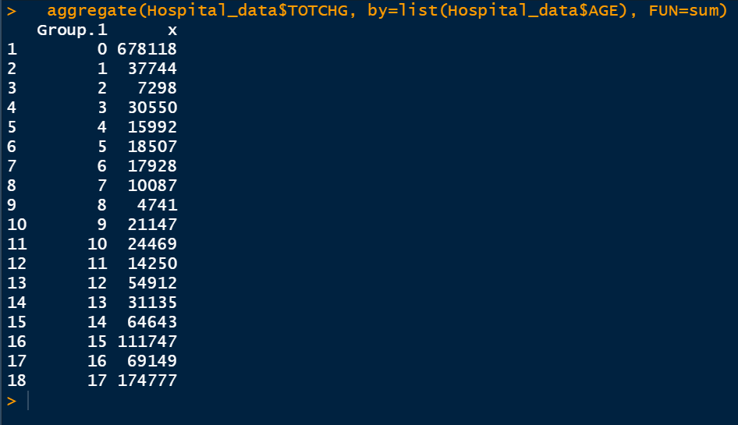
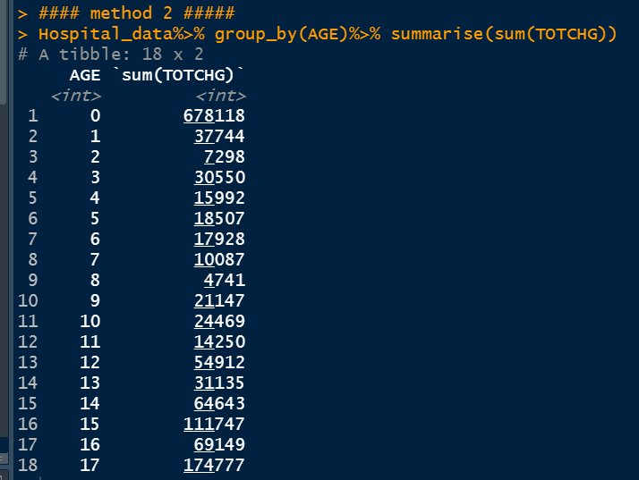
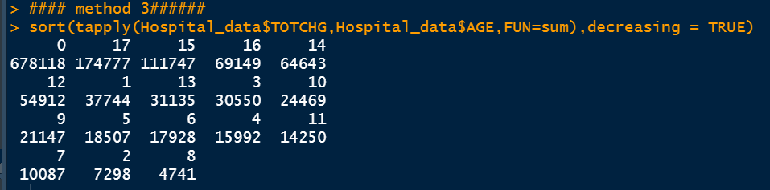
To record the patient statistics, the agency wants to find the age category of people who have maximum expenditure
Code:
#### method 1 #####
aggregate(Hospital_data$TOTCHG, by=list(Hospital_data$AGE), FUN=sum)
#### method 2 #####
Hospital_data%>% group_by(AGE)%>% summarise(sum(TOTCHG))
#### method 3######
sort(tapply(Hospital_data$TOTCHG,Hospital_data$AGE,FUN=sum),decreasing = TRUE)
#### method 4 ######
barplot(tapply(Hospital_data$TOTCHG,Hospital_data$AGE,FUN=sum))
Result: This analysis indicates that age group-0 (infants) highest/maximum expenditure ($67,8118 ) than remaining age category people

Slide 3
In order of severity of the diagnosis and treatments and to find out the expensive treatments, the agency wants to find the diagnosis related group that has maximum hospitalization and expenditure.
Code: ### diagnosis related group that has maximum expenditure.####
#### method 1 #####
Expenditure_diagnosis <- aggregate(Hospital_data$TOTCHG, by=list(Hospital_data$APRDRG), FUN=sum)
Expenditure_diagnosis
Expenditure_diagnosis %>% arrange(Expenditure_diagnosis$x,desc(x))
##### method 2 #####
sort(tapply(Hospital_data$TOTCHG,Hospital_data$APRDRG,FUN=sum),decreasing = TRUE)
#### diagnosis related group that has maximum hospitalization #####
#### method 1 #####
LOS_diagnosis <- aggregate(Hospital_data$LOS, by=list(Hospital_data$APRDRG), FUN=sum)
LOS_diagnosis
LOS_diagnosis %>% arrange(LOS_diagnosis$x,desc(x))
##### method 2 #####
sort(tapply(Hospital_data$LOS,Hospital_data$APRDRG,FUN=sum),decreasing = TRUE)
###### method 3 ####
table(Hospital_data$APRDRG)
Results
Diagonosis-640 have maximum expenditure and maximum hospitalization

Slide 4
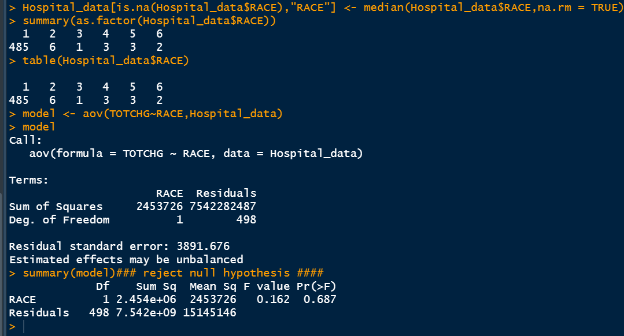
To make sure that there is no malpractice, the agency needs to analyze if the race of the patient is related to the hospitalization costs.
### Ho= Race is not influencing hospital costs #### NULL hypothesis
### Ha= Race is influencing hospital costs #### Alternative hypothesis
Code:
summary(as.factor(Hospital_data$RACE)) ### indicates presence of any missing values
Hospital_data[is.na(Hospital_data$RACE),"RACE"] <- median(Hospital_data$RACE,na.rm = TRUE)
#### to test the relationship between Race and hospital cost ANOVA test is used to analyse ####
model <- aov(TOTCHG~RACE,Hospital_data)
Summary(model )
Result:
As can be seen 485 patients out of 500 fall under group 1, showing that the number of observations for 1 category is way higher than others - hence data is skewed.
The residual variance (deviation from original) (of all other variables) is very high. This implies that there is very little influence from RACE on hospitalization costs
As can be seen, the degree of freedom (Df) for RACE is 1 and that of residuals is 498 observations
The F-Value, the test statistic is 0.162 which is much less than 0.5 showing that RACE doesn’t affect the hospitalization cost.
The Pr(>F), the p-value of 0.69 is high confirming that RACE does not affect hospitalization cost.(accepting null hypothesis)

Slide 5
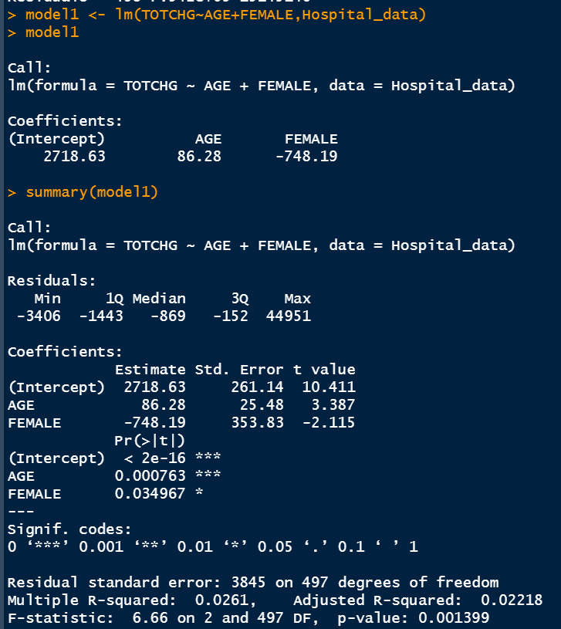
To properly utilize the costs, the agency must analyze the severity of the hospital costs by age and gender for proper allocation of resources.
Linear regression model is used
Code
model1 <- lm(TOTCHG~AGE+FEMALE,Hospital_data)
model1
summary(model1)
### Ho= Age and gender is not affecting hospital costs
### Ha= Age and gender is affecting hospital costs
Results
The p-Values of AGE is much lesser than 0.05, the ideal statistical significance level, and it also has three stars (***) next to it, it means AGE has the most statistical significance.
Similarly, gender is also less than 0.05.Hence, we can conclude that the model is statistically significant.
Rejecting null hypothesis and accepting alternative hypothesis. Therefore, we can conclude Age and gender variables can influence hospital costs.

Slide 6
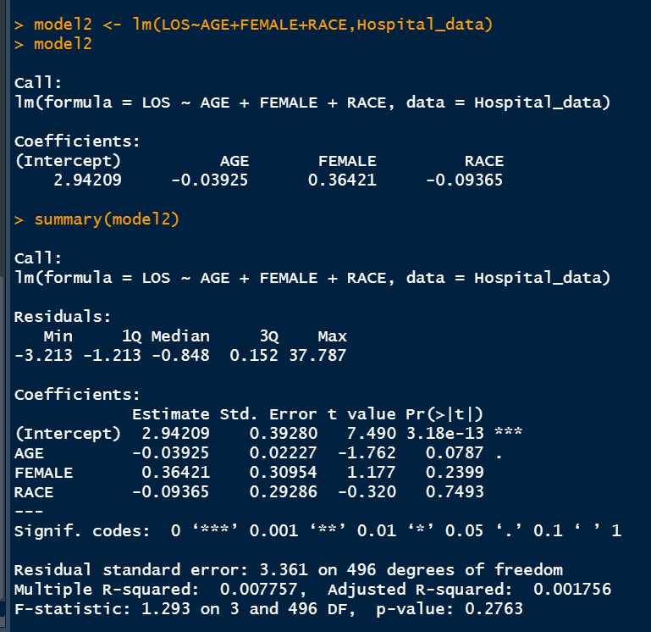
Since the length of stay is the crucial factor for inpatients, the agency wants to find if the length of stay can be predicted from age, gender, and race
Prediction can be done by using linear regression model
Code
model2 <- lm(LOS~AGE+FEMALE+RACE,Hospital_data)
model2
summary(model2)
Results
The p-value is higher than 0.05 for age, gender and race, indicating there is no linear relationship between these variables and length of stay.
Hence, age, gender and race cannot be used to predict the length of stay of inpatients.

Slide 7
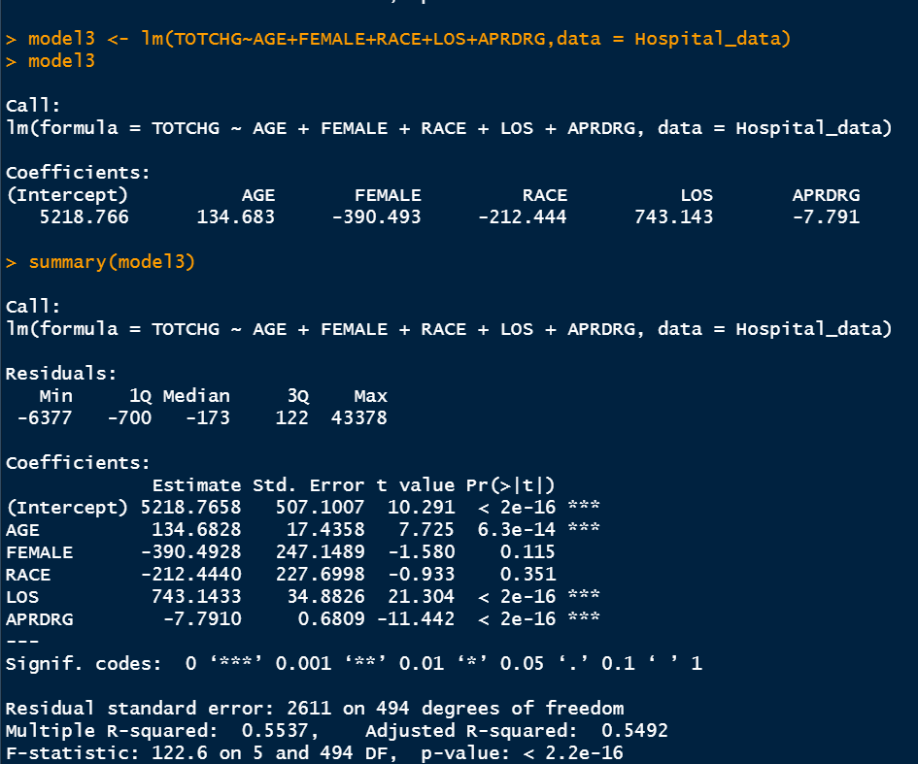
To perform a complete analysis, the agency wants to find the variable that mainly affects the hospital costs
Build a linear regression model using all independent variables vs dependent variable
Code:
model3 <- lm(TOTCHG~AGE+FEMALE+RACE+LOS+APRDRG,data = Hospital_data)
model3
summary(model3)
Results
As it is evident from the coefficient values, Age, Length of stay (LOS) and patient refined diagnosis related groups(APRDRG) have three stars (***) next to it. So they are the ones with statistical significance
Gender and RACE are not significant. build a model after removing RACE and gender

Slide 8
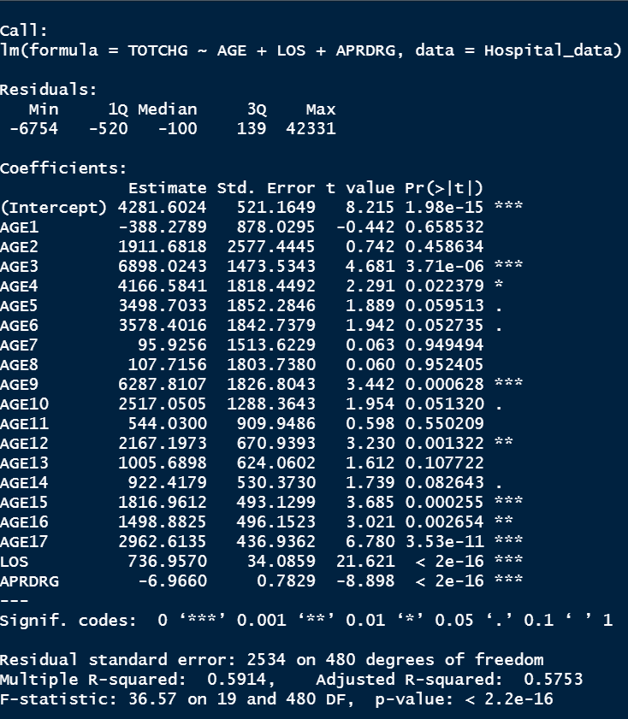
Another model removing the Race and Gender variables
model4 <- lm(TOTCHG~AGE+LOS+APRDRG,data = Hospital_data)
model4
summary(model4)

Slide 9
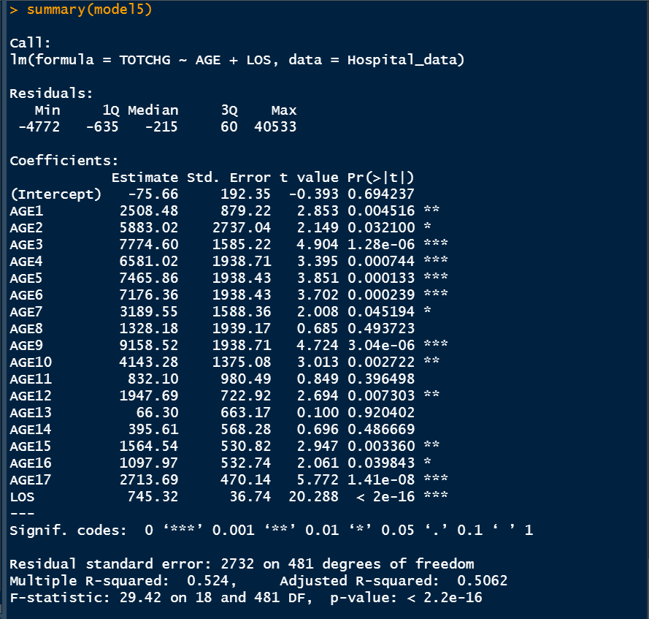
## APRDRG has -ve t-value, dropping it ####
model5 <- lm(TOTCHG~AGE+LOS,data = Hospital_data)
model5
summary(model5)
When compared model3,4,5
Removing Race and gender doesn’t change the R2 value. It doesn’t impact cost
Removing APRDRG in model5 increases the standard error. Hence model model4 seems to be better.
In conclusion this created model indicates hospital costs can be mainly affected by Age, Length of Stay(LOS) and diagnosis(APRDRG)

Slide 10
Summary
From linear regression model it is evident that health care costs is dependent on age, length of stay and the diagnosis type.
Healthcare cost is maximum for patients in the 0-1 yrs age group category
Maximum expenditure for 0-1 yr is 678118
Length of Stay increases the hospital cost
All Patient Refined Diagnosis Related Groups also affects healthcare costs
640 diagnosis related group had a max cost of 437978
Race or gender doesn’t have that much impact on hospital cost

