Slide 1
Applications of natural language processing
Search Engine
Speech to Text
Review Rating Prediction
Sentiment Classiﬁcation
Entity Extraction
Topic Extraction
Autocomplete
Question Answering
Chatbots / VAs
Translation

Slide 2

Pre-processing the text data
can u he.lp me with loan? 😊
Unintentional Characters
Abbreviations
Symbols
Emojis
can you help me with loan ?
8

Slide 3
Pre-processing the text data
Removing weird spaces
Tokenization
Spelling correction
Contraction mapping
Stemming
Emoji handling
Stopwords handling
Cleaning HTML
9

Slide 4
Pre-processing the text data
Removing weird spaces
Tokenization
Spelling correction
Contraction mapping
Stemming
Emoji handling
Stopwords handling
Cleaning HTML
def remove_space(text): text = text.strip()
text = text.split()
return " ".join(text)
10

Slide 5
Pre-processing the text data
Removing weird spaces
Tokenization
Spelling correction
Contraction mapping
Stemming
Emoji handling
Stopwords handling
Cleaning HTML
Very important step
Is not always about spaces
Converts words into tokens
Might be diﬀerent for diﬀerent languages
Simplest is to use `word_tokenizer` from NLTK
Write your own ;)
11

Slide 6
Pre-processing the text data
Removing weird spaces
Tokenization
Spelling correction
Contraction mapping
Stemming
Emoji handling
Stopwords handling
Cleaning HTML
import nltk
nltk.download('punkt')
from nltk.tokenize import word_tokenize text = "hello, how are you?"
tokens = word_tokenize(text)
print(tokens)
hello, how are you?
'hello', ',', 'how', 'are', 'you', '?'
12

Slide 7
Pre-processing the text data
Removing weird spaces
Tokenization
Spelling correction
Contraction mapping
Stemming
Emoji handling
Stopwords handling
Cleaning HTML
Very very crucial step
In chat: can u tel me abot new sim card pland?
Most models without spelling correction will fail
Peter Norvig’s spelling correction
Make your own ;)
13

Slide 8
Pre-processing the text data
Removing weird spaces
Tokenization
contraction = {
"'cause": 'because',
',cause': 'because',
';cause': 'because',
"ain't": 'am not',
'ain,t': 'am not',
'ain;t': 'am not',
'ain´t': 'am not',
'ain’t': 'am not',
"aren't": 'are not',
'aren,t': 'are not',
'aren;t': 'are not',
'aren´t': 'are not',
'aren’t': 'are not'
Spelling correction
Contraction mapping
Stemming
Emoji handling
Stopwords handling
Cleaning HTML
}
16

Slide 9
Pre-processing the text data
Removing weird spaces
Tokenization
Spelling correction
Contraction mapping
Stemming
Emoji handling
Stopwords handling
Cleaning HTML
def mapping_replacer(x, dic):
for word in dic.keys():
if " " + word + " " in x:
x = x.replace(" " + word + " ", " " + dic[word] + " ")
return x
17

Slide 10
Pre-processing the text data
Removing weird spaces
Tokenization
Spelling correction
Contraction mapping
Stemming
Emoji handling
Stopwords handling
Cleaning HTML
Reduces words to root form
Why is stemming important?
NLTK stemmers
18

Slide 11
Pre-processing the text data
Removing weird spaces
Tokenization
Spelling correction
Contraction mapping
ﬁshing
ﬁshed
ﬁsh
ﬁshes
Stemming
Emoji handling
Stopwords handling
Cleaning HTML
In [1]: from nltk.stem import SnowballStemmer In [2]: s = SnowballStemmer('english')
In [3]: s.stem("ﬁshing")
Out[3]: 'ﬁsh'
19

Slide 12
Pre-processing the text data
Removing weird spaces
Tokenization
Spelling correction
Contraction mapping
Stemming
Emoji handling
Stopwords handling
Cleaning HTML
pip install emoji
import emoji
emojis = emoji.UNICODE_EMOJI
20

Slide 13
Pre-processing the text data
I need new car insurance
Removing weird spaces
Tokenization
Spelling correction
Contraction mapping
Stemming
Emoji handling
I
car insurance
Stopwords handling
Cleaning HTML
new
need
21

Slide 14
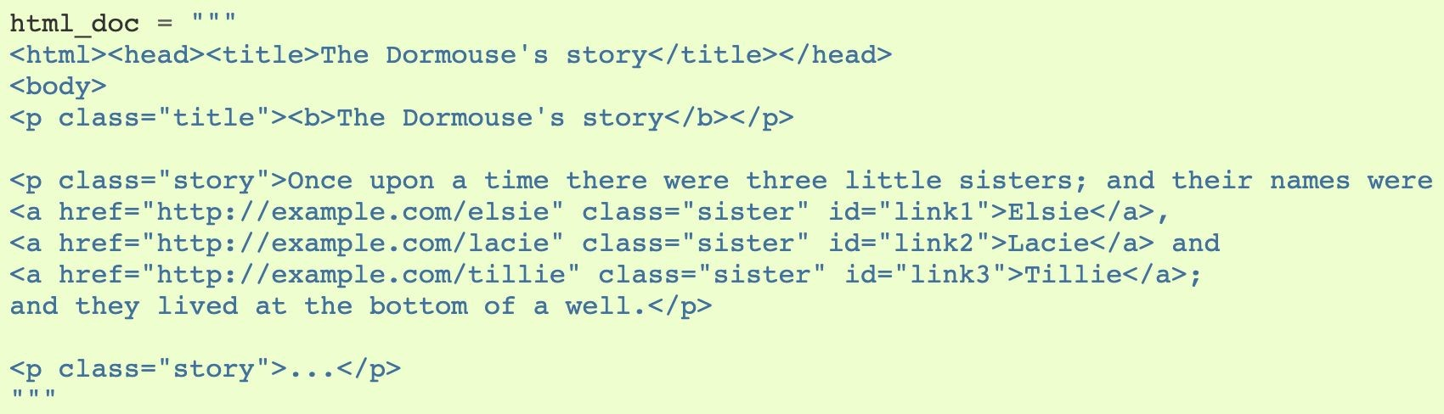
Pre-processing the text data
Removing weird spaces
Tokenization
Spelling correction
Contraction mapping
Stemming
Emoji handling
Stopwords handling
Cleaning HTML
22
https://www.crummy.com/software/BeautifulSoup/bs4/doc/

Slide 15
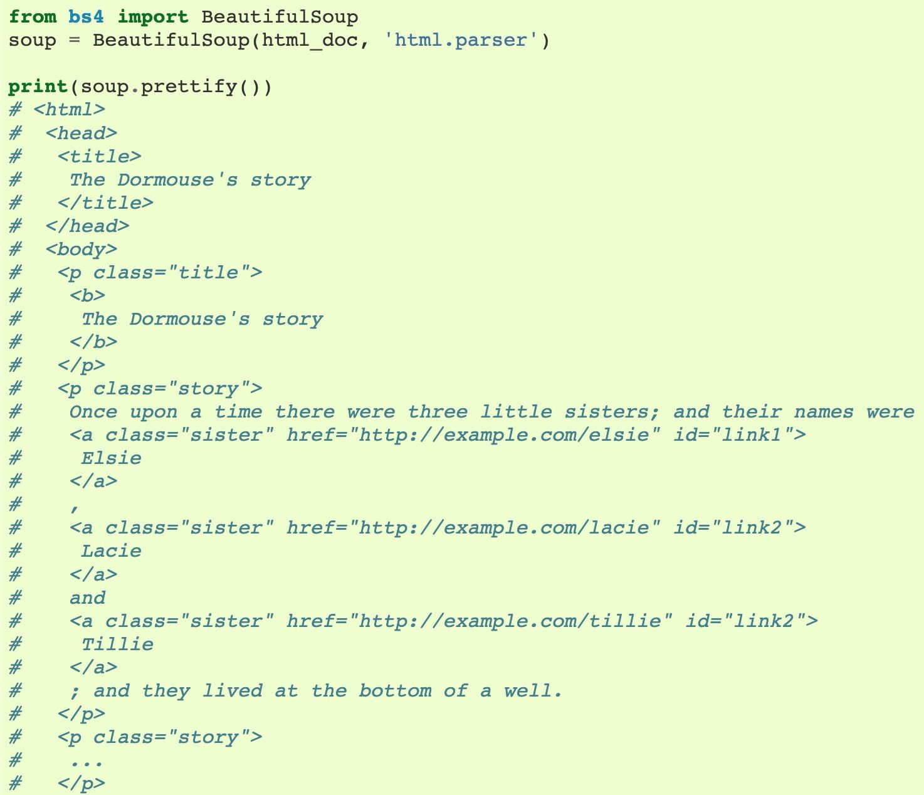
Pre-processing the text data
Removing weird spaces
Tokenization
Spelling correction
Contraction mapping
Stemming
Emoji handling
Stopwords handling
Cleaning HTML
23
https://www.crummy.com/software/BeautifulSoup/bs4/doc/

Slide 16
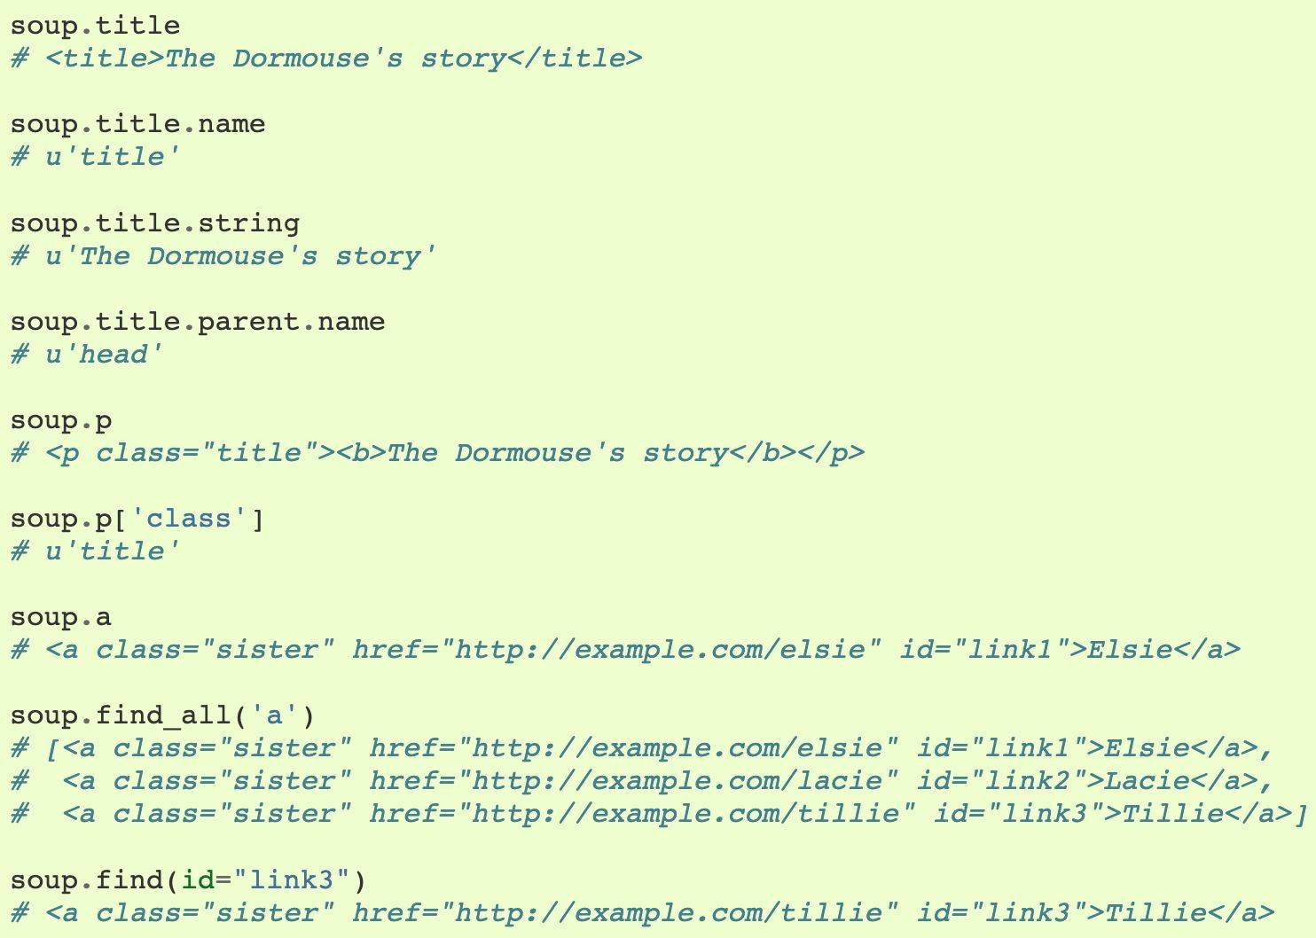
Pre-processing the text data
Removing weird spaces
Tokenization
Spelling correction
Contraction mapping
Stemming
Emoji handling
Stopwords handling
Cleaning HTML
24
https://www.crummy.com/software/BeautifulSoup/bs4/doc/

Slide 17
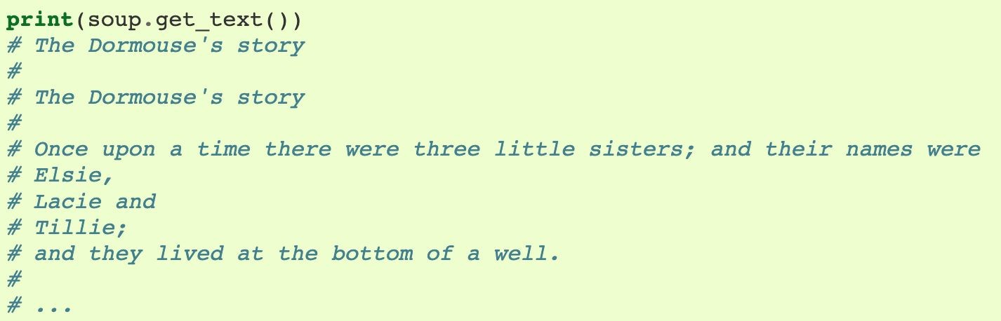
Pre-processing the text data
Removing weird spaces
Tokenization
Spelling correction
Contraction mapping
Stemming
Emoji handling
Stopwords handling
Cleaning HTML
25
https://www.crummy.com/software/BeautifulSoup/bs4/doc/

Slide 18
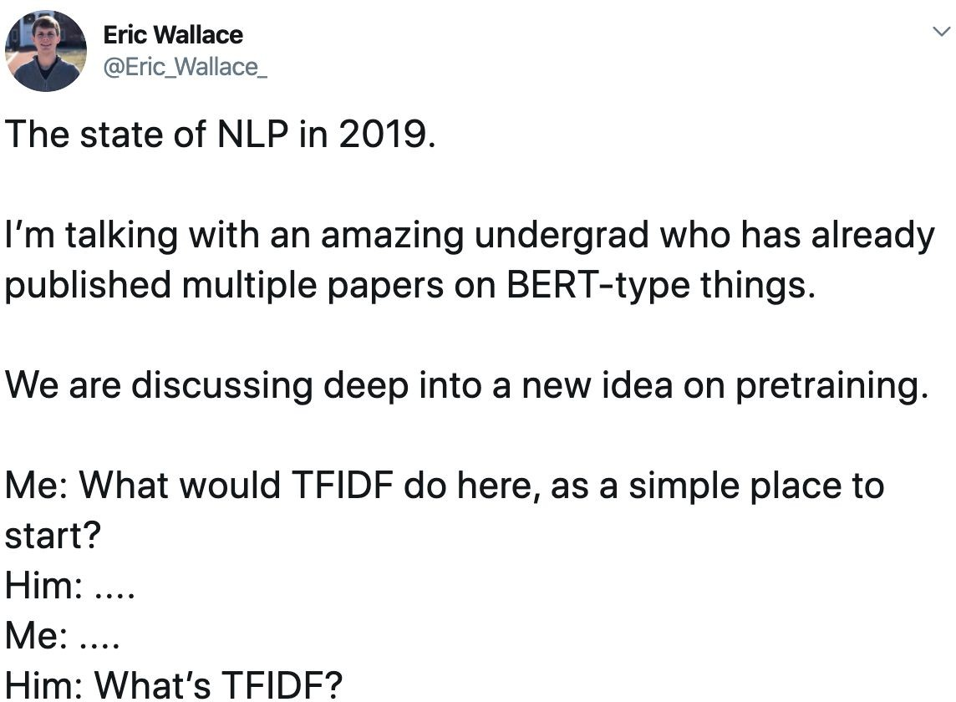

Slide 19
Traditional handling of text data
Count vectorization
TF-IDF
SVD
46

Slide 20
TF--IDF
Number of times a term t appears in a document
-------------------------------------------------------
Total number of terms in the document
TF(t) =
Total number of documents
LOG( ------------------------------------------------------- )
Number of documents with term t in it
IDF(t) =
TF-IDF(t) = TF(t) * IDF(t)
47

Slide 21
TF-IDF
tfidf = TfidfVectorizer(
min_df=3, max_features=None, strip_accents='unicode', analyzer='word', token_pattern=r'\w{1,}', ngram_range=(1, 2), use_idf=1,
smooth_idf=1, sublinear_tf=1, stop_words='english'
)
48

Slide 22
SVD
Latent semantic analysis
scikit-learn version of SVD
120 components
svd = decomposition.TruncatedSVD(n_components=120) xtrain_svd = svd.fit_transform(xtrain)
xtest_svd = svd.transform(xtest)
49

Slide 23
Word embeddings
WORD
| | | | | | |
Multi-dimensional vector for all the words in any dictionary
Always great insights
Very popular in natural language processing tasks
Google news vectors 300d
GloVe
FastText

Slide 24
Word Vectors
▪ Goal: represent a word by an m-dimensional vector (for medium-sized m, say, m=300)
▪ Have “similar” words be represented by “nearby” vectors in this m-dimensional space
▪ Words in a particular domain (economics, science, sports) could be closer to one
another than words in other domains.
▪ Could help with synonymy
– e.g. “big” and ”large” have nearby vectors
▪ Could help with polysemy
– “Java” and ”Indonesia” could be close in some dimensions
– “Java” and “Python” are close in other dimensions

