Slide 1
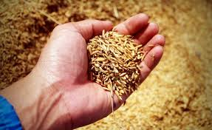
SCertify
SECURE - SIMPLE - SOUND
Seed Certification Using Block Chain Technology
Team Members:
S. Sumathi
G. Lathaselvi
M. Esther Hannah
L. Sherly
R. Deepa
11-<number>

Slide 2
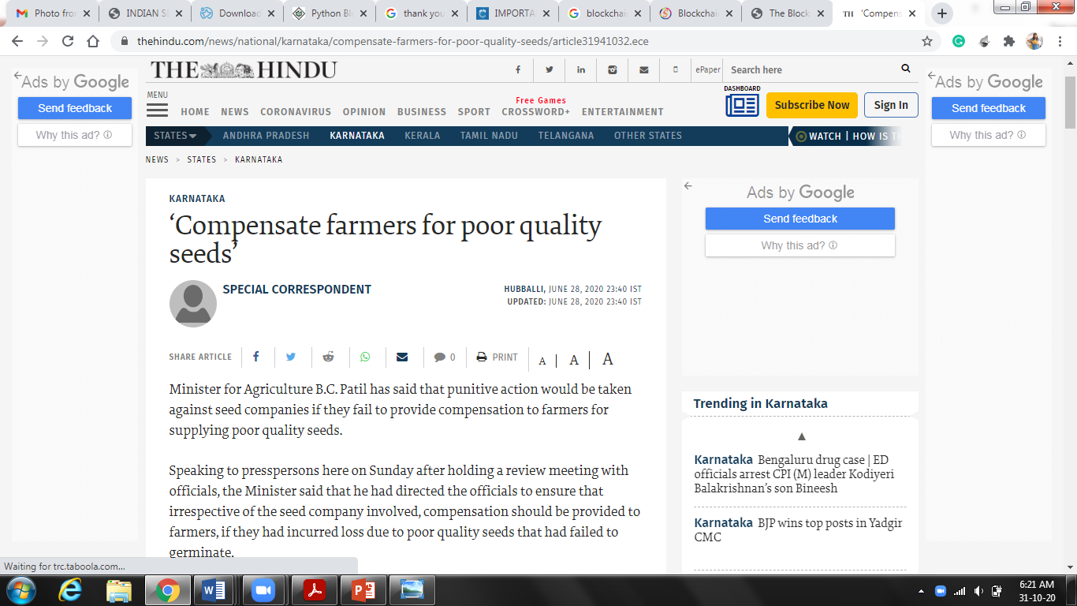
Present Status of Farmers
11-<number>

Slide 3
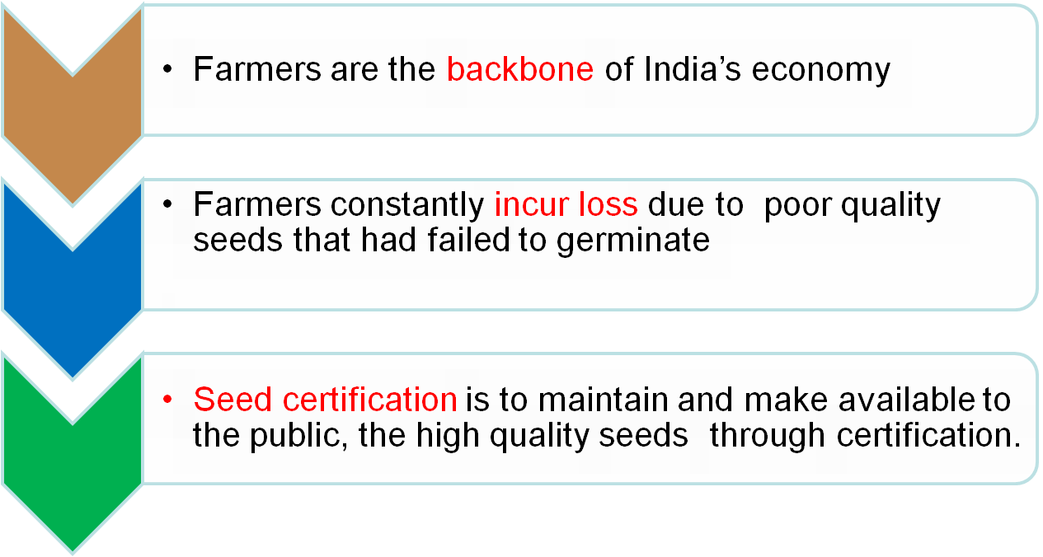
Motivation
11-<number>

Slide 4
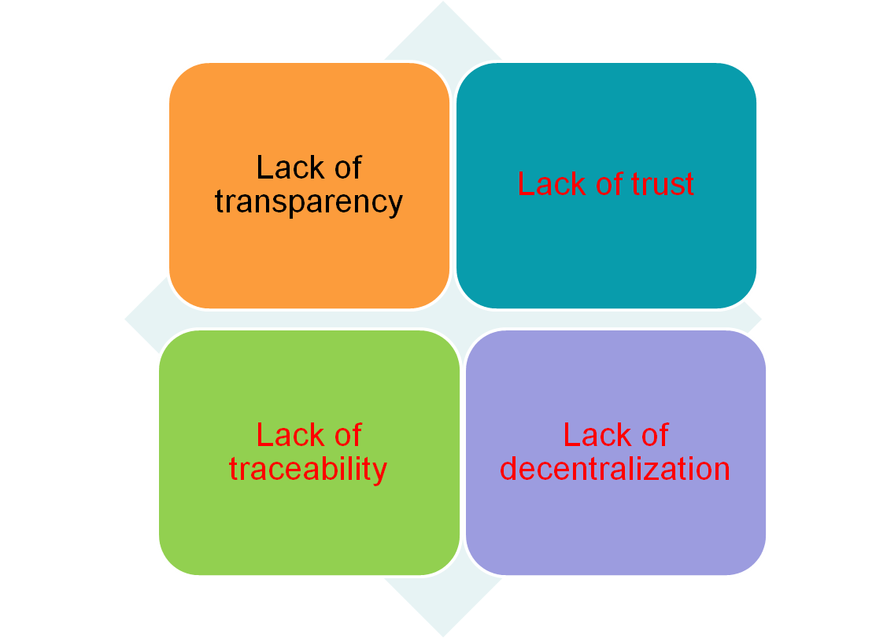
Loopholes in the Seed Supply Chain system
11-<number>

Slide 5
Objectives of Seed Certification
To provide the farmers continuous supply of high quality seeds
Systematic increase of the superior varieties of cash crops
The Block-chain technology is a great tool with very practical applications that will make a difference in the lives of farmers
This project is the first mile of the journey to see how block-chain will fit into the Seed supply chain.
Information related to crop origin, expiry, validity, etc will be stored in an immutable manner.

Slide 6
Seed certification Process
Authorization of Seed Growers (SG)
Verification of seed source, class, etc. and field inspections to verify conformity to the prescribed field standards by Seed Processing Plant (SPP)
Supervision at post harvest stages including processing & packing by Seed Producing Agency (SPA) and Seed sample Testing and analysis by Seed Testing Lab (STL)
Grant of certificate, tagging and sealing by Seed Certification Agency (SCA)
The system is designed such that various Reports can be downloaded

Slide 7
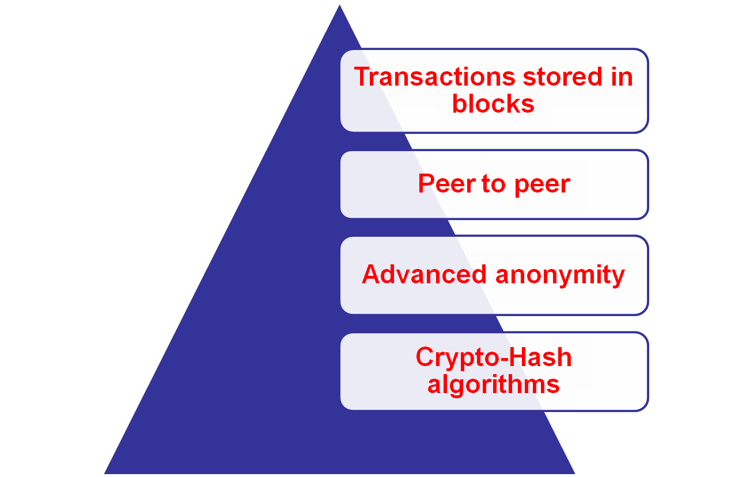
Why is Block Chain called the game-changer?

Slide 8
Is Block Chain fit for Seed Supply chain?
As per the NASSCOM 2019, nearly 50% of the states are involved in significant initiatives driving block chain technology.
The number of projects built by block-chain development services providers have crossed the $20 billion across multiple industries.
Deployed for tracking, tracing, and supporting quality of seeds in supply chains.
Traceability information regarding seed quality will be stored in a secured manner
Adds value to the end product - Quality Seeds
Gives the stakeholders a chance to know the farm to farmer route of seeds.

Slide 9
Security Advantage of the System
Confidentiality
  Seed Grower Data is encrypted and Hash key is generated and sent to the Seed Producing Plant.
  Even Large Data will be compressed and sent through blockchain by using secure hash algorithm SHA-512 algorithm
Authentication
  As Digital Signature is provided by the seed certification agency, authentication is maintained.
Data Integrity
A single change in a block will affect the entire block chain. Hence SHA-1 algorithm is applied in every block
Encryption-
  Public Key Encryption -Rivest Schmir Adlemen algorithm is used
11-<number>

Slide 10

Software Requirements
Front End Tools
  React
  Python 3.0
Back End Tools
  Mongo DB

Slide 11
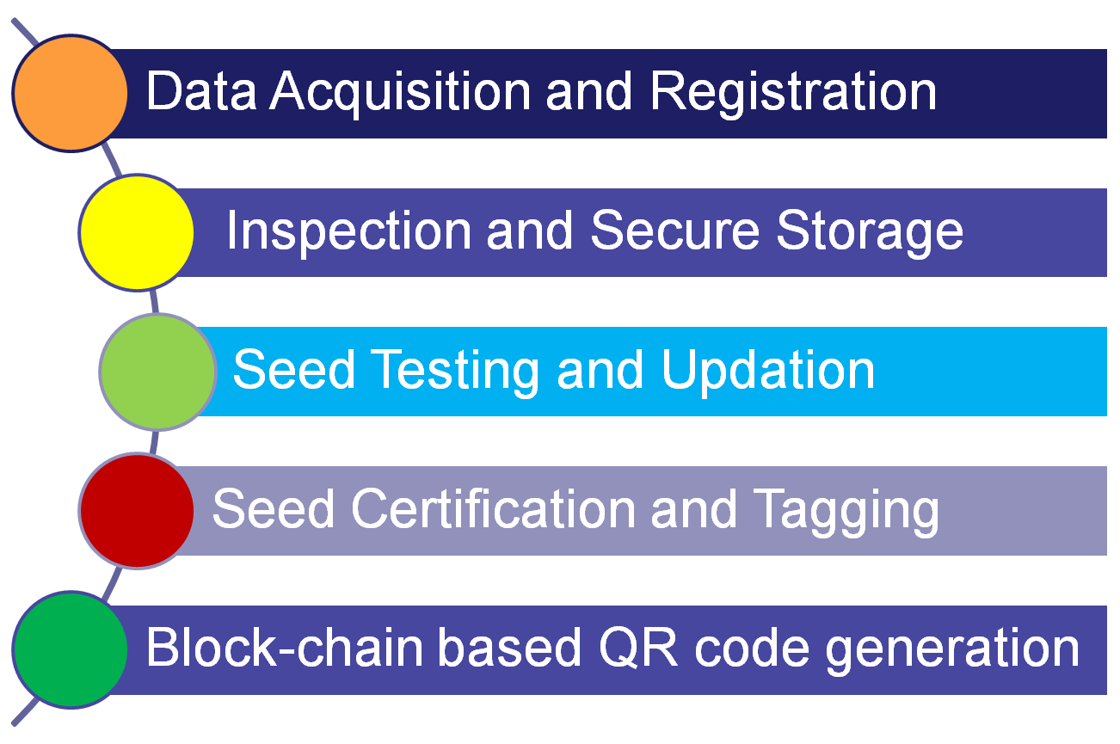
Modules
1
2
3
4
5

Slide 12
Project Focus
Farmer-Centric and Market-driven
Seed Grower →one-time registration and creation of first block
Seed Producing Agency → Processing, post-processing and data upload –using block chain
Seed Testing Lab →Update seed test reports
Seed Certification Agency – CA generates certificates and tag based on quality of seeds

Slide 13
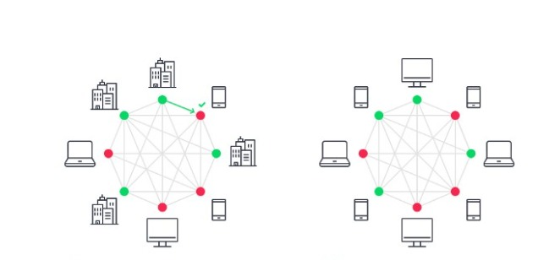
Blockchain Accessibility
Public Block Chain → SG and farmer data will be public
Private Block Chain→ SPP, SDL, STL, SCA data will be private
PRIVATE
PUBLIC

Slide 14
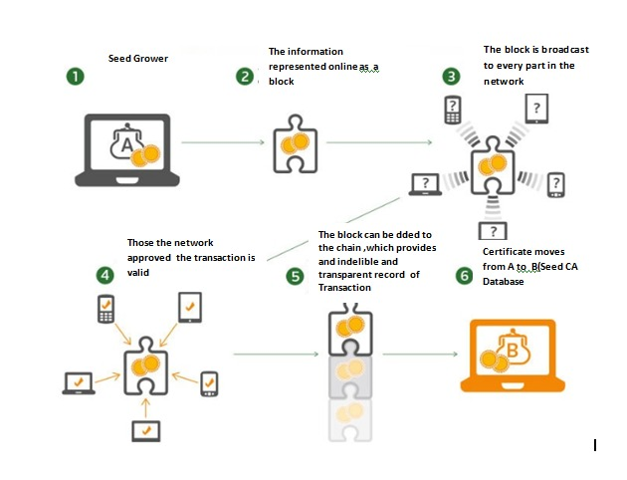
Hash Key Generation

Slide 15
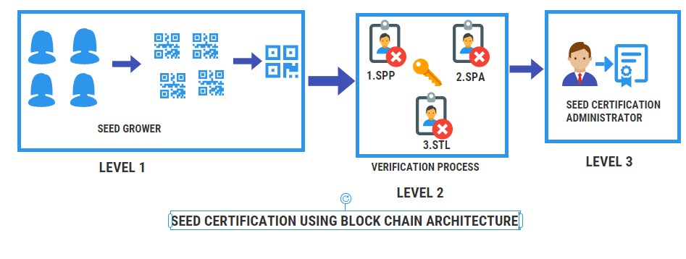
Seed Certificate Design Architecture
11-<number>

Slide 16
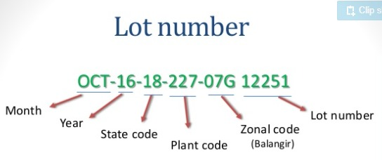
Seed Lot Number
11-<number>

Slide 17
Data Acquisition and Registration
Login creation and authentication of all stake holders
Seed Grower Registration Form and client-side validation
Completed Table Design and User Interface
Sample Blocks are created, cryptographically signed and hash value is generated.

Slide 18
Table design
Table Name : spadata_upload
S.No | Field Name | Datatype
1 | lotNumber | Varchar
2 | owner | Varchar
3 | crop | Varchar
4 | variety | Varchar
5 | sourceTagNo | Number
6 | sourceClass | Varchar
7 | destinationClass | Varchar
8 | sourceQuantity | Varchar
9 | sourceDateOfIssue | date
10 | growerName | Varchar
11 | spaName | Varchar
12 | dateOfIssue | date

Slide 19
Table design
Table Name : spadata_upload
S.No | Field Name | Datatype
13 | sourceStorehouse | Varchar
14 | destiStorehouse | Varchar
15 | sgName | Varchar
16 | sgId | Varchar
17 | finYear | Varchar
18 | season | Varchar
19 | landRecordsKhatano | Number
20 | landRecordsPlotno | Number
21 | landRecordsArea | Number
22 | cropRegCode | Varchar
23 | sppName | Varchar
24 | sppId | Number

Slide 20
Table design
Table Name : sppdata_upload
S.No | Field Name | Datatype
1 | Raw seed Intake &stock verification | Varchar
2 | Processing & Sampling | Varchar
3 | Issue of Certificates and Tagging | Varchar
11-<number>

Slide 21
Table Name : stldata_upload
S.No | Field Name | Datatype
5 | Sample_Secret_Code | Varchar
6 | Sample_passed | Varchar
7 | Sample_TestDate | date
11-<number>

Slide 22
Table design
Table Name : stcdata_upload
S.No | Field Name | Datatype
1 | Date of Sample Test | date
2 | Sample Test Pass or fail | Varchar
3 | Sample Secret Code | Varchar
4 | Primary key | Date
5 | Source Tag No | Varchar
6 | Source Quantity | Number
7 | Source Class | Varchar
8 | Destination Class | Varchar
11-<number>

Slide 23
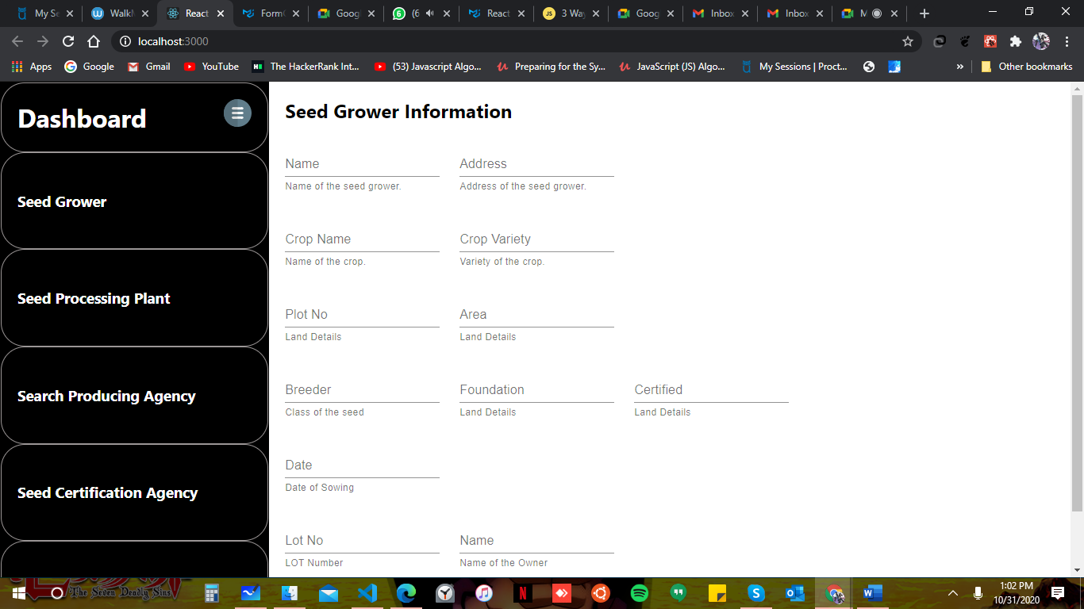
Screen Shot- Seed Grower
11-<number>

Slide 24
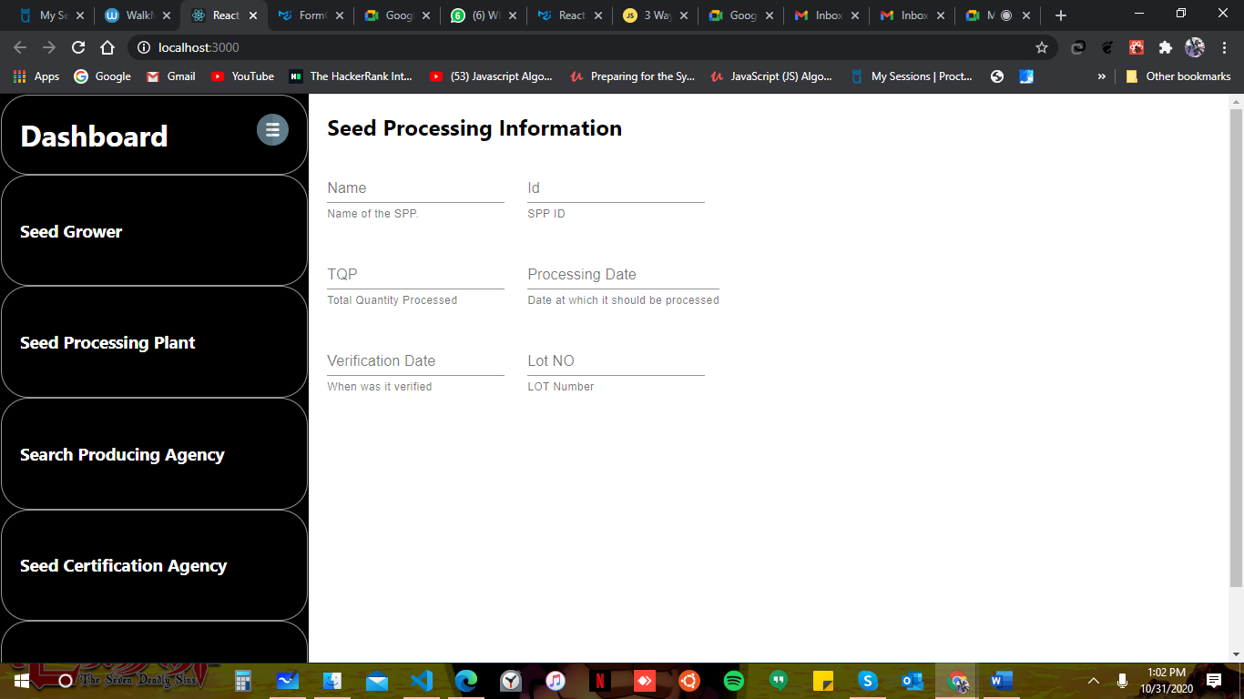
Screen Shot- SPA
11-<number>

Slide 25

Screen Shot - SCA
11-<number>

Slide 26


