Slide 1
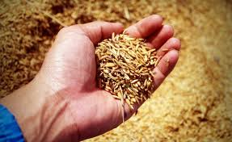
SCertify
SECURE - SIMPLE - SOUND
Seed Certification Using Block Chain Technology
Team Members:
S. Sumathi
G. Lathaselvi
M. Esther Hannah
L. Sherly Puspha Annabel
R. Deepa
SCertify-35

Slide 2
Project Background
  Problem Statement
  Seed quality issues have demanded a need for effective traceability solution.
  Several important criteria such as origin of the seed, stages in production, conformance to quality standards such as genetic purity, germination rate etc. are to be validated.
  Project Scope
To maintain and make available to the farmers, high quality seeds and propagating materials of notified kind and varieties.
To ensure the acceptable standards of seed viability, vigour, purity and seed health.
To ensure genetic identity and genetic purity.
SCertify-35

Slide 3
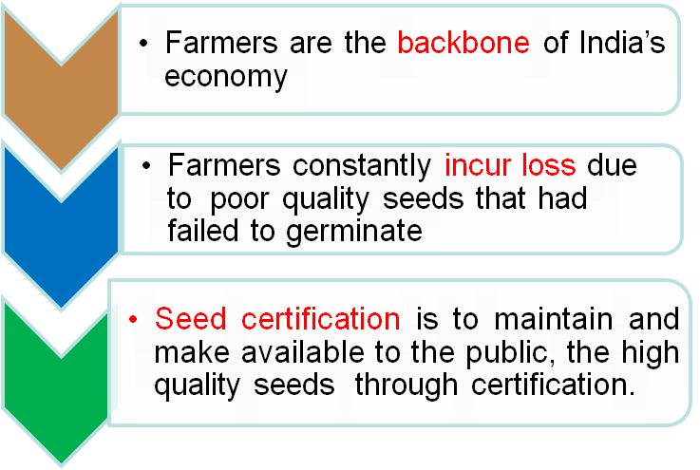
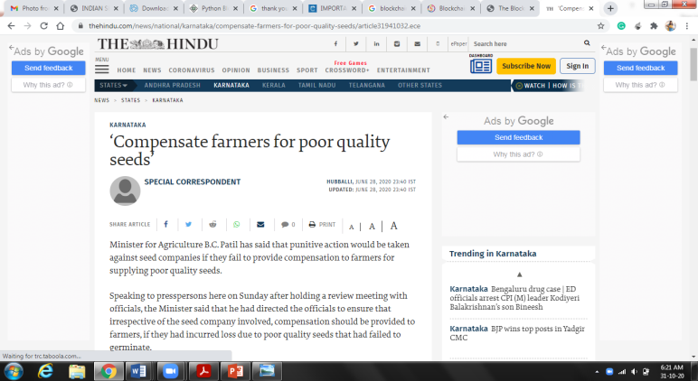
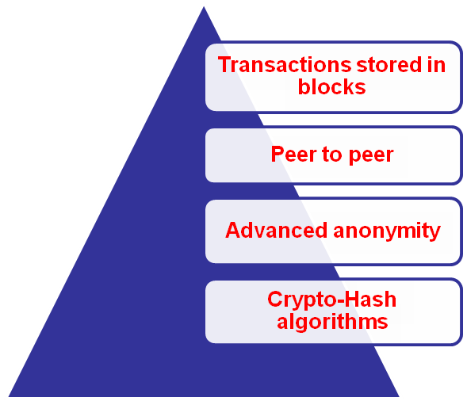
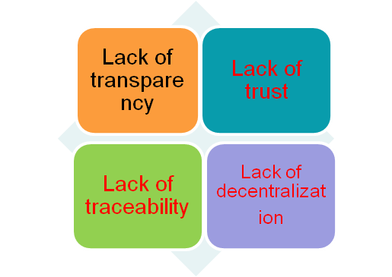
Key Challenges and Mitigation Plan
SCertify-35

Slide 4
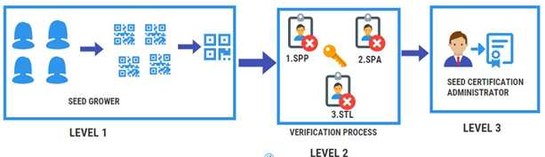
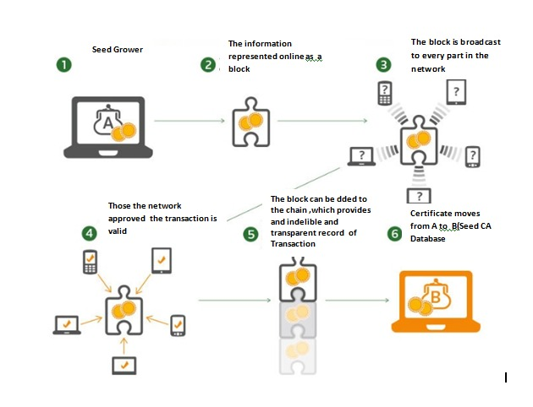
Project Objective & Outline
Key Problem Identified | Impact if we solve the problem using blockchain
Transparency Issues | The status of each seed lot whether is certified as high quality or not
Immutability Issues | The open ledger ensures the records cannot be altered and the destination of each item can be tracked
Legitimity Issues | The codes cannot be forged, as scanning a forged code will reveal the fact of counterfeit at once.
Feasibility Issues | Replacing the expensive (and forgeable) excise stamps with inexpensive (yet unforgeable) blockchain based QR-codes
Security Issues | Each stake Holder data is encrypted and Hash key is generated
  System Architecture
  BlockChain QRCode Generation
  Project Objectives
To provide the farmers continuous supply of high quality seeds
To systematic increase of superior varieties of cash crops
To protect the information related to crop origin, expiry, validity of the seed
SCertify-35

Slide 5
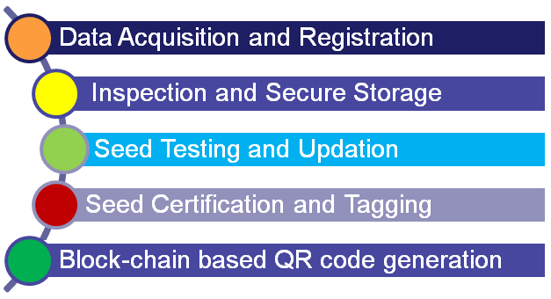
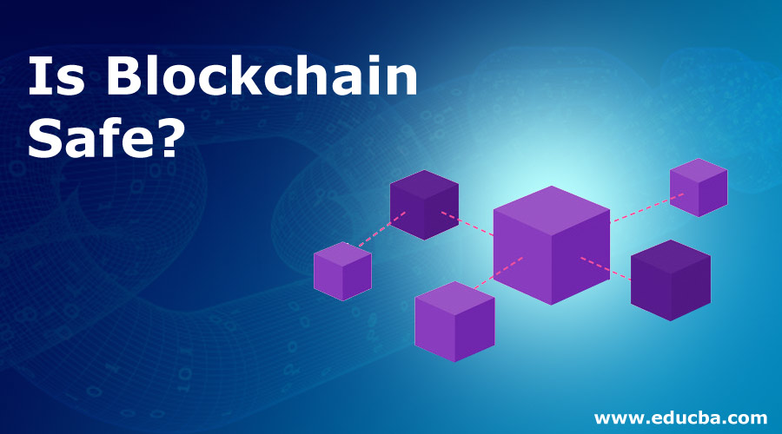
Project Approach & Focus
  System Modules
Supporting Tools
Front End Tools
  React
  Python 3.0
  JavaScript
Back End Tools
  Mongo DB with Replica Sets Enabled
Project Focus
Seed Grower →one-time registration and creation of first block
Seed Producing Agency → Processing, post-processing and data upload –using block chain
Seed Testing Lab →Update seed test reports
Seed Certification Agency – CA generates certificates and tag based on quality of seeds
QRCode Generation - BlockChain based QRcode will be generated finally. The farmers can scan the seed bag QRcodes to ensure their validity
SCertify-35

Slide 6
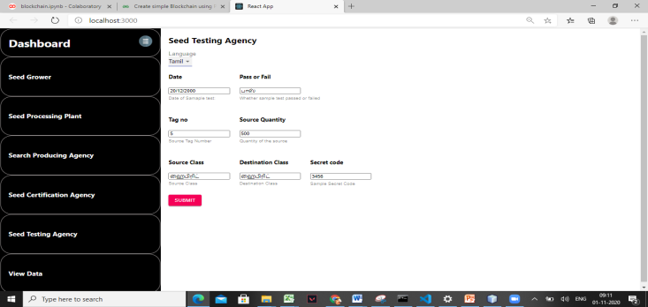
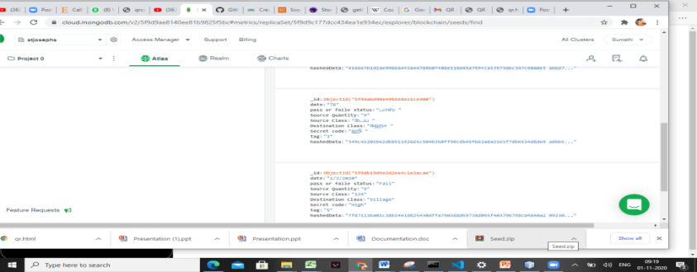


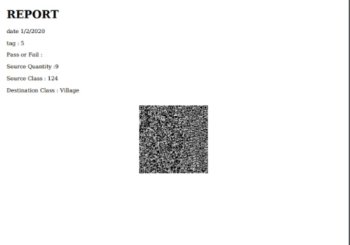
Project Output & Analysis
  Data Acquisition
  Hash Code Generation
  Support of Local Languages
  Sample Code
  Certificate & QRCode Generation
SCertify-35

Slide 7
Project Summary
Transparency, traceability, authentication is achieved using blockchain
TamperProof – Man in the Middle attack is eliminated
Scalable - Adaptable to accommodate large number of stakeholders
Cryptographic Transparent Distributed blockchain on seed certification is focused
Trusted Executed Environment is developed
Multilingual support is provided in the system
Provides the farmers with high quality seeds
SCertify-35

Slide 8

SCertify-35
8

