Slide 1


HOSPITAL MANAGEMENT PROJECT PRESENTATION
Aman Mattta
185018 [ CSE 4year-6th Sem ]

Slide 2
INTRODUCTION :
A “HOSPITAL MANAGEMENT SYSTEM’’ is a computerized management system.
This management system has been developed to keep a track on Hospital Employees, Doctors , Nurses, Patients, Bills etc.
This project has software that will help in storing, updating and retrieving the information.
The interactions between the hospital and the patient can be simplified for the convenience of both sides.
The hospital's administrator can ensure proper working of the Hospital system work and can be accessed at any time.

Slide 3

OBJECTIVE OF PROJECT :
The project “Hospital Management System” is aimed to develop to maintain the day-to-day state of admission/discharge of Patients, List of Doctors, List of medicines, Bills etc.

Slide 4
There are following main objectives of the Hospital :
Keeping records of admission of patient.
Keeping patient-care as utmost priority.
Scheduling the appointment of Patient with Doctor (Consultant) to make it convenient for both.
Scheduling the services of specialized Doctor and emergency properly so that facilities provided by Hospital are fully utilized in effective and efficient manner.
Keeping records of Medicine department in a meticulously arranged order so that the treatment of Patient becomes quick and satisfactory.

Slide 5
OPERATION ENVIRONMENT :
PROCESSOR | INTEL CORE PROCESSOR OR BETTER PERFORMANCE
OPERATING SYSTEM | WINDOWS 7 OR HIGHER , LINUX OS - UBUNTU
MEMORY | 1GB RAM OR MORE
HARD DISK SPACE | MINIMUM 3 GB FOR DATABASE USAGE FOR FUTURE

Slide 6
TECHNOLOGY STACK :
FRONT END | HTML, CSS, JAVASCRIPT, BOOTSTRAP
SERVER SIDE SCRIPT | PHP
DATABASE | MySQL
RUN-TIME ENVIRONMENT | XAMPP SERVER

Slide 7
PROPOSED METHODOLOGY :
The general methodology in developing a system is involved in different phases for developing software project.
Phase 1 : Front-end development
Phase 2 : Connection with backend
Phase 3 : Back-end development
This project is based on iterative and incremental development model with the collaboration of the system’s user.

Slide 8
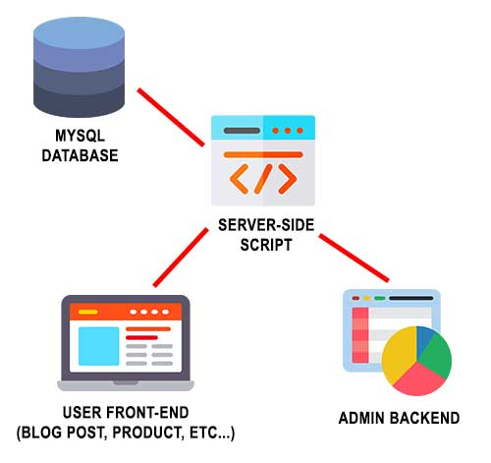

Slide 9
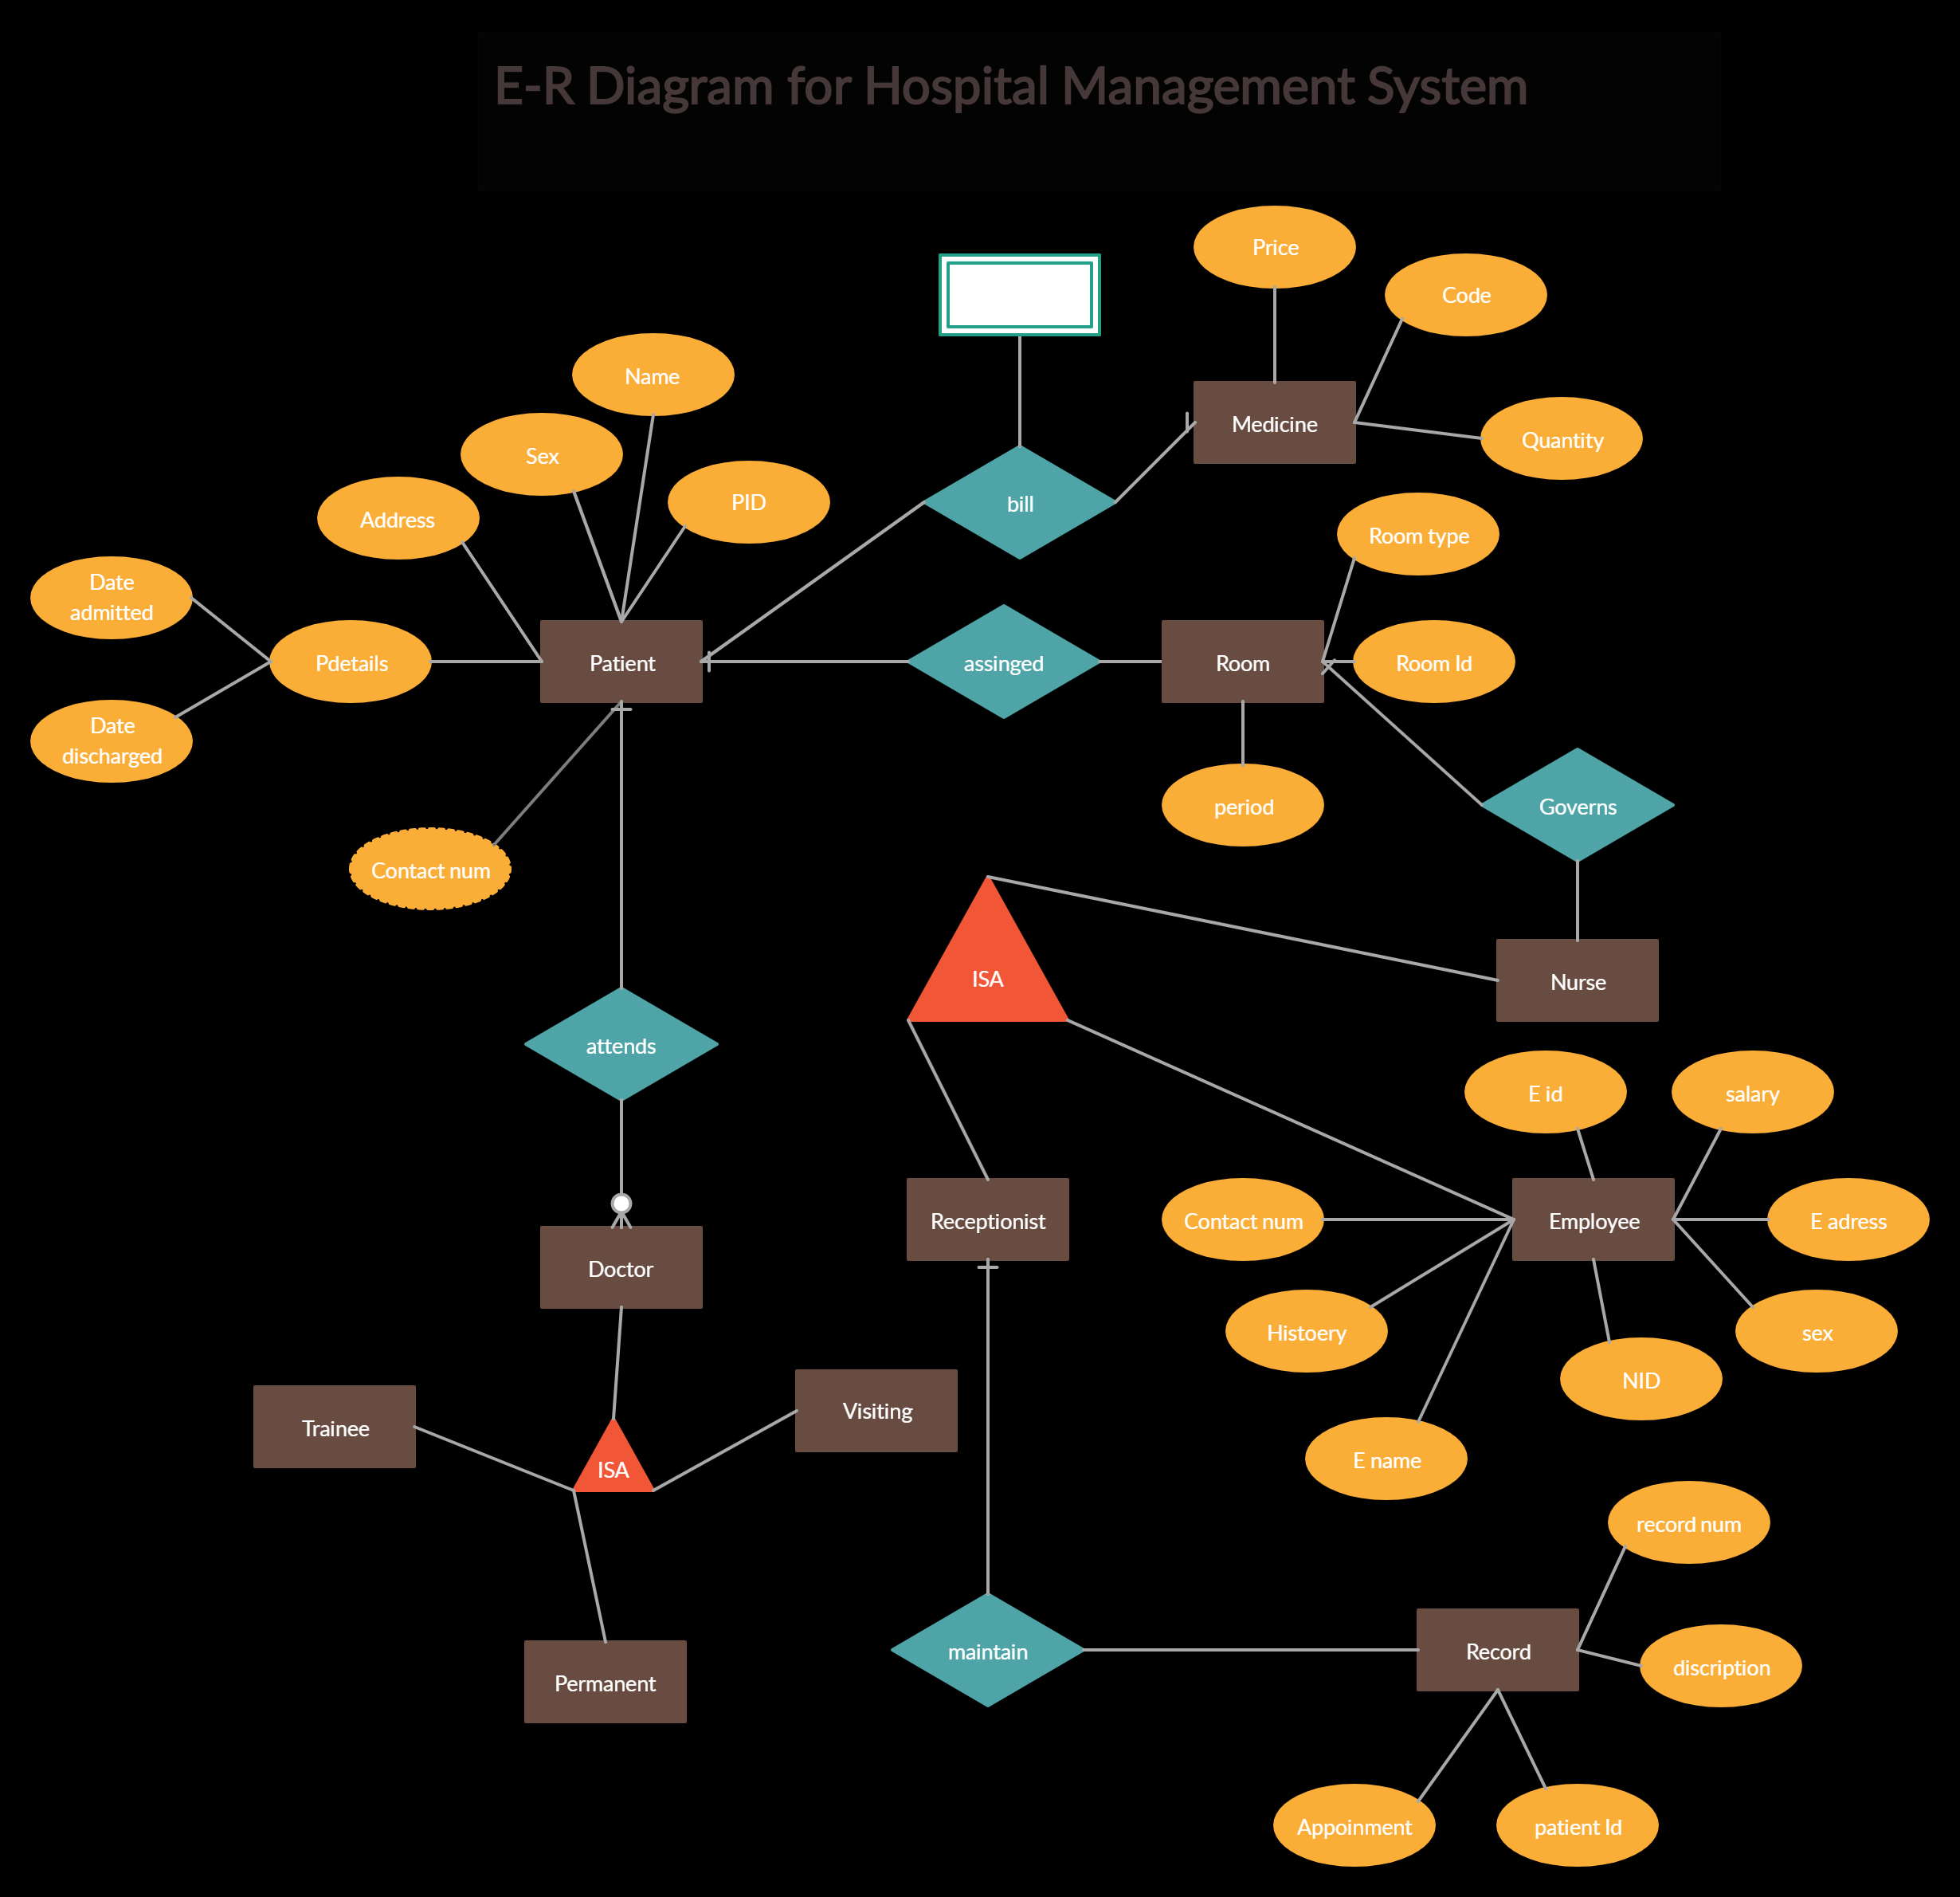

Slide 10
MAIN FEATURES :
Managing Doctors: User can add new listings of doctors and list can be modify and deleted also. Records will be displayed in tabular format.
Managing patients: Manage patient records and all the features such as modify and delete can be done on the records.
Appointments: appointments can be managed through doctor id and patients id in the application.

Slide 11
CONCLUSION :
The need for the HOSPITAL MANAGEMENT SYSTEM to computerize the application processing and servicing the Patients request through automated modules is most necessary and now inevitable in today's era.
Key Points :
Time saving.
Friendly user interface.
Easy to approach data.

Slide 12
THANK YOU...

