Slide 1
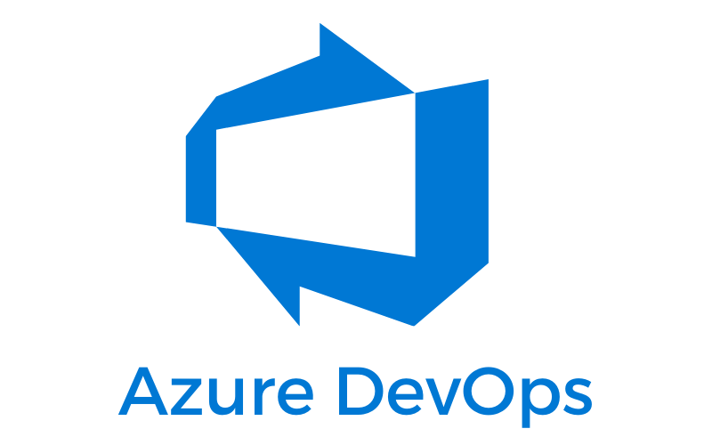

Slide 2
After completing this module, you'll be able to:
Define the term Agile.
Begin to make recommendations for incorporating Agile practices into your organization.
Create a project in Azure DevOps.
Add work items to Azure Boards by using the Basic process.

Slide 3
What is Agile?
Agile is a term that's used to describe approaches to software development, emphasizing incremental delivery, team collaboration, continual planning, and learning. Agile isn't a process as much as it's a philosophy or mindset for planning the work that a team will do. It's based on iterative development and helps a team better plan for and react to the inevitable changes that occur in software development.
Exercise - Plan work using Azure Boards
The Tailspin team is eager to see how Azure Boards is going to work. With the pre-planning out of the way, they can start to use the tools and build the solution they planned.

Slide 4
Create the project
Sign in to your account at dev.azure.com.
Select your organization.
Select + New project. If you don't already have existing projects in your organization, there won't be a + New project button, and you can proceed to step 3.
The Create a project dialog box opens.
In the Project name field, enter Space Game - web.
In the Description field, enter The Space Game website.
Under Visibility, choose whether to make your project public or private. For now, you can select private.
Open-source project creators will often choose public visibility so that others can view active issues and build status.
Select Advanced.
Under Version control, ensure that Git is selected. Under Work item process, ensure that Basic is selected.
Select Create.

Slide 5
Create a team
Select Project settings in the lower corner.
On the Project details page, under General, select Teams.
You see that a default team, based on the name of the project, Space Game - web Team, has been created. We'll use this team, but in practice you might have multiple teams that contribute to the same project.
Select Space Game - web Team.
Create the board
In the column on the left, hover over Boards and select Boards from the menu that appears.
Select Space Game - web Team. A blank board appears.

Slide 6
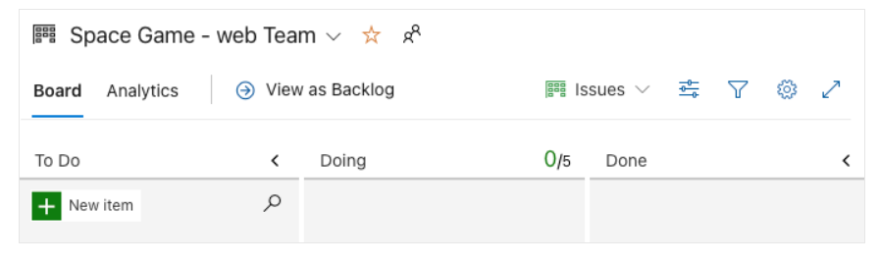
In the To Do column, select the green + button next to the New item field.
Enter Stabilize the build server, and then press Enter.
Select the ellipsis (...) on the item you just created, then select Open.
In the Description field, enter this text:
Select Save & Close.
Follow the same steps for the next two items.

Slide 7
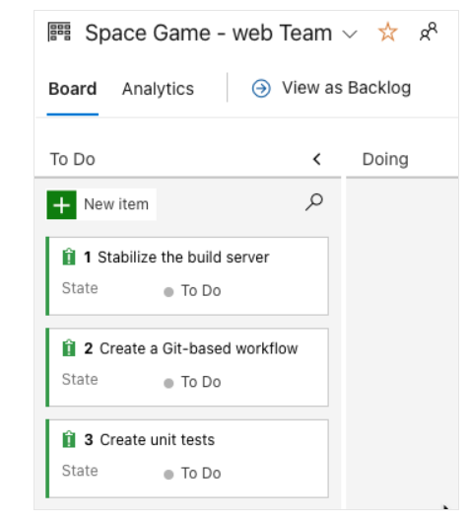
Drag Stabilize the build server to the top of the stack, then drag Create a Git-based workflow to the second item position. Your final board looks like this:
Define a sprint
When you create an Azure Boards project, you get an initial sprint called Sprint 1. All you need to do is assign dates to the sprint and add tasks. Here's how to follow along with the team:

Slide 8
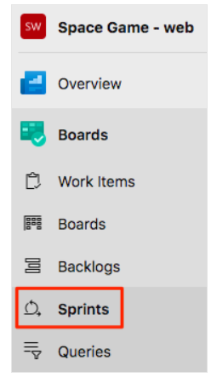
In the left-side column, select Sprints.
Select the Set dates link in the upper-right corner.
Leave the name as Sprint 1.
In the Start date field, select the calendar and pick today's date.
In the End date field, select the calendar and pick the date two weeks from today.
Select Save and close.

Slide 9
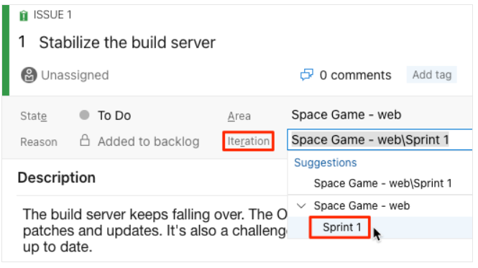
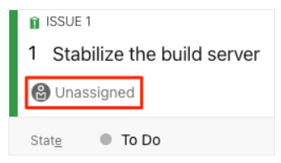
Assign tasks and set the iteration
Under Boards, select Work items.
Select Stabilize the build server.
In the Iteration dropdown, select Sprint 1.
4.From the same window, select Unassigned and set yourself as the task owner.
5.Select Save.
6.Repeat the process for the other two work items.
Create a Git-based workflow
Create unit tests

Slide 10
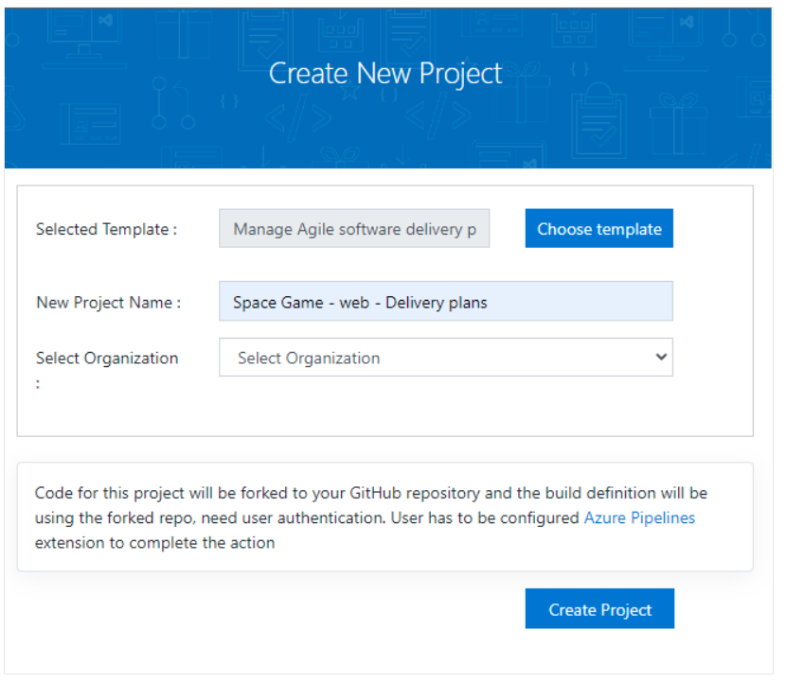
Get the Azure DevOps project
Set up your Azure DevOps organization to complete the rest of this module by running a template that creates a project in Azure DevOps.
Select Sign In and accept the usage terms.
On the Create New Project page, enter a project name, such as Space Game - web - Delivery plans. Then, select your Azure DevOps organization.

Slide 11
3.Select Create Project.
4.The template takes a few moments to run.
Select Navigate to project to go to your project in Azure DevOps.
Plan a sprint using Delivery Plans
The Tailspin team is eager to see how Delivery Plans is going to work. They already have two teams with sprints set up in Azure DevOps, so now they can review and optimize the work schedules.
To do this, you:
Create a delivery plan.
Add team sprints and milestones.
Rearrange work items to fit the overall schedule.

Slide 12
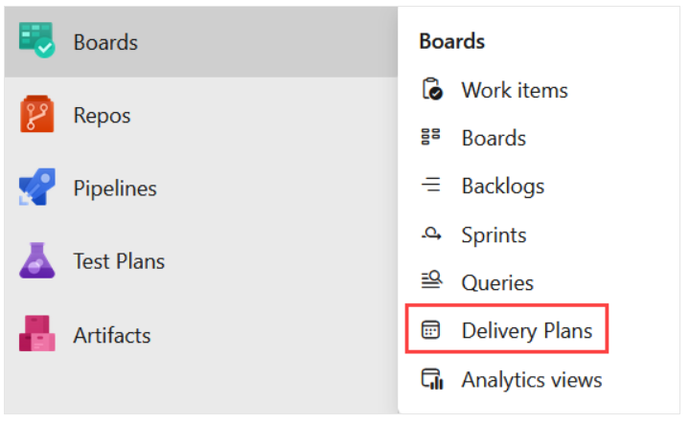
Create a delivery plan
You create a delivery plan from the Delivery Plans tab of Azure Boards. You can create as many delivery plans as you need to manage different aspects of your organization.
From Azure DevOps, navigate to your project.
Under Boards, select Delivery Plans.
3.Select New plan.
4.In the form, enter these fields:
Name: Space Game Delivery Plan.
Select the Backlog items backlog for the Space Game Web Team.
Add the Space Game Engine Team's Backlog items backlog using the Add team option.
The Web team and the Engine team share a common set of backlog items.

Slide 13
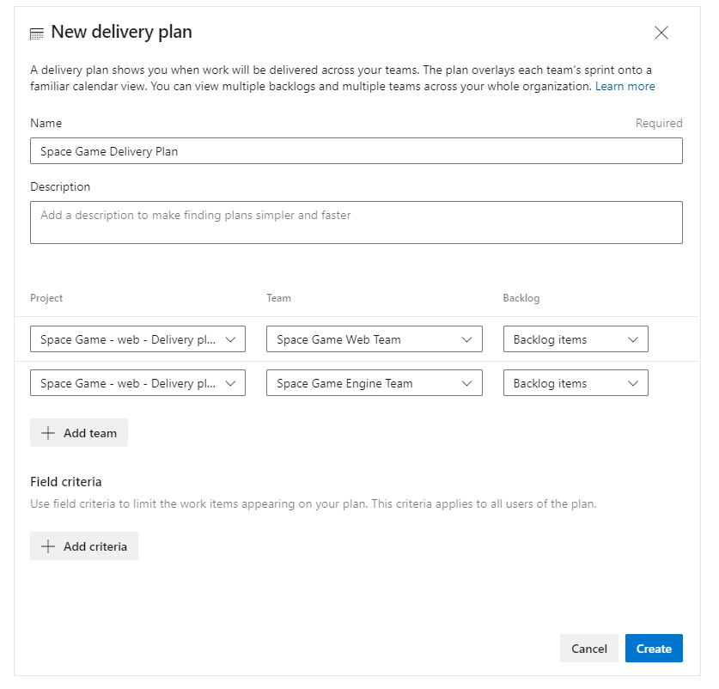
5. Select Create.

Slide 14
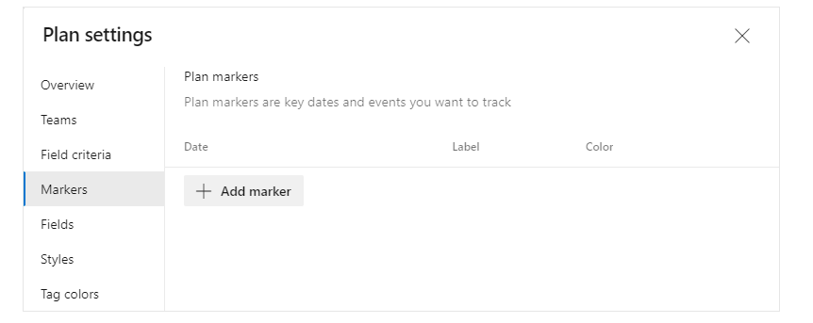
Add schedule milestone markers
Select your delivery plan.
In the top right toolbar, select Settings, and then, on the Plan settings pane, select Markers.
3.From the Markers tab, select Add marker.
4. In the form, enter these fields:
Date: Select a date one week from now
Label: Cliffchella
Color: Red

Slide 15
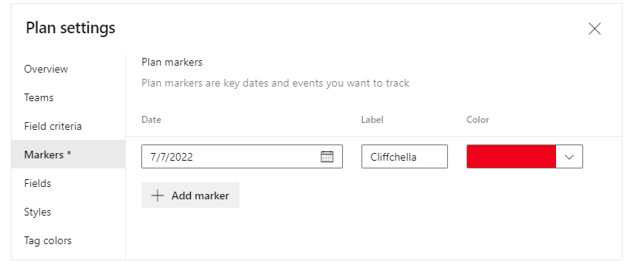
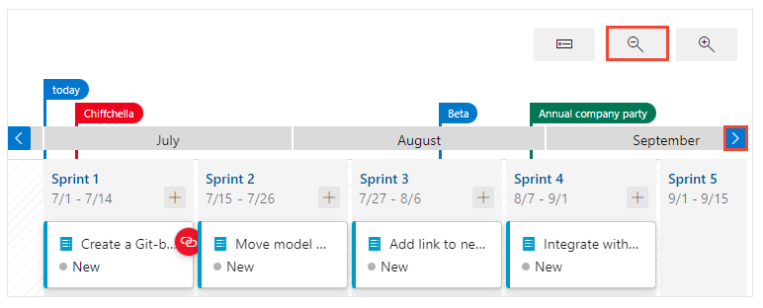
5.Repeat the process to add markers with labels, dates, and colors:
Beta: five weeks from today (blue)
Annual company party: six weeks from today (green)
6.Select Save.
7.Use the Scroll calendar and Zoom out controls to bring all markers into view.

Slide 16
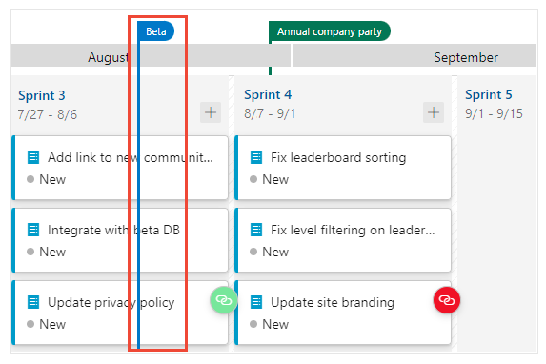
8.Select the Beta marker at the top of the design plan. A solid line shows the boundary of the beta milestone.
Optimize the work schedule
Notice that there's a work item for the Web team to Integrate with beta DB that's scheduled to be completed before the beta will be ready. This is a problem because this work item is dependent on that beta.
Drag the integration work item from Sprint 3 to Sprint 4 to ensure that its dependency will be available.
This change opens a significant amount of bandwidth in Sprint 3. Because that time is now available for productive work, drag the two Fix work items from Sprint 4 back into Sprint 3.

Slide 17
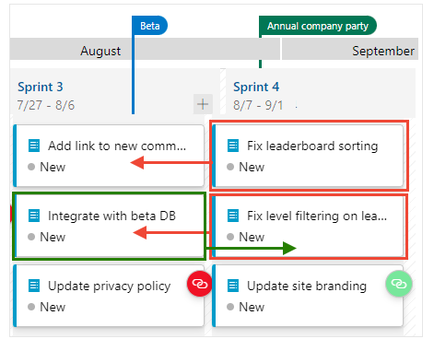
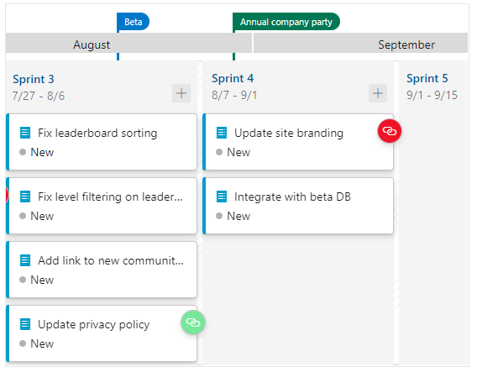
Your final sprint plan should look similar to this:
Although the team has made some adjustments, they haven't addressed all the dependency issues that are identified in the delivery plan. In the next unit, they learn more about dependencies and how to resolve the issues that can occur in the schedule.

Slide 18


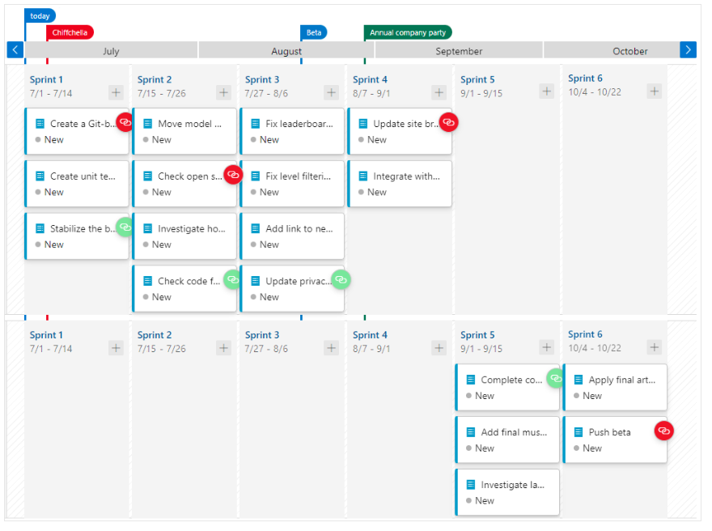
Track dependencies using Delivery Plans
The Tailspin team noted previously that some cards in the delivery plans have green icons or red icons attached. You'll now learn about how these icons showcase the dependencies that exist between work items and how to resolve dependency issues.
The team created dependencies between several work items using the Predecessor/Successor link type. The links they've created automatically appear in the delivery plan they created. Now they need to review these dependencies and address any dependencies that have issues.
To do this, you:
Review delivery plans for dependencies.
Identify work items with dependency issues.
Resolve dependencies that have issues.
View work items with dependencies
The first thing the team notices when they open the delivery plan is that link icons appear. Cards with a green icon indicate there are no dependency issues. Cards with a red icon indicate there are issues with one or more dependencies.
Dependency issues arise when a predecessor work item is scheduled to finish after a successor work item.

Slide 19
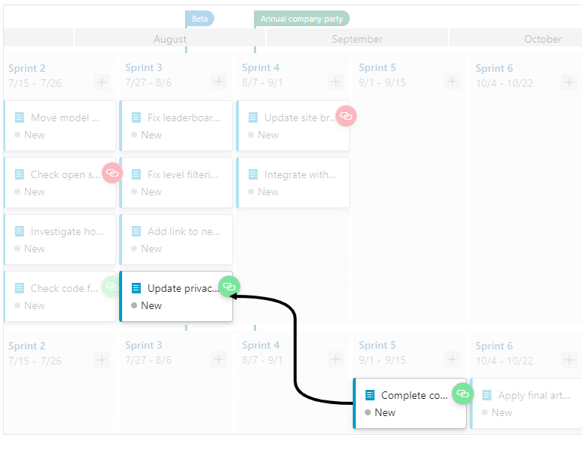
View lines linking work items with dependencies
To view the work items that share in a dependency, select the card with an icon attached. Here, we select the Update privacy policy card.
A link appears that indicates which work item is participating in the dependency. In this case, it highlights that the Complete community interaction training work item for the Engine Team. The arrow indicates the direction of the dependency, and the black line reinforces that there's no issue.

Slide 20
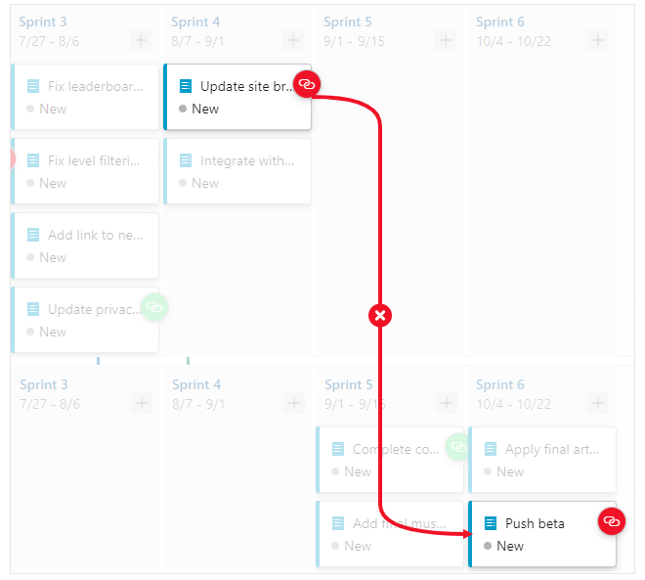
To dismiss the dependency line, select the card or anywhere in the view.
Now, choose a card with an issue. Here we select Update site branding. An issue is shown with the link to the Push beta item defined for the Engine Team. The red line indicates there's an issue and the arrow indicates that the Push beta item is scheduled to complete after Update site branding, which depends on it being completed first.

Slide 21
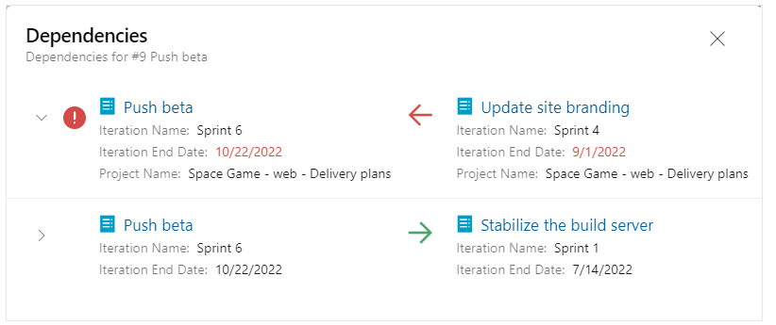
Open the dependency dialog
To review details of the Push beta work item, choose the card's icon to open the Dependencies dialog. The first dependency indicates an issue where the Update site branding work item requires the Push beta work to be completed first. The second dependency listed shows no issue.
Resolve dependencies that have issues
The team decides to change the order in which to complete selected work items so as to resolve the dependency issues. They perform the following actions:
Web team:
Drag Create a Git-based workflow card from Sprint 1 to Sprint 2.
Drag Check open source code for vulnerabilities and licensing terms card from Sprint 2 to Sprint 1.
Drag Update site branding card from Sprint 4 to Sprint 6.
Engine team:
Drag Push beta card from Sprint 6 to Sprint 5.

Slide 22
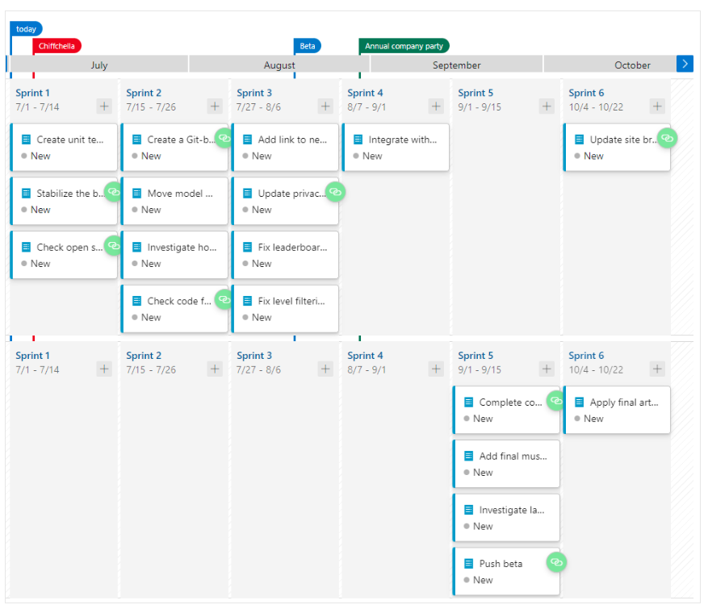

Slide 23
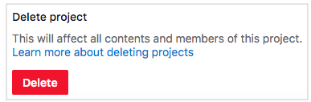
Clean up your environment
Now that you're done with the tasks for this module, clean up your Azure DevOps environment.
Optional - Delete your project
Delete your Azure DevOps project, including what's in Azure Boards. In future modules, you can run another template that brings up a new project in a state where this module leaves off. Choose this option if you don't need your DevOps project for future reference.
To delete the project:
In Azure DevOps, go to your project. Earlier we recommended that you name this project Space Game - web - Delivery plans.
Select Project settings in the lower corner.
At the bottom of the Project details area, select Delete.
4.In the window that appears, enter the project name, and then select Delete again.
Your project is now deleted.

Slide 24
Manage build agents
Now that you and the team are familiar with Azure Pipelines, let's talk a bit more about build agents. A build agent is a piece of installable software that runs one build or deployment job at a time. To build your code or deploy your software, you need at least one agent. As you add more code and people, you'll eventually need more than one agent. There are two main categories of agents.
Microsoft-hosted agents are agents managed by Microsoft, and maintenance and upgrades are taken care of for you. Each time you run a pipeline, you get a new agent for each job in the pipeline. In this module, when you choose Local development environment using a Microsoft-hosted agent, you are running your pipeline on a Microsoft-hosted agent. To run pipelines on a Microsoft-hosted agent, your organization must have at least one Microsoft-hosted parallel job. Check your Microsoft-hosted parallel jobs count to ensure that you have at least one Microsoft-hosted parallel job. If your Microsoft-hosted parallel jobs count is zero (new Azure DevOps organizations typically have zero parallel jobs), you can request a free grant. The approval process for the free grant typically takes 2-3 business days.
Self-hosted agents are agents that are managed by you. You configure the virtual machines or containers by installing the agent software and desired tools, and register the agents with Azure DevOps. In this module, when you choose GitHub Codespaces development environment using a self-hosted agent, you're using a self-hosted agent running in your GitHub Codespaces container. Self-hosting the agent on a GitHub Codespaces container is not a typical production scenario, but it does provide an environment for completing this training module.

