Slide 1
Prediction of Cardiovascular Disease (CVD) from Historical Data
Group members:
Carla Rosas
Huma Zafar
Ruth Njuguna
Sumaya Bare

Slide 2
CONTENTS
Exploratory data analysis (EDA)
Data pre-processing
Developing & evaluating classification models
Model selection and prediction on holdout data

Slide 3
INTRODUCTION
Cardiovascular diseases (CVDs) are the main cause of deaths throughout the world according to World Health Organization.
The objective of the project is to develop a classification model to predict the occurrence of cardiovascular disease using historical data.

Slide 4
EXPLORATORY DATA ANALYSIS (EDA)

Slide 5
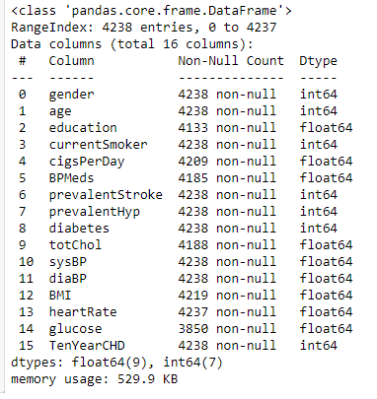

DATASET DESCRIPTION
The data is the Framingham.csv
The data set consists of 4238 rows and 16 columns.
No duplicate records were found in the data.

Slide 6
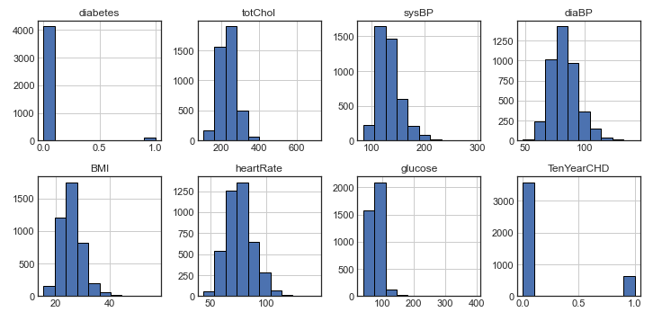
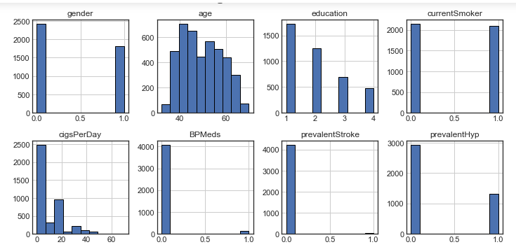
DATA VISUALIZATION
HISTOGRAM

Slide 7
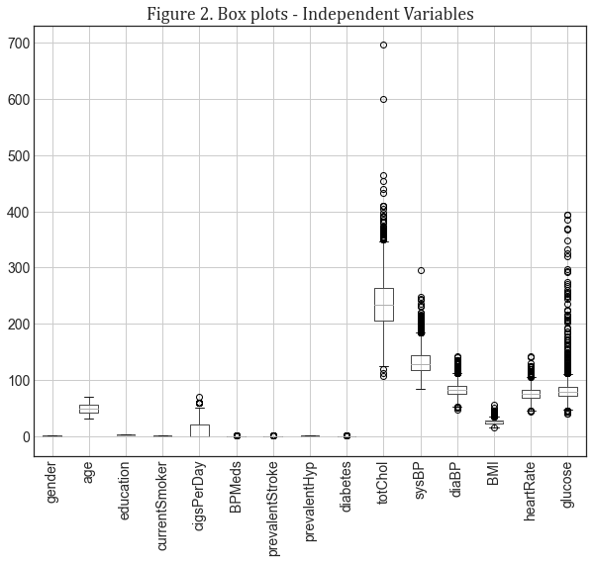
DATA VISUALIZATION
BOX PLOTS

Slide 8
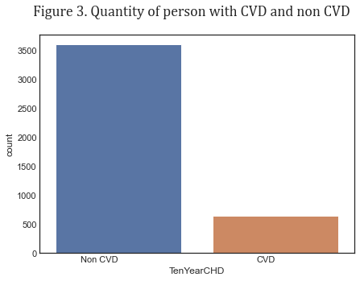
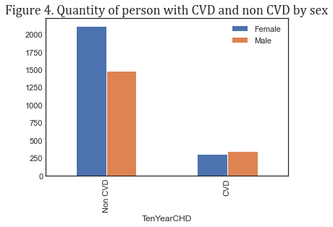
DATA VISUALIZATION
CLASS DISTRIBUTION
CLASS DISTRIBUTION BY GENDER

Slide 9
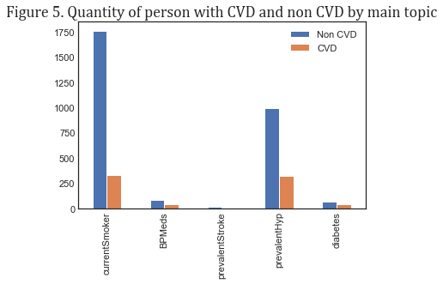
DATA VISUALIZATION
CLASS DISTRIBUTION WITH RESPECT TO OTHER VARIABLES

Slide 10
DATA PRE-PROCESSING

Slide 11
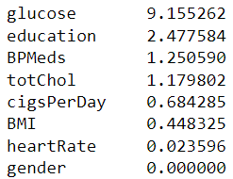
TREATING MISSING VALUES
15.21% of the entire data set.
Highest percentage of missing values in one column was 9%.
Filled with the mean of each feature.
Percentage of missing values in each column in descending order.

Slide 12
STANDARDIZATION
Continuous variables were standardized using MinMaxScaler.
Ordinal encoding was done for the multi-category variable ‘education’.
Categorical variables were not transformed.
All independet variables lie within the range of 0 to 1.

Slide 13
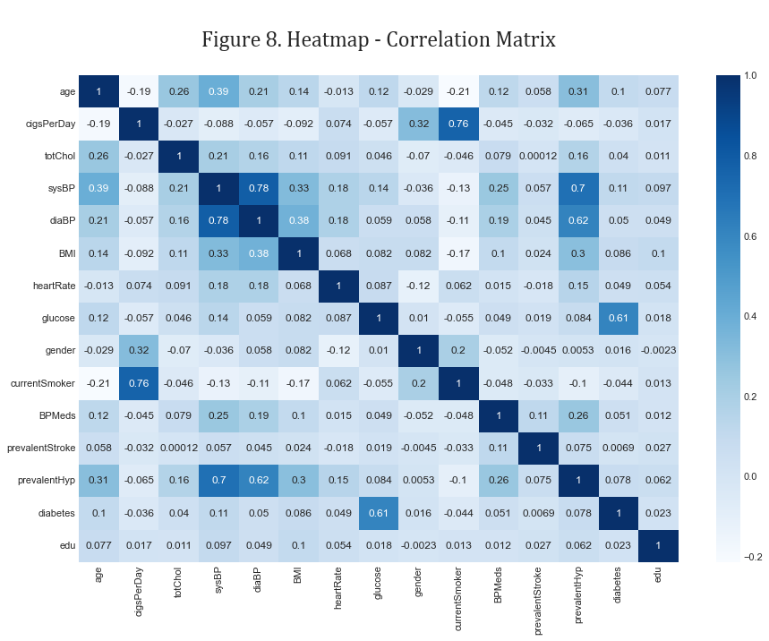
CORRELATION HEATMAP

Slide 14
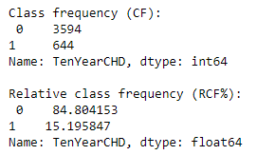
Handling class imbalance
Stratified split was done to preserve class frequencies all data sets.
The data was split into 3 parts:
Training (70%)
Validation (15%)
Holdout (15%)
SMOTE was done separately on each data set after data splitting.

Slide 15
DEVELOPING & EVALUATING CLASSIFICATION MODELS

Slide 16
CLASSIFICATION MODELS
Model name | F-1 Score
 | Baseline | With Parameter Tuning
Logistic Regression | 0.64 | 0.67
Random Forest Classifier | 0.71 | 0.71
Gradient Boost Classifier | 0.79 | 0.86

Slide 17
MODEL selection & PREDICTIONS WITH Holdout data

Slide 18
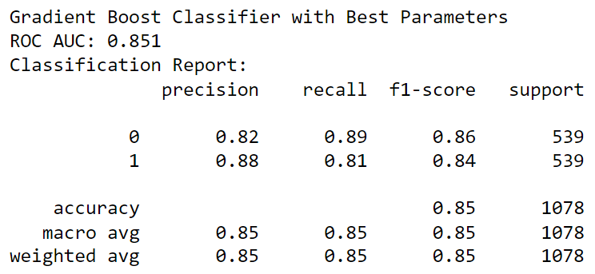
Gradient boost classifier (with parameter tuning)
Performance on the holdout data:

Slide 19
THANK YOU!!

