Slide 1
Extractive Query-Answering Model
Deepti Saravanan

Slide 2
Inputs and Outputs
Input : Query, Document
Output : Answer span, Answer Regulation
Inputs -
Major Processing – Conditional Query Expansion, Vector Space Model, BERT Q&A, Semantic Knowledge Graph
Outputs -
Query 1 | Query 2
How much amount will be provided as reward for informants in insider trading cases? | What legal formalities are to be followed for sweat equity issuance?
Answers | Answer 1 | Answer 2
Answer Span | ten percent of the monetary sanctions collected or recovered and shall not exceed Rupees One crore | Section 79A of Companies Act, 1956 and these Regulations to its – (a) Employees (b) Directors Special Resolution
Answer Regulation | 7D. (1) Upon collection or substantial recovery of the monetary sanctions amounting to at least twice the Reward, the Board may at its sole discretion, declare an Informant eligible for Reward and intimate the Informant or his or her legal representative to file an application in the format provided in Schedule-E for claiming such Reward: Provided that the amount of Reward shall be ten percent of the monetary sanctions collected or recovered and shall not exceed Rupees One crore or such higher amount as the Board may specify from time to time: Provided further that the Board may if deemed fit, out of the total Reward payable, grant an interim reward not exceeding Rupees Ten lacs or such higher amount as the Board may specify from time to time, on the issue of final order by the Board against the person directed to disgorge. | 4. A company whose equity shares are listed on a recognized stock exchange may issue sweat equity shares in accordance with Section 79A of Companies Act, 1956 and these Regulations to its – (a) Employees (b) Directors Special Resolution.

Slide 3
Components – Working Mechanism
Query Pre-processing
Answer Prediction
Knowledge Graph Highlight
Regulations Retrieval
Query and document input
Query vocab information
Top k retrieved regulations
Textual Answer output
Knowledge Graph with expanded output
Query Pre-processing
Conditional Expansion (Topic Modeling)
Synonyms and Hypernyms (wordNet and pretrained legal model embeddings)
Regulations Retrieval
Glossary based document retrieval
Vector Space Model (Normalized tf-idf)
Answer
Pretrained MRC Bert Model
Prediction of output from the top k retrieved regulations
Knowledge Graph
Highlight top k regulation nodes and all the reference documents connected to it
Ranked Sampling (Cosine similarity, important query keywords)
User interactive to click and navigate through documents
Keywords importance

Slide 4

Demo

Slide 5

The Idea
Regulations retrieval based on user query.
Employment of combination of classical and state-of-the-art models for accurate answering.
Visual representation of expanded output (answer + associated additional documents and legal cases) via user interactive knowledge graph.

Slide 6
Components of the Model
Query Pre-processing Module
Regulations Retrieval Module
Answer Module
Semantic Knowledge Graph Module (Ongoing)
Input : Query, Document
Output: Answer span, Answer Regulation

Slide 7
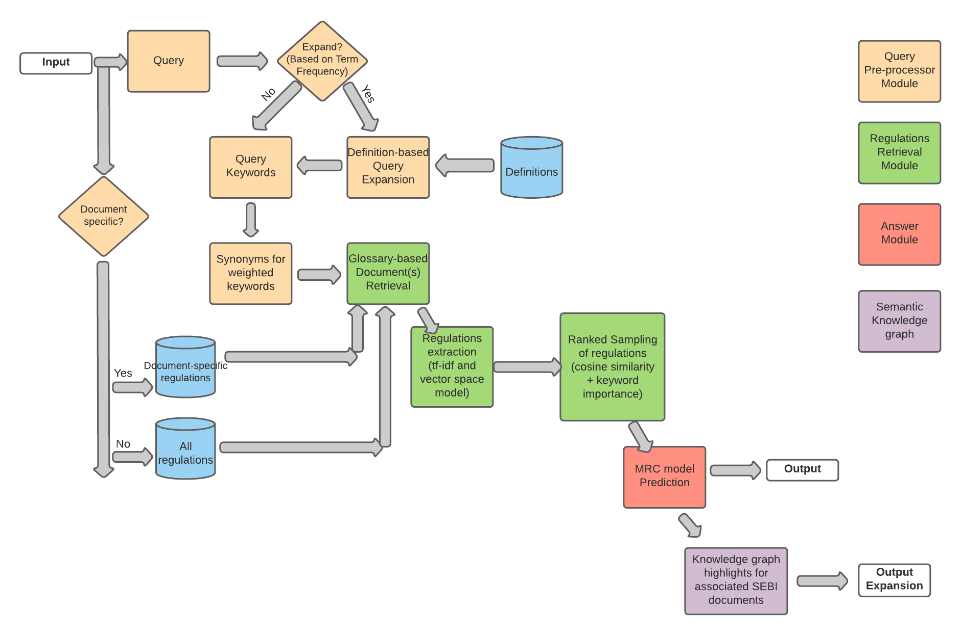
Flowchart

Slide 8
Challenges
Query Pre-processing: Accurate capture of synonyms and hypernyms
Regulations retrieval: Capture of answer regulation(s) in top k
Answer Module: Accurate answer span for vague queries
Knowledge Graph: Capture text span defining edge relationship between regulations and associated documents
Demo : <link>

Slide 9
Future Steps
Knowledge graph construction and integration
Refine the retrieval module
Expansion of the model to other SEBI documents

