Slide 1
1. Query-Answering System 2. Amendments
Deepti Saravanan
December 11, 2020

Slide 2
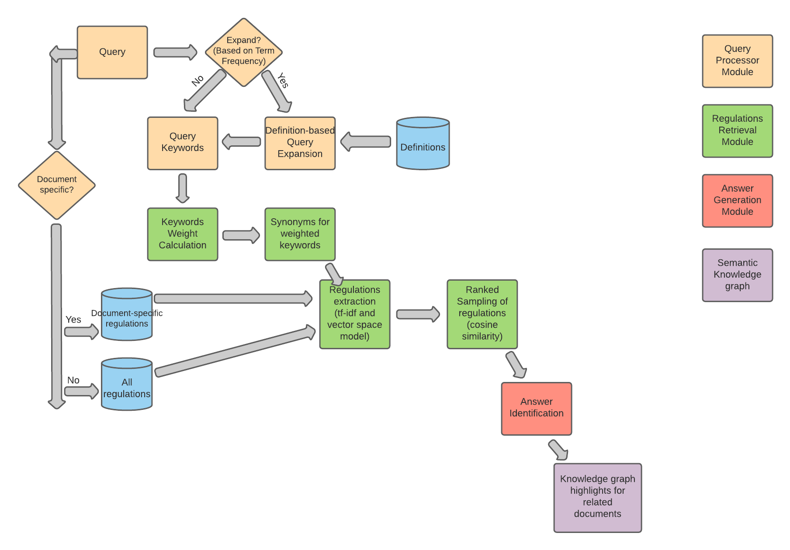
Flowchart

Slide 3
Challenges
Sampled Regulations – high in number
SOLUTION
– Synonyms for keywords with high importance
– Threshold-based Ranked Retrieval
Synonyms (Announce -> Disclose not captured by wordnet)
SOLUTION
Answer Retrieval
Top ranked regulation
– Conditional Query Expansion
– Embed the query keyword; nearest neighbours - synonyms

Slide 4
Next Steps
Fine-tuning
Synonyms snippet
Chapter names, regulation titles (weighted tf-idf)
LSA layer instead of cosine similarity
Answer Module – Answer keywords
Knowledge Graph Highlights

Slide 5
Recontruction of Regulatory Documents from Amendment Information
PIT
2015 – base
2018 – 2 Amendments each wrt 2015 base
2019 – 1 Amendment each wrt 2015 base
2019 – Updated Regulatory Document of 2015
2020 – 2 Amendments each wrt 2015 base
2 cases
Incremental Construction
Branching

