Slide 1
The Basics of East Coast Swing
Nicole Hite
Sumit Khanna

Slide 2
Introduction
Learning how to swing dance
East Coast Style

Slide 3
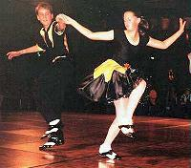
History of Swing
Shorty George
Basic Lindy (Charles Lindberg)
Several Styles
  East Coast
  West Coast
  Shag

Slide 4
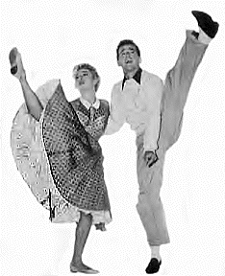
The Basics
Open and Closed Positions
Basic Step
Leading with your Arms
  Inside Lead
  Outside Lead

Slide 5
The Steps (open position)
Natural Turn
Sweetheart
Barrel Roll
Arm Slide

Slide 6
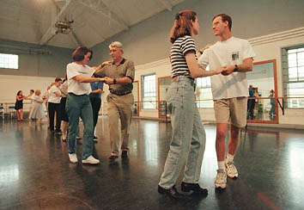
The Steps (closed position)
Inside Turn
Tuck Turn
Tuck Turn with one Hand
Tuck and Spin out

Slide 7
Conclusion
Importance of Fundamentals
Everything is based off the one-two quickstep
Important thing is to have fun

Slide 8
Places to Swing Dance
In a parking lot
Cookeville Swing Society
Nashville's Jump Jive and Swing
  www.nashvillelindyhop.com
Knoxville Swing Dance Association
  www.utk.edu/~ksda

