Slide 1
Multi-CPU Architectures
  Sumit Khanna
  CPSC – 533 / Harris

Slide 2
Single Processors
  All processes and threads must share time with a single set of resources

Slide 3
Symmetric Multi-Processors
Typically has between 2 and 32 processors
All processors access main memory
Operating System must support SMP

Slide 4
SMP Myths
2 CPUs x 500Mhz != 1000Ghz
A single program will run at the same speed
Exception: multi-threaded programs
Operating System Interrupt Management

Slide 5
Processors
Many Consumer Grade (Intel 486, Pentium through Pentium-4, AMD Athlon)
Server Variations (AMD Opteron, Intel Xeon)
Server (Sun UltraSparc, SGI MIPS, Intel Itanium)
Celerons / old Athlons Cavets
Matched Processor Sets (Family/Stepping)
AMD's Interesting Chipset

Slide 6
NUMA
Non-Uniform Memory Architecture
Each processor has its own memory bank
Introduces the concepts of Local and Remote Memory
Typically large amounts of processors (over 32)
Processors are placed into Nodes

Slide 7
NUMA
Information for a nodes current process is stored in local memory
Information outside of a node is remote memory
ccNUMA (Cache Coherent NUMA)

Slide 8
NUMA - Example
You are baking a cake (executing process) and you have a set of ingredients (memory pages)
You store some ingredients in your cabinets (local memory) and some are on the other side of the house in the pantry (remote memory)
You cabinets can only hold a small amount of ingredients and if you need more than it can hold, you'll have to place them in the pantry
Minimize the trips to the pantry to bake your cake
Reference: http://lse.sf.net/numa/faq/index.html#real_world_analogy

Slide 9
NUMA Systems
IBM NUMA-Q
Compaq Wildfire
SGI MIPS64
Source: http://lse.sf.net/numa/faq/index.html#architectures

Slide 10
Hyper-Threading
Intel's implementation of two-thread Simultaneous Multi-Threading (SMT)
One Physical Processor with Two Logical Processors
Architecture State is duplicated but Execution Units are not
Resources are shared but number of idle units are minimized

Slide 11
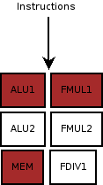
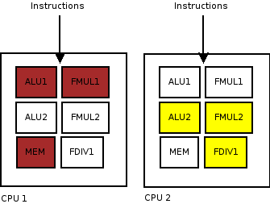
Hyper-Threading

Slide 12
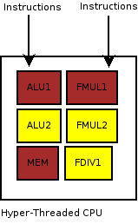
Hyper-Threading
Reference: Multi-processing on a single CPU, Antoine & Mendez

Slide 13
HT Hazards
Cache Missing for Fun and Profit by Colin Percival
SMP / HT Systems with 4 logical processors

Slide 14
Future of HT
Being Phased out by Dual Core which consume about the same amount of power with much better performance
Used by Intel to denote hi and low end chips
Pentium D does not support HT
Pentium 4 Extreme Edition does
Source: http://en.wikipedia.org/wiki/Hyper-Threading

Slide 15
Massively Parallel Processing
A cluster of systems each with their own processor(s), memory and I/O
Moving away from the architecture level and more to the Operating System and Application level
Cray T3E / IBM SP (Source: http://www.auditmypc.com/acronym/MPP.asp)
Seti@Home and Folding@Home

Slide 16
MPP
Software APIs: MOSIX, PVM, RMI
Most software must be specifically written for MPP systems
Software ranges from Nuclear Simulations to searching for Extraterrestrial Life

Slide 17
Conclusion
SMP – Affordable, Common, Used as Servers, Good for Medium to Large Problems
NUMA – More Scalable than SMP, However more Expensive
HT – Intel's approach to Utilizing more Resources by simulating SMP
MPP – Good for very large processor intensive projects or open source distributed projects. Tend to be Expensive

Slide 18
Questions
?

