Slide 1

Population
PowerPoint by Lois Rood

Slide 2

Demography
The study of population size, composition
and distribution

Slide 3

Fertility
The actual level of childbearing for an individual or a population

Slide 4

Fecundity
The potential number of children who could be born if every woman reproduced at her maximum biological capacity

Slide 5
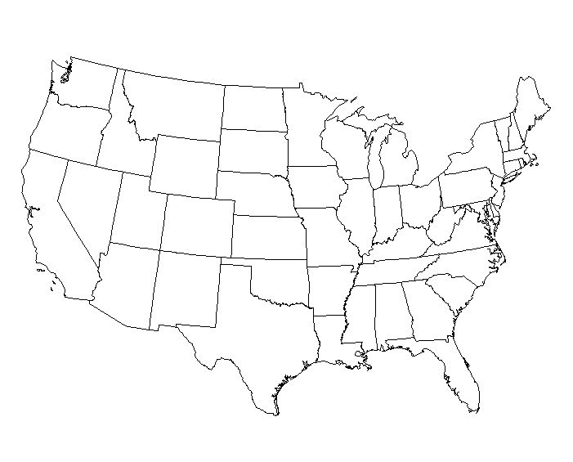
Crude Birth Rate
The number of live births per 1,000 people ina population in a given year.
2000 United States 14.2 per 1,000
1947 United States 27.0 per 1,000

Slide 6
Mortality
The incidence of death in a population
Crude Death Rate – the number of deaths per 1,000 people in a population
2000 United States 8.8 per 1,000
Infant Mortality Rate – number of deaths of infants under 1 year of age per 1,000 live births

Slide 7
Migration
The movement of people from one geographic area to another for the purpose of changing residency
  Distribution – physical location of people
  Density – number of people in a geographic area
  (often computer per square mile)

Slide 8
Migration Factors
Immigration – Movement into an area
Emigration – Movement out of an area
Push Factors – Favorable to emigration (political unrest, violence, war, famine, plagues, and natural disasters)
Pull Factors – Favorable to immigration (liberty, freedom, democracy, land ownership, education, jobs)

Slide 9
Population Composition
The biological and social characteristics of a population
Sex Ratio – Number of males for every hundred females in a given population
  100 indicates equal number of males and females
  Over 100 indicates more males than females
  Under 100 indicates more females than males
  U.S. in 200 was 96.3; slightly more females than males
  124 males are conceived for every 100 females; However, male fetuses miscarry naturally at a much higher rate

Slide 10
Population Composition
The biological and social characteristics of a population
Population Pyramid
A graphic representation of the distribution of population by sex and age
(See page 606, figure 19.2 in your textbook)

