Slide 1
GiPost
A GTK+ newspost frontend
Sumit Khanna
CSC 4950

Slide 2
What is UseNet?
The NNTP Protocol
  Old Fashion Message Boards
  Server to Server Relay
Posting Binaries
7bit ASCII
UUEncode/MIME/yEnc
Multi-part files

Slide 3
What does GiPost do?
What does newspost do?
Adding a Graphical User Interface
Queuing up multiple posts

Slide 4
Functional Requirements
Store Server Information
  Hostname, Username, Password, etc.
  List of Newsgroups
Post Single or Multiple File(s)
  Automatic Compression (Zip/Rar/etc)
  Parity and Sfv information

Slide 5
Nonfunctional Requirements
GNU Build Tools (autoconf) for portability
Nautilus File Manager Scripts (right click on a file and post)
Possible plugins for newsreaders?

Slide 6
Implementation
GTK+ Graphical Toolkit
Glade
Linux Operating System
  Packages for Gentoo and Fedora
C/C++ Programming Language

Slide 7
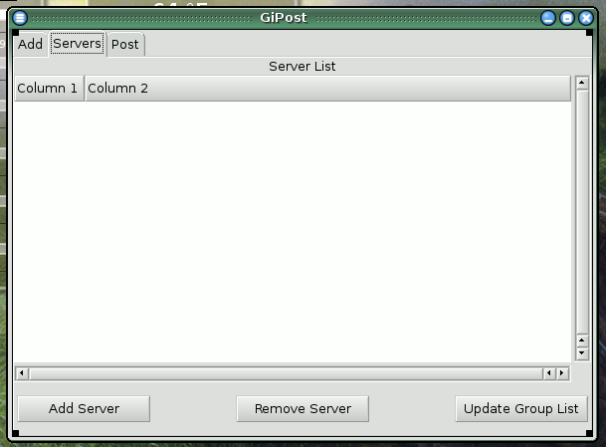
Screen Layouts

Slide 8
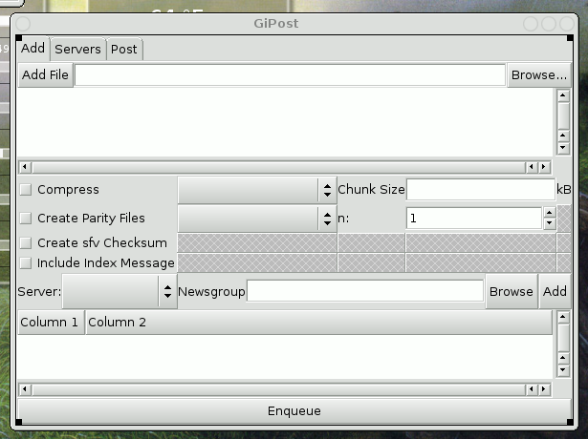
Screen Layouts

Slide 9
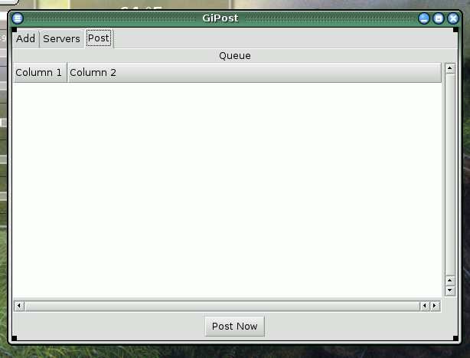
Screen Layouts

Slide 10
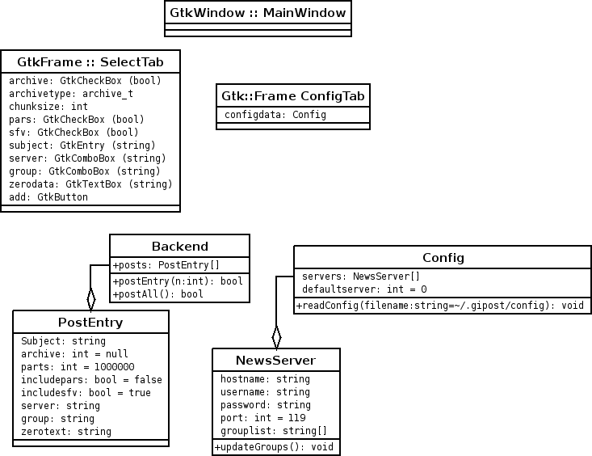
Class Diagrams

Slide 11
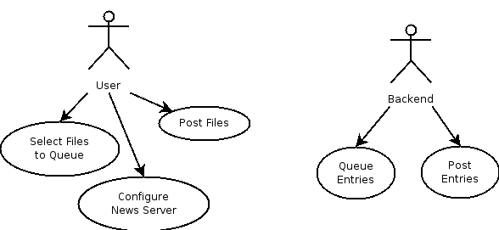
Use Cases

Slide 12
Status of Project
Basic GUI designed in Glade
Autoconf Scripts Designed and Functional
Currently Implementing Data Structures and Backend

Slide 13
Conclusion
Why I am doing this project?
Who will this project be useful to?
What skill sets am I displaying with this project?
What am I learning with this project?

