Slide 1
Device Nodes in Linux
A look at /dev
Sumit Khanna

Slide 2
/dev progression
Originally every device had its own file
Major Minor Number Problem
devfs, the virtual device file system
Problems with devfs
The new standard: udev
Utopia: udev + dbus +hald

Slide 3
Basic devices
/dev/hd??
  IDE hard disks
  hda, hda1, hdb, hdb1, etc.
  Quirks with partition tables
/dev/sd??
  SCSI Hard Drives
/dev/usb, /dev/input
  USB devices and progression
/dev/v4l – Video For Linux
/dev/nvidia – prosperity devices

Slide 4
Static Nodes
Each device had a file node in /dev
Number of devices became long causing long directory lookups
Major / Minor numbers were only 16-bit (Minix conversion)
Running out of Major Minor numbers
/dev was a mess

Slide 5
devfs
/proc is a virtual file system generated dynamically, why not the same for /dev
/dev only contains the devices you have
New naming convention
devfsd to create symbolic links to 'legacy' names

Slide 6
devfs naming
Standard fstab:
/dev/sda1 /boot ext3 noauto,noatime 1 2
/dev/sda2 / jfs noatime 0 1
/dev/sda3 none swap sw 0 0
/dev/cdrom /mnt/cdrom iso9660 noauto,ro,user 0 0
devfs fstab:
/dev/scsi/host0/bus0/target0/lun0/part1 /boot ext3 noauto,noatime 1 2
/dev/scsi/host0/bus0/target0/lun0/part2 jfs noatime 0 1
/dev/scsi/host0/bus0/target0/lun0/part3 swap sw 0 0
/dev/ide/host0/bus0/target0/lun0/disk iso9660 noauto,ro,user 0 0
devfs short notation:
/dev/sd/c1b2t3u4 for the whole disc
/dev/sd/c1b2t3u4p5 for the 5th partition
/dev/sd/c1b2t3u4p5s6 for the 6th slice in the 5th partition

Slide 7
Problems with devfs
devfsd needed to be running to get less cryptic device names
Still required major/minor numbers
Author was a jerk (no seriously)

Slide 8
udev: the successor to devfs
Understanding USB and other hotplugable devices and the SCSI subsystem
Originally designed for consistent naming
Userspace daemon vs devfs which operated mostly in kernel space.
Used standard device node names

Slide 9
udev rules
# input devices
KERNEL=="mice", NAME="input/%k", MODE="0644"
KERNEL=="mouse*", NAME="input/%k", MODE="0644"
KERNEL=="event*", NAME="input/%k", MODE="0600"
KERNEL=="js*", NAME="input/%k", MODE="664"
KERNEL=="ts*", NAME="input/%k", MODE="0600"
# md block devices
KERNEL=="md[0-9]*", NAME="md/%n", SYMLINK+="%k", GROUP="disk"

Slide 10
Still not 'really' plug-n-play
Devices still need to be added to fstab
Redhat tried to address this using kudzu
Hardware Abstraction Layer Daemon
D-Bus event system

Slide 11
USB, Firewire, etc
All new devices placed in SCSI subsystem
USB drives, Firewire and SATA drives show up as SCSI (/dev/sd?) devices
Your USB device name can change
devfs rules allowed for consistency
Still not as easy as Windows
Introduce d-bus

Slide 12
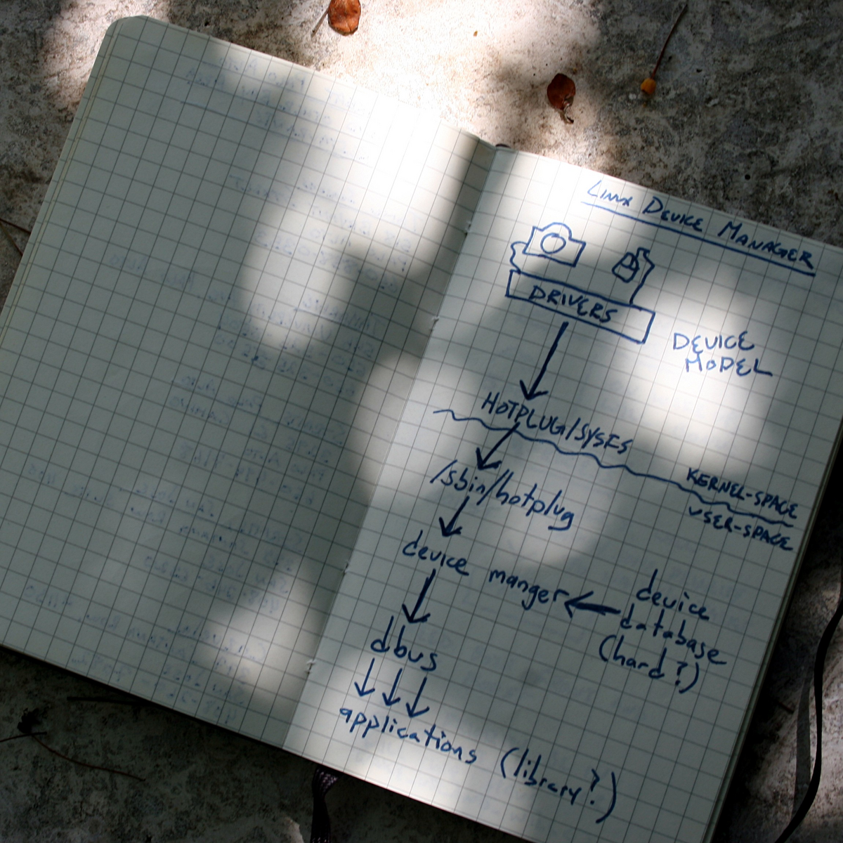
Linux Utopia
Taken From Linux Journal (6/26/2005)

Slide 13
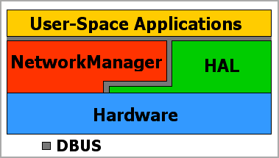
Linux Utopia
Taken From Linux Journal (6/26/2005)

Slide 14
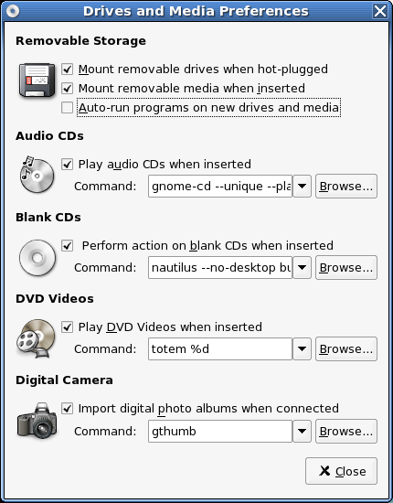
Linux Utopia

Slide 15
Linux Utopia
hald – hardware abstraction layer
  Detects and manages devices
udev – manages devices notes/hotplug
d-bus -notifies userspace applications
gnome/KDE/XFce – accept d-bus messages
Linux now has the plug-n-play functionality of Windows and MacOS
Still very experimental
Found in Fedora Core 3, Gentoo, etc.

Slide 16
Conclusion
Linux has good driver support, but until now no good plug-and-play support
New security issues arise
New programs still experimental

