Slide 1
Social Structure
Power Point by
Lois R. Rood

Slide 2
Macro
Level
Society
Social Institutions
Statuses & Roles
Traditional
Family
Religion
Education
Government
Economy
Emergent
Sports
Media
Science
Medicine
Military
Ascribed Status
Race
Ethnicity
Age
Gender
Class
Achieved Status
Occupation
Education
Income
Social Groups
Secondary Group
Schools
Churches
Corporations
Primary Group
Family
Friends
Peers

Slide 3
Social Structure
Various groups within a society
Patterns of relationships within and among these groups
Religious – Spiritual Groups
Political Groups
Job Groups
Educational Groups
Family Groups

Slide 4
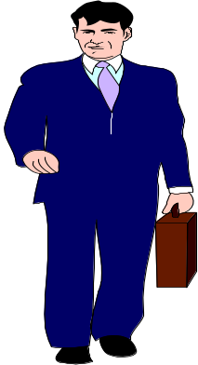
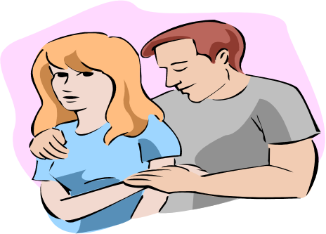
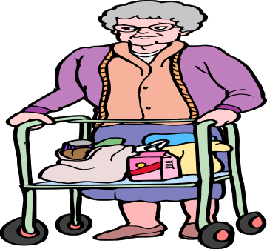
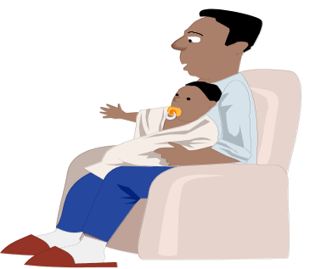
Status
A defined or recognized position within a group or society
One occupies a status
It is what we ARE, not what we DO

Slide 5
What are your statuses?
I am a…
_________________
_________________
_________________
_________________
_________________
_________________
_________________
_________________
_________________
_________________
Woman
United States Citizen
3rd generation German-Czech American
Mother
Grandmother
Sister
College graduate
College Instructor
Violin Student
Caucasian
Musician
Resident of Cookeville

Slide 6
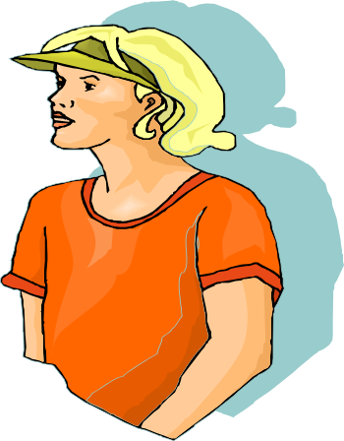
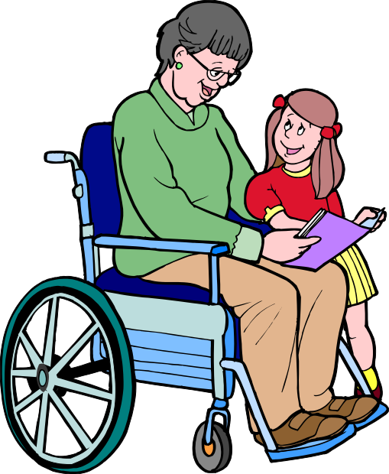
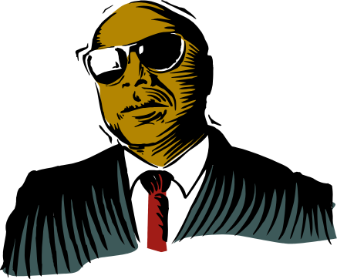
Ascribed Status
Position assigned to a person based on
an attribute or characteristic
Generally acquired at birth
Not voluntarily chosen or earned
Age
Sex
Race
Ethnicity
Disabilities

Slide 7
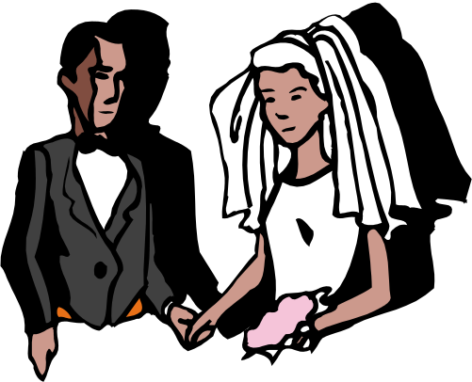
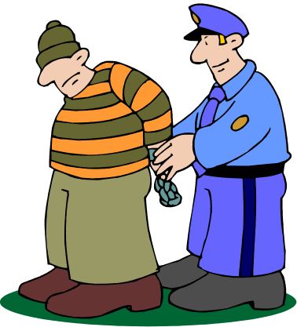
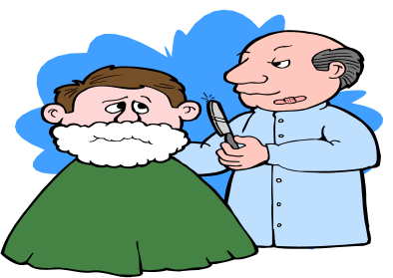
Achieved Status
Position a person has attained through his or her own efforts or behaviors
Voluntarily chosen or earned
Occupation
Education
Achievements, Recognitions, Awards
Labels & Sanctions

Slide 8
Which are ascribed?
Which are achieved?
Ascribed | Achieved
Woman | College Graduate
U.S. Citizen | College Instructor
Sister | Musician
Caucasian | Resident of Cookeville
Older Adult | Mother
3rd Generation Czech-German | Grandmother
Farmers’ Daughter | Organization President

Slide 9
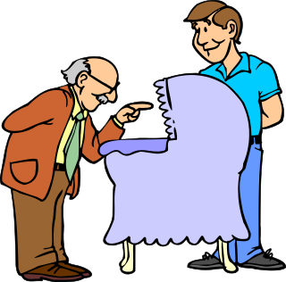
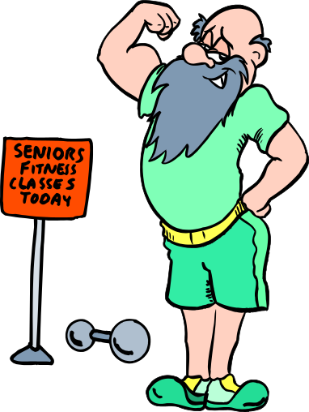
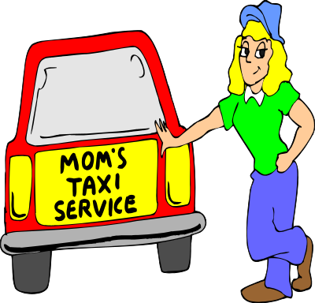
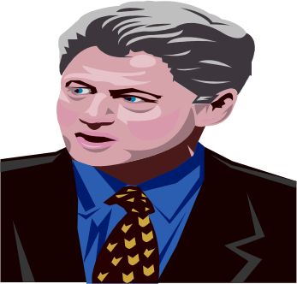
Master Status
Primary social identity
Primary determinant of social relationships
?
What's Yours?

Slide 10
Which is your MASTER STATUS?
Ascribed | Achieved
Woman | College Graduate
U.S. Citizen | College Instructor
Sister | Musician
Caucasian | Resident of Cookeville
Older Adult | Mother
3rd Generation Czech-German | Grandmother
Farmers’ Daughter | Organization President
Baby Boomer | Member of a Spiritual Community

Slide 11
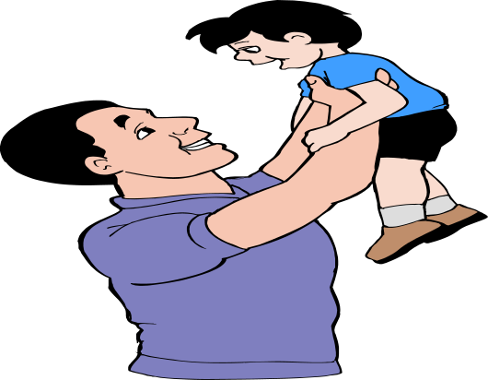
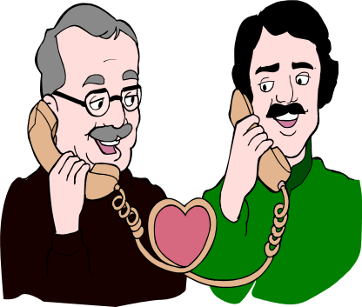
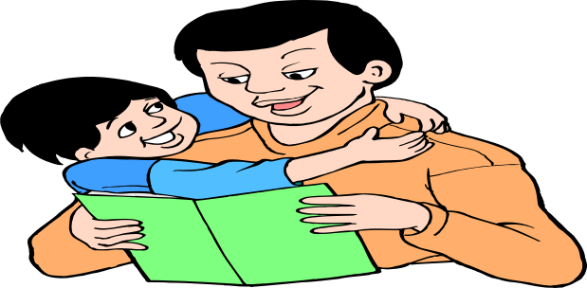
Role
Dad!
A set of expected behaviors and attitudes associated with a particular status
One plays a role
It is what we DO, because of who we ARE

Slide 12
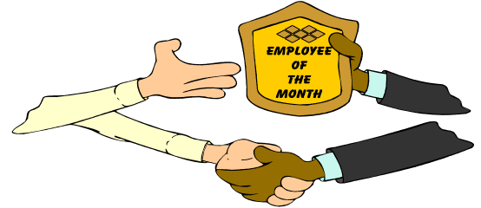
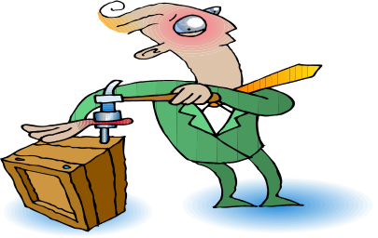


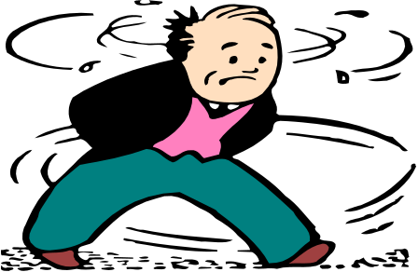
Formal Role & Role Performance
Formal Role – What one is suppose to do when he or she occupies that status
Role Performance – Actual behaviors and attitudes in relationship to the formal expectations

Slide 13

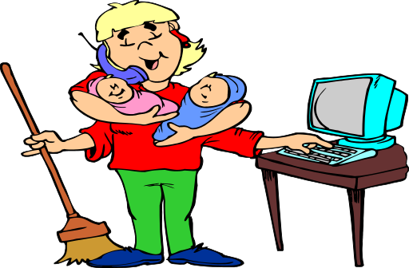
Role Strain & Role Conflict
Role Strain
  Strain caused by competing expectations for a particular, single status
Role Conflict
  Strain caused by competing expectations between two or more statuses

Slide 14
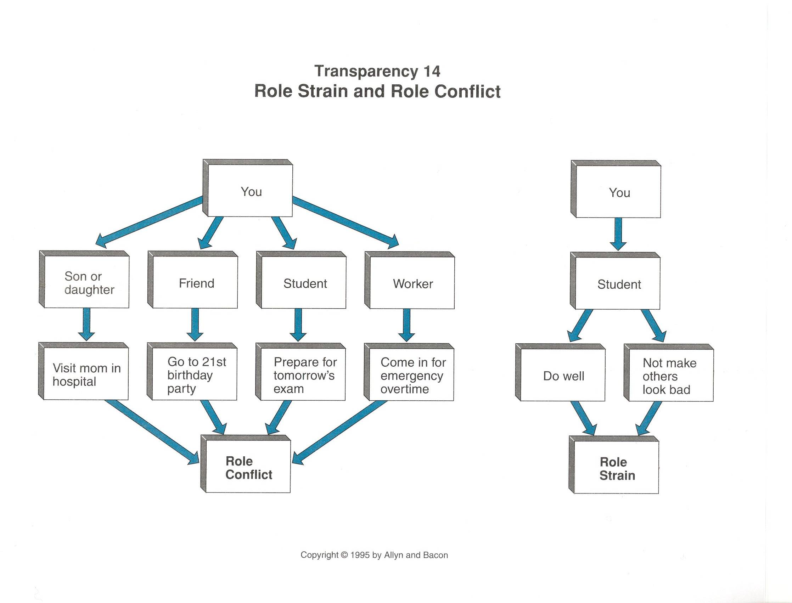
Role Strain & Role Conflict Example

Slide 15
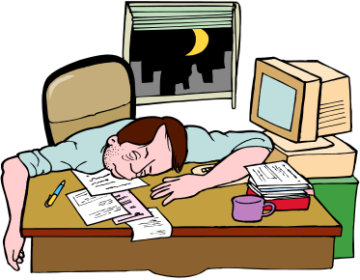
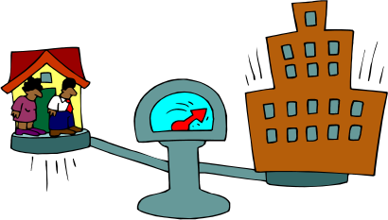
Stress?
What status causes you the most role strain? (single status)
Between which two or more statuses do you feel the most role conflict? (multiple statuses)

Slide 16


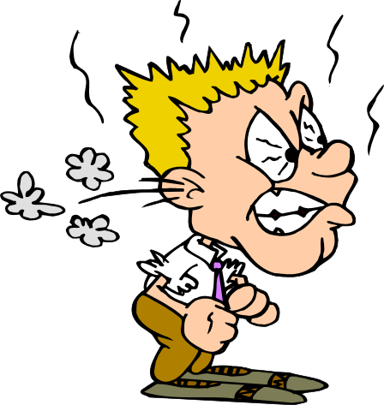
Role Exit
Graduation!
Disengagement from a social role that has been central to one’s self identity
Divorce
Losing a job

Slide 17
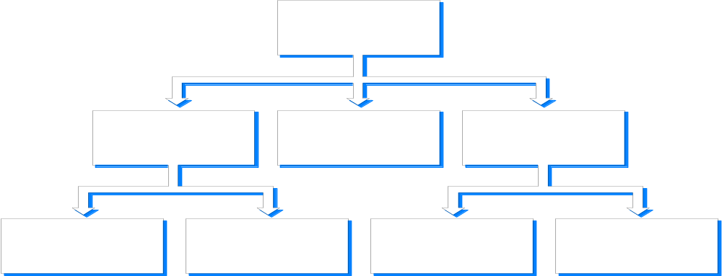
Formal Organizations
Large
Deliberately planned to achieve an objective
Organized with a structure
Procedures & rules
Mission

Slide 18
Social Institutions
A set or organized beliefs and rules that establishes how a society will attempt to meet basic human needs
  Replace members
  Teach new members
  Produce, distribute and consume goods & services
  Preserve order
  Provide and maintain a sense of purpose

Slide 19
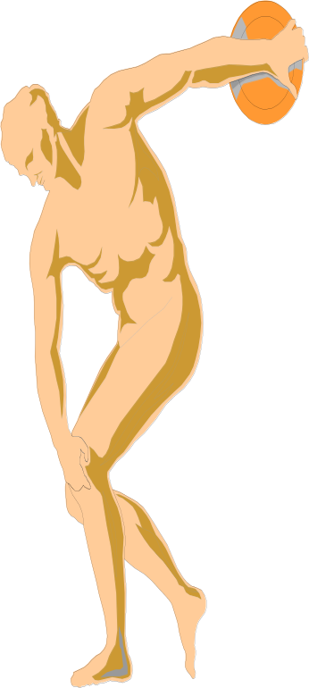
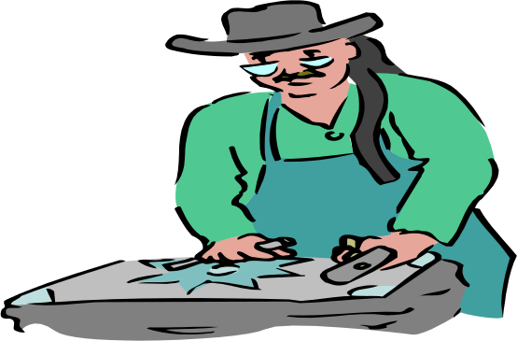



Societies
Self-perpetuating groups
Occupying the same geographic area
Sharing the same culture
Behaving under the same authority

Slide 20


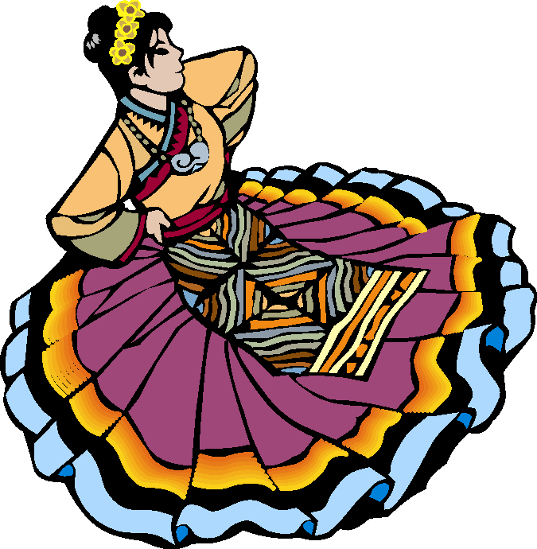
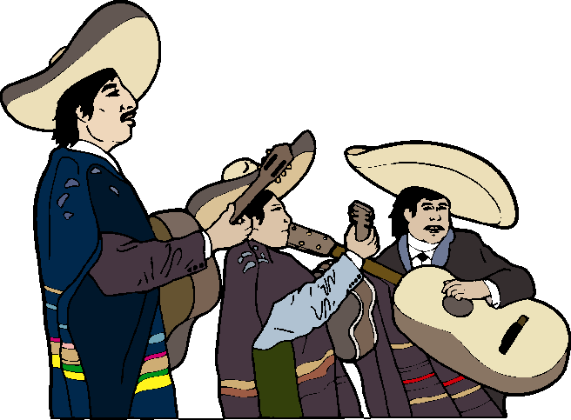
Societies, Technology & Change
Hunting & Gathering
Horticultural & pastoral
Agricultural
Industrial
Post-Industrial

Slide 21
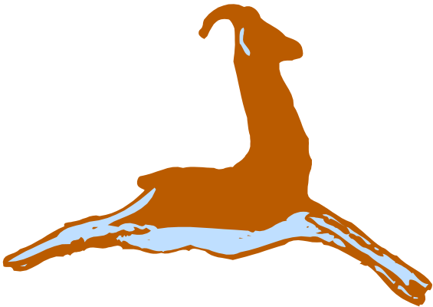
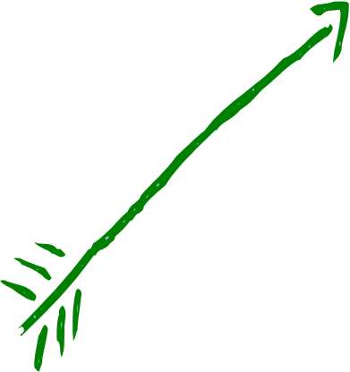
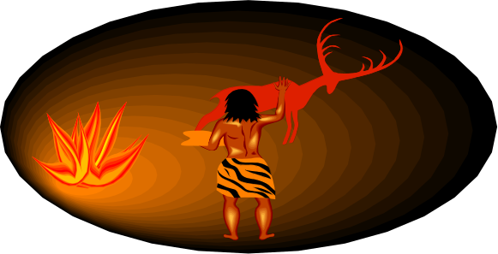
Hunting & Gathering
Technology: simple
Economics: hunting & gathering
Group size: small
Lifestyle: nomadic
Surplus: none
Inheritance: none
Stratification: egalitarian
Control over procreation: none
Women’s status: equal & valued due to birth
Spirituality: Goddess worship (fertility) or God & Goddess equal worship; spirits found in nature

Slide 22
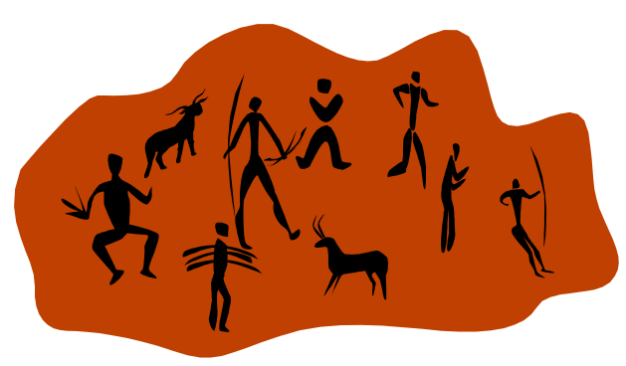
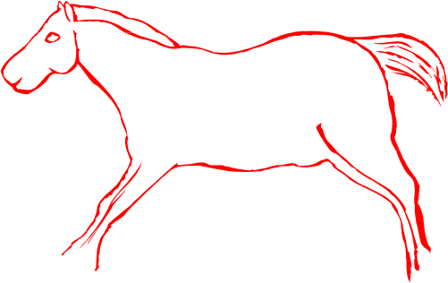
Horticultural &
Pastoral
Technology: hand tools, the hoe
Economics: cultivation of crops, domestication of animals for food
Group size: pastoral bands or tribes; horticulture groups
Lifestyle: pastoral nomadic; cultivators settled
Surplus: some; controlled by men
Inheritance: shared – patrilineal & matrilineal
Stratification: males over females; polygamy
Control over procreation: controlled by men
Women’s status: decreasing with pastoralism; somewhat with horticulturalists
Spirituality: Horticultural: Goddess worship (fertility) or God & Goddess equal worship in horticultural groups; spirits found in nature; Sun and earth Gods;
Pastoral: A male God concept in pastoral groups; vengeful and able to control nature

Slide 23
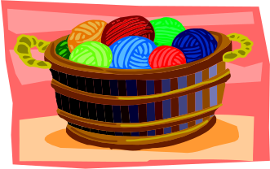
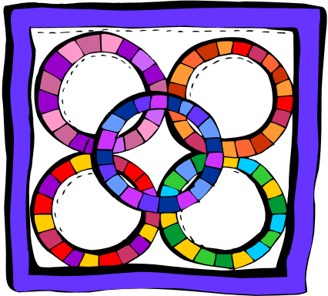
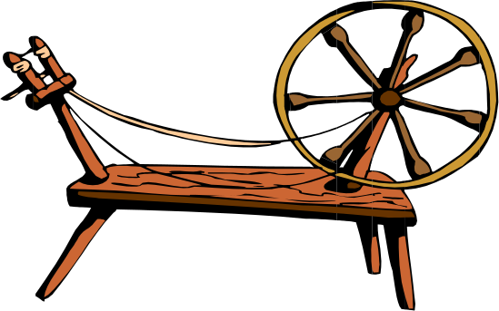
Agricultural
Technology: increasingly complex; “the plow”
Economics: farming; labor-intensive
Group size: large, rural; emergence of cities
Lifestyle: land ownership and herds
Surplus: Controlled by male land owners; and traders
Inheritance: patrilineal
Stratification: men over women; land owners wealth & peasant class poor; based on ascribed (not achieved) status
Control over procreation: men to ensure legitimacy of heirs
Women’s status: low
Spirituality: A male God concept; Attempt to stamp out Goddess worship; Judaism & Catholicism in the Western World; Patriarchial in the Eastern World

Slide 24
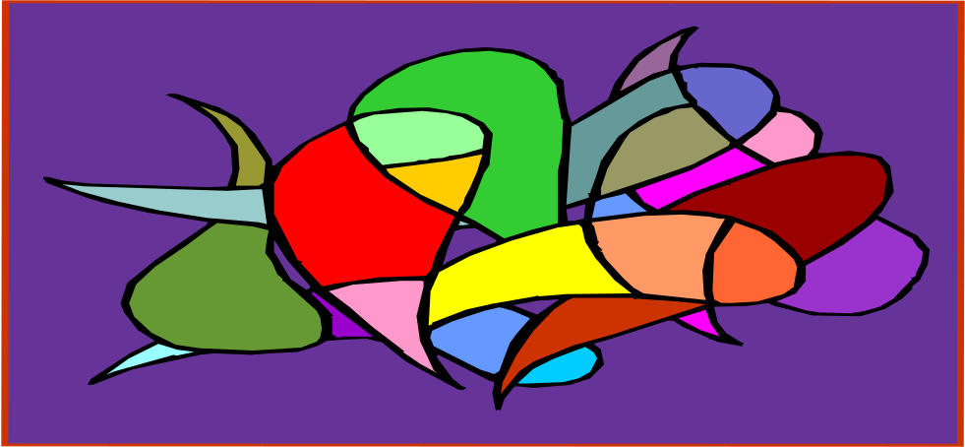
Industrial
Technology: Modern; the “steam engine”
Economics: Manufacturing
Group size: Large;
Lifestyle: Settled; Cities; Urbanization
Surplus: Men controlling means of production (capitalists)
Inheritance: Patrilineal
Stratification: Capitalists wealthy, but large middle class; Based on race & ethnicity
Control over procreation: Men, but birth control available to women
Women’s status: Low; but efforts to increase it
Spirituality: Protestantism in western world; Individualistic

Slide 25
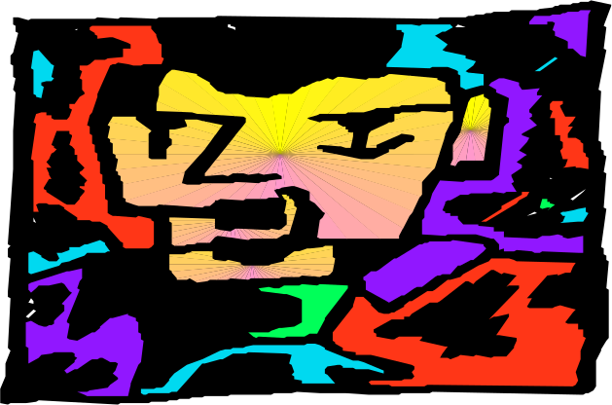
Post-Industrial
Technology: Modern; the “computer chip”
Economics: Information & services economy
Group size: Very large & mobile based on economics
Lifestyle: Urban
Surplus: Controlled by big business, big government controlled by men
Inheritance: Patrilineal
Stratification: Increasing lower class; decreasing middle class; stable upper class controlling most of the wealth
Control over procreation: Mixed (women’s ability to control their own fertility)
Women’s status: Class based (achieved, not ascribed)
Spirituality: Multiple perceptions and practices; cultural clashes between traditionalists/fundamentalists and spiritual searching and freedom of expression worldwide

Slide 26
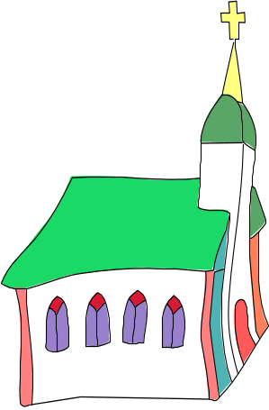
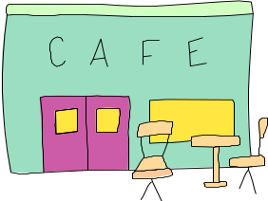
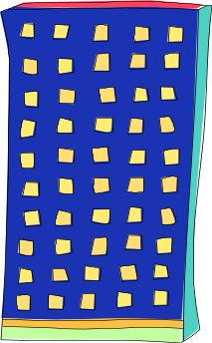

Social Cohesion
Durkheim
Mechanical solidarity
  Communities tied together by common values, beliefs, and even often economies
Organic solidarity
  Communities tied together by interdependency and interlocking functionality of different statuses

Slide 27



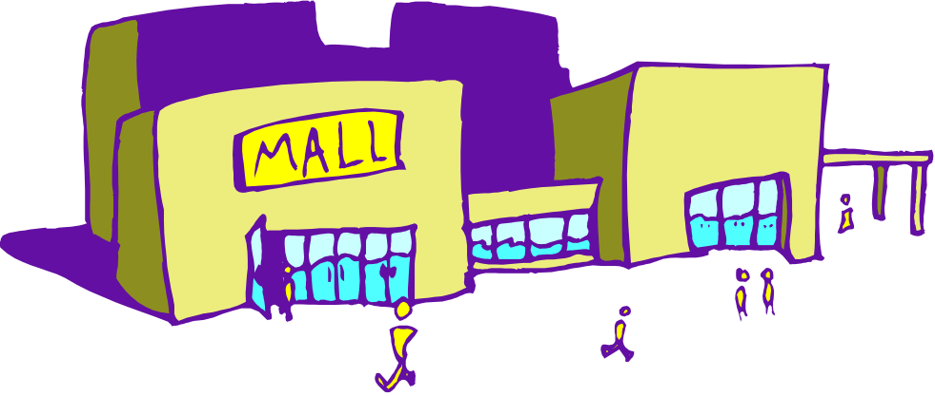
Social Cohesion
Tonnies
Gemeinschaft
Communal
Family & kinship ties
Customs & emotions
Face-to-face commitments
Gesellschaft
Individualistic
Economic ties
Rational & efficient
Formal contracts

Slide 28
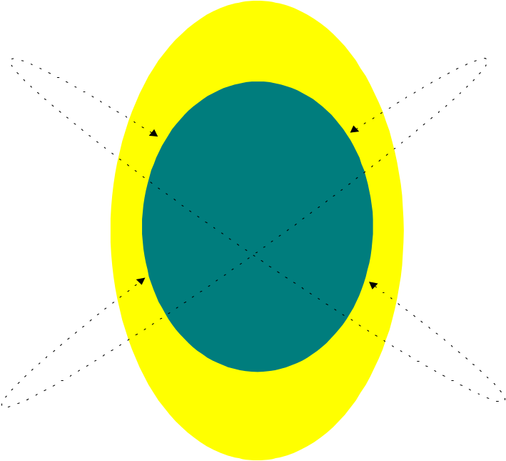
Social Construction of Reality
The process by which our perception of reality is largely shaped by the subjective meaning we give to experience
If we perceive something to be true, it is true in its consequences
?

Slide 29
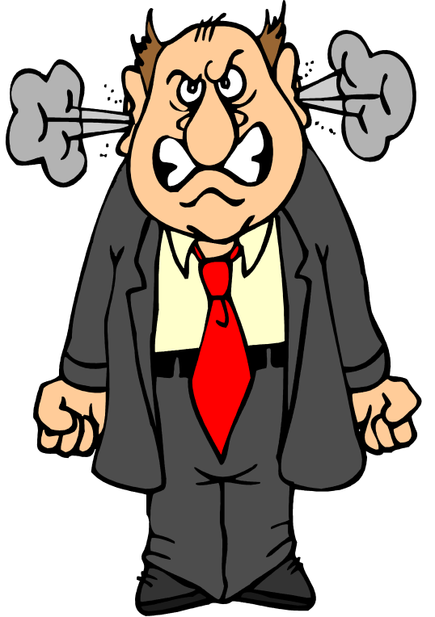
Ethnomethodology
Harold Garfinkle
The study of the commonsense knowledge that people use to understand the situations in which they find themselves in
The best way to understand the significance of a norm is to violate it
Breaching experiments

Slide 30
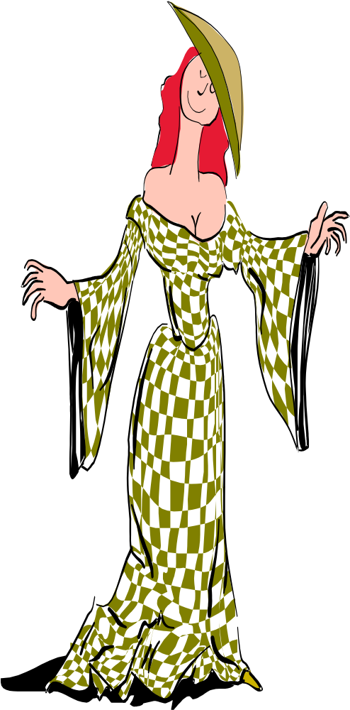
Dramaturgical Analysis
Erving Goffman
The study of social interaction that compares everyday life to a theatrical presentation
Impression management: Effort to get a favorable evaluation by others
Presentation of self: Our presentation of self to others
Front stage: What we show others
Back stage: Our preparation for social encounters

Slide 31
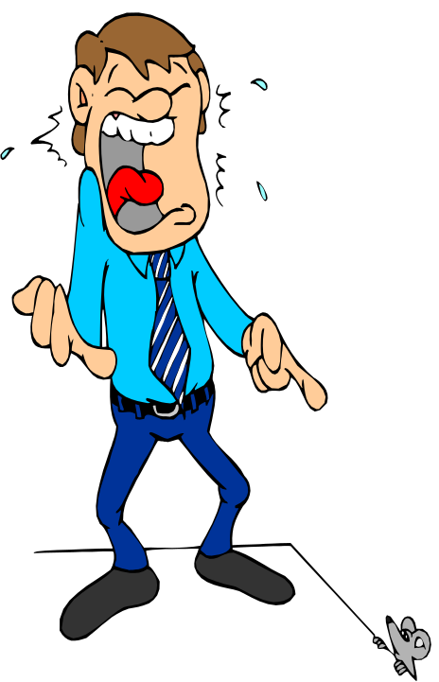
Sociology of Emotions
Arlie Hochschild
Feeling rules learned in a culture on how to express emotions, which are in fact, universal
  Age
  Class
  Gender
  Subculture
  Situation
  Location
  Role being played
Emotional labor – the amount of effort necessary to control emotions in social situations

Slide 32
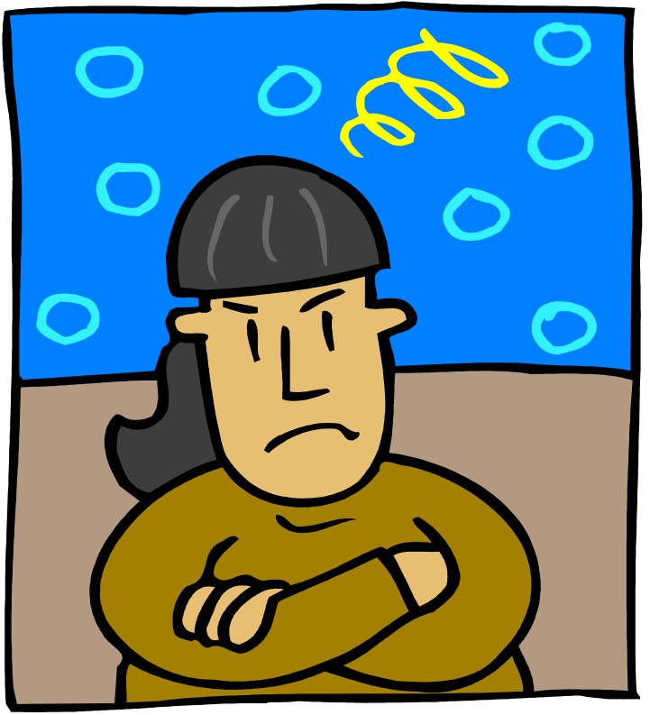
Nonverbal communication
Transferring information between persons without the use of words
Gestures
Posture
Eye Contact
Facial expressions
Touching

Slide 33
Personal Space
The immediate area surrounding a person that the person claims is private
Intimate | Up to 18 inches | Significant others
Personal | 18 inches to 4 feet | Friends
Social distance | 4 to 12 feet | Formal transactions
Public distance | 12 feet & beyond | Denote status difference
Culturally based

