Slide 1
Electronic Voting
Dangers and Myths
Nicole Hite
Sumit Khanna

Slide 2
Introduction
Why should we use it?
What is it dangerous?
What are the options and alternatives?

Slide 3
Why?
Voting in the Early US
Florida and the 2000 Presentational Elections

Slide 4
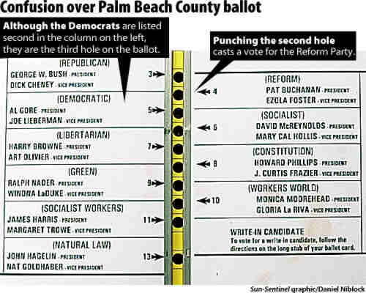
Confusing Ballots

Slide 5
Risks
Closed Security (Security Through Obscurity)
  Adobe e-Books and Dmitry Sklyarov
Open Security

Slide 6
Security Through Obscurity
Dmitry helped create the Advanced eBook Processor (AEBPR) software for his Russian employer Elcomsoft.
Translated eBooks into regular PDFs
Arrested in July 2001 in Las Vegas and wasn't allowed to return home until December

Slide 7
Security Through Obscurity
Palm County, FL – Election for Mayor
Company claimed that the machines are "self auditing", but won't say how they are "audited"
Disassembling Machine voids Warranty
Nobody knows how they work
http://slashdot.org/articles/02/07/20/0124232.shtml?tid=126

Slide 8
Security Through Obscurity
Security is dependent on keeping the internals of the system hidden from everyone
Who ever knows how the system works can break it
Example: Dibold Electronic Voting Machines

Slide 9
Open Security
2002 German Bundestag election (national parliament)
Software written in Java, deployed on Tomcat using Jboss and MySQL
Developed in Berlin by IVU
http://slashdot.org/articles/02/05/10/123206.shtml?tid=99

Slide 10
Open Security
Everyone has access to software source code
If there is a problem, there are many people who can find it
Examples where this works: Linux Kernel, Apache Web Server, leaked Microsoft Source code

Slide 11
What makes a good voting system?
Convenience
Flexibility
Mobility
http://www.acm.org/crossroads/xrds2-4/voting.html

Slide 12
Laws about Voting Machines
Each voting device shall have a serial number permanently attached to or stamped to the device
It shall prevent the voter from voting for the same person more than once for the same office
It shall correctly record and accurately count all votes cast for any and all candidates of a political party, and for or against any and all questions, and correctly record the names of all candidates written in by votes
Title 15, Part 4, Chapter 50A of the Delaware Electronic Voting Laws (excerpt)

Slide 13
Voting Machines
(the good and the bad)
Diebold
Electronic Voting Machine (http://www.electronicvoting.ie)

Slide 14
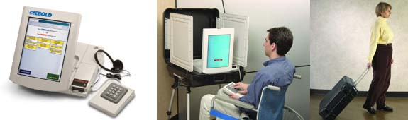
Diebold
Formerly closed source, recently made open source
Accuview-TS
Runs on Windows CE (Pocket PC)
No encryption between Terminal and Server

Slide 15
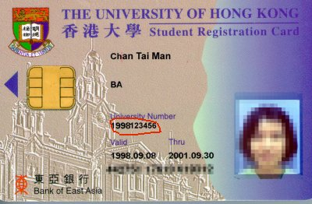
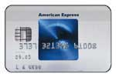
Smart Cards
After presenting an ID (drivers license, etc) voter is given a Smart Card
Smart Cards have an encryption chip built-in
Used in Satellite Dishes, Cell Phones, Credit Cards, etc
However, almost anyone can buy a smart card reader

Slide 16
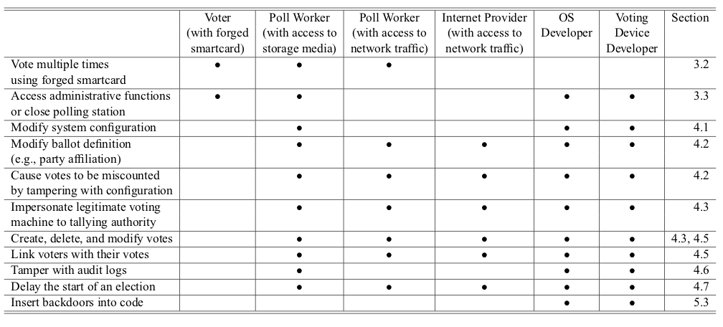
Failure of the Diabold
Taken from Analysis of an Electronic Voting System, IEEE February 2004
http://avirubin.com/vote.pdf

Slide 17
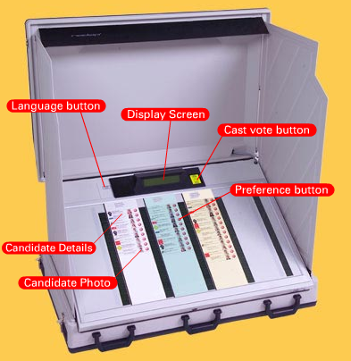
Electronic Voting Machine (http://www.electronicvoting.ie)
Intuitive
Supports multiple languages
Made by an Irish company
No public risk analysis

Slide 18
Conclusion
Electronic voting systems can be very helpful
However, many systems in the US simply aren't mature enough for wide scale use
The last thing we need is another Florida 2000

Slide 19
Other Resources
Black Box Voting: Ballot Tampering in the 21st Century
  www.blackboxvoting.com
Analysis of an Electronic Voting System (White paper)
  http://avirubin.com/vote.pdf
Electronic Voting (Article from ACM Crossroads Magazine)
  http://www.acm.org/crossroads/xrds2-4/voting.html

