Slide 1
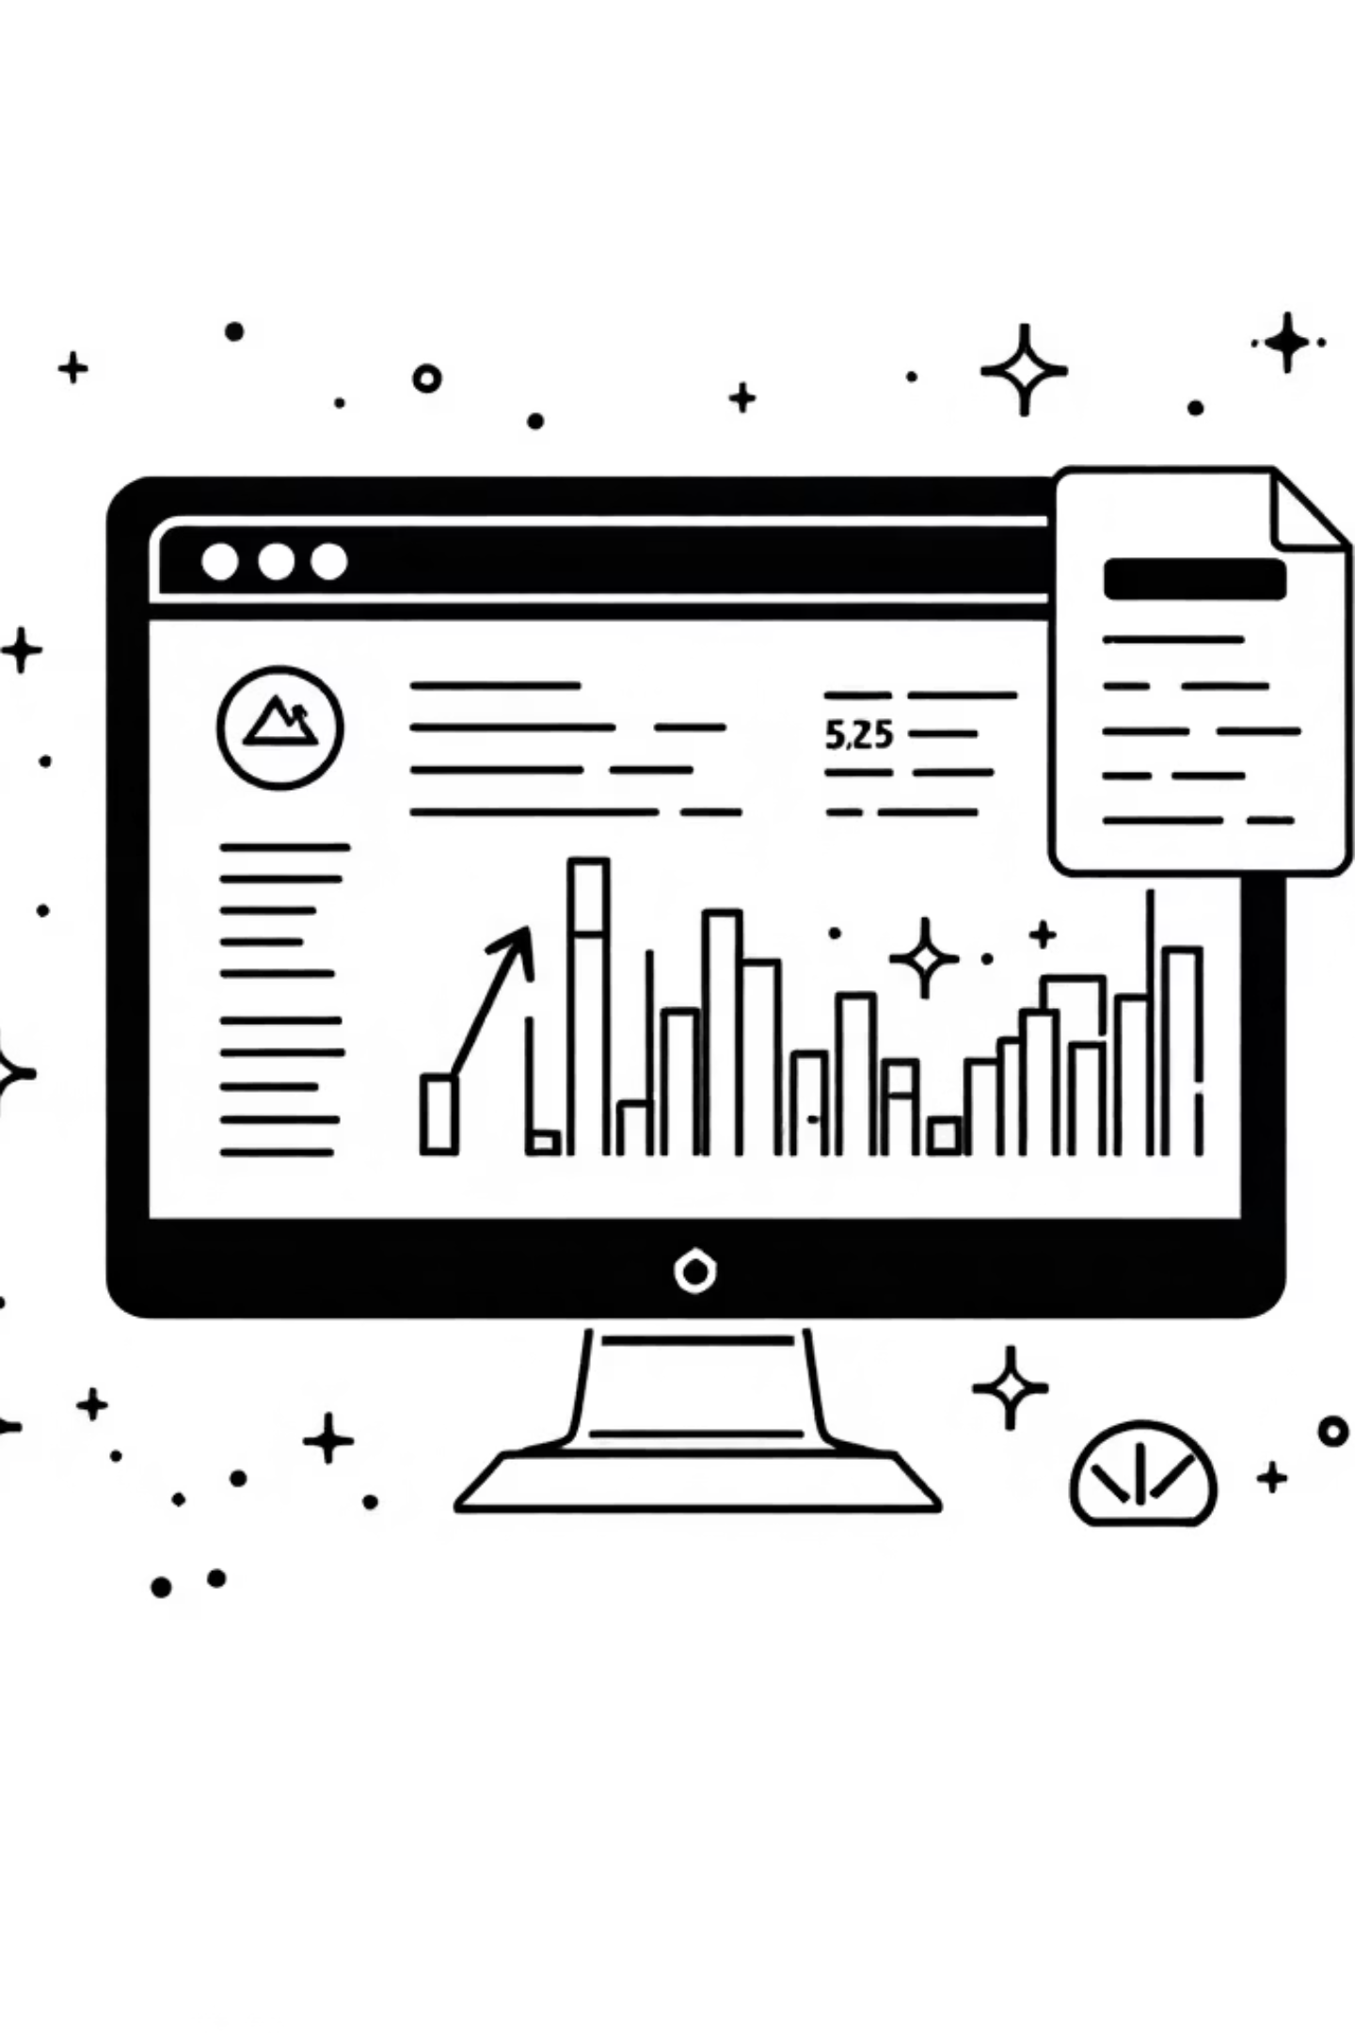
SmartRetail: Sales Forecasting and Customer Analytics with Machine Learning
Team Members:
2310030184 - Sadhwika
2310030363 - Hannah
2310030186 - Sumeaira

Slide 2
Abstract: The Smart-Retail project leverages advanced machine learning techniques to revolutionize retail operations through accurate sales forecasting and customer analytics. Using models such as ARIMA, Prophet, and Random Forest Regression, the system predicts future sales trends with high precision, enabling better inventory management and resource optimization. Additionally, RFM analysis combined with K-Means Clustering segments customers based on purchasing behavior, helping retailers design personalized marketing strategies. By integrating data-driven insights into decision-making, Smart-Retail enhances business efficiency, reduces waste, and promotes sustainable and customer-focused retail management. The project demonstrates how artificial intelligence can transform traditional retail into a smart, adaptive, and sustainable ecosystem.

Slide 3
Introduction:
SmartRetail revolutionizes retail operations by leveraging advanced data-driven techniques to enhance sales performance and deepen customer understanding. This innovative approach empowers businesses to make informed decisions.
Sales Forecasting
Inventory Management
Customer Strategies
Predict future demand with high accuracy.
Optimize stock levels and reduce waste.
Develop personalized marketing campaigns.
By integrating sophisticated Machine Learning models, SmartRetail predicts market trends and segments customers effectively, transforming retail decisions into smarter, faster, and more profitable actions.

Slide 4
Motivation: The modern retail industry faces increasing challenges due to dynamic customer behavior, demand fluctuations, and intense competition. Traditional decision-making methods often fail to keep pace with rapidly changing market conditions .To address these issues, Smart-Retail was developed with the motivation to: Enhance sales forecasting accuracy through data-driven insights. Optimize inventory management to reduce overstocking and wastage. Understand customer behavior using intelligent analytics and segmentation. Support small and medium retailers by providing affordable, AI-powered decision tools. By combining machine learning and business intelligence, Smart-Retail aims to make retail operations smarter, sustainable, and customer-centric.

Slide 5





Key Objectives:
SmartRetail’s core objectives are designed to deliver a comprehensive suite of benefits, ensuring that retailers are equipped to navigate and capitalize on the complexities of the modern market landscape.
Accurate Sales Prediction
Customer Behavior Insights
Targeted Marketing
Improve planning and resource allocation by precisely forecasting future sales volume and demand fluctuations. This allows for better staffing and financial forecasting.
Gain a deep, granular understanding of customer preferences, purchasing patterns, and decision drivers to tailor product offerings and store experiences.
Segment customers effectively using clustering techniques like K-Means to craft highly personalized and impactful marketing campaigns, maximizing ROI.
Reduced Inventory Costs
ML-Driven Decisions
Optimize stock levels dynamically to minimize excessive holding costs, reduce the risk of obsolescence, and prevent costly out-of-stock scenarios.
Empower every decision—from merchandising to logistics—with actionable, data-informed insights generated by our robust machine learning models.

Slide 6
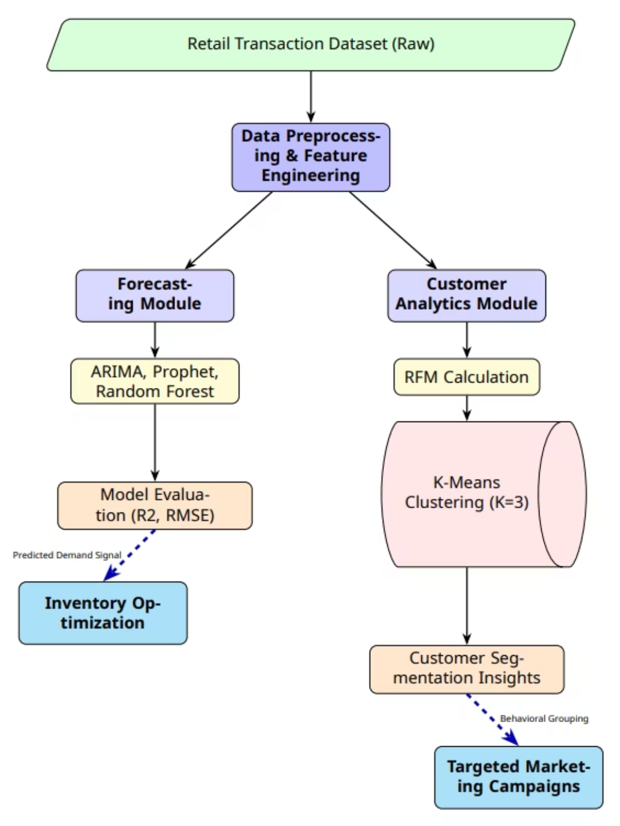
Architecture Diagram:

Slide 7





Project Workflow:
This structured workflow illustrates the entire pipeline, detailing how raw transactional data is processed, modeled, and ultimately converted into strategic business actions.
Data Acquisition
Initial extraction of the Kaggle Retail Transaction Dataset.
Data Preprocessing
Critical steps including cleaning, missing value imputation/handling, and sophisticated feature engineering.
Model Training
Concurrent training of specialized models: Time Series (ARIMA, Prophet), Regression (Random Forest), and Clustering (K-Means).
Prediction/Segmentation
Generation of accurate Sales Forecasts and distinct, behavioral Customer Groups.
Actionable Insights
The model results directly inform and optimize inventory planning, marketing campaign design, and overall business strategy.

Slide 8
Methodology:
The SmartRetail framework is engineered around a robust, multi-faceted approach to harness the full potential of transactional data. This methodology is divided into three interconnected phases:
Data Processing Pipeline
Forecasting Models
Customer Segmentation
Ensures data quality and model readiness through thorough preprocessing, including handling missing values, encoding categorical variables, and advanced feature engineering to extract maximum signal.
Employs a powerful suite of time-series and regression models, specifically ARIMA, Prophet, and Random Forest Regression, to predict future sales demand with high fidelity.
Utilizes the tried-and-true RFM analysis combined with K-Means clustering to group customers into meaningful segments based on their intrinsic transactional behavior.

Slide 9

Data Preprocessing:
Thorough data preparation was essential to ensure model accuracy and reliability. Key steps included:
Handling Missing Values: Rows containing incomplete data were systematically dropped (df = df.dropna()), ensuring a clean, reliable sample.
Data Cleaning: The 'Total' column was standardized by removing non-numeric characters (like '$' and ',') and explicitly converted to a float data type for accurate numerical analysis.
Feature Engineering: This critical step involved transforming the 'Order Date' into a datetime format and extracting valuable, granular, time-based features for enhanced regression modeling, including: Year, Month, Day, DayOfWeek, and WeekOfYear.

Slide 10
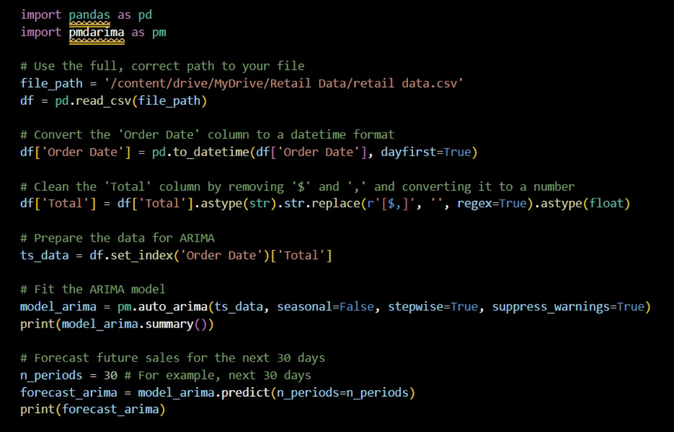
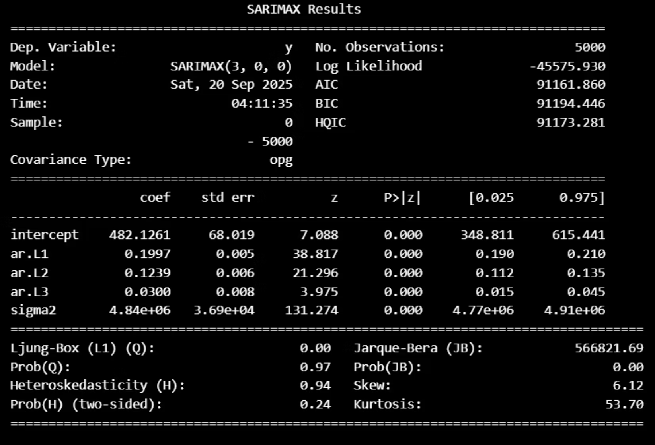
Forecasting Models: ARIMA
The AutoRegressive Integrated Moving Average (ARIMA) model is a fundamental statistical method used for time series forecasting. It's particularly effective for predicting future sales based on historical data.
ARIMA excels at capturing underlying trend and seasonality within sales data.
It decomposes time series into autoregressive (AR), integrated (I), and moving average (MA) components.
Pros: Relatively simple to implement and offers high interpretability of results.
Cons: Requires the time series data to be stationary (constant mean, variance, and autocorrelation over time), often necessitating differencing operations.

Slide 11
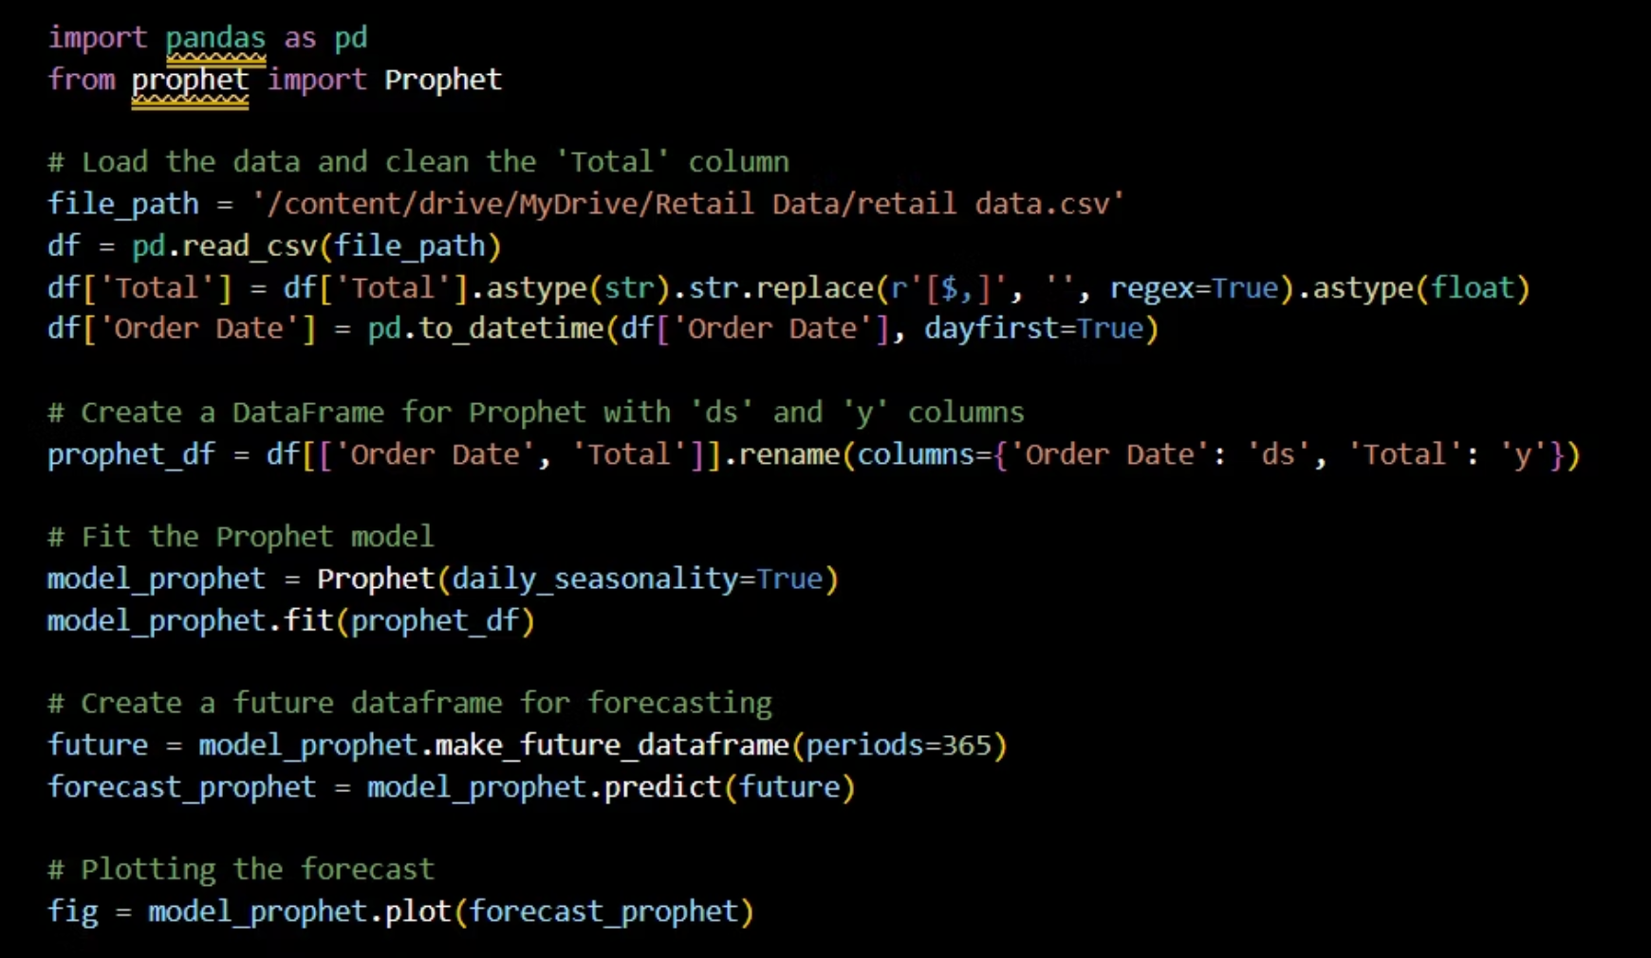
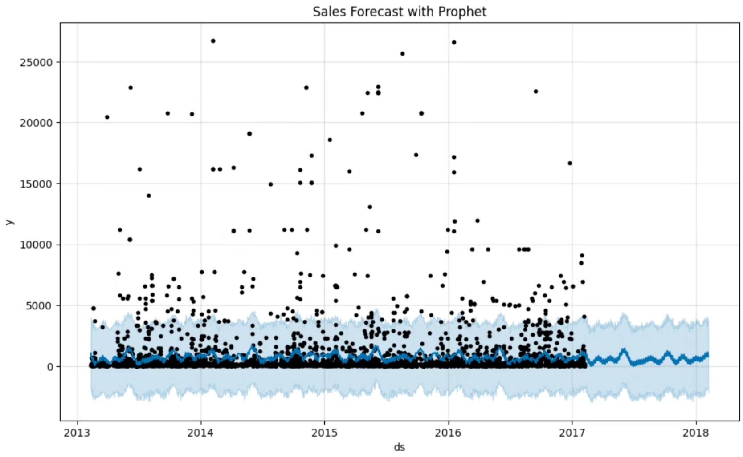
Forecasting Models : Prophet
Prophet, an open-source forecasting tool developed by Facebook, is specifically designed for business forecasting, handling daily, weekly, and yearly seasonality patterns effectively.
It is robust to outliers, missing data, and significant shifts in the time series.
Prophet automatically incorporates known holidays and special events, which is crucial for retail sales forecasting.
Its user-friendly interface allows for minimal parameter tuning, making it accessible for a wide range of users.
Provides interpretable components such as trend, seasonality, and holiday effects, aiding business understanding.

Slide 12
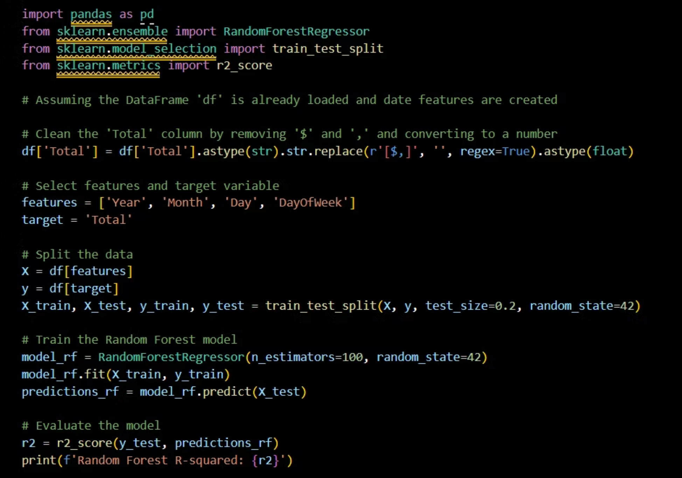
Machine Learning Models: Random Forest Regression
Random Forest Regression is a powerful supervised machine learning algorithm versatile for predicting continuous target variables like sales figures. It constructs multiple decision trees during training and outputs the mean prediction of the individual trees.
Utilizes an ensemble learning method, combining predictions from many decision trees to improve accuracy and control overfitting.
Excellent for predicting sales based on a variety of input features such as product attributes, customer demographics, and promotional activities.
Handles high-dimensional data and complex interactions between features well without requiring feature scaling.
Provides insights into feature importance, indicating which factors most influence sales predictions.

Slide 13
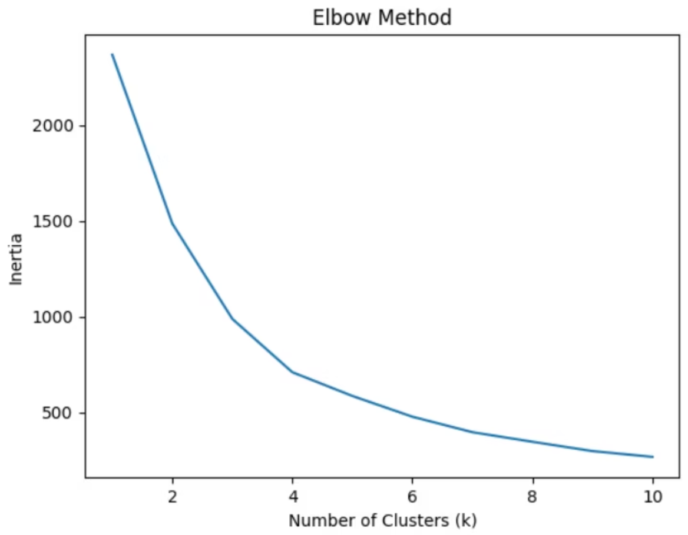
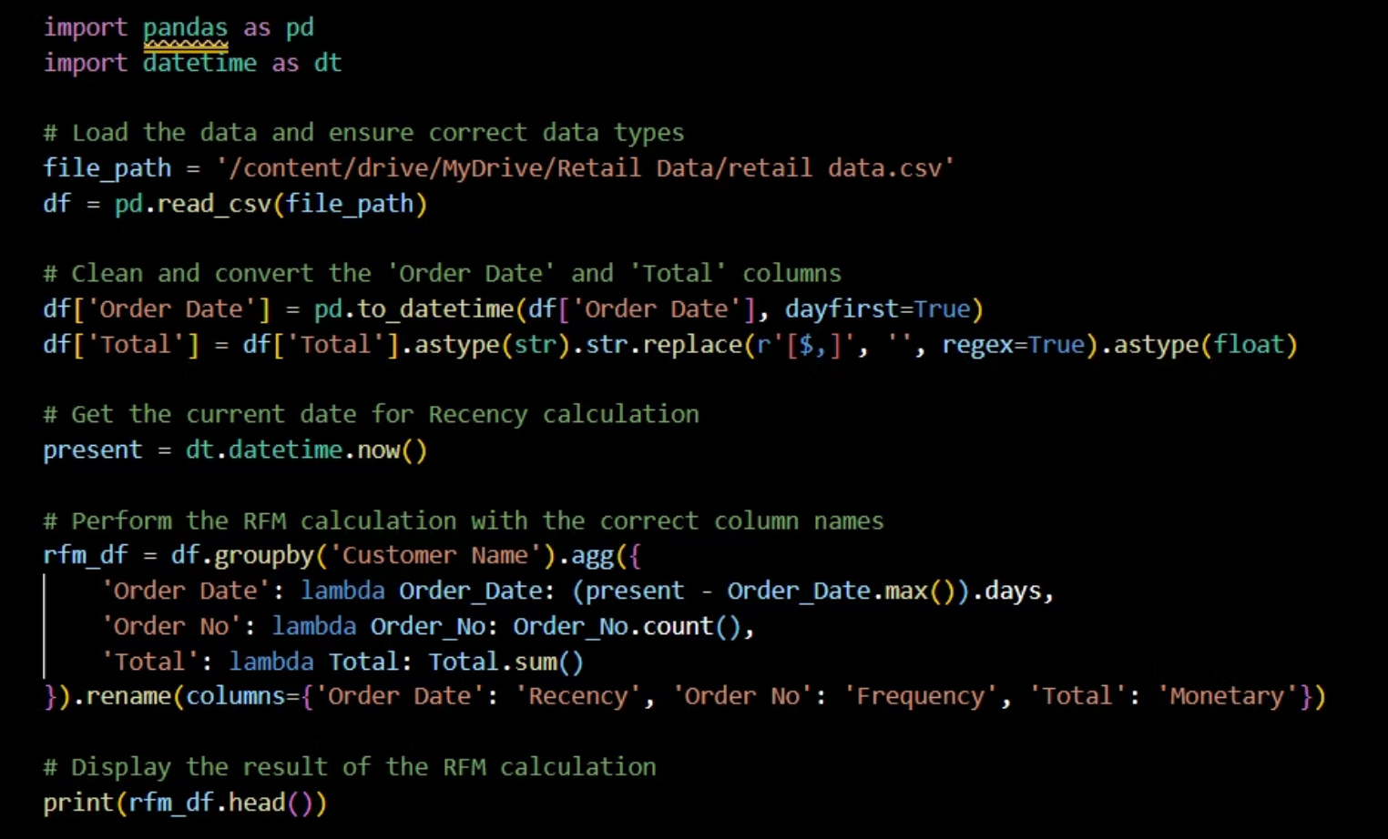
Customer Analytics: RFM and K-Means Clustering
Goal & Application: This two-step process allows retailers to clearly identify high-value, loyal, and at-risk customers. The derived customer segments are then used to design highly personalized and impactful marketing campaigns, directly improving customer retention and maximizing Customer Lifetime Value (CLV).

Slide 14
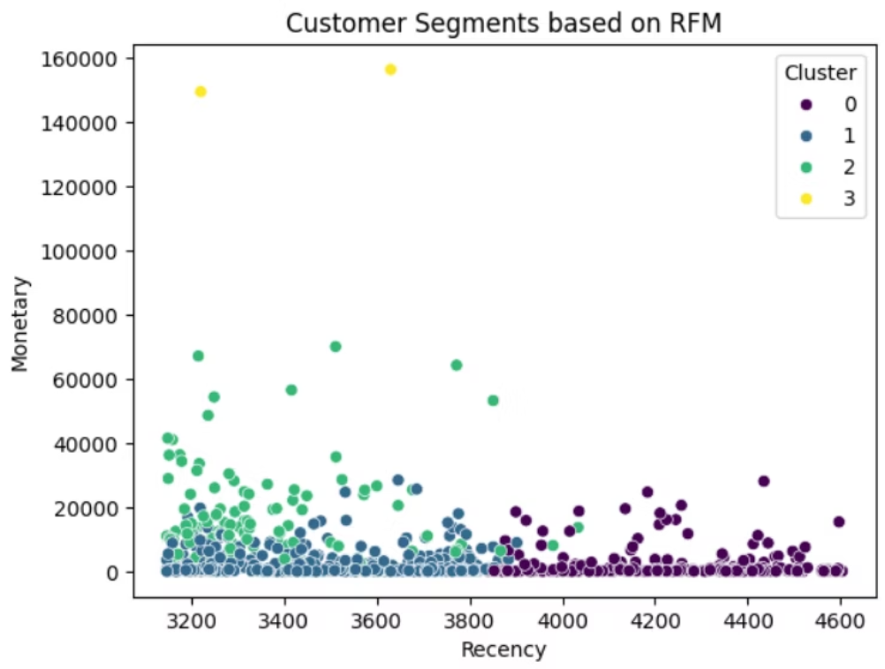
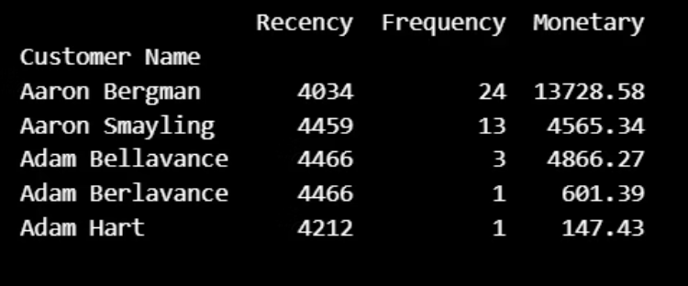

Slide 15
Conclusion
Machine learning models successfully demonstrate their capability to improve sales forecasting accuracy and provide deeper customer understanding in the retail domain.
The system helps in better inventory planning and informed business decisions.
The combination of advanced forecasting (ARIMA, Prophet, RF) and effective clustering (K-Means on RFM) provides actionable insights for retailers.
SmartRetail makes retail operations data-driven, efficient, and customer-focused, addressing the challenge of fast-changing market trends.

Slide 16
Future Work: The Smart-Retail project can be further enhanced through advanced technologies and real-time capabilities. Future developments aim to: Integrate deep learning models (e.g., LSTM, RNN) for improved time-series forecasting. Implement real-time data analytics for dynamic sales and inventory updates. Expand customer segmentation using advanced clustering and predictive CLV models. Incorporate external factors such as market trends, holidays, and weather patterns. Develop a user-friendly dashboard or mobile app for interactive forecasting and visualization. These enhancements will make Smart-Retail a more intelligent, scalable, and real-time decision-support system for the retail industry.

Slide 17
THANK YOU

