Slide 1

DISTRIBUTED AND PARALLEL COMPUTING

Slide 2
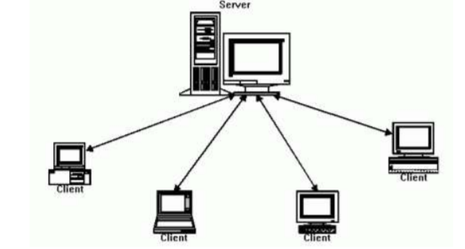
Client Server Architecture
On a network built using the client-server architecture, the devices communicate to other devices through a central computer known as a server.
The server is a terminal with high processing power, which provides services to the users on the network.
The client is a terminal that accesses the resources available on a server.

Slide 3
TCP/IP Protocol
TCP/IP protocol ensures a sound, well-structured, errorless data transmission.
In the TCP protocol, a connection is established between the pair of sockets.
Communication between clients and server takes place using sockets.
A socket is a combination of an IP address and a port number of the machine.
On getting connected, systems can transmit data in both directions. This ensures: - Safe transfer of data, managing the sequence of bytes and structure of packets. - Error detection, re-sending the lost packets. - Flow control, estimating the speed at which packets can be sent reliably.

Slide 4
Project Architecture:
Monte Carlo simulation/Stock price prediction
Wants to solve this
User
Command line argument
Server
Socket()
TCP/IP
Job done
Busy
Free for >= 15 secs
Socket()
Socket()
Yes
Socket()
Job assigned
User 1
User 2
User n

Slide 5
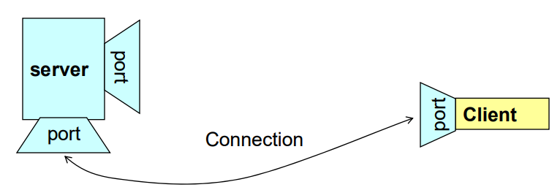
Making a connection:
A server possesses socket that is bound to a particular port. The server listens to the socket until a client makes a connection request.
It accepts the connection. The server then gets a new socket bound to a different port. This is to ensure that a server keeps on listening to the original socket for connection requests while serving the connected client.

Slide 6
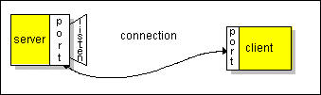
Server Program Flow:
Creates and open a server socket.
Waits for connection from Client.
Adds the connected client to the database.
Looks up for the slave system that has been free for more than 15 seconds.
Opens an input stream and an output stream to the slave.
Submits a job to the slave
Receives output from the slave
Deletes the client’s IP from the database that are not presently connected to the server.
Closes the streams.

Slide 7

Slave Program Flow:
Initiates a connection with Server.
Opens an input stream and an output stream to the socket.
Reads input from the Server socket, does computation and writes the result back to the Server socket.
Closes the socket.

Slide 8
Jobs submitted to slave:
Monte carlo simulations (PI calculation)
Stock price prediction

Slide 9
Monte carlo simulations (PI calculation)
A Monte Carlo simulation approximates the value of pi by involving randomly selected points (xi,yi)^{n}_{i=1} in the unit square and determining the ratio m/n where m is the number of points that lie inside a circle and n is the total number of points.
Suppose, m=787, n=1000,
pi=787/1000 * 4 (calculating for the first quadrant)
pi=3.148

Slide 10
Stock Prediction:
It predicts the current value of the stock from the given data in which it contains value of stock in previous dates. It contains its open, close, high and low price of the stock.
We used different libraries of machine learning that is numpy, sklearn, linear regression, quandl, cross validation.

Slide 11
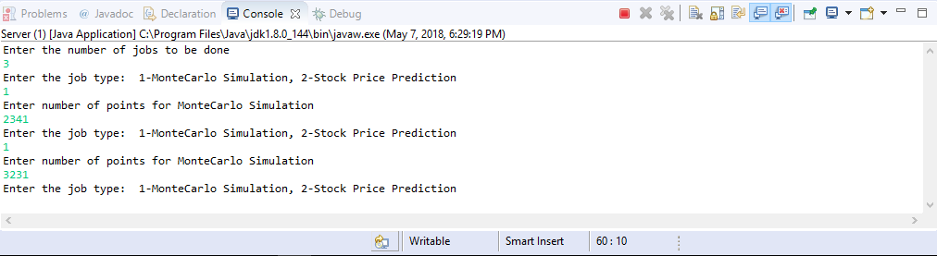
Jobs Queued:

Slide 12
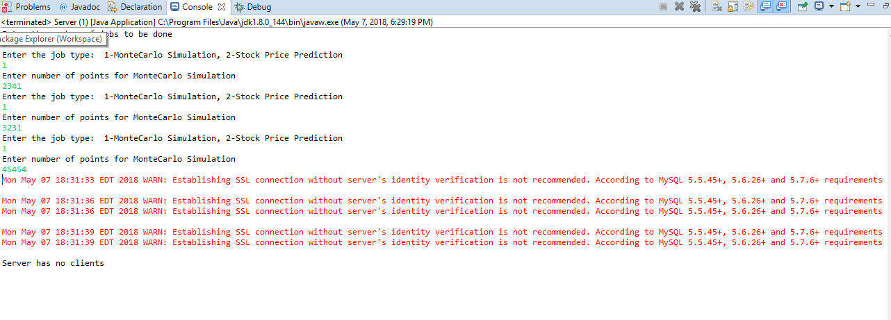
No clients connected:

Slide 13
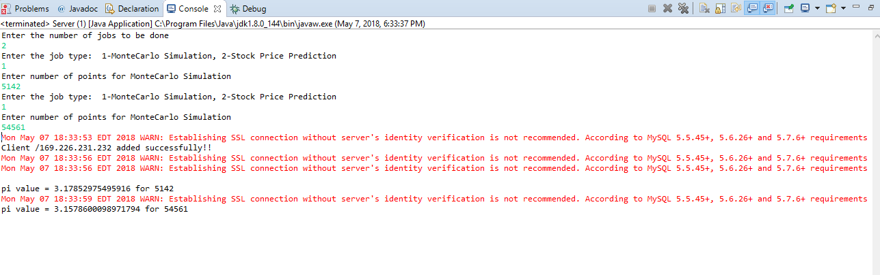
Single client connected:

Slide 14
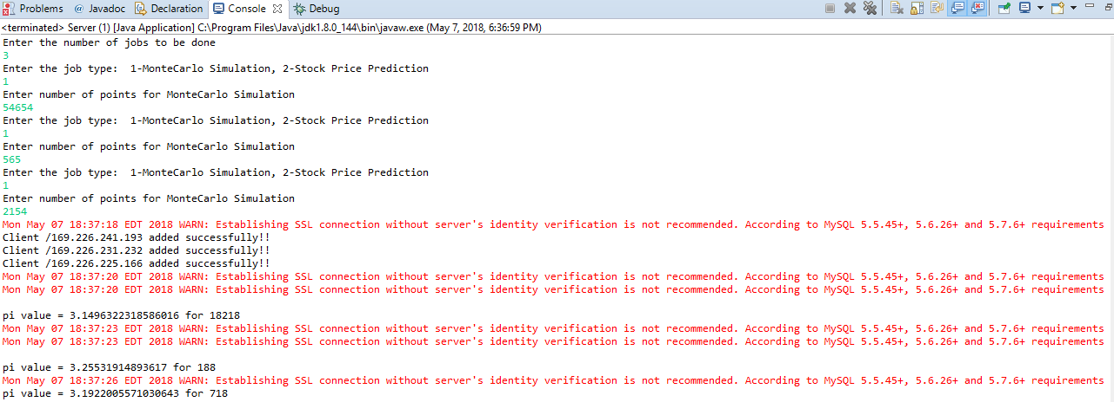
Multiple Clients Connected:

Slide 15
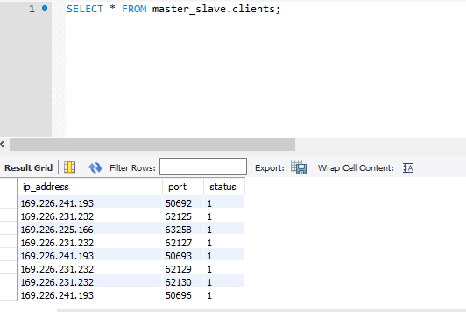
Active list of Clients:

