Slide 1
Bootcamp Track 5: Data Intelligence & AI
By: Dr. Atul Kumar Ramotra, Assoc. Prof., CSD Department

Slide 2
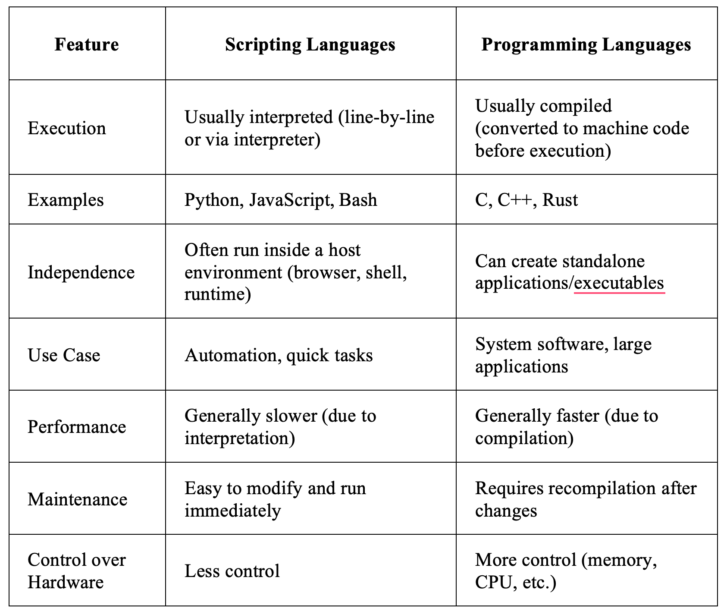
Programming Languages

Slide 3
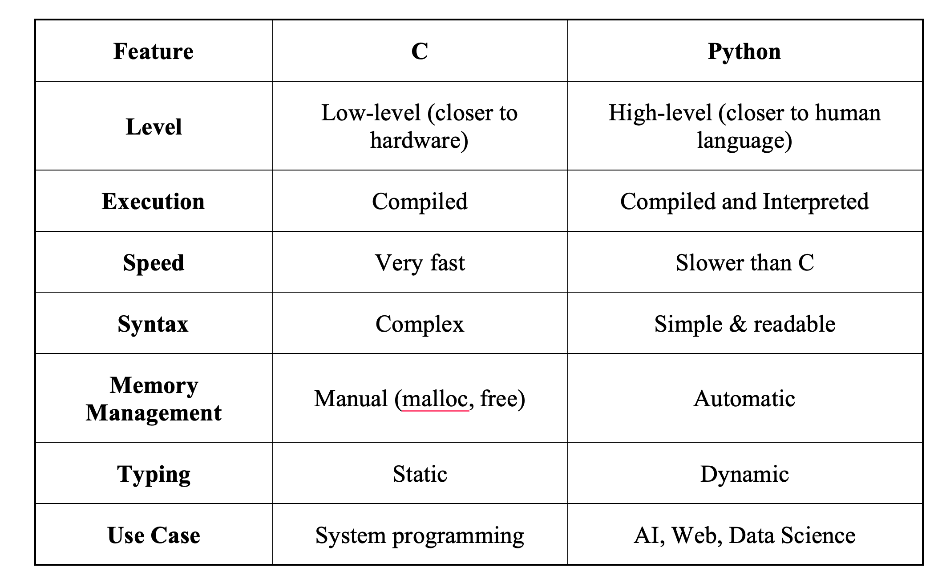
Programming languages

Slide 4
Python Lists
Dynamic
Heterogeneous
Mutable
Ordered sequence
Implemented in C (CPython) as a resizable array of pointers to Python objects.
list = [1, 2, 3]

Slide 5
Python Language
In Python, the concept of fixed data type sizes (like in C) does not apply the same way.
Python is a high-level, dynamically typed language, so sizes depend on the object implementation and system architecture.
Python uses more memory, but is easier to use.
Dynamically typed language
In C
int x = 10;
x = "hello"; {not allowed}
But in python
x = 10
x = "hello" {allowed}

Slide 6
Python Language
Python does not store raw values directly like C.
Instead, it creates a special container (object) that holds
For Example:
x = 10
1.Creates an object for value 10
2.Tags it with type → int
3.Makes x point to that object
x → points to that box
x → [10, type=int]

Slide 7
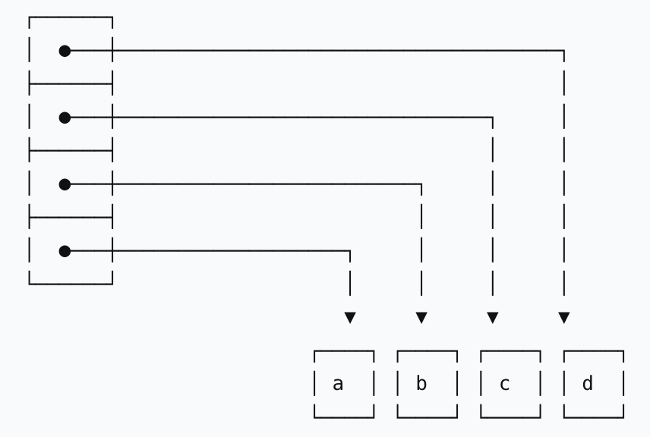
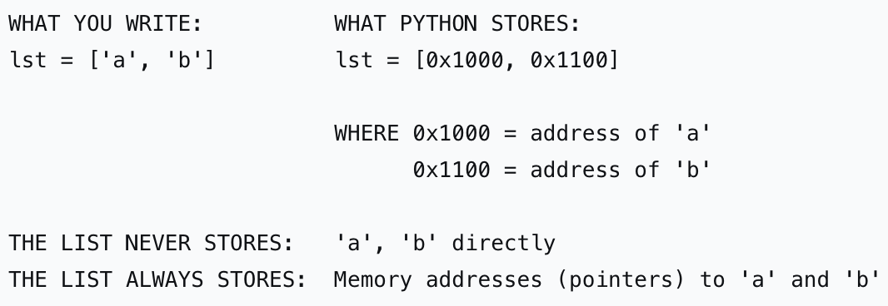
Python List

Slide 8
Python List
Because lists store only pointers (uniform size, typically 8 bytes on 64-bit systems), each slot is identical in size regardless of what object it points to. This means:
For example:
mixed = [42, "hello", 3.14, [1,2], None, lambda x: x+1]
42 (int object) → lives somewhere in heap
"hello" (str object) → lives elsewhere
3.14 (float object) → different location
[1,2] (list object) → another location
None (singleton) → global None object
lambda (function object) → yet another location

Slide 9
Problems with Python Lists
Heterogeneous Data Storage
Python lists can store different data types:
Internally:
* Each element is a reference (pointer) to an object
* Objects are stored at different memory locations
* Leads to cache inefficiency
Non-Contiguous Memory Allocation
* List elements are scattered in memory
* CPU cache cannot efficiently preload data
* Results in slower access times

Slide 10
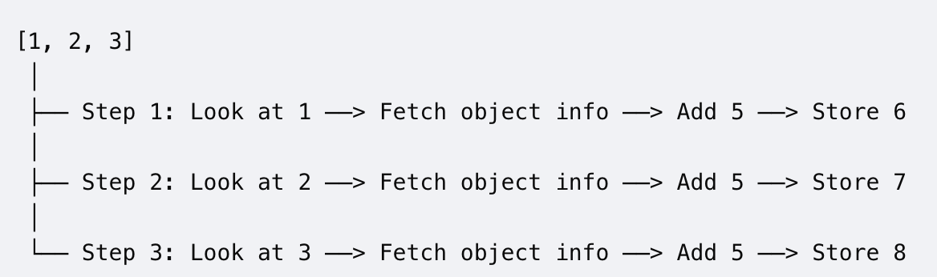
Problems with Python Lists
Non-vectorized operations
Calculations are processed one element at a time using explicit loops.
The CPU must continually check data types and instructions for every single item, making them significantly slower for large datasets
E.g.: original_list = [1, 2, 3]
new_list = [x + 5 for x in original_list]
Python executes a hidden loop that forces the CPU to perform multiple individual actions for every single item.

Slide 11
NumPy
NumPy (Numerical Python) is a core scientific computing library in Python that provides:
* A powerful N-dimensional array object (ndarray)
* High-performance vectorized operations
* Efficient memory management
* A rich collection of mathematical functions (linear algebra, statistics, FFT, etc.)
import numpy as np
arr = np.array([1, 2, 3, 4])
* arr is an ndarray
* Elements are stored sequentially in memory
* Data type is fixed (e.g., int32, float64)

Slide 12
NumPy
At its core, NumPy is implemented in C, and exposes its functionality to Python, which is why it is much faster than pure Python operations.
Core Data Structure: ndarray
A NumPy array is:
* Homogeneous → all elements are of the same data type
* Stored in contiguous memory locations
* Indexed using multi-dimensional indexing
Example: import numpy as np
arr = np.array([1, 2, 3, 4])
* arr is an ndarray
* Elements are stored sequentially in memory

Slide 13
NumPy Solves Computational Overhead
Homogeneous Data → Efficient Storage
NumPy arrays enforce same data type:
Benefits:
* No type checking per element
* Fixed-size elements → faster computation
Data is stored in a single continuous block
Enables:
* Faster iteration
* Better CPU cache utilization
This is similar to C arrays

Slide 14
NumPy Solves Computational Overhead
Vectorized Operations (No Python Loops)
arr = np.array([1, 2, 3])
result = arr * 2
Internally:
* Uses compiled C loops
* Avoids Python interpreter overhead
Much faster than list comprehension
SIMD Hardware Acceleration: Modern computer processors use Single Instruction, Multiple Data (SIMD). This allows a CPU chip to execute one instruction (like addition) on multiple data points simultaneously at the hardware level

Slide 15
NumPy Solves Computational Overhead
Lower Memory Usage
* Stores raw data directly (no object overhead)
* Example:
* List → ~28 bytes per element
* NumPy → ~4 or 8 bytes per element
Built-in Mathematical Operations
np.mean(arr)
np.sum(arr)
np.dot(arr, arr)

Slide 16
2D Array
np.random.randint: used to generate random integers within a specified range.
np.random.randint(low, high, size)
* low → starting value (inclusive)
* high → ending value (exclusive)
* size → shape of the output array
np.random.randint(1, 10) #7 (random)
arr = np.random.randint(1, 10, size=5)
print(arr) #[3 8 1 6 4]
arr = np.random.randint(10, 50, (3, 4))
print(arr) [[23 49 12 30]
[18 40 27 33]
[11 29 35 20]]

Slide 17
NumPy
Several local distributions, cloud platforms, and browser-based coding environments come with NumPy pre-installed and ready to use right out of the box
Desktop Platforms & Distributions:
Anaconda Distribution, Miniconda (A smaller, stripped-down alternative to Anaconda)
Cloud & Browser-Based Environments:
Google Colab, Kaggle Notebooks, Streamlit Live Playground
Platforms & Libraries Built Natively On NumPy:
SciPy, Pandas, Scikit-Learn

Slide 18
NumPy
How to check if NumPy is installed
import numpy
print(numpy.__version__)
If no error means already installed
pip install numpy (Using pip)
pip3 install numpy (Using pip3)

Slide 19
Array Shapes & Dimensions
Dimension:The number of directions/axes in an array
Shape
* Shape tells how many elements exist along each axis
(rows, columns)
Examples:
* (3,) → 1D array with 3 elements
* (2, 3) → 2 rows, 3 columns
Array Type | Dim | Meaning | Example
1D array | 1 axis | Vector (list-like) | [1, 2, 3]
2D array | 2 axes (rows, columns) | Matrix (table/grid) | [[1,2],[3,4]]
3D array | 3 axes | Multiple tables | [[[...]]]

Slide 20
Creating 1D Arrays (Vectors)
import numpy as np
arr1 = np.array([10, 20, 30, 40])
print(arr1)
#[10 20 30 40]
arr1D = np.array([10, 20, 30, 40])
print(arr1D.shape)
# (4,)
print(arr1D.ndim)
# 1
print(arr1D.size)
# 4
shape = (4,) → 4 elements in 1 axis
* ndim = 1 → one-dimensional
* size = total elements

Slide 21
Creating 2D Arrays
A 2D array is like a table (rows × columns)
arr2D = np.array([
[1, 2, 3],
[4, 5, 6]
])
print(arr2D) # [[1 2 3]
[4 5 6]]
print(arr2D.shape) # (2, 3)
print(arr2D.ndim) # 2
print(arr2D.size) # 6
* shape = (2, 3) → 2 rows, 3 columns
* ndim = 2 → two-dimensional
* size = 6 → total elements

Slide 22
Important Attributes
Attribute | Meaning
ndim | Number of dimensions
shape | Structure (rows, columns, etc.)
size | Total elements
dtype | Data type
import numpy as np
int_array = np.array([10, 20, 30])
print(int_array.dtype)
# Output: int64 (or int32 depending on your system)
import numpy as np
colors = np.array(["red", "green", "blue"])
print(colors.dtype)
# Output: <U5 (Unicode string of maximum 5 characters)
print(type(colors))
# Output: <class 'numpy.ndarray'>

Slide 23
2D Arrays
Command | Description | Example
np.mean() | Average | np.mean(arr)
np.median() | Median | np.median(arr)
np.std() | Standard deviation | np.std(arr)
np.var() | Variance | np.var(arr)
np.min() | Minimum | np.min(arr)
np.max() | Maximum | np.max(arr)
np.sum() | Sum | np.sum(arr)
np.argmin() | Index of min | np.argmin(arr)
np.argmax() | Index of max | np.argmax(arr)

Slide 24
Numpy Arrays
Creating Arrays using Built-in Functions
Reshaping Arrays Convert 1D → 2D:
arr = np.array([1, 2, 3, 4, 5, 6])
reshaped = arr.reshape(2, 3)
(2, 3)
np.random.rand() | Random values (0–1) | np.random.rand(2,2)
np.zeros() | Array of zeros | np.zeros((2,3))
np.ones() | Array of ones | np.ones((2,2))
np.empty() | Uninitialized array | np.empty((2,2))
np.random.randint() | Random integers | np.random.randint(1,10,(2,2))

Slide 25
Slicing Columns & Rows
Slicing means extracting specific parts of an array (rows, columns, or sub-grids) using indices.
Works like coordinates in a grid:
* Row index → horizontal (i)
* Column index → vertical (j)
Slicing Instruction:
arr[row_start:row_end, col_start:col_end]
Type | Example | Meaning
Single index | arr[1,2] | One element
Slice | arr[0:2, 1:3] | Range
Full (:) | arr[:,1] | All rows
List : Fancy Indexing | arr[[0,2], :] | Specific rows
Condition | arr[arr>5] | Filter

Slide 26
Slicing Columns & Rows
arr = [[10,20,30],
[40,50,60],
[70,80,90]]
arr[1,2] #60
arr[0:2, 1:3] (Rows → 0 and 1 Columns → 1 and 2) # [[20 30]
[50 60]]
arr[:, 1] (All rows, Column 1) #[20 50 80]
arr[[0,2], :] # [[10 20 30]
[70 80 90]]
arr[arr > 50] # [60 70 80 90]

Slide 27
Slicing and Axis
Slicing (arr[rows, cols]) → Selects data
Axis → Tells direction of operation, How to process data
axis = 0 → collapse rows → result per column
axis = 1 → collapse columns → result per row
np.sum(arr, axis=0)
[10+40+70, 20+50+80, 30+60+90] #[120, 150, 180]
np.sum(arr, axis=1)
[10+20+30, 40+50+60, 70+80+90] #[60, 150, 240]
Axis | Direction | Meaning
axis = 0 | ↓ Down (rows) | Work column-wise
axis = 1 | → Across (columns) | Work row-wise

Slide 28
Slicing Columns & Rows
arr = [[10,20,30],
[40,50,60],
[70,80,90]]
np.mean(arr, axis=0)
[(10+40+70)/3, (20+50+80)/3, (30+60+90)/3] #[40, 50, 60]
np.max(arr, axis=1) #[30, 60, 90]
np.argmax(arr, axis=0) #[2, 2, 2]

Slide 29
Vectorization
Vectorization means performing operations on entire arrays (or columns) at once without using explicit Python loops
NumPy arrays are stored in continuous memory
* Operations are implemented in C (fast)
* So instead of using: Python loop → slow, It uses: C loop → fast
import numpy as np
arr = np.array([1, 2, 3])
result = arr * 2
#[ 2 4 6]

Slide 30
Vectorization
Element-wise Operations
arr * 2
arr + 5
arr ** 2 (Square every element of the array)
Column-wise Operations
arr[:,1] * 2
Row-wise Operations
arr[1,:] + 10
Multiply each column differently
arr * [1,2,3]
means Column 1 × 1
Column 2 × 2
Column 3 × 3

Slide 31
Thank You !

