Slide 1
Don’t Forget the Can Opener!
NASA Space Apps Challenge
TeamYOLO
- Navin Infant Raj
- Sumedha Rajan
- Elango Rajan
- Robin Tommy

Slide 2
Problem Statement
Create an easy-to-use way for people to develop their own, custom checklists – both items and plans – for specific kinds of disasters. Use NASA images, videos, or data visualizations to illustrate each disaster type, to help people understand how to prepare.

Slide 3
Our Solution
3 Parts :
  Preparation
  Survival
  Detection & Broadcasting

Slide 4
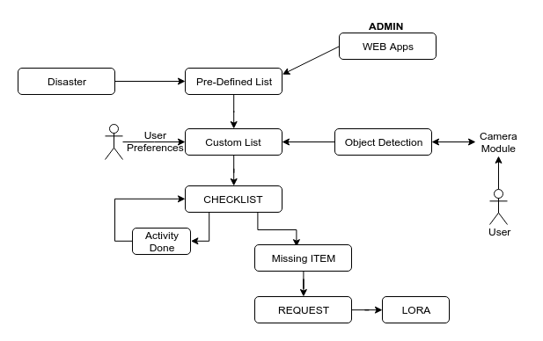
Preparation

Slide 5
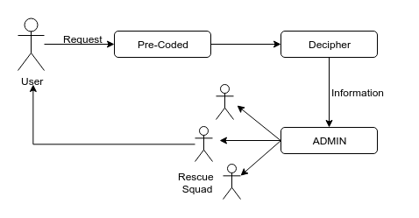
Survival

Slide 6
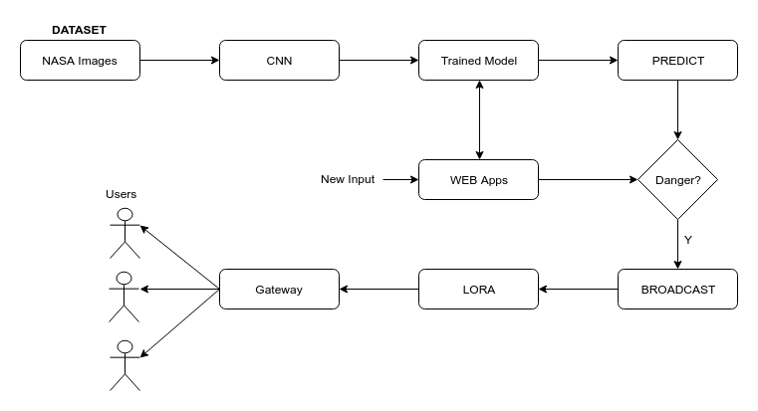
Detection & Broadcasting

Slide 7
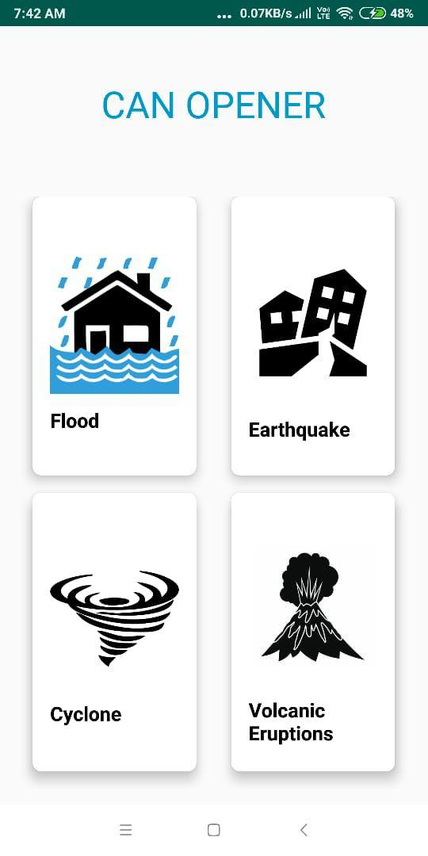
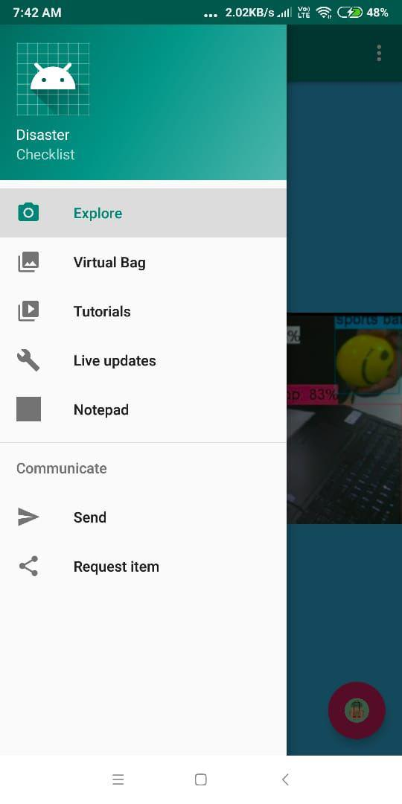
PROTOTYPE

Slide 8
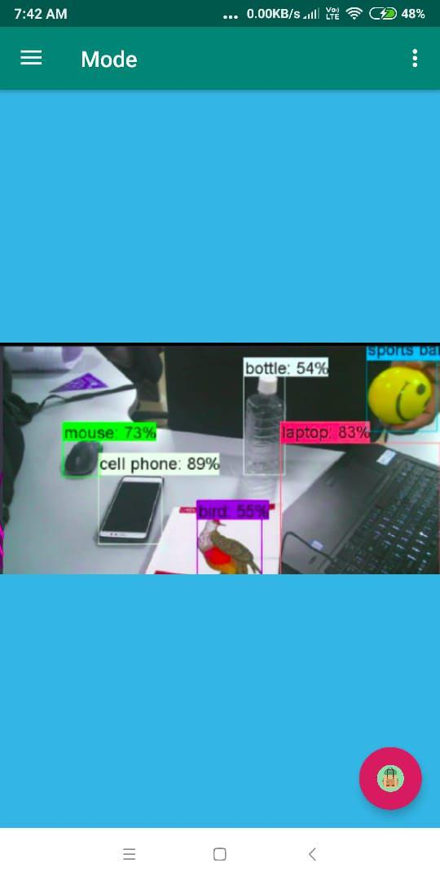
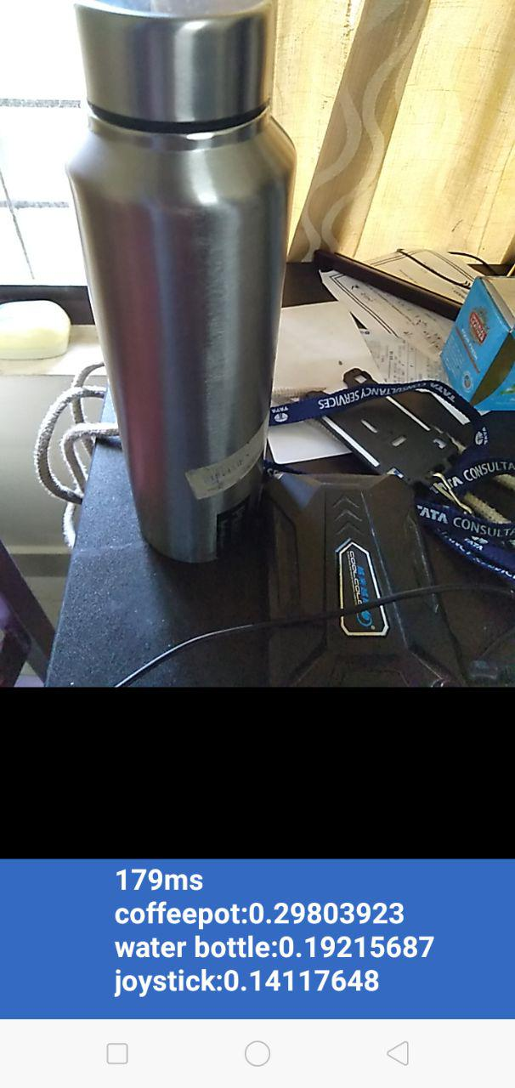
PROTOTYPE

Slide 9
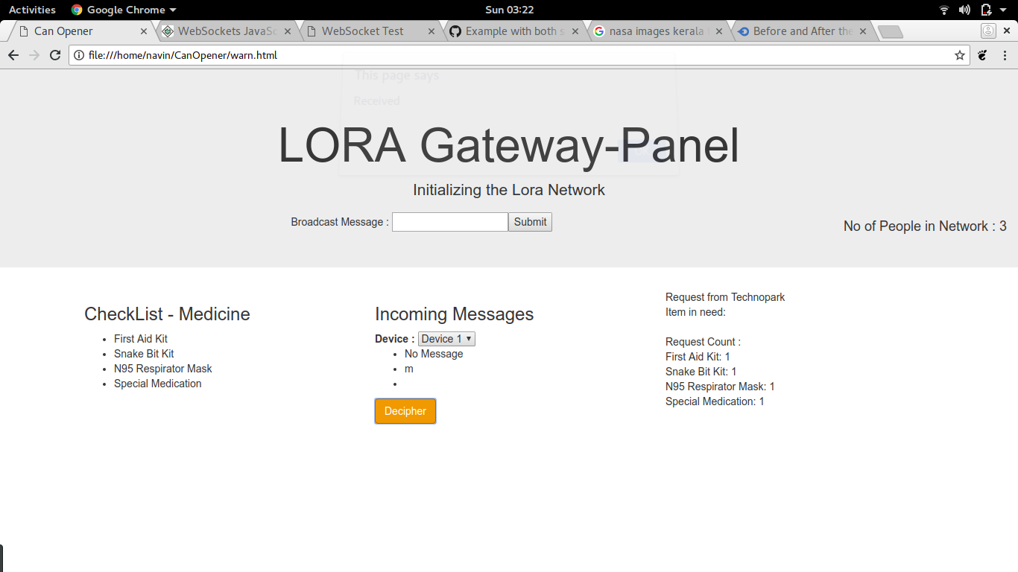
PROTOTYPE

Slide 10
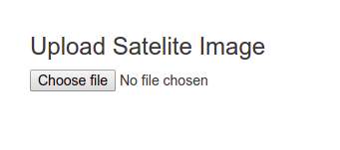
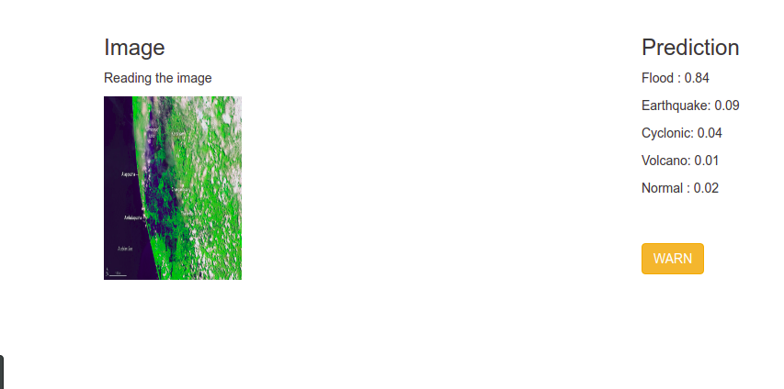
PROTOTYPE- LORA

Slide 11
Future Scope
End to End Rescue management.
Drone based communication.
Secure data exchange platform.
Drone path management using DAV Blockchain.

