Slide 1
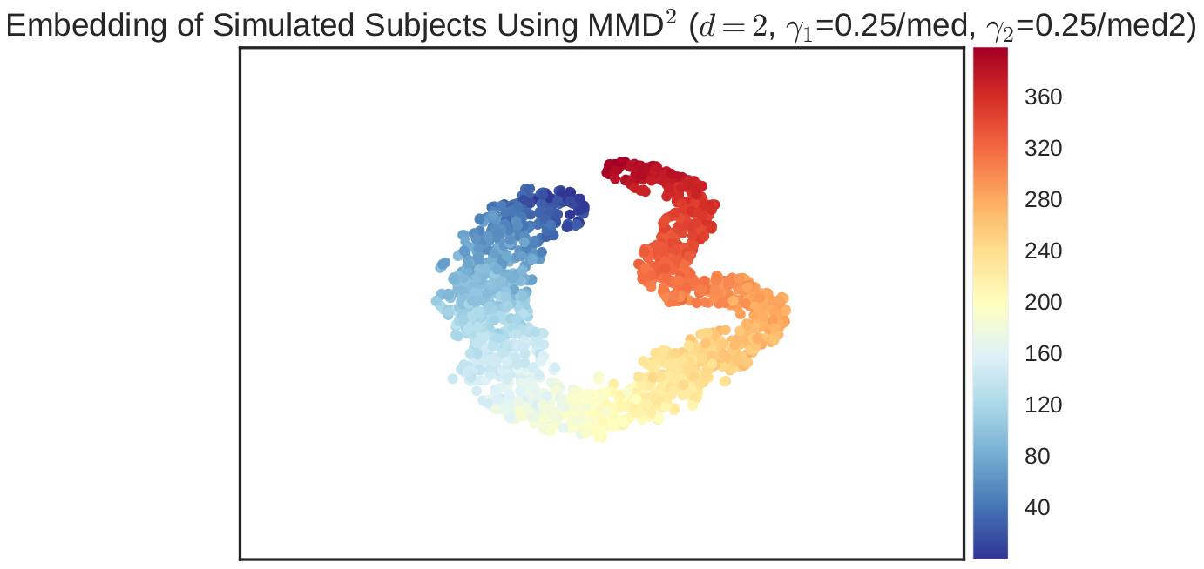
Gamma1 = .25/med Gamma2 = .25/med2

Slide 2
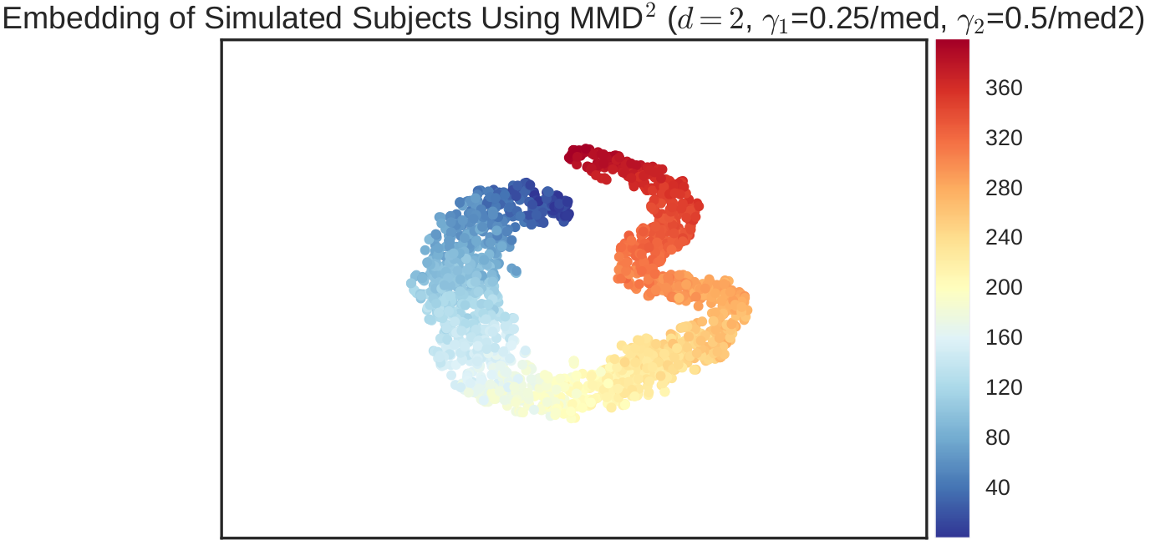
Gamma1 = .25/med Gamma2 = .5/med2

Slide 3
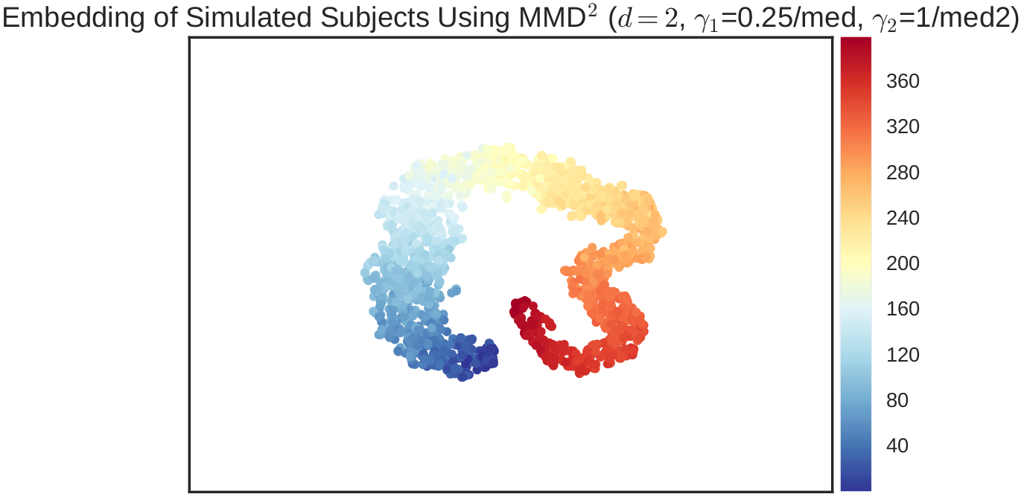
Gamma1 = .25/med Gamma2 = 1/med2

Slide 4
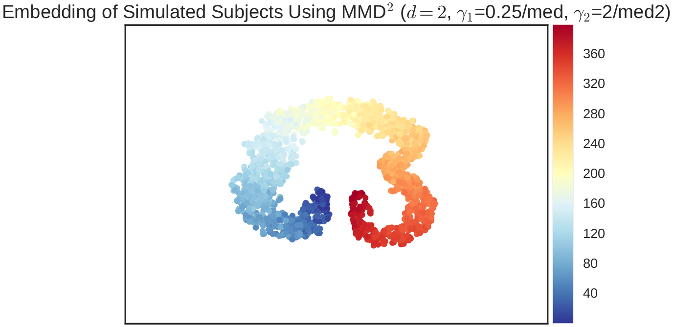
Gamma1 = .25/med Gamma2 = 2/med2

Slide 5
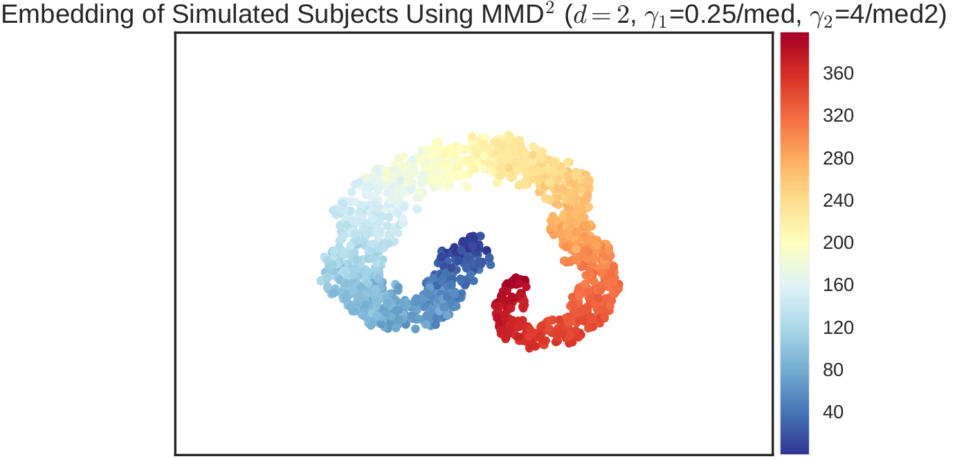
Gamma1 = .25/med Gamma2 = 4/med2

Slide 6
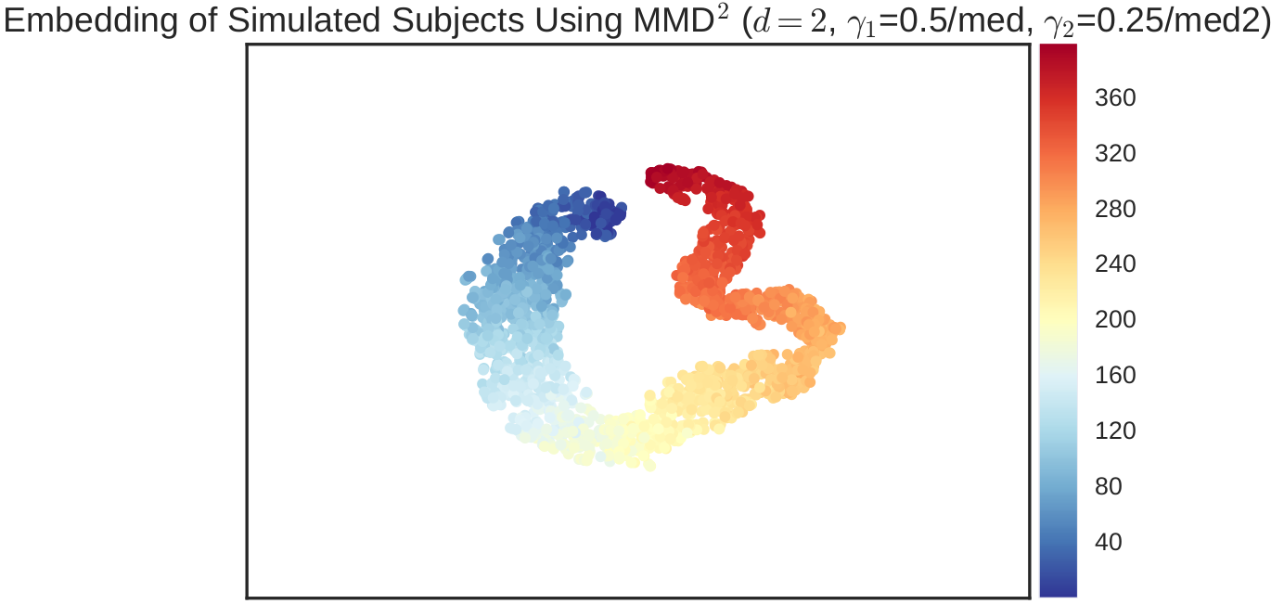
Gamma1 = .5/med Gamma2 = .25/med2

Slide 7
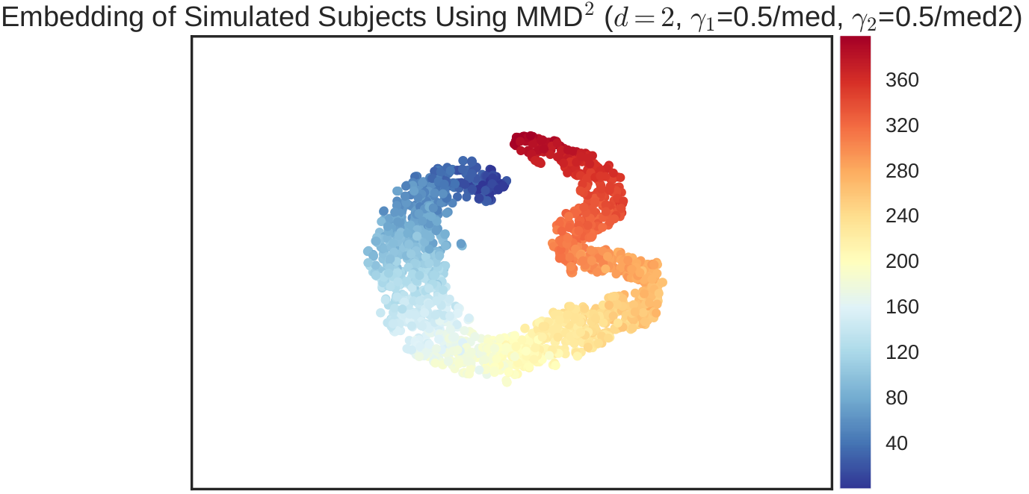
Gamma1 = .5/med Gamma2 = .5/med2

Slide 8
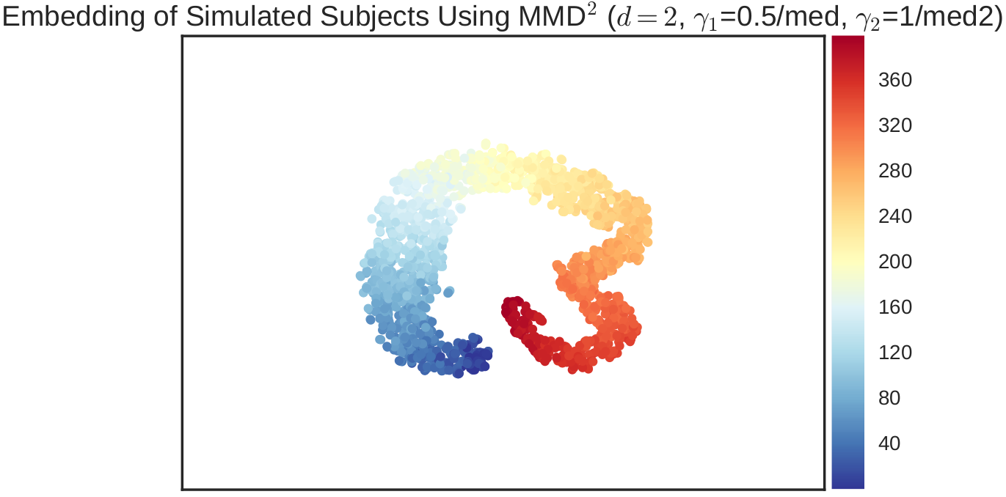
Gamma1 = .5/med Gamma2 = 1/med2

Slide 9
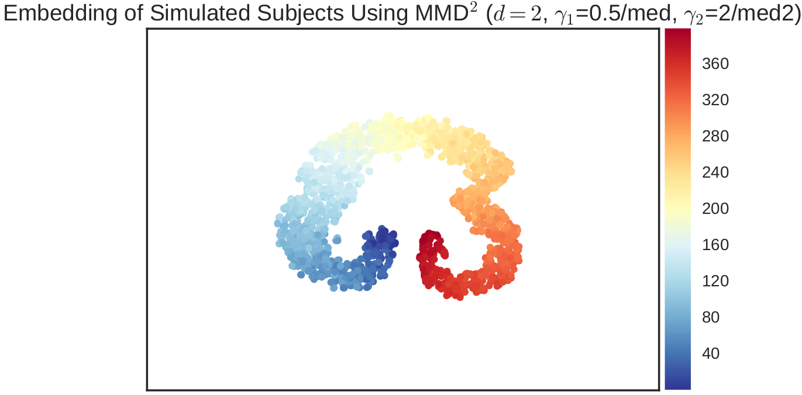
Gamma1 = .5/med Gamma2 = 2/med2

Slide 10
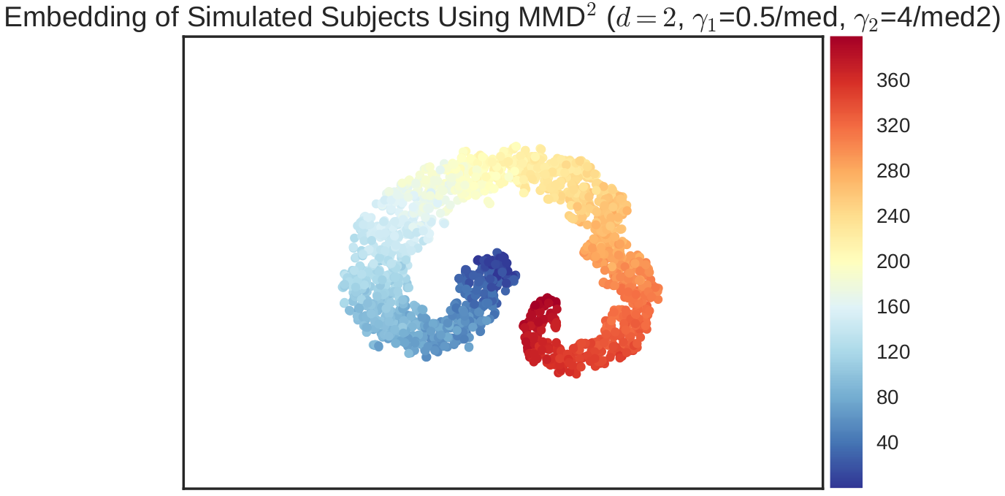
Gamma1 = .5/med Gamma2 = 4/med2

Slide 11
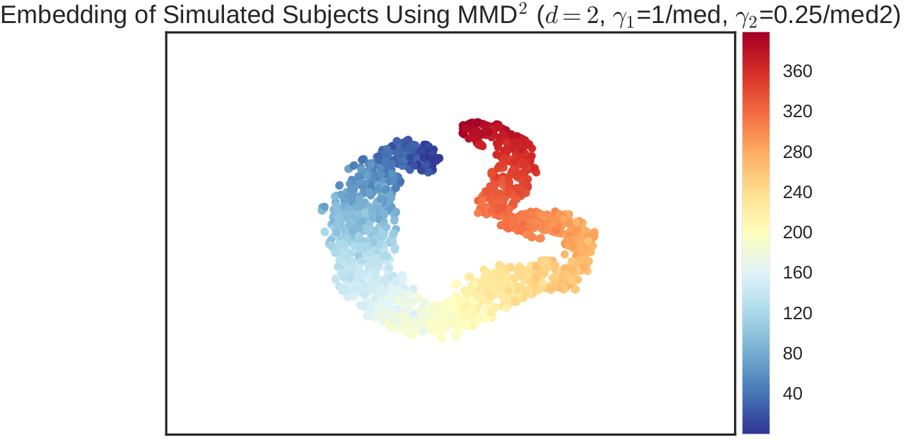
Gamma1 = 1/med Gamma2 = .25/med2

Slide 12
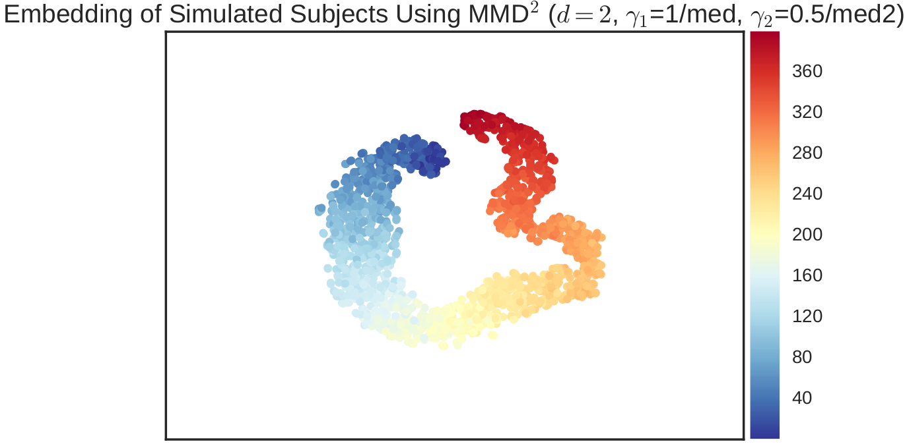
Gamma1 = 1/med Gamma2 = .5/med2

Slide 13
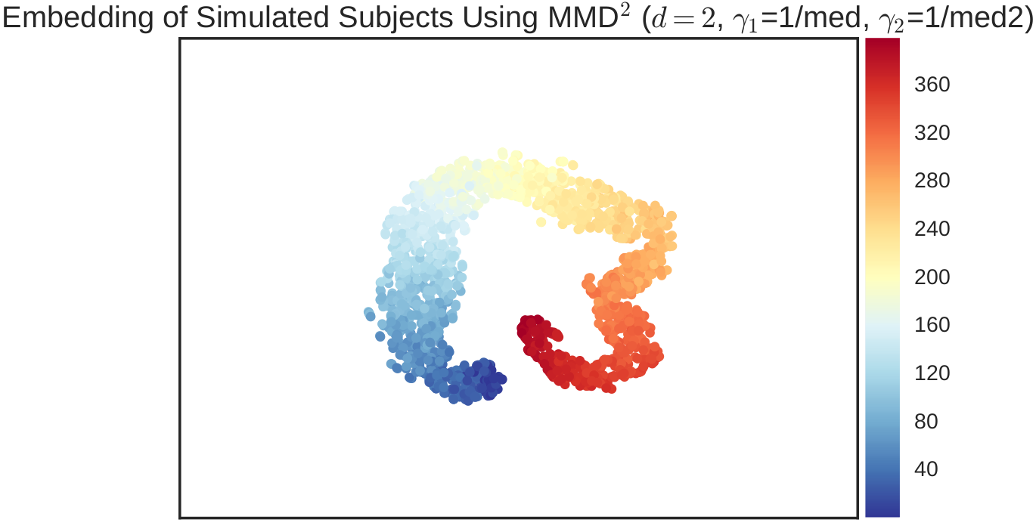
Gamma1 = 1/med Gamma2 = 1/med2

Slide 14

Gamma1 = 1/med Gamma2 = 2/med2

Slide 15
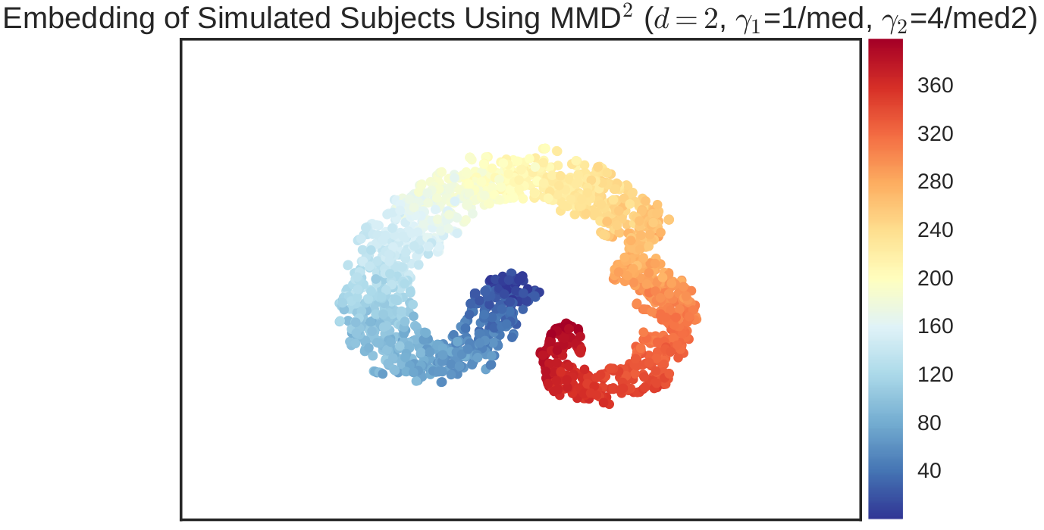
Gamma1 = 1/med Gamma2 = 4/med2

Slide 16

Gamma1 = 2/med Gamma2 = .25/med2

Slide 17

Gamma1 = 2/med Gamma2 = .5/med2

Slide 18
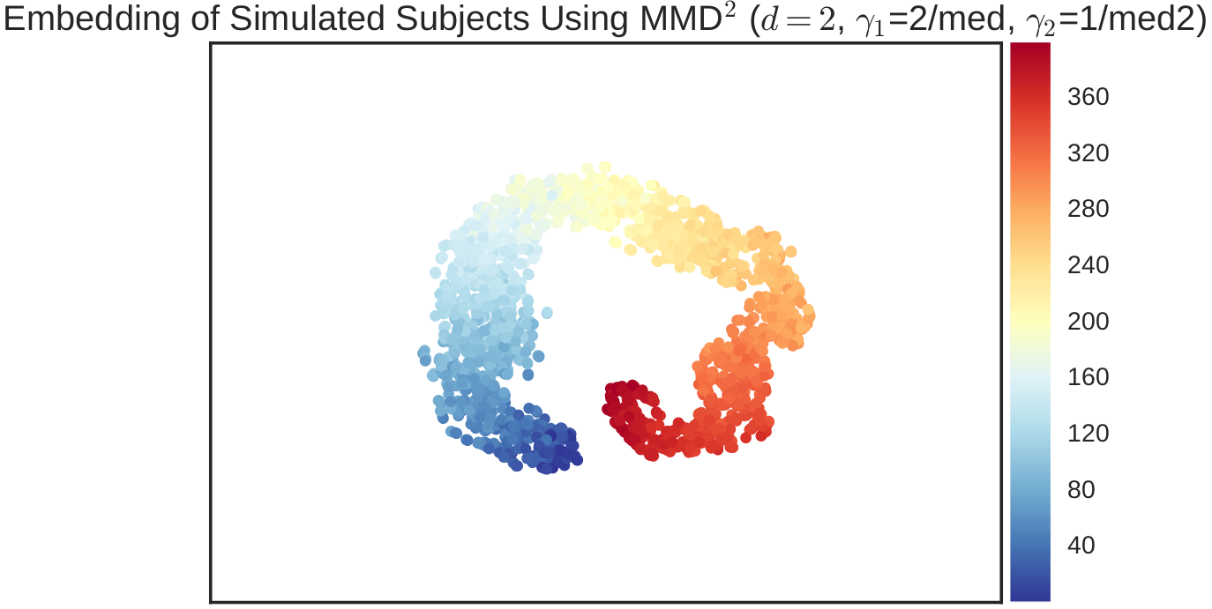
Gamma1 = 2/med Gamma2 = 1/med2

Slide 19
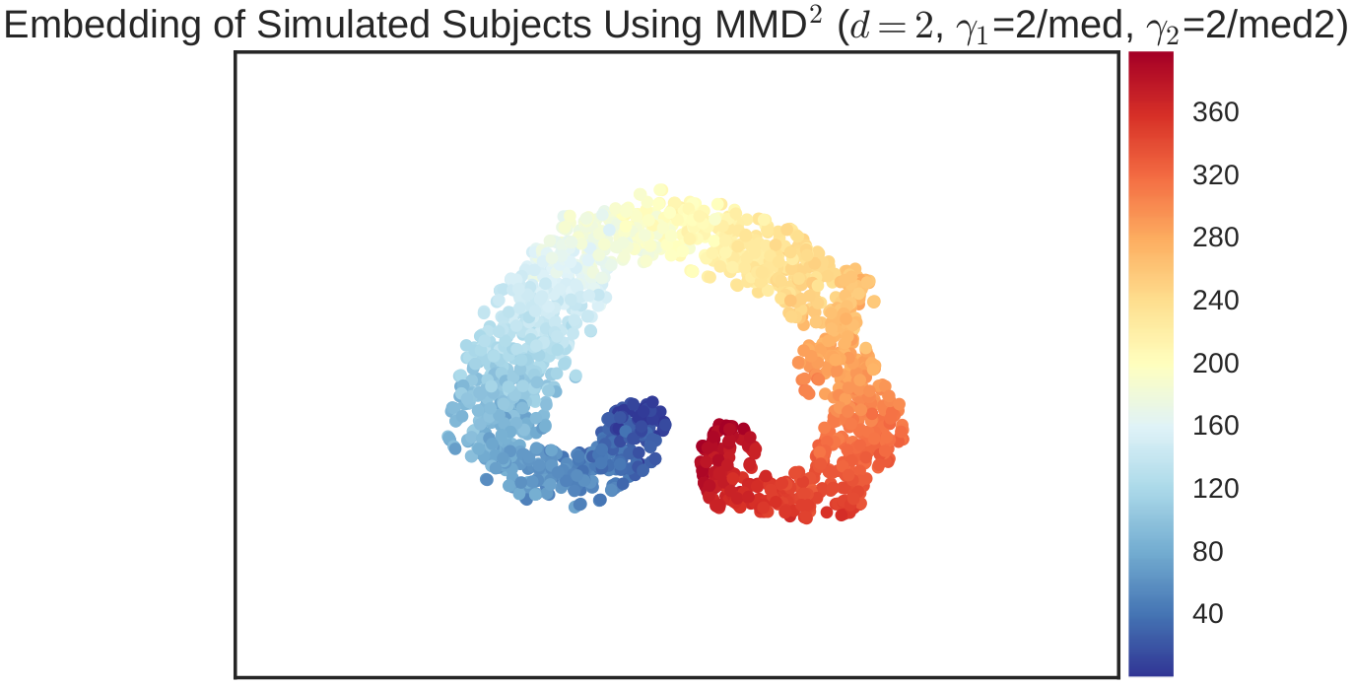
Gamma1 = 2/med Gamma2 = 2/med2

Slide 20
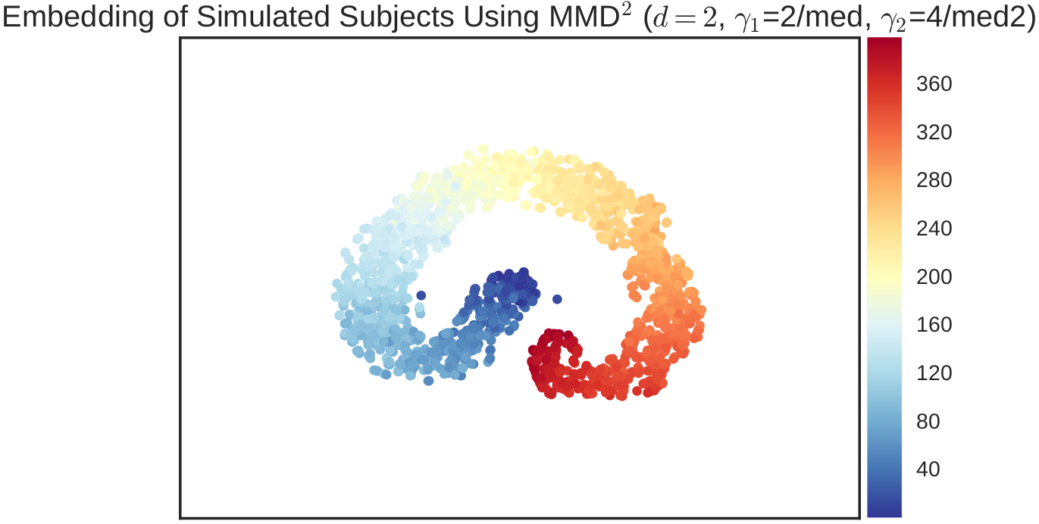
Gamma1 = 2/med Gamma2 = 4/med2

Slide 21
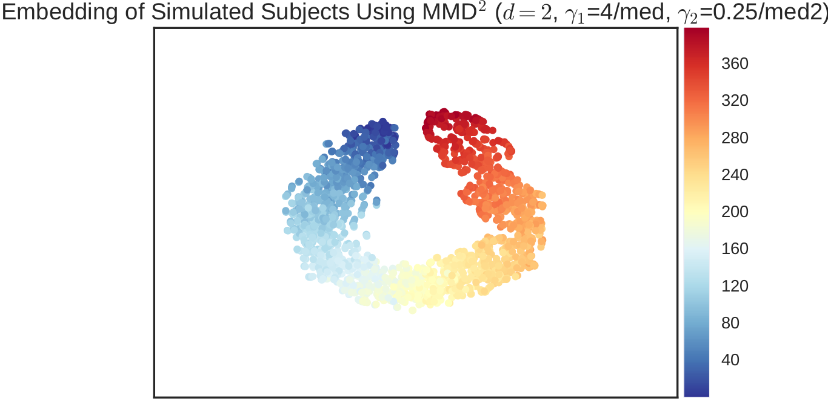
Gamma1 = 4/med Gamma2 = .25/med2

Slide 22

Gamma1 = 4/med Gamma2 = .5/med2

Slide 23
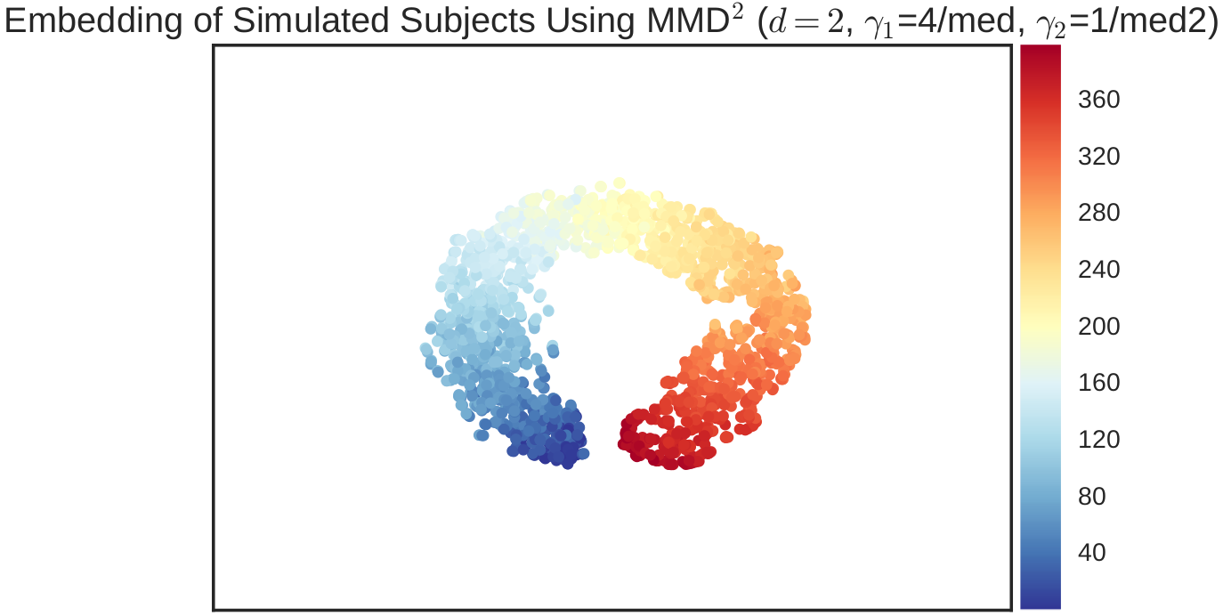
Gamma1 = 4/med Gamma2 = 1/med2

Slide 24
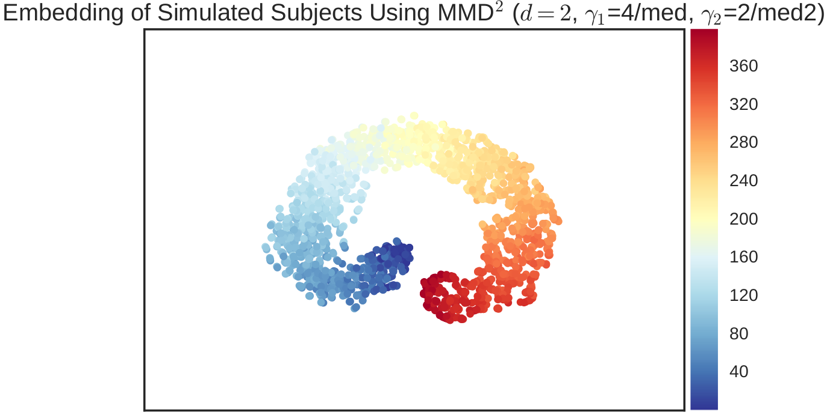
Gamma1 = 4/med Gamma2 = 2/med2

Slide 25
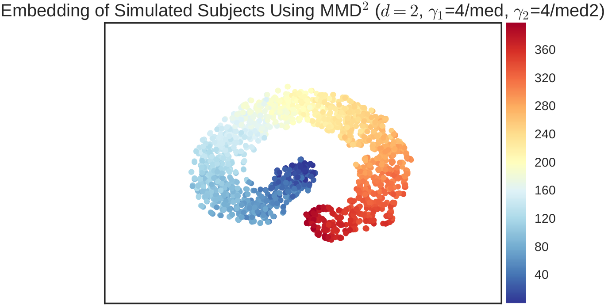
Gamma1 = 4/med Gamma2 = 4/med2

