Slide 1
Placement Simulation Activity
Real company-style project
Focus on thinking, design, teamwork
Not just coding

Slide 2
Objective
Improve problem solving
Learn system design basics
Prepare for companies like HWI NI & MoveInSync

Slide 3
1.Introduce the Task
“Today we are not doing a normal assignment. This is a placement simulation round similar to what companies like HWI NI and MoveInSync conduct.
You will work in teams, discuss, design, and present a solution in front of me. I am not only evaluating your code — I am evaluating:
How you think
How you communicate
How you collaborate
This is how real companies hire.”

Slide 4
Team Formation
3–4 students per team
Assign roles: Leader, Designer, Developer, Presenter

Slide 5
Step 1: Task Structure
“You will work in a team of 3–4 students.”
Phase 1: Problem Understanding (10–15 mins)
Read the problem carefully
Identify:
Inputs
Outputs
Constraints
Edge cases
Instruction:
“Do NOT jump to coding. First discuss and understand.”

Slide 6
Phase 2: Discussion & Design (20–30 mins)
Each team must:
Discuss multiple approaches
Choose the best one
Draw solution (flowchart / pseudo code)
Instruction:
“One person should act as:
Leader (drives discussion)
Scribe (writes solution)
Presenter (explains solution)”

Slide 7
Phase 3: Implementation (30–40 mins)
Start coding
Follow clean coding practices
Handle edge cases
Instruction:
“I may interrupt and ask questions while you code — be ready.”

Slide 8
Phase 4: Presentation + Defense (10 mins per team)
Each team must explain:
Approach
Why they chose it
Time & space complexity
Edge cases handled
Instruction:
“Other teams can challenge your solution.”

Slide 9
Step 5: Implementation
Write clean code
Use modular approach
Handle edge cases

Slide 10
Step 6: Testing
Test with multiple cases
Check boundary conditions
Fix bugs

Slide 11
Step 7: Presentation
Explain solution
Justify approach
Answer questions

Slide 12
6. What I Do During the Session
Walk around and:
Ask questions like interviewer:
“Why this approach?”
“What if input is huge?”
“Can you optimize this?”
Observe:
Who dominates discussion
Who is silent

Slide 13
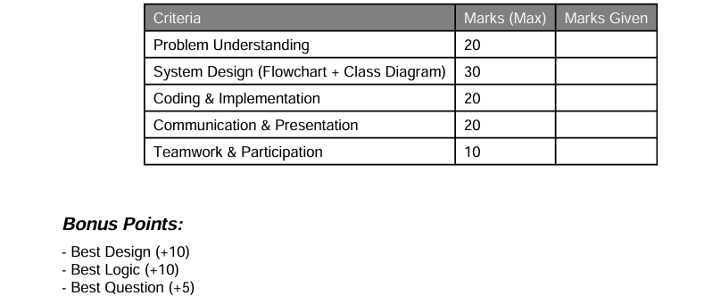
Evaluation Criteria
Carpooling System Project - Evaluation Sheet Team Name: ____________________ Members: ____________________

