Slide 1
MoViz
An Analysis and Visualization of Movie Data
Group 14
Vipul Gharde (vig4)
Bryan Law (bpl52)
Sumedh Mohile (ssm202)

Slide 2
Overview

Slide 3
Goals
To use interactive visualization to get an insight into movie trends over time
To understand how different actors and crew correlate to the commercial success of a movie
To find interesting results on movie metrics vs the demographics of the people working on them

Slide 4
Target Users
Producers wanting to gauge earnings of upcoming movies
Writers wanting to know the likely popularity of their scripts
Analysts looking to understand movie trends over time

Slide 5
Data

Slide 6
Data Selection and Collection
Building out a dataset using the TheMovieDB API
https://www.themoviedb.org/documentation/api
700K+ movies with ~30 fields
2.4M+ people with ~15 fields
Script to make API calls and store the results in a relational database
Will make API calls for incremental data at predefined intervals
Focus on People, Crew and Movie endpoints and storage of relationships between them

Slide 7
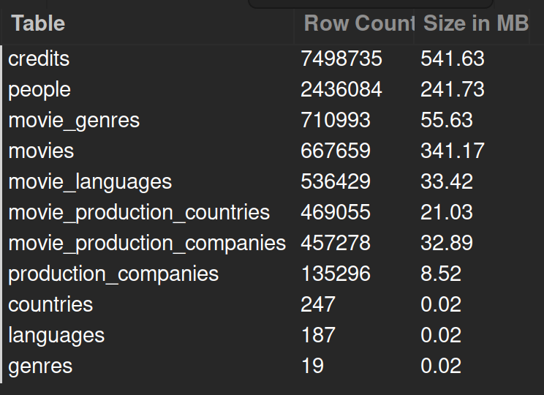
Data Size
Total row count: 12.9 M
Total dataset size: 1.24 GB

Slide 8
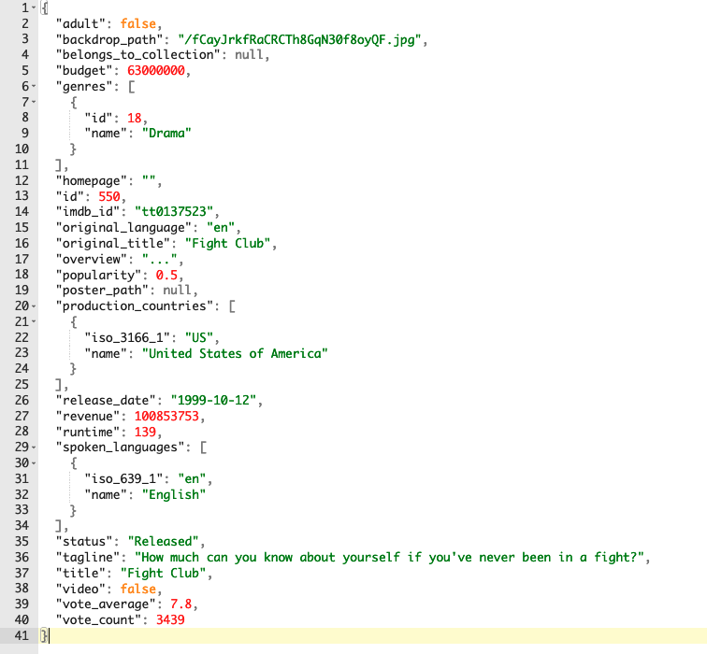
Data Snapshot
Movie Object

Slide 9
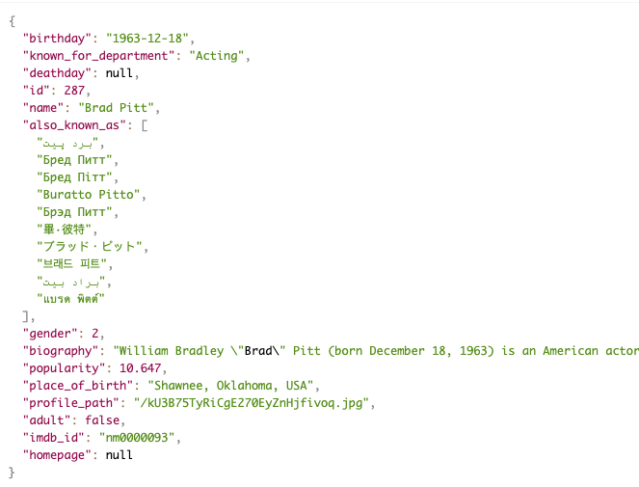
Data Snapshot
Actor Object

Slide 10
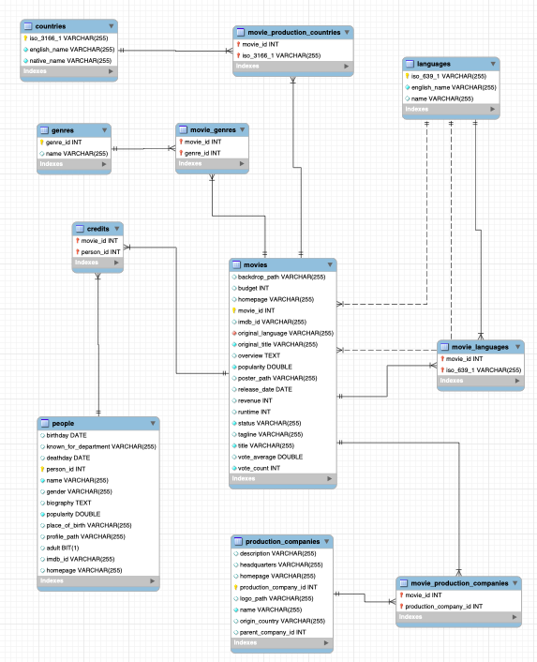
Schema

Slide 11
Questions

Slide 12
Questions
Genre vs. Revenue:
What genres of movies are most popular (possibly in what regions too)?
Are the most popular genres also the most profitable?
Range selector - What genres were most popular during specific time frames?
Filter by genre
Genre vs. Ratings:
What trends can we see in the general ratings of movie genres?
Can a movie with low ratings still be successful?
How have ratings affected the popularity of genres?

Slide 13
Questions
Actors vs. Movies vs. Revenue:
What actors are frequently in the same cast?
What combinations of actors result in the most revenue?
Chord diagram - Select multiple actors and see how often they are in the same cast and what is the correlating revenue
Do the popularity of actors affect the revenue and popularity of their movies?
Actors vs. Genre:
What genres are actors mostly associated with?
What genres are most profitable for certain actors?

Slide 14
Questions
Budget vs. Revenue:
Does more budget necessarily mean more revenue?
How successful can a movie be if it is low budget?
Crew vs. Revenue:
How does the crew of a movie production affect its revenue/ratings?
Is it only the director that people mostly look at?
Which directors produce the most revenue?
Are there certain recurring production members associated with more revenues?

Slide 15
Questions
Duration vs. Revenue:
Does the duration of a movie affect its revenue, ratings and popularity?
With and without all previous factors above
What trends can we see in the length of movies over time?
Language vs. Revenue:
Are foreign movies successful in the US and are US movies popular in foreign countries?
Filter by language

Slide 16
Architecture

Slide 17
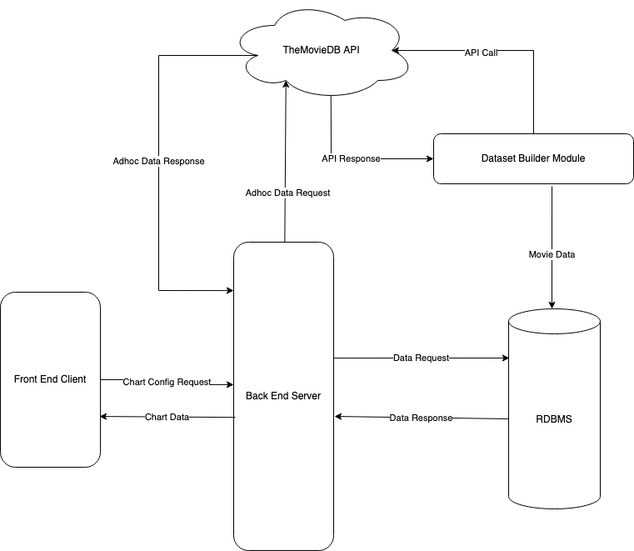
Architecture

Slide 18
Architecture
ReactJS Front End with Plotly for Charts and Plots
Django Back End running on Amazon EC2
MySQL RDBMS on Amazon RDS
Python scripts running on Amazon EC2 for data collection API calls

Slide 19
Demo

Slide 20
Key
Highlights

Slide 21
Key Highlights
High performance multithreaded data collection module. Largest TheMovieDB dataset available anywhere
Only real-time TheMovieDB dataset currently in existence.

Slide 22
References
https://www.themoviedb.org/documentation/api

Slide 23
End

