Slide 1

HTTP Proxy Server with Intelligent Caching
Mini-project presentation
Computer Networks Laboratory (CSE20110)
Department of Computer Engineering and Technology
Students:
1.Archita Agarwal (1262243769) 3. Sumedh Nilawar (1262250022)
2.Swarali Lokare (1262243762) 4.Soumya Kumari (1262243783)
Group :[3] Panel :E Batch :1
Faculty: Swati mam
Academic Year: 2026–2027
Presentation date: 22-10-2026
Computer Networks Laboratory CSE20110
15 seconds
Notes:
Suggested time: 15 seconds. Replace all bracketed placeholders and prompts with your own project details. Keep explanations brief. Total time across slides 1–7 is 5 minutes, including the demonstration. Slide 8 is for reference during questions. Logo source: https://mitwpu.edu.in/uploads/images/MIT-WPU-logo-1.webp. Introduce only the title and team; do not read every PRN.

Slide 2
Problem and Objectives
Problem:
Repeated requests for the same HTTP resources cause unnecessary communication with origin servers, increasing network traffic and response latency.
Local caching optimizes this, but fixed memory capacity requires an efficient replacement policy (LRU) to handle overflows.
Objectives:
Implement an HTTP proxy server using Python TCP sockets to parse and forward plain HTTP GET requests.
Integrate an in-memory Least Recently Used (LRU) cache to serve repeated successful (200 OK) responses directly from memory.
Provide real-time operational visibility and telemetry via a Streamlit monitoring dashboard.
Computer Networks Laboratory CSE20110
40 seconds
Notes:
Suggested time: 40 seconds. Replace all bracketed placeholders and prompts with your own project details. Keep explanations brief. Total time across slides 1–7 is 5 minutes, including the demonstration. Slide 8 is for reference during questions.

Slide 3
Proposed Design and Tools
[Client / Test Client]
│
▼(HTTP GET)
[HTTP Proxy Server (127.0.0.1:8888)] ──(Cache Lookup)──► [In-Memory LRU Cache]
├── [Cache HIT] ──────────► Returns stored response directly[cite: 1]
└──[Cache MISS] ──────────► Connects to [Origin Web Server] ──► Stores 200 OK Response[cite: 1]
Tools & Versions:
Python 3: Core proxy logic, sockets, threading, and OrderedDict.
Streamlit & Pandas: Real-time monitoring dashboard and telemetry interface.
Protocols & Addressing:
Plain HTTP/1.1 GET requests over TCP sockets.
Local listener configured at 127.0.0.1:8888.
Computer Networks Laboratory CSE20110
45 seconds
Notes:
Suggested time: 45 seconds. Replace all bracketed placeholders and prompts with your own project details. Keep explanations brief. Total time across slides 1–7 is 5 minutes, including the demonstration. Slide 8 is for reference during questions. Explain the diagram and only the most relevant design decisions. Use an actual project diagram with readable labels.

Slide 4
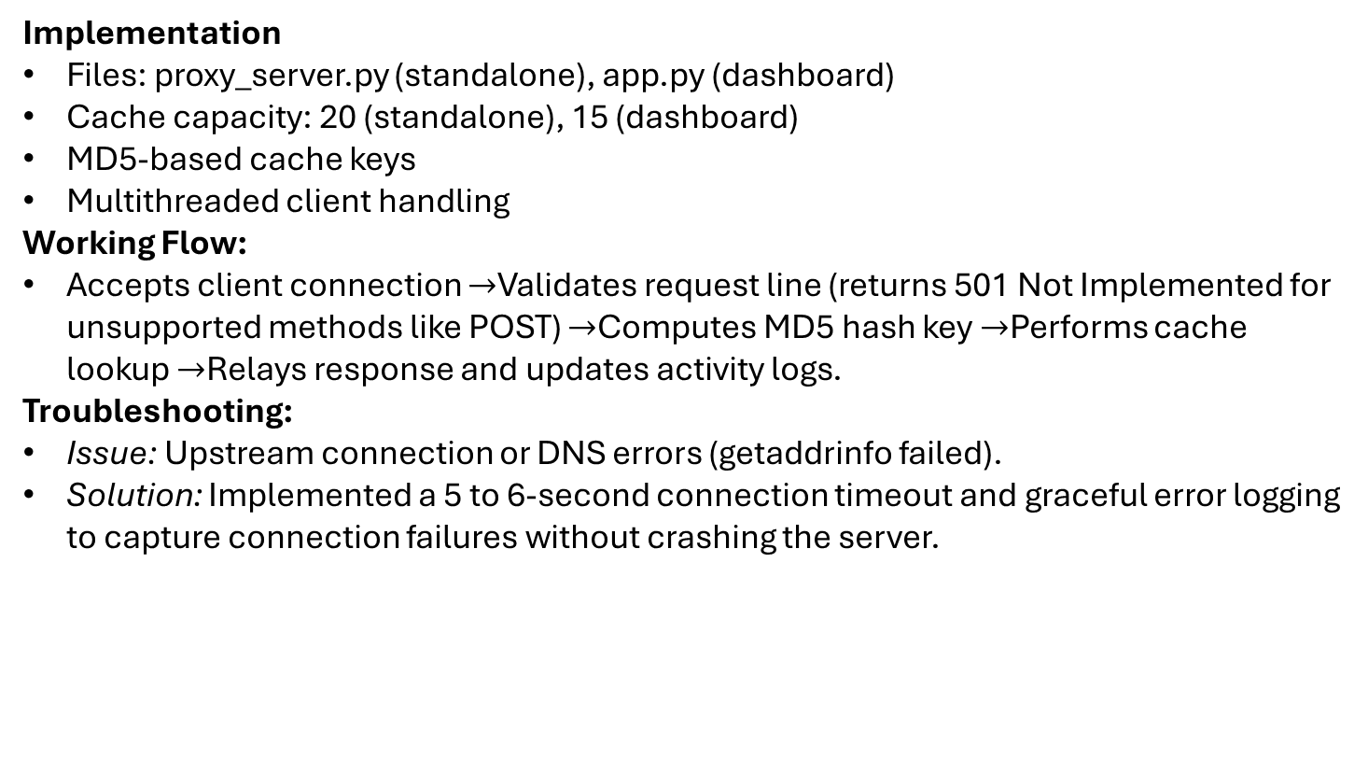
Implementation and Working
Implementation
Files: proxy_server.py (standalone), app.py (dashboard)
Cache capacity: 20 (standalone), 15 (dashboard)
MD5-based cache keys
Multithreaded client handling
Working Flow:
Accepts client connection $→$Validates request line (returns 501 Not Implemented for unsupported methods like POST) $→$Computes MD5 hash key $→$Performs cache lookup $→$Relays response and updates activity logs.
Troubleshooting:
Issue: Upstream connection or DNS errors (getaddrinfo failed).
Solution: Implemented a 5 to 6-second connection timeout and graceful error logging to capture connection failures without crashing the server.
Computer Networks Laboratory CSE20110
55 seconds
Notes:
Suggested time: 55 seconds. Replace all bracketed placeholders and prompts with your own project details. Keep explanations brief. Total time across slides 1–7 is 5 minutes, including the demonstration. Slide 8 is for reference during questions.

Slide 5
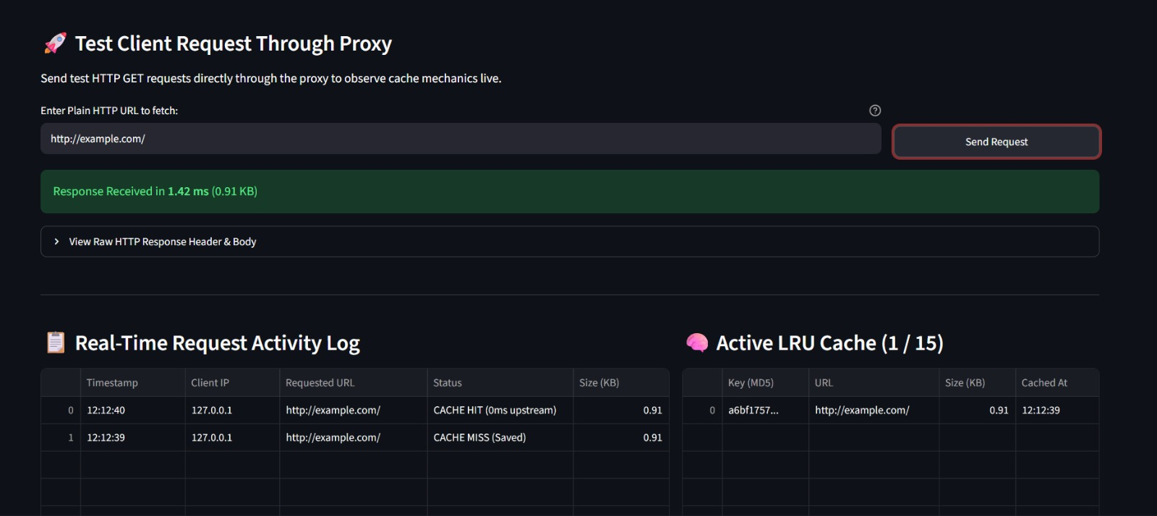
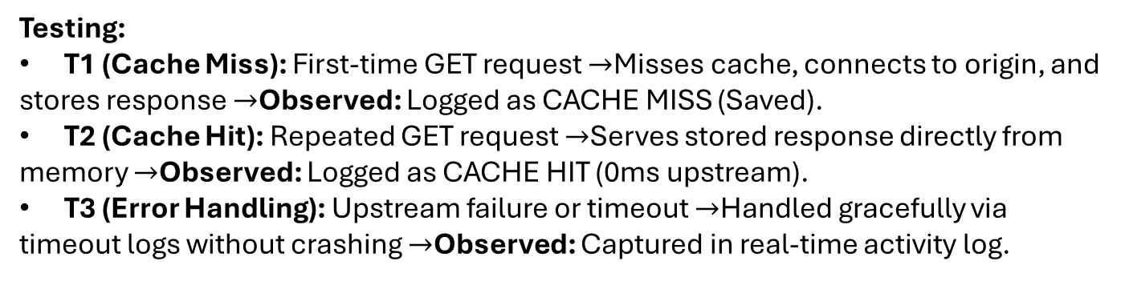
Testing and Results
Testing:
T1 (Cache Miss): First-time GET request $→$Misses cache, connects to origin, and stores response $→$Observed: Logged as CACHE MISS (Saved).
T2 (Cache Hit): Repeated GET request $→$Serves stored response directly from memory $→$Observed: Logged as CACHE HIT (0ms upstream).
T3 (Error Handling): Upstream failure or timeout $→$Handled gracefully via timeout logs without crashing $→$Observed: Captured in real-time activity log.
Objectives Achieved:
Successfully verified TCP request handling, MD5-keyed LRU caching, and real-time dashboard telemetry.
Visual Evidence:
Computer Networks Laboratory CSE20110
50 seconds
Notes:
Suggested time: 50 seconds. Replace all bracketed placeholders and prompts with your own project details. Keep explanations brief. Total time across slides 1–7 is 5 minutes, including the demonstration. Slide 8 is for reference during questions. Show actual evidence. Explain the output and mention any failed or partial tests. Do not invent performance figures.

Slide 6
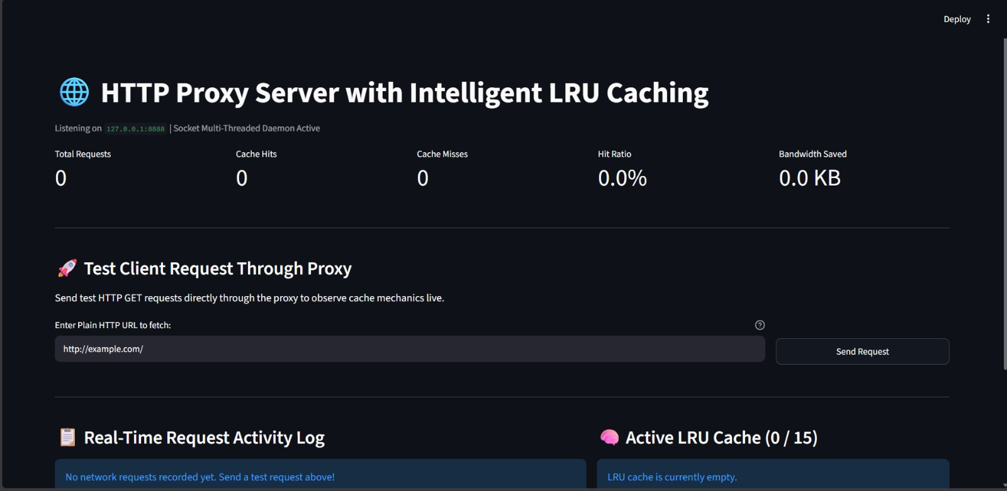
Working Demonstration
Function to Demonstrate:
  Live HTTP Request Handling, MD5-Keyed LRU Caching, and Real-Time Streamlit Telemetry.
Execution Steps:
  Launch Application: Run streamlit run app.py to start the dashboard server on port 8888.
  Send Test Request (Cache Miss): Enter a plain HTTP URL (e.g., [http://example.com/](http://example.com/)) in the test client and click Send Request.
  Verify Cache Hit: Re-send the exact same URL to instantly serve the response from the in-memory LRU cache.
Success Criterion:
  The dashboard successfully logs the initial CACHE MISS (Saved) and subsequent CACHE HIT (0ms upstream), updates hit/miss counters, computes bandwidth saved, and displays active entries in the LRU cache table.
Computer Networks Laboratory CSE20110
65 seconds
Notes:
Suggested time: 65 seconds. Replace all bracketed placeholders and prompts with your own project details. Keep explanations brief. Total time across slides 1–7 is 5 minutes, including the demonstration. Slide 8 is for reference during questions. Prepare the project before the timer starts. Keep the demo to about one minute. Keep a screenshot or short recording ready as a backup, and identify it as recorded evidence if used.

Slide 7
Conclusion and Contributions
Outcome: Successfully implemented a multi-threaded Python TCP HTTP proxy with an MD5-keyed LRU cache and Streamlit monitoring interface.
Application: Demonstrates core gateway and caching concepts used in web content delivery networks (CDNs).
Limitation: Supports plain HTTP GET requests only; cache is volatile (in-memory) and lost when the process terminates.
Future Scope: Integrating HTTPS CONNECT tunnelling, RFC-compliant Cache-Control headers, and persistent database storage
Team Contributions:
Archita Agarwal: [Core Proxy Logic & Sockets]
Sumedh Nilawar: [Threading & Request Parsing]
Swarali Lokare: [LRU Cache & MD5 Key Generation]
Soumya Kumari: [Streamlit Dashboard & Testing]
Computer Networks Laboratory CSE20110
30 seconds
Notes:
Suggested time: 30 seconds. Replace all bracketed placeholders and prompts with your own project details. Keep explanations brief. Total time across slides 1–7 is 5 minutes, including the demonstration. Slide 8 is for reference during questions.

Slide 8
References
[1] Python Software Foundation, “socket — Low-level networking interface,” Python documentation.
[2] Python Software Foundation, “threading — Thread-based parallelism,” Python documentation.
[3] R. Fielding, M. Nottingham, and J. Reschke, “HTTP Semantics,” RFC 9110, IETF, Jun. 2022.
Computer Networks Laboratory CSE20110
Backup slide
Notes:
Suggested time: Backup slide. Replace all bracketed placeholders and prompts with your own project details. Keep explanations brief. Total time across slides 1–7 is 5 minutes, including the demonstration. Slide 8 is for reference during questions.

