Slide 1

GIMP
Downloadable open source software

Slide 2


IDEA:- FROM THE BEGNING
began developing GIMP as a semester-long project at the University of California, Berkeley for the experimental Computing Facility. In 1996 GIMP (0.54) was released as the first publicly available release.

Slide 3
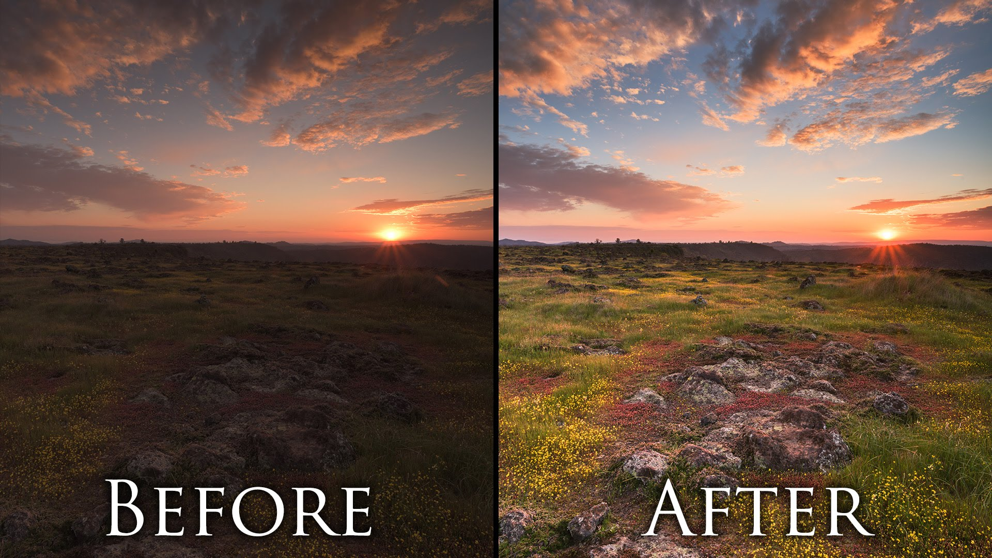
WHAT PROBLEM DOES IT SOLVES???

Slide 4
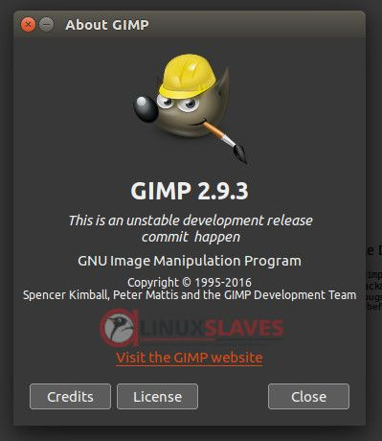
LICENSING MODEL

Slide 5

INTEND BEHIND MAKING IT OPEN SOURCE????

Slide 6



Slide 7

MONETIZING MODEL?????

Slide 8


Slide 9
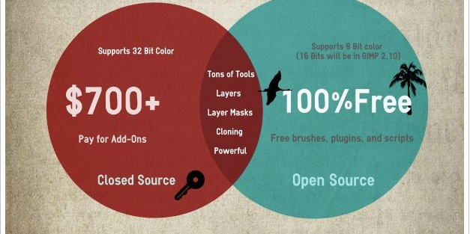

POPULARITY..!!!!!!

Slide 10
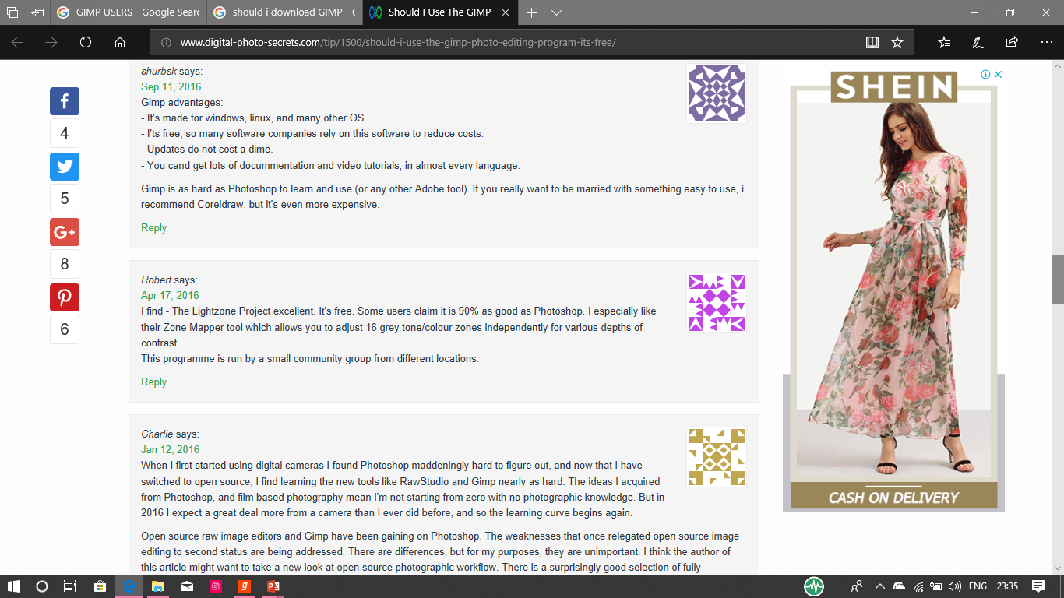
IMPACT…!!!!

Slide 11
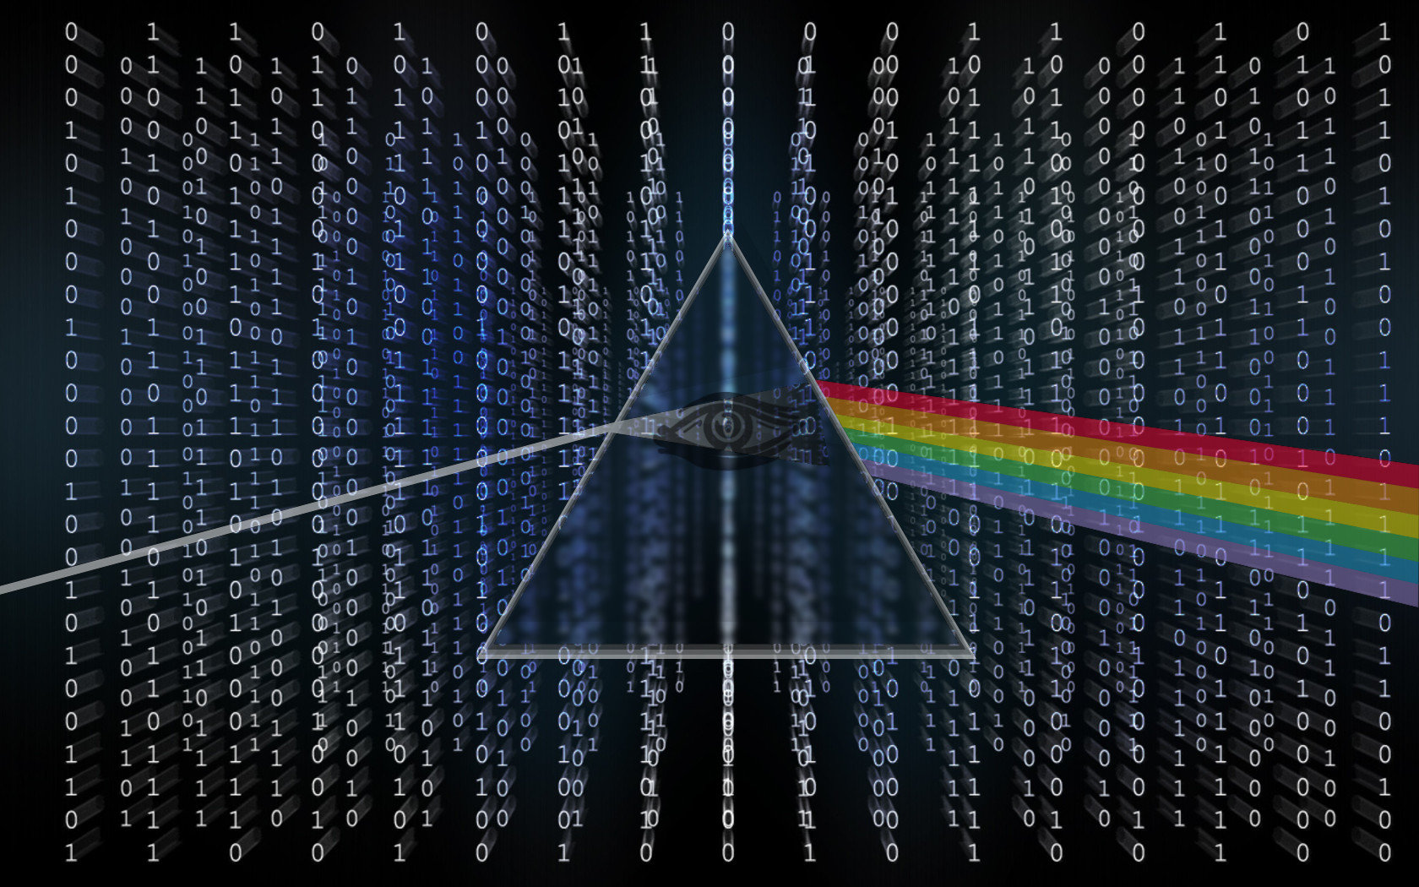
THANK YOU

