Slide 1
POWER BI PROJECT • DATA ANALYST PORTFOLIO
Supply Chain Analytics
Procurement, Supplier & Logistics Performance Dashboard
Built end-to-end in Power BI — data modeling, DAX measures, Power Query transformation, and a 3-page interactive report.
Sumit
Data Analyst (Fresher) | Power BI · DAX · Power Query · SQL

Slide 2
THE BUSINESS PROBLEM
One dashboard for a scattered supply chain
Procurement and logistics teams work across multiple disconnected tables — purchase orders, supplier master data, shipments, carrier data, warehouse data, and monthly targets.
Leadership cannot quickly compare actual procurement spend against monthly targets.
Supplier performance is split across pricing, quality, delivery, and risk fields — no single view.
Logistics teams need visibility into carrier reliability, transport mode cost, and delay patterns.
GOAL
Replace scattered manual checks with one clean, 3-page Power BI report that supports executive review, supplier decisions, and logistics improvement.
Supply Chain Analytics — Project Report
02

Slide 3
REPORT SCOPE
Three pages, one complete story
Overview → Supplier & Procurement → Logistics & Delivery
Page 1 — Overview
Page 2 — Supplier & Procurement
Page 3 — Logistics & Delivery
Actual vs target spend trend
Spend variance by category
PO status split
Supplier risk split
Delayed shipment root-cause tree
Supplier performance matrix
Purchase price variance by supplier
Monthly PPV trend
Supplier detail table
Freight cost vs transit time
Freight cost by transport mode
On-time delivery % by region
Carrier OTD vs SLA target
Avg transit time by carrier
Supply Chain Analytics — Project Report
03

Slide 4
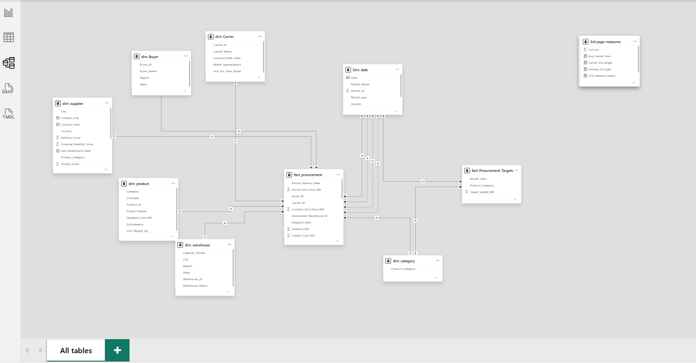
DATA MODELING
A galaxy schema built for accurate comparisons
Two fact tables
fact_procurement (transaction grain) and fact_Procurement_Targets (category-month grain).
Conformed dimensions
Dim_date and dim_category filter both facts, so actual-vs-target comparisons stay correct.
7 dimension tables
supplier, carrier, product, category, warehouse, buyer, date.
Measures kept separate
DAX measures organized into dedicated per-page tables, not scattered across the model.
Supply Chain Analytics — Project Report
04

Slide 5
DAX MEASURES
The KPI logic behind the dashboard
KPI | Core logic | Why it matters
On-Time Delivery % | On-time delivered shipments ÷ total delivered shipments | Delivery reliability
Purchase Price Variance % | (Actual spend − Contract spend) ÷ Contract spend | Pricing control
Rejection Rate % | Rejected quantity ÷ Received quantity | Quality leakage
Avg Lead Time | Order date → actual delivery date | Procurement speed
Spend Variance | Target spend − Actual spend | Budget tracking
Freight Cost | Sum of transport cost across carriers | Logistics cost control
SLA Gap | Actual OTD % − Carrier SLA target | Carrier accountability
Supply Chain Analytics — Project Report
05

Slide 6
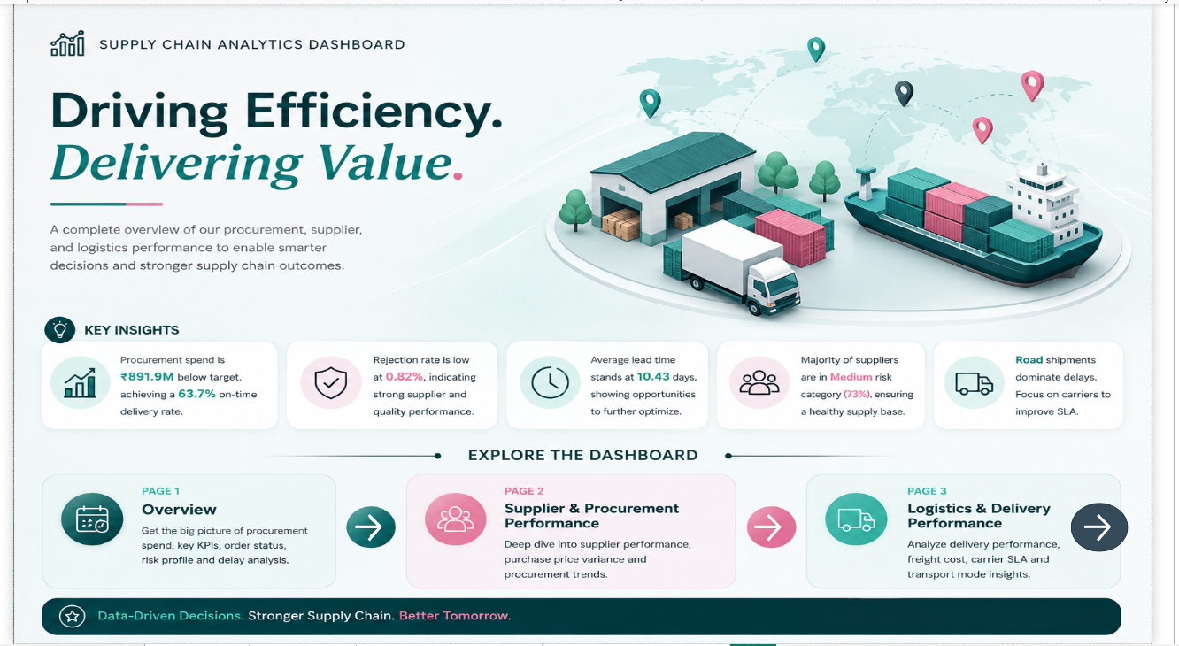
THE REPORT
Landing page
DESIGN NOTES
Clean entry point — headline KPIs plus a one-line summary before diving into pages.
Sidebar navigation buttons let a viewer jump straight to Overview, Supplier, or Logistics.
Built to be readable by a non-technical exec in under 10 seconds.
Supply Chain Analytics — Project Report
06

Slide 7
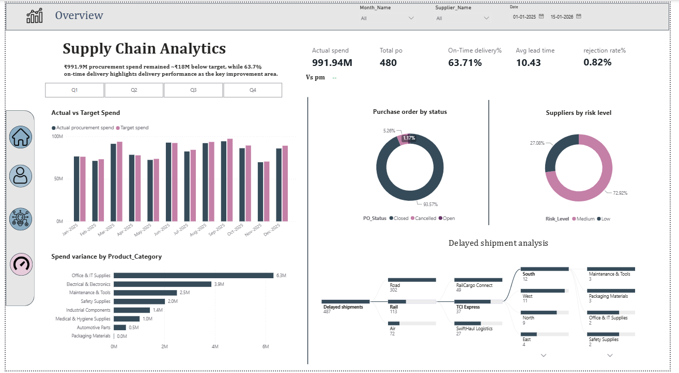
PAGE 1
Overview
KEY READS
₹991.9M procurement spend, ~₹18M below target.
63.71% on-time delivery — the clearest improvement area.
480 total POs; only 1.17% cancelled.
72.9% of suppliers sit in the Medium risk band.
Decomposition tree traces the 487 delayed shipments down to Road → Rail Cargo Connect → South region.
Supply Chain Analytics — Project Report
07

Slide 8
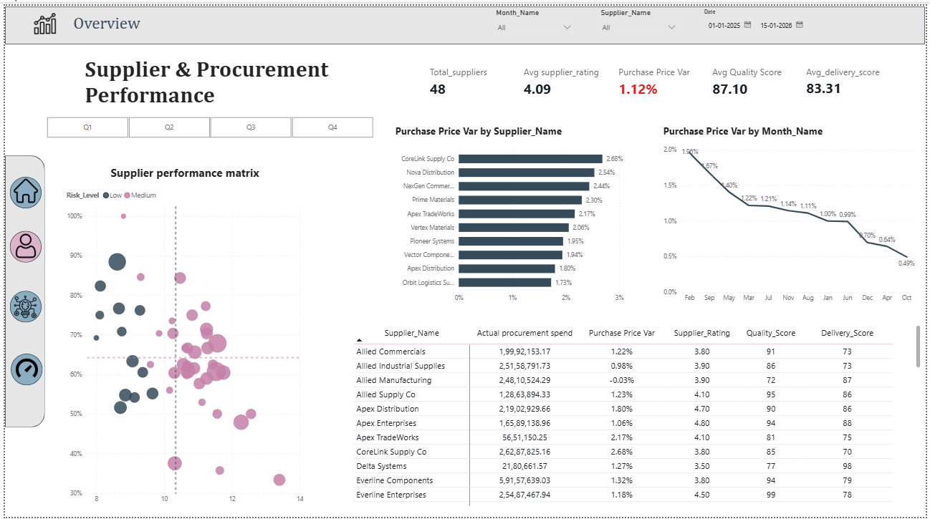
PAGE 2
Supplier & Procurement Performance
KEY READS
48 active suppliers, avg rating 4.09/5.
Purchase Price Variance running at 1.12%, trending down since February.
Scatter matrix plots quality score against lead time, colored by risk level, to flag underperformers fast.
Avg quality score 87.1, avg delivery score 83.3.
Supply Chain Analytics — Project Report
08

Slide 9
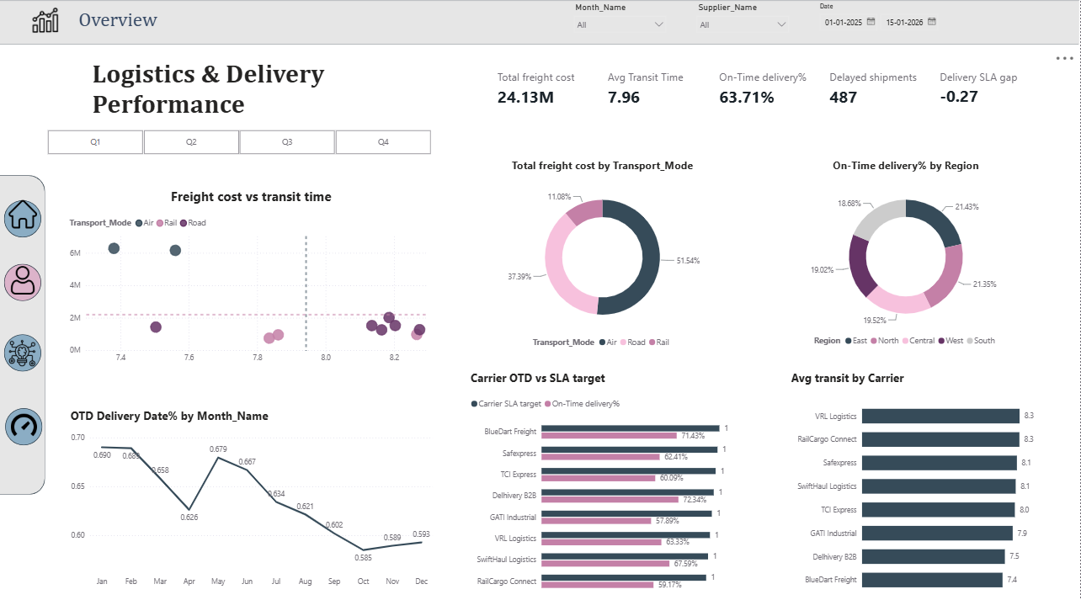
PAGE 3
Logistics & Delivery Performance
KEY READS
₹24.13M total freight cost; Road carries 51.5% of it.
Avg transit time 7.96 days across all modes.
Delivery SLA gap of -0.27 — carriers are missing committed SLA targets on average.
BlueDart Freight and Delhivery B2B post the strongest OTD% against target.
Supply Chain Analytics — Project Report
09

Slide 10
BUSINESS IMPACT
What the dashboard tells the business
₹18M
63.7%
0.82%
below target spend, despite ₹991.9M in total procurement
on-time delivery — priority area for improvement
rejection rate — strong supplier quality control
72.9%
487
-0.27
of suppliers rated Medium risk, not yet Low
delayed shipments, concentrated in Road transport
avg SLA gap — carriers under-delivering vs committed targets
Supply Chain Analytics — Project Report
10

Slide 11
REFLECTION
Challenges & what I'd improve next
Challenges
Next steps
No access to real company data, so I built a realistic synthetic dataset that mirrors true supply-chain patterns (lead time, SLA, rejection rate).
Connecting two fact tables at different grains (transaction vs category-month) without inflating totals — solved with conformed dimensions instead of merging tables.
Balancing analytical depth with a report that's still explainable to a non-technical viewer.
Connect to a live or larger dataset and add incremental refresh.
Add row-level security so a supplier only sees their own performance.
Add a simple forecast visual for spend and delivery trends.
Publish to Power BI Service with a scheduled refresh for a live demo link.
Supply Chain Analytics — Project Report
11

Slide 12
Thank you
Supply Chain Analytics Dashboard — Power BI, DAX, Power Query
Sumit
GitHub: github.com/sumeet582004
LinkedIn: linkedin.com/in/sumit-kale-773704261

