Slide 1
Secure Instant Messaging System
Under: Prof. Guevara Noubir
By: Sumeet Dubey and Sharuya Katiyar

Slide 2
Architecture
One server, multiple clients
Server maintains a list of every online client
To communicate, a client need to send a message to the server
This message will ask for the IP and port of the destination client
Server has a public/private key pair
Provides mutual authentication by using passwords and message signing
Message data is not sent through server to protect against malicious server

Slide 3
Assumptions
Every client knows server’s public key
Every client knows the IP and port of server
Every client remembers his own ID and password

Slide 4
Protocols
Communication will happen over UDP connections between clients
Every client will generate a Diffie-Hellman (DH) key with the server
Server generates shared secret key for clients willing to communicate
Encryption protocol – AES (256 bits) with CBC and random IV (128 bits)
Hashing protocol – SHA256

Slide 5
Changes compared to initial design
The overall design remains almost the same.
Server to client communication now over TCP
A timer of 1 minute to try entering a password again after 5 wrong attempts
We are now using the concept of KDC to generate shared keys
Less load at server’s end

Slide 6
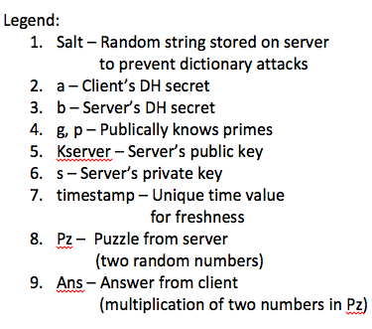
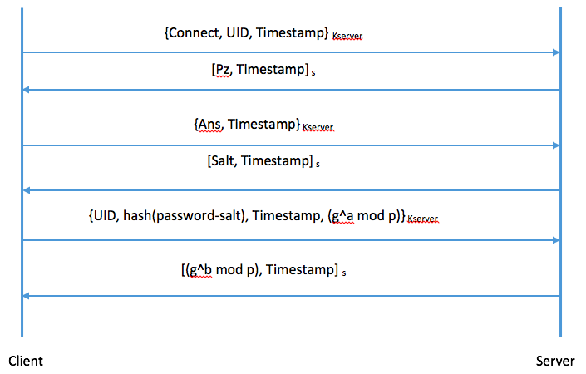
Client-Server Communication for Authentication

Slide 7
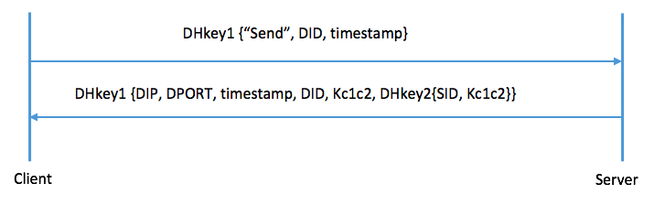
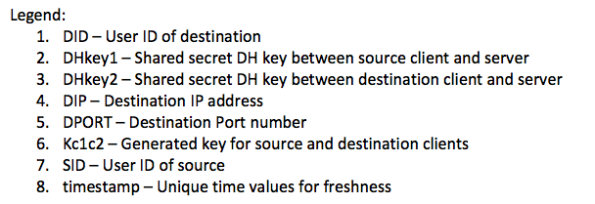
Client-Server Communication for IP and Port Request

Slide 8
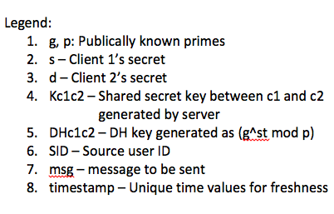
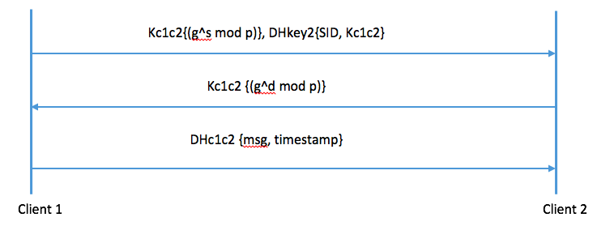
Client-Client for Exchanging Messages

Slide 9
Client Sign-off
TCP connection is immediately closed when a client exits the program
Name is deleted from the list of online clients
Shared key with the particular client is deleted

Slide 10
Discussion of attacks
Online Password Attacks: Timer
Offline Password Attacks: Hashing and Salting
Server Compromised in Future: Prefect Forward Secrecy
Replay Attack: Timestamps
Denial of Service: Proof-of-work

Slide 11
Thank You!

