Slide 1
BIockchain
Let’s Decentralize this Planet…

Slide 2
What is Blockchain ??
Peer-to-Peer
Decentralized
Public
Uses a Distributed Ledger
Open source code.

Slide 3
What is the need of Blockchain ??
Removes the need of middleman.
No need to worry about data getting hacked or stolen.
Reliable and Open Source.
Data is available publicly.
Highly secured.

Slide 4
Mining..
Think about it as Digging Gold until you find it…

Slide 5
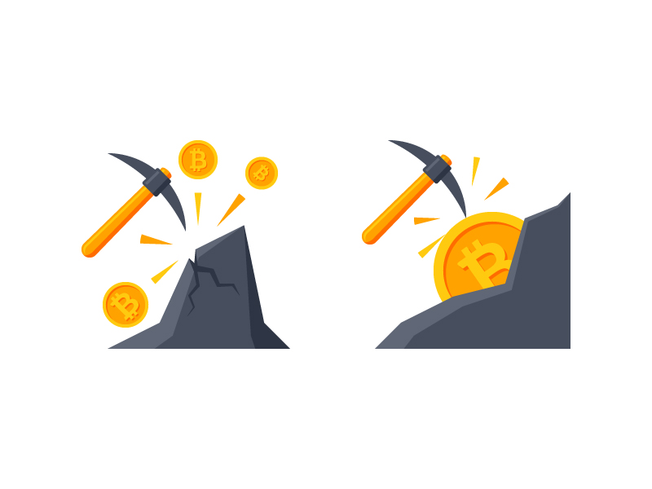
What is mining ??
Validate the Transactions in a Blockchain.
Used to issue new Currencies in a network.

Slide 6
Issues with Blockchain..
Everything has its own pros and cons right….??

Slide 7
Scalability
5-10 transactions per second.
Time delay between transactions and verification is too much resulting in network clogging.
Higher transaction fees.

Slide 8
Let’s Revise
Persistent
Transparent
Public
Append-only

Slide 9
What exactly is a BlockChain?
A Chain of Blocks…

Slide 10
Ethereum
BlockChain 2.0

Slide 11
Why Ethereum?
Because it is <Code> Blooded…

Slide 12
Smart Contracts
Contract between a number of parties written as code
Works on Triggers
Public

Slide 13
Smart Contracts are Awesome
Autonomy
Trust Less
Backup
Accuracy

Slide 14
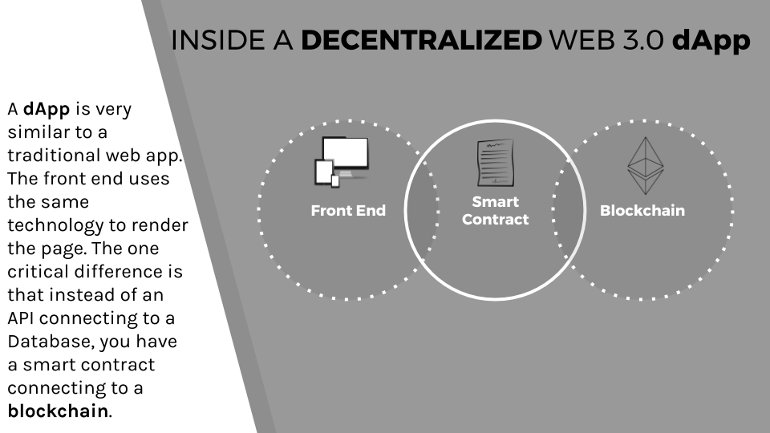
DAPPS

Slide 15
Where can we use it?
Voting platforms
Games
Social Media
Industrial uses
Entertainment
KYC
1201 dApps are live as of march 2018 and more are being made everyday
Dank coin – a meme reward tool

Slide 16
51% Attack
This is how you Wreak Havoc…

Slide 17
Scalability
Use less of BlockChain too use more of BlockChain…

Slide 18
Why Should I Learn BlockChain?
Because History Repeats Itself…

Slide 19
How to Earn from BlockChain?
Build your own Dapp and Monetize it
Get paid for Contributing to Open Source Projects
Create your own Startup
Work at a Startup
Work as a Free-Lancer
Join a Larger Company

Slide 20
Languages of Ethereum
Solidity (a JavaScript-like language)
Serpent (a Python-like language),
Mutan (C-like)
LLL (Lisp-like)

Slide 21
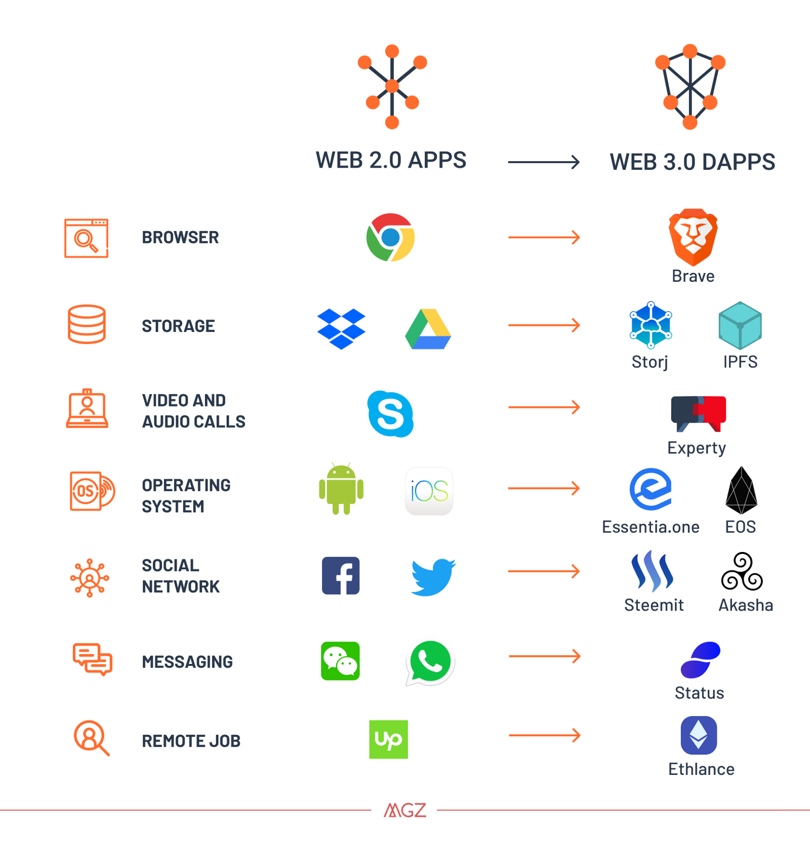

Slide 22
Who are we ?
Sumeet Rohra
C/Python Developer
Certified Ethical Hacker
Blockchain Enthusiast
Contact me on:
sumeetrohra1@gmail.com
Github.com/sumeetrohra
Arjun Sasikumar
Knows something about everything.
Web Developer
Blockchain Enthusiast.
Contact me on:
arjun1709@gmail.com
Github.com/arjun-r34

Slide 23
STUDYLEAGUE EDUCATION SERVICES
STUDYLEAGUE WORKSHOP SERVICES
STUDYLEAGUE IT SOLUTIONS

