Slide 1

Airline Safety Sumeet Shah 4/21/2022 DSC640-T301 (2223-1) Executive Presentation

Slide 2
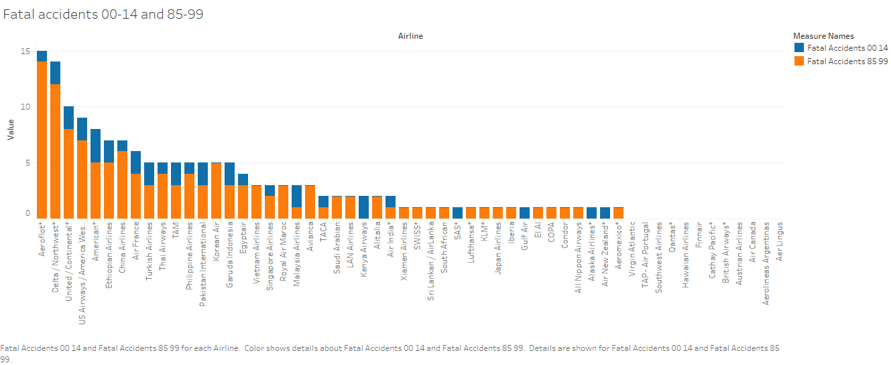

Slide 3
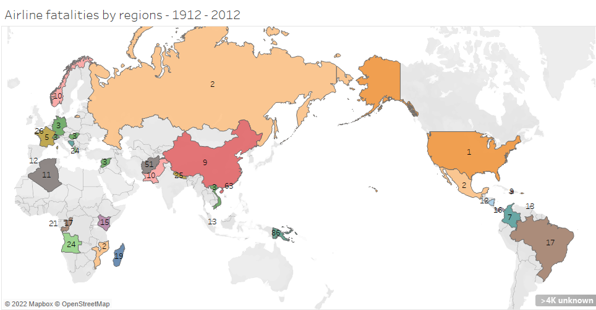

Slide 4
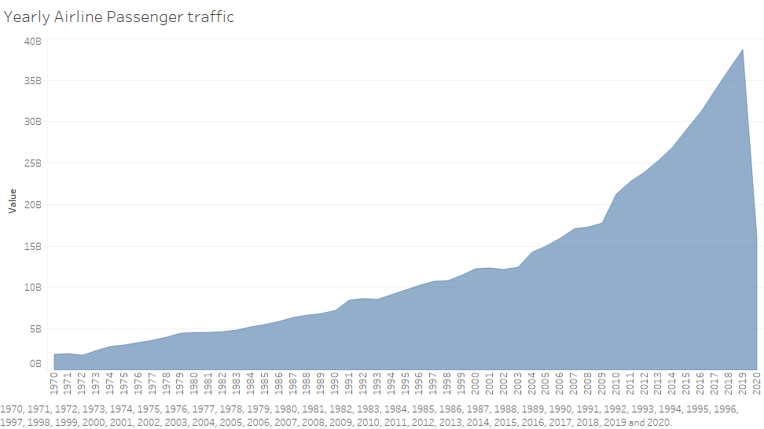

Slide 5
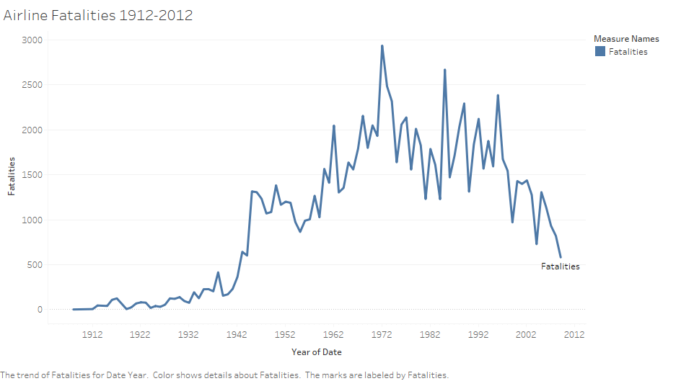

Slide 6


Slide 7
