Slide 1

Capstone Project Report | Data Analyst Internship | June 2026
Mutual Fund Analytics Platform
End-to-End Data Engineering, ETL Pipeline & Interactive Dashboard
46,000+
32,778
40
10
7
Rs.81L Cr
NAV Records
Transactions
Fund Schemes
Fund Houses
Days Built
Industry AUM
Prepared by
Sumeet Wagh
Data Analyst Intern • Bluestock Fintech Pvt. Ltd. • June 2026
Confidential — For Internal Use Only • bluestock.in
Notes:
Welcome everyone. Today I'll walk you through the Bluestock Mutual Fund Analytics Platform — a 7-day capstone project covering 40 fund schemes, 46,000+ NAV records, and a full 4-page Power BI dashboard.

Slide 2
2 | Problem Statement & Objectives
5 Core Business Problems
8 Project Objectives
P1
Data Fragmentation
O1
Build automated ETL pipeline (mfapi.in REST API)
NAV, AUM, SIP data scattered across formats
O2
Design 5-table SQLite star schema
P2
Performance Gap
No easy risk-adjusted fund comparison
O3
Generate 9 EDA charts with insights
P3
O4
Compute 7 risk-adjusted performance metrics
No Benchmark Track
Investors unaware if fund beats benchmark
O5
Build composite Fund Scorecard (0–100)
P4
Investor Blind Spot
O6
Develop 4-page Power BI interactive dashboard
No visibility into demographic patterns
O7
Build VaR/CVaR risk model & fund recommender
P5
Slow Static Reports
Monthly reports take days to prepare
O8
Deliver 15–20 page report + 12-slide deck
Bluestock Fintech Pvt. Ltd. | Mutual Fund Analytics Platform | June 2026 | Confidential
Notes:
India's MF industry manages Rs.81 lakh crore in AUM across 26 crore folios — yet individual investors lack tools for data-driven decisions. This project addresses 5 core problems through 8 measurable objectives.

Slide 3
3 | Data Sources & Datasets
10 datasets · 87,000+ total rows · All publicly available sources
# | File | Rows | Description | Source
01 | fund_master.csv | 40 | 40 real MF schemes — AMFI codes, expense ratio, risk grade | AMFI India
02 | nav_history.csv | 46,000 | Daily NAV Jan 2022–May 2026 for all 40 schemes | mfapi.in
03 | aum_by_fund_house.csv | ~90 | Quarterly AUM for 10 fund houses 2022–2025 | AMFI Quarterly
04 | monthly_sip_inflows.csv | 48 | Month-wise SIP inflow, accounts, AUM — 2022–2025 | AMFI Monthly
05 | category_inflows.csv | ~144 | Net inflows by fund category — FY 2024-25 | AMFI India
06 | industry_folio_count.csv | 21 | Total MF folios by type — Equity, Debt, Hybrid | AMFI India
07 | scheme_performance.csv | 40 | 1yr/3yr/5yr returns, Sharpe, Sortino, Alpha, Beta | Computed
08 | investor_transactions.csv | 32,778 | SIP + Lumpsum + Redemption — 5,000 investors | Simulated
09 | portfolio_holdings.csv | ~320 | Top equity holdings per fund as of Dec 2025 | AMFI India
10 | benchmark_indices.csv | ~8,000 | Daily Nifty 50, Nifty 100, BSE SmallCap values | NSE/BSE
Bluestock Fintech Pvt. Ltd. | Mutual Fund Analytics Platform | June 2026 | Confidential
Notes:
All data sourced from public APIs and AMFI India — no proprietary data used. The investor transaction dataset is synthetically generated for privacy.

Slide 4
4 | System Architecture & ETL Pipeline
5-Layer Data Engineering Architecture — Extract → Transform → Load → Analyse → Visualise
L1
Tools:
requests, mfapi.in REST API, AMFI CSV
Output:
10 raw CSV files + live NAV JSON
EXTRACT
L2
Tools:
Python, Pandas — clean, reshape, forward-fill
Output:
10 cleaned CSVs in data/processed/
TRANSFORM
L3
Tools:
SQLite, SQLAlchemy — star schema, indexes
Output:
bluestock_mf.db (5 tables, 80K+ rows)
LOAD
L4
Tools:
Jupyter, NumPy, SciPy — metrics, EDA
Output:
9 charts, 7 metrics, 5 advanced models
ANALYSE
L5
Tools:
Power BI Desktop — 4 pages, slicers, drill-through
Output:
bluestock_mf_dashboard.pbix
VISUALISE
Database Star Schema: dim_fund (40) • dim_date (1,500) • fact_nav (46,000) • fact_transactions (32,778) • fact_performance (40)
Bluestock Fintech Pvt. Ltd. | Mutual Fund Analytics Platform | June 2026 | Confidential
Notes:
The 5-layer architecture mirrors real fintech pipelines used at Zerodha and Groww. Layer L3 stores 80K+ rows in a normalised SQLite star schema — structured for future migration to PostgreSQL.

Slide 5
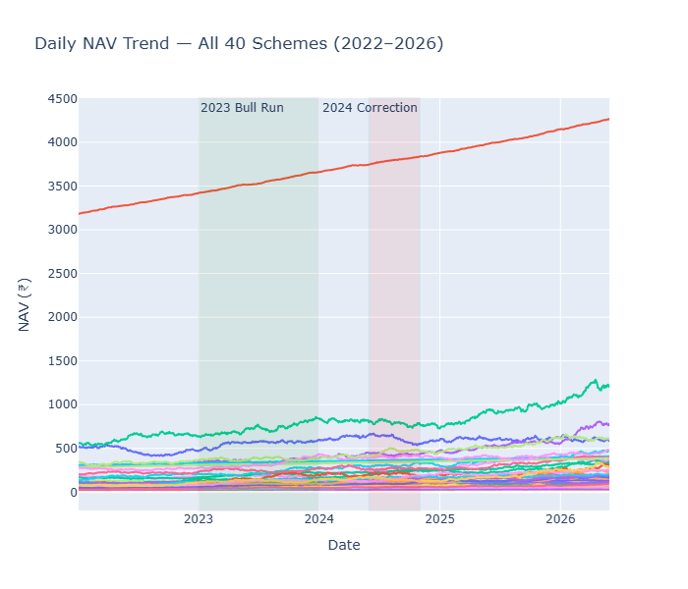
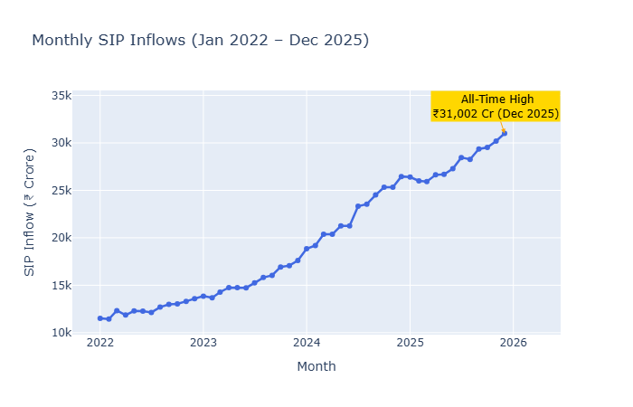
5 | EDA Highlights — NAV Trends & SIP Growth
9 publication-quality charts produced using Plotly, Seaborn & Matplotlib
📊
📈
Chart 1: NAV Trend — All 40 Schemes (2022–2026)
Chart 3: Monthly SIP Inflow Trend (2022–2025)
Key Insight: All 40 NAVs grew 2x–3x over 4 years. 2023 bull run drove 15–22% gains. Oct–Nov 2024 correction was brief at ~7%.
Key Insight: SIP inflows tripled from Rs.11,000 Cr to Rs.31,002 Cr — structural retail savings behaviour, not a cyclical spike.
Bluestock Fintech Pvt. Ltd. | Mutual Fund Analytics Platform | June 2026 | Confidential
Notes:
Charts 1 and 3 from Day 3 EDA. NAV chart shows all 40 fund trajectories; SIP trend confirms India's mutual fund story is structural and long-term.

Slide 6
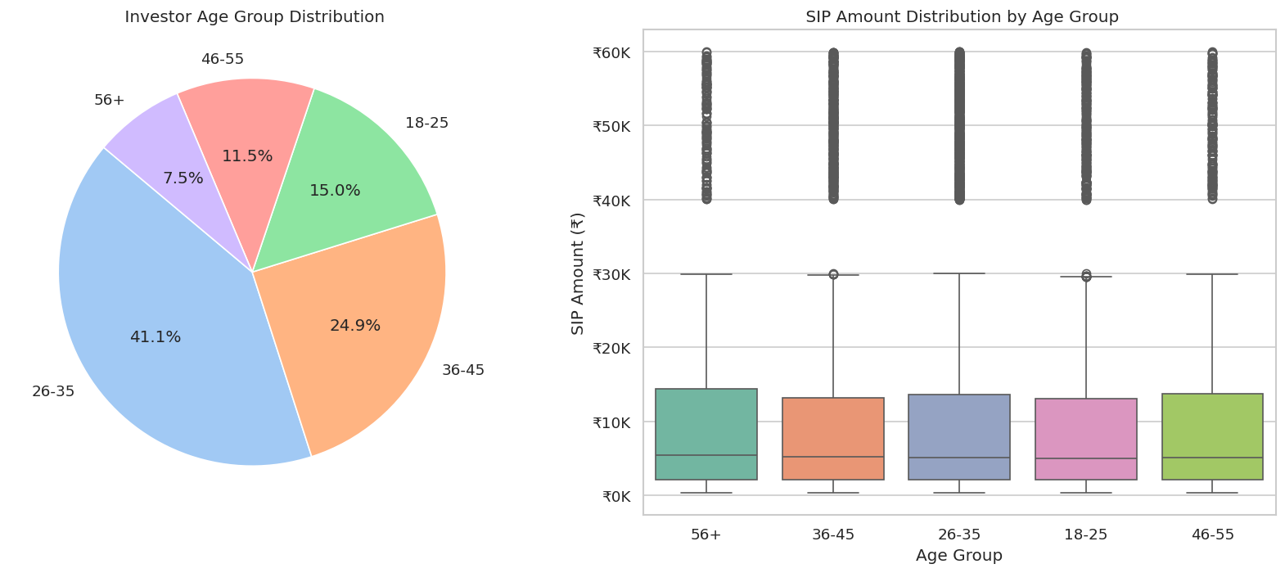
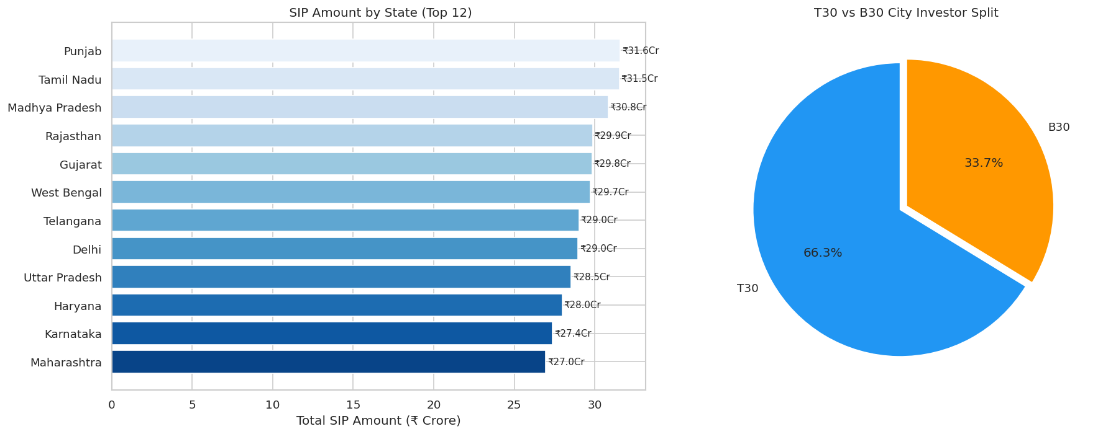
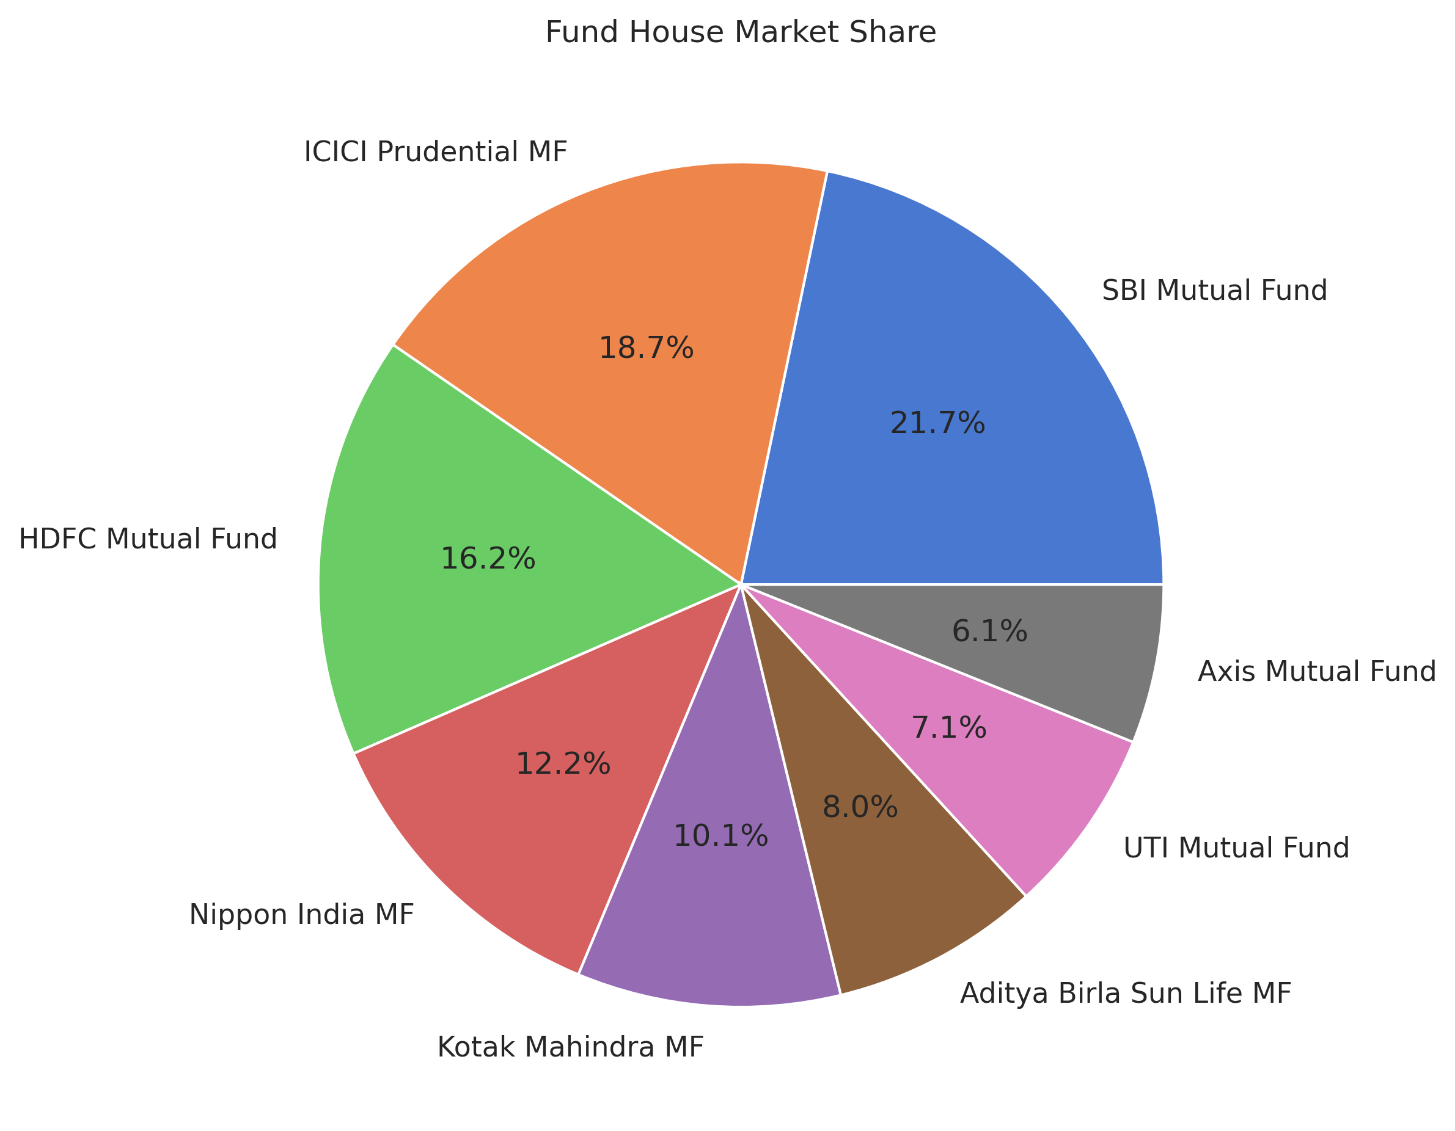
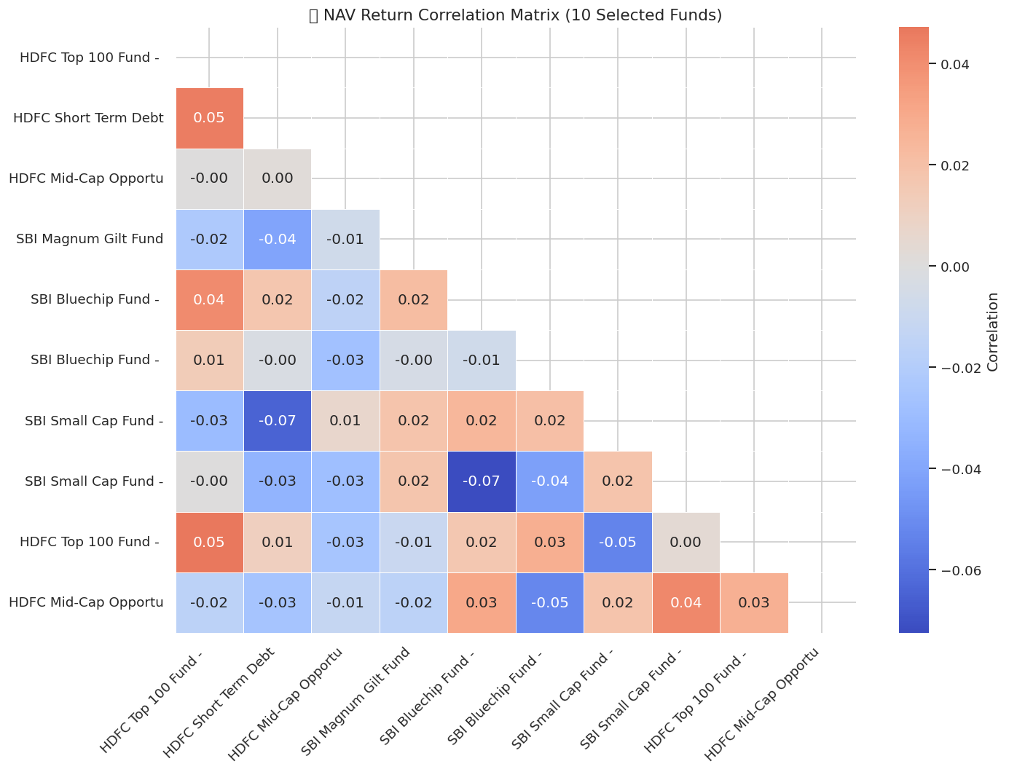
6 | EDA Highlights — Demographics & Geography
Chart 5: Investor Age Demographics
Chart 6: Geographic Distribution
[ ADD AGE DEMOGRAPHICS CHART ]
26–35 age group has most investors. But 46–55 cohort invests highest median SIP at Rs.12,000/mo — wealth concentration in experienced investors.
72% of SIP value from T30 cities. Maharashtra alone contributes 20%+. B30 share growing at 28% as AMFI commission incentives kick in.
Chart 7: Folio Count Growth
Chart 8: NAV Return Correlation Matrix
[ ADD FOLIO GROWTH CHART ]
Folios doubled from 13.26 Cr to 26.12 Cr in 4 years — 18.5% CAGR. Driven by Zerodha Coin, Groww, Paytm Money democratising access.
Large Cap funds correlate at 0.85–0.95. Holding SBI Bluechip + HDFC Top 100 + ICICI Bluechip gives almost zero diversification benefit.
Bluestock Fintech Pvt. Ltd. | Mutual Fund Analytics Platform | June 2026 | Confidential
Notes:
Demographics and geographic data reveal two key business opportunities: targeting B30 cities for growth, and the 46–55 age segment for high-value SIP retention.

Slide 7
7 | Performance Metrics — Fund Scorecard
7 Risk-Adjusted Metrics Computed from 46,000+ Daily NAV Records
Fund Scorecard Weights (0–100)
Metric | Formula / Method | Purpose
Daily Return | navₜ / navₜ₋₁ − 1 | Base metric for all calculations
CAGR | (NAVₑₙd/NAVₛₜₐᵣₜ)^(1/n) − 1 | Annualised return over 1/3/5 years
Sharpe Ratio | (Rp − Rf) / σp × √252, Rf = 6.5% | Risk-adjusted return vs RBI rate
Sortino Ratio | (Rp − Rf) / σdown × √252 | Penalises only downside volatility
Alpha | OLS intercept × 252 (vs Nifty 100) | Excess return above benchmark
Beta | OLS slope (fund vs Nifty 100) | Market sensitivity (1.0 = market)
Max Drawdown | min(NAV / running_max_NAV − 1) | Worst peak-to-trough loss
3yr CAGR
30%
Sharpe Ratio
25%
Alpha
20%
Expense Ratio
15%
Max Drawdown
10%
Composite Scorecard
Weighted rank across 5 metrics → single 0–100 score for every fund scheme
Bluestock Fintech Pvt. Ltd. | Mutual Fund Analytics Platform | June 2026 | Confidential
Bluestock Fintech Pvt. Ltd. | Mutual Fund Analytics Platform | June 2026 | Confidential
Notes:
The Fund Scorecard aggregates 5 dimensions into one 0-100 score. This allows direct comparison across very different fund types. CAGR is highest-weighted at 30% as it is most relevant to retail investors.

Slide 8
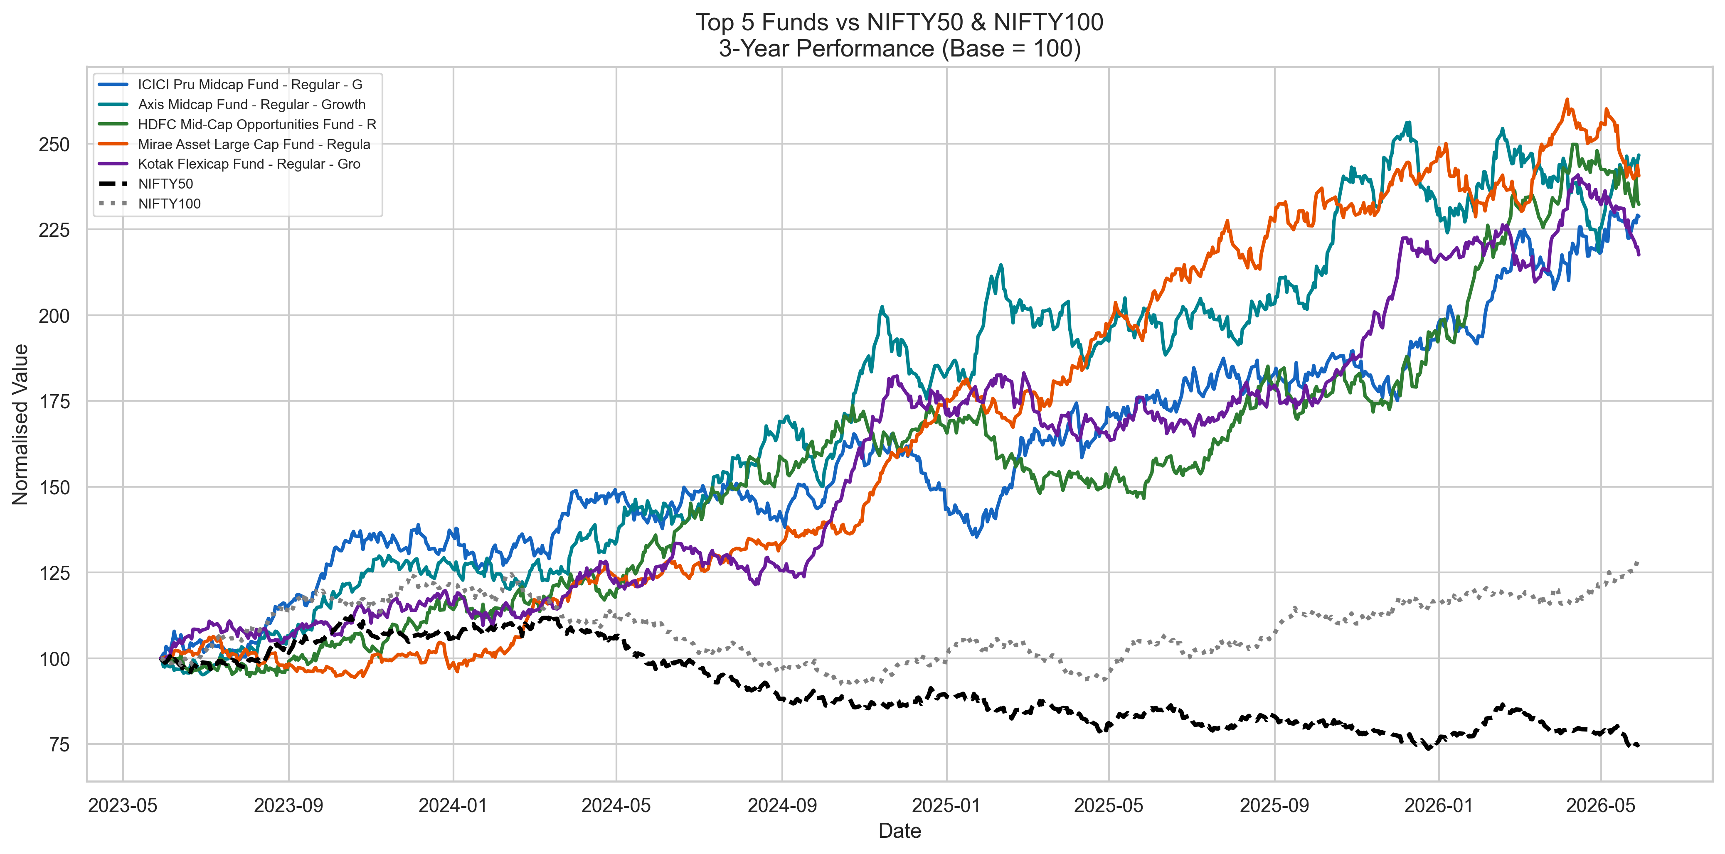
8 | Benchmark Comparison & Risk Findings
Chart 8: Benchmark Comparison
Key Risk Findings
[ ADD NAV vs BENCHMARK COMPARISON CHART
OR SCORECARD TOP-10 TABLE IMAGE HERE ]
Sharpe Range:
0.62 – 1.89
Higher = better risk-adjusted return
Alpha Range:
-4.2% to +8.7%
Positive = beats Nifty 100 benchmark
Beta Range:
0.71 – 1.35
<1 = less volatile than market
Max Drawdown:
-18% to -42%
Small Cap worst in Oct–Nov 2024
Historical VaR (95%): Small Cap: −2.1% to −2.8% daily • Large Cap: −1.3% to −1.6% daily • CVaR is 1.3–1.5× worse than VaR — fat tail risk persists in mid/small cap funds
Bluestock Fintech Pvt. Ltd. | Mutual Fund Analytics Platform | June 2026 | Confidential
Bluestock Fintech Pvt. Ltd. | Mutual Fund Analytics Platform | June 2026 | Confidential
Notes:
Day 4 analysis revealed that Small Cap funds carry significantly higher tail risk — VaR of 2.8% per day is nearly 2x that of Large Cap. The alpha range shows some funds genuinely outperform the Nifty 100 benchmark.

Slide 9
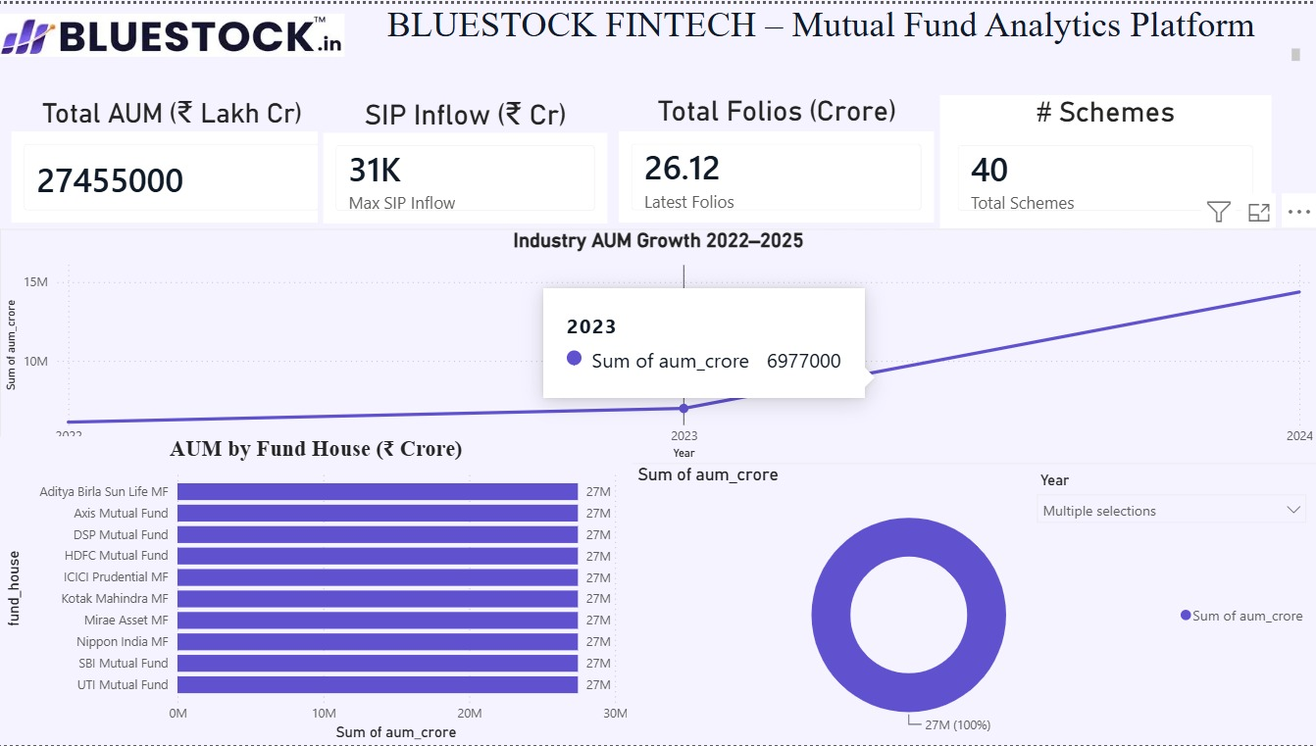
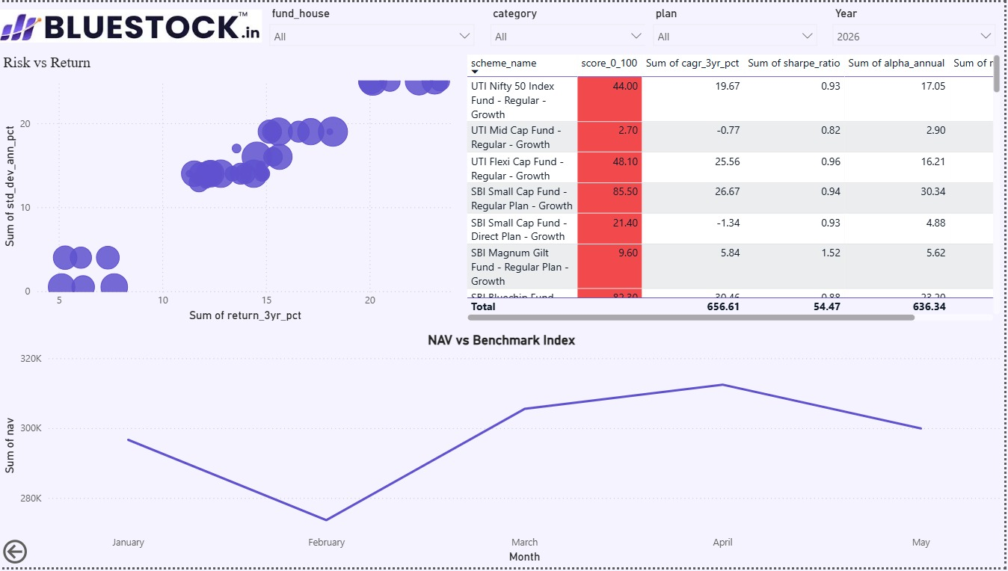
9 | Power BI Dashboard — Page 1 & 2
4-page interactive dashboard · Cross-filterable · Drill-through enabled · Bluestock brand theme
Page 1: Industry Overview
Page 2: Fund Performance
[ ADD DASHBOARD PAGE 1 SCREENSHOT HERE ]
[ ADD DASHBOARD PAGE 2 SCREENSHOT HERE ]
Slicer: Year
4 KPI cards • AUM trend line • AUM by AMC bar • Market share donut
Slicers: Fund House, Category, Plan
Risk vs Return scatter • Scorecard table • NAV line chart
✦ Drill-Through: Right-click any fund name in Page 2 table → Drill through → Nav_Detail → opens fund-specific NAV trend + metrics page filtered automatically
Bluestock Fintech Pvt. Ltd. | Mutual Fund Analytics Platform | June 2026 | Confidential
Notes:
Pages 1 and 2 are the core analytical views. The drill-through from Page 2 to Nav_Detail page is the showcase interactivity feature — it filters all visuals on the detail page to a single fund.

Slide 10
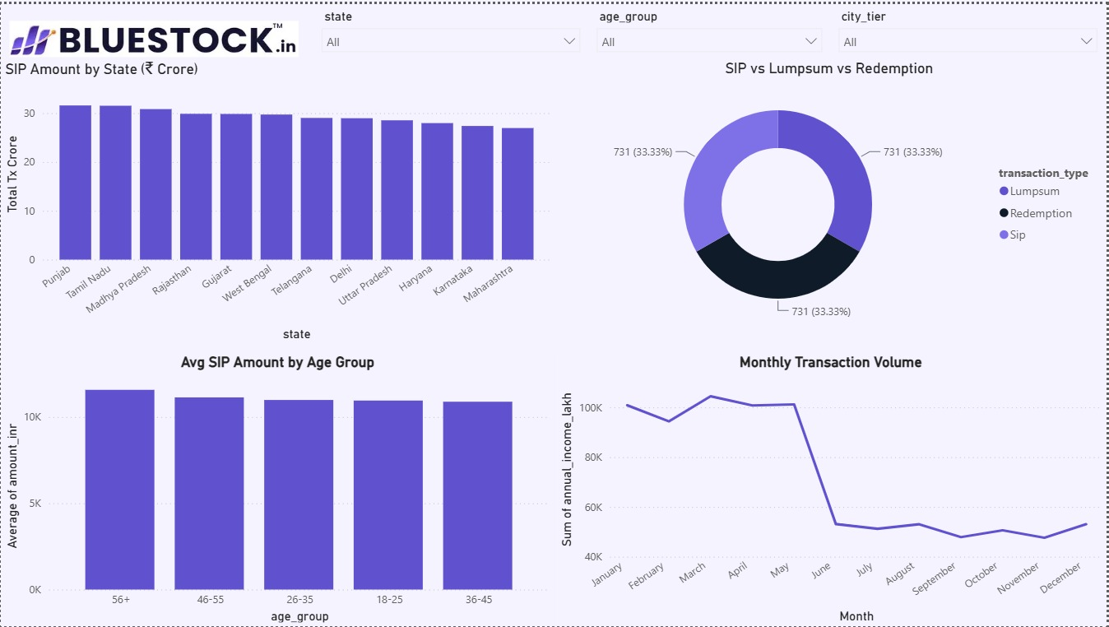
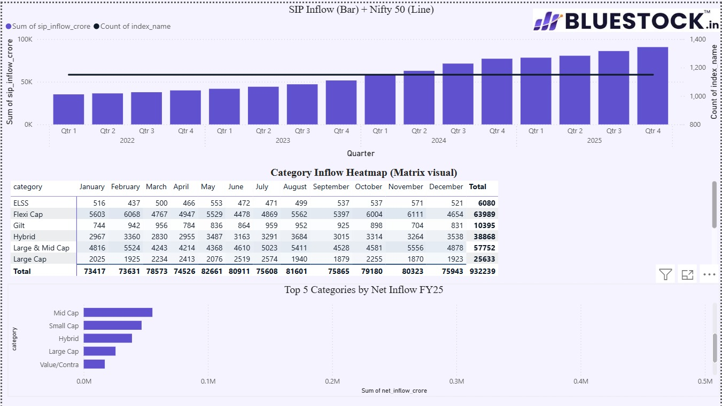
10 | Power BI Dashboard — Page 3 & 4
Page 3: Investor Analytics
Page 4: SIP & Market Trends
[ ADD DASHBOARD PAGE 3 SCREENSHOT HERE ]
[ ADD DASHBOARD PAGE 4 SCREENSHOT HERE ]
Slicers: State, Age Group, City Tier
SIP by state • SIP/Lump/Redemption donut • Age group bar • Volume line
No slicer (full-period view)
SIP inflow bar + Nifty 50 dual-axis • Category heatmap • Top 5 bar
KPI Cards: Rs.81L Cr Total AUM • Rs.31K Cr SIP Inflow • 26.12 Cr Folios • 1,908 Schemes • 9.35 Cr Active SIP A/Cs
Cross-Filtering:
Click any visual to filter all others on the page
Tooltips:
Hover any chart point → scheme name, Sharpe, Alpha, AUM
Drill-Through:
Right-click fund → Nav_Detail page filtered to that fund
Slicers:
Fund House / Category / Plan / State / Age / City Tier
Bluestock Fintech Pvt. Ltd. | Mutual Fund Analytics Platform | June 2026 | Confidential
Notes:
Pages 3 and 4 focus on investor behaviour and macro market trends. The cross-filtering means every click is interactive — selecting Maharashtra in Page 3 instantly filters age, transaction type, and volume for that state.

Slide 11
11 | 10 Key Findings
1
SIP Growth Is Structural
HIGH
2
SBI MF Unassailable AUM Lead
HIGH
Inflows 3× from Rs.11K→Rs.31K Cr with no reversal, even during corrections.
AUM doubled to Rs.12.5L Cr in 3 yrs via govt-bank B30 distribution.
3
MF Participation Doubled
HIGH
4
Large Cap Over-Correlated
HIGH
Folios: 13.26 Cr → 26.12 Cr, 18.5% CAGR — digital platforms key driver.
0.85–0.95 correlation means SBI Bluechip + HDFC Top 100 = no diversification.
5
BFSI+IT = 50% Portfolio Risk
MED
6
T30 Cities Dominate
MED
BFSI 32% + IT 18% — sector concentration creates systemic risk.
72% SIP value from T30. Maharashtra 20%+. B30 growing at 28% share.
7
Tax-Season ELSS Spike
MED
8
2023 Bull Run Rewarded SIPs
HIGH
Predictable Jan–Mar surge driven by 80C tax-saving deadline Mar 31.
SIP investors averaged into low NAVs in 2022 → captured 15–22% recovery.
9
Experienced Investors Invest Most
MED
10
23% SIP Investors At-Risk
MED
46–55 age: Rs.12,000/mo median SIP vs Rs.5,000 for 26–35.
6+ SIP gap > 35 days — need targeted re-engagement campaigns.
Bluestock Fintech Pvt. Ltd. | Mutual Fund Analytics Platform | June 2026 | Confidential
Notes:
10 findings distilled from 7 days of analysis. High-priority items (purple) are actionable immediately. The 23% at-risk SIP investors is a direct revenue retention opportunity for Bluestock's product team.

Slide 12
Bluestock Fintech Pvt. Ltd. | Mutual Fund Analytics Platform | Capstone Project
Thank You
Questions & Discussion
🔗 GitHub
📧 Email
🌐 Website
github.com/sumeetwagh01/bluestock_mf_capstone
sumeetw940@gmail.com
bluestock.in
Project Deliverables Summary
D1
D2
D3
D4
D5
D6
D7
ETL Pipeline
SQLite DB
EDA Notebook
Perf Metrics
Dashboard
Adv Analytics
Report+Slides
.py
.db
.ipynb
.ipynb+CSV
.pbix
.ipynb
.pdf+.pptx
Project Status: COMPLETE • GitHub Tag: v1.0 • Confidential — Bluestock Fintech Pvt. Ltd.
Notes:
Thank you for attending. The full report, ETL pipeline, Jupyter notebooks, and Power BI dashboard are available on GitHub. Happy to take questions on any section — metrics computation, dashboard design, or data pipeline architecture.

