Slide 1

SMART INDIA HACKATHON 2026
SPECTRA — evidence-scored signal analysis workbench
Problem Statement ID – SIH26147 (PS 147)
Problem Statement Title – Automated model for analysis of .IQ and .wav files along with signal parameter extraction
Theme – Miscellaneous
PS Category – Software · Organisation – NTRO
Team ID – <<TEAM ID>>
Team Name – <<TEAM NAME>>

Slide 2
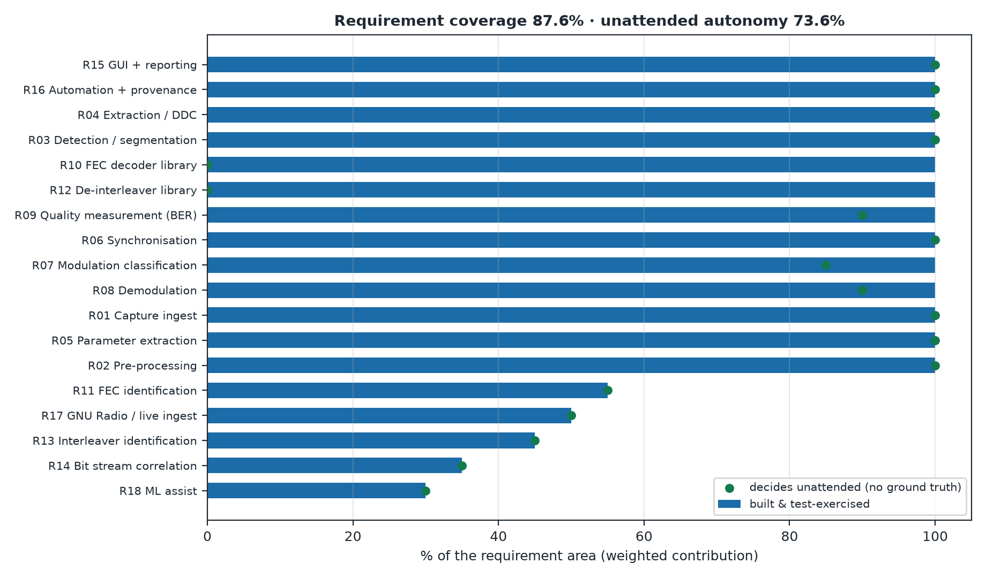
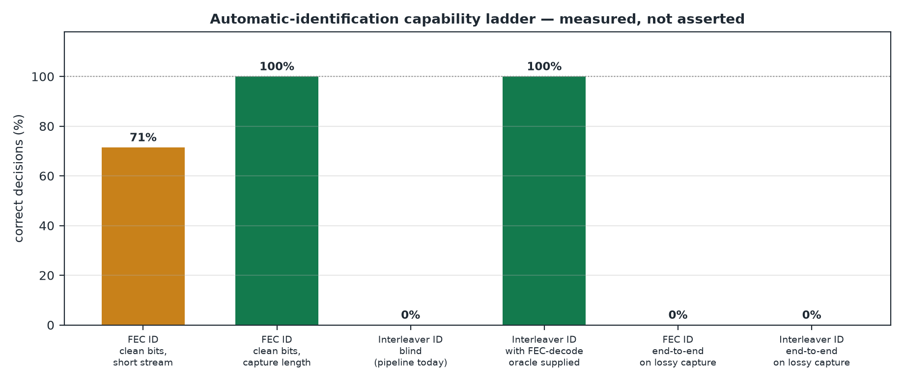
SPECTRA — evidence-scored IQ/WAV signal analysis workbench
<<TEAM NAME>>
Proposed Solution (Describe your Idea/Solution/Prototype)
Detailed explanation of the proposed solution
How it addresses the problem
Innovation and uniqueness of the solution
Problem: .IQ and .wav store the same waveform differently; manual analysis is slow, operator-dependent and not reproducible — and the missing detail (sampling rate, modulation, FEC, interleaving) is exactly what downstream sensors need.
Solution: one pipeline — load → detect → isolate → parameterise → synchronise → classify → demodulate → FEC / de-interleave → correlate → report.
Every stage returns value + method + confidence + evidence. "Unknown" is a first-class result: a confident wrong answer is worse than no answer.
Covered today: sampling rate / bandwidth / Fc / SNR / symbol rate · modulation (PSK, QAM, FSK, OOK/ASK) + demodulation · 6 FEC schemes (Viterbi, Reed-Solomon, LDPC, concatenated, Hamming, repetition) · 4 interleaver families · sync-word bit-stream correlation · GUI (spectrum, waterfall, constellation).
Innovation: evidence fusion instead of a single-shot guess · honest-Unknown by design · per-stage provenance for audit · closed-loop escalation · fully offline.
Status: 13 of 18 requirement areas built and test-verified in 13 days · 435 tests passing · 11/11 demo captures classified correctly · symbol-rate error ≤ 0.059%.

Slide 3
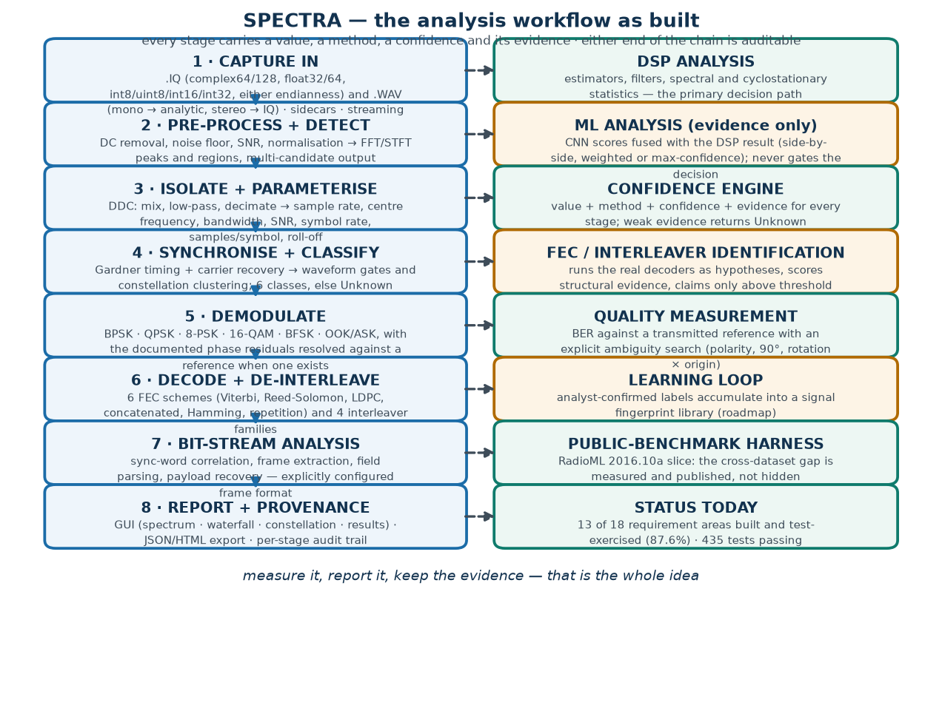
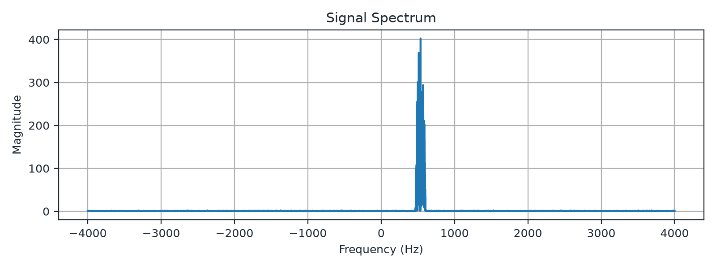
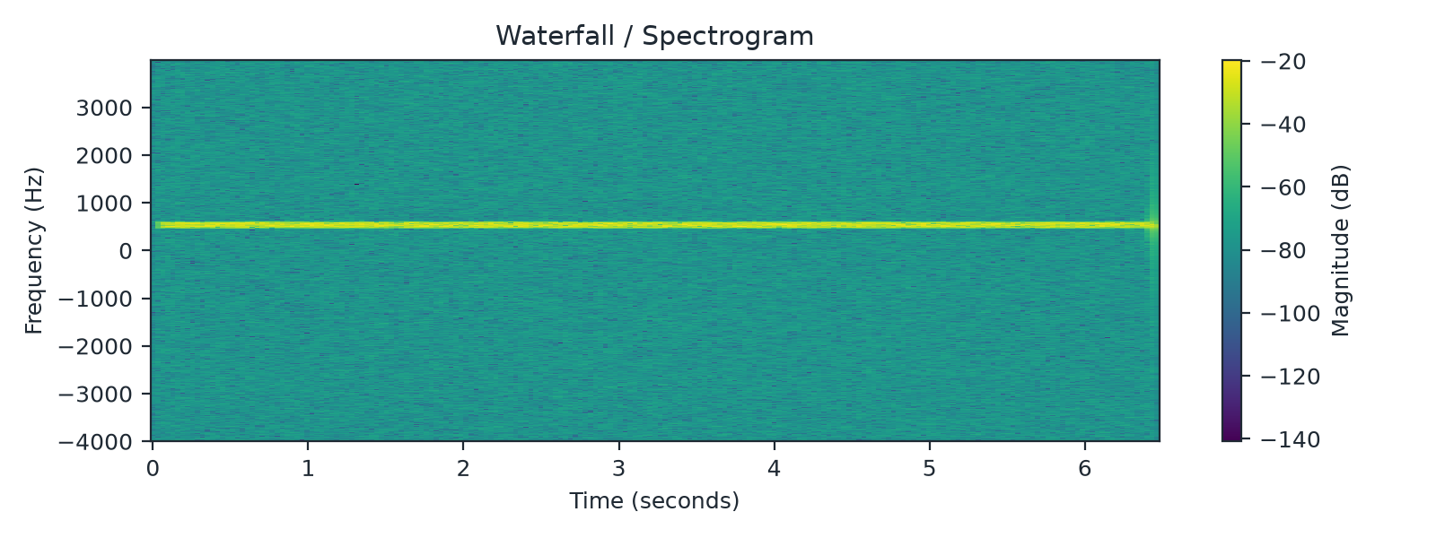
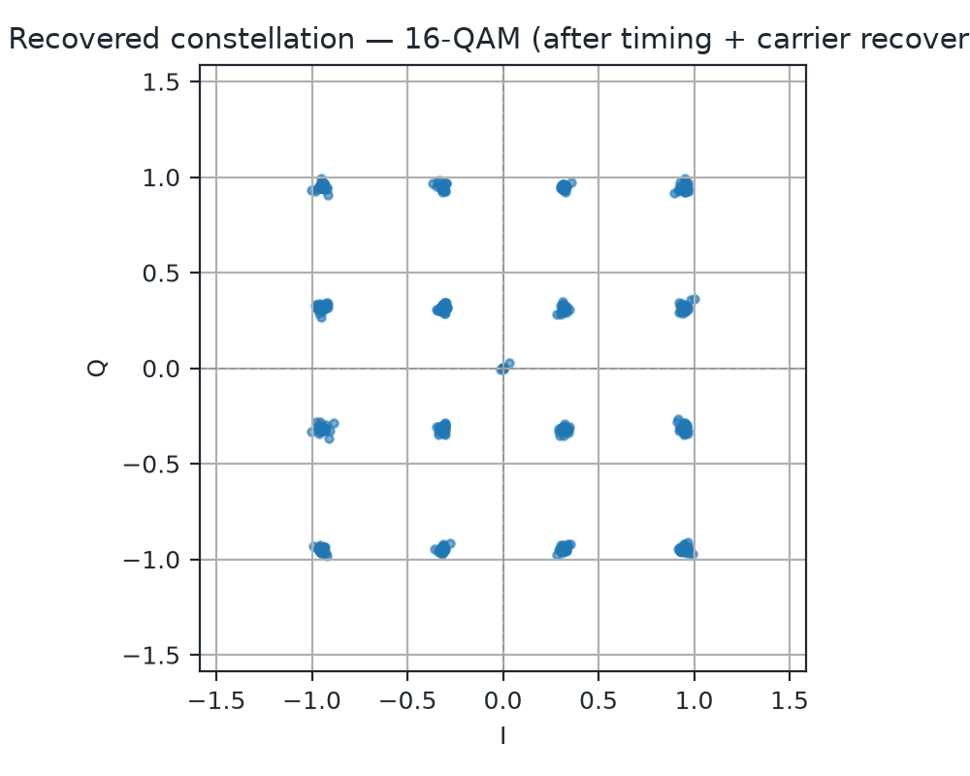
TECHNICAL APPROACH — built, not proposed
<<TEAM NAME>>
Technologies to be used (e.g. programming languages, frameworks, hardware)
Methodology and process for implementation (Flow Charts/Images/ working prototype)
Stack: Python 3.13 · NumPy / SciPy DSP core · PySide6 + matplotlib GUI · GNU Radio as the ingest layer · pytest · optional NumPy-only CNN · SigMF-style metadata sidecars · C++ kernels (planned).
Method: spectral detection → DDC isolation → parameter estimation (M-th power / QAM-specific / BFSK symbol-rate estimators) → Gardner timing and carrier recovery → waveform gates + constellation classification → per-modulation decisions → BER with an ambiguity search → FEC and interleaver identification → frame correlation.
Measured: 435 tests passing · 11/11 demo captures classified correctly · symbol-rate error ≤ 0.059% · RS and concatenated payloads recovered bit-exactly (1024/1024) · flagship 16-QAM + concatenated + block: BER 0.0, 1024 bits decoded.
Automatic identification, measured honestly: FEC 3/3 on clean coded streams (confidence 70–83); interleaver AUTO_DETECTED at depth 8 with confidence 1.0 when a FEC-decode validator is supplied; end-to-end on lossy captures it returns UNKNOWN/UNRESOLVED — root cause and milestone on Slide 4.

Slide 4
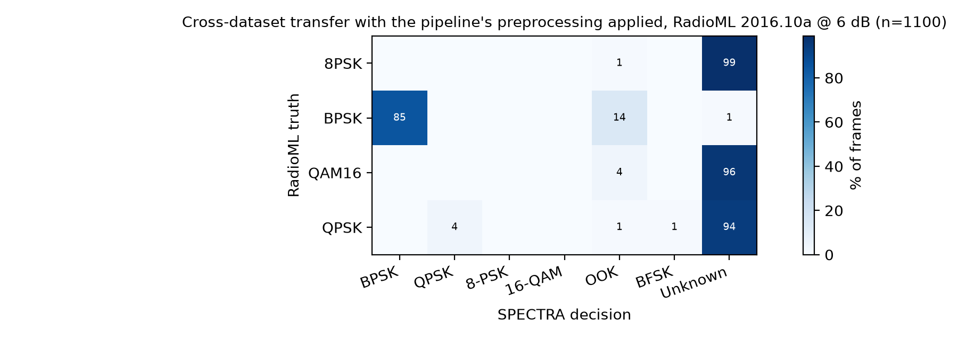
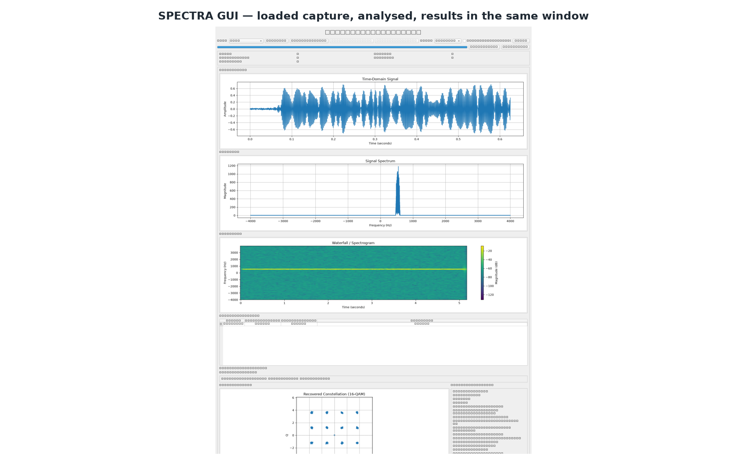
FEASIBILITY AND VIABILITY
<<TEAM NAME>>
Analysis of the feasibility of the idea
Potential challenges and risks
Strategies for overcoming these challenges
Feasible: pure software, 100% open-source, fully offline, no RF emission — evaluation is safe and reproducible. Band-agnostic by construction: all analysis runs on baseband captures, so HF / VHF / UHF / GHz use one chain.
Demonstrated: 8 commits in 13 days produced the full pipeline, the GUI and 387 test functions (435 tests passing).
Challenge → strategy, each measured:
· Blind FEC ID: 3/3 correct on clean coded streams (conf 70–83); UNKNOWN end-to-end on lossy captures because the pulse-shaping tail is lost → partial-codeword and soft-decision evidence (M2).
· Interleaver ID: AUTO_DETECTED, block, depth 8, confidence 1.0 with a FEC-decode validator; UNRESOLVED blind → wire the existing decoder as the validator (M1).
· Cross-dataset transfer: 22–25% agreement on 1100 public RadioML frames, and raw-mode input collapsed to a single answer → run the full front-end, train the learning layer, gate abstention (M3).
· Short records: symbol-rate error 84% at 512 samples while reporting 98.3 confidence → gate confidence by observation length (M4, cheapest win).
· No live SDR: GNU Radio is an ingest interface today; hardware backend is roadmap (M5) — evaluation never depends on procurement.
Viability: monitoring/SIGINT stations, SDR test benches, spectrum regulators and RF labs; workstation today, headless CLI for pipeline integration; zero licensing. Honest scope: validated on synthetic ground truth and a public benchmark slice — not on classified or operational recordings.

Slide 5
IMPACT AND BENEFITS
<<TEAM NAME>>
Potential impact on the target audience
Benefits of the solution (social, economic, environmental, etc.)
Analysts: hours of manual parameter hunting become one automated pass — with the method and confidence recorded, so the result can be defended.
Sensor engineering: the parameters this tool extracts are exactly the inputs needed to configure sensors. An honest Unknown prevents a mis-configured sensor; a confident wrong answer causes one.
Monitoring stations: consistent, reproducible extraction instead of operator-specific notes; batch mode sweeps every candidate in a wide capture.
Regulators, responders and labs: fast identification of unknown or legacy emitters during interference investigations, disaster communications and RF teaching.
Strategic / national: indigenous, offline, self-hosted spectrum tooling — no cloud dependency, no foreign closed-source licences (Atmanirbhar Bharat).
Economic: zero licensing cost, commodity hardware, convertible into a workstation product or an API for existing collection chains.
Social / educational: a documented, reproducible DSP testbed — including the negative results — for training the next cohort of RF analysts.
Long term: analyst-confirmed identifications grow a signal-fingerprint library, turning isolated captures into a queryable national signal knowledge base.

Slide 6
RESEARCH AND REFERENCES
<<TEAM NAME>>
Details / Links of the reference and research work
Benchmark used directly
· O'Shea et al., RadioML 2016.10a / 2018.01A (DeepSig) — the public AMC benchmark; our offline harness evaluates 1100 public frames and reports the cross-dataset gap.
Blind code and interleaver recognition
· ConvLSTM-TFN (Sensors 2025): >90% convolutional-code identification above 0 dB SNR — the accuracy target for our FEC-ID roadmap.
· CRANet (2025); dual-branch CNN (Sci. Rep. 2026) — DL blind code recognition under heterogeneous signals.
· Ahamed et al., IEEE Access 2024 — blind interleaver recognition with deep learning; Wee, Choi & Jeong — depth estimation from Hamming-weight distributions.
Standards that define our template library
· MIL-STD-188-110C and STANAG 4285/4539 — HF serial tone (convolutional + block interleaving): the terrestrial bands in the statement.
· CCSDS 131.0-B — RS + convolutional, turbo, LDPC. · DVB-S2 — LDPC + BCH with block interleaving. · 3GPP channel coding.
Tooling and metadata
· GNU Radio (acquisition interface) · SigMF, Hilburn GRCon 2018 (the metadata standard our sidecars align with) · PySDR · inspectrum · Universal Radio Hacker.
Classical links
· Gardner timing recovery · Costas loop · cyclostationary symbol-rate estimation · M-th power carrier-phase estimation.
Links: GitHub <<GITHUB LINK>> · demo <<DEMO VIDEO LINK>> · deepsig.ai/datasets · public mirror zenodo.org/records/18397070 · sigmf.org · wiki.gnuradio.org

