Slide 1
Heart Failure Prediction

Slide 2
Business Objective
The primary objective of this machine learning project is to develop a predictive model that accurately forecasts the probability of death due to heart failure in patients based on their health condition and clinical features. This model aims to support healthcare providers in making informed decisions regarding patient care and intervention strategies.

Slide 3
Project Architecture
Data collection and Loading
Dividing the dependent and independent variables
Splitting the data for training and validation
Results
Model training

Slide 4
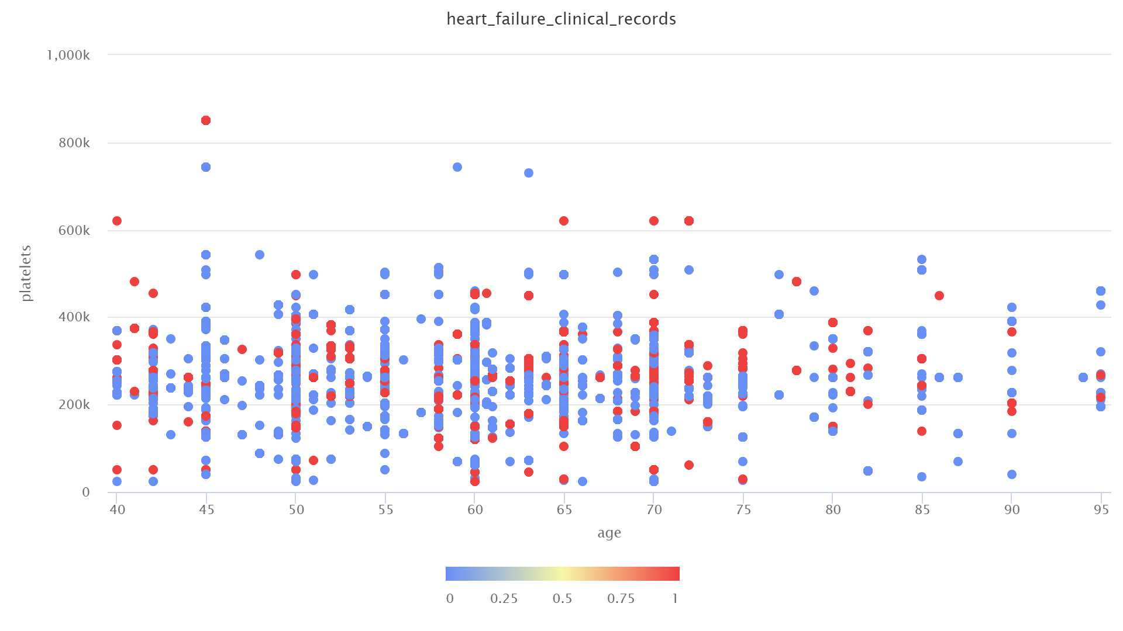
Age vs Platelets

Slide 5
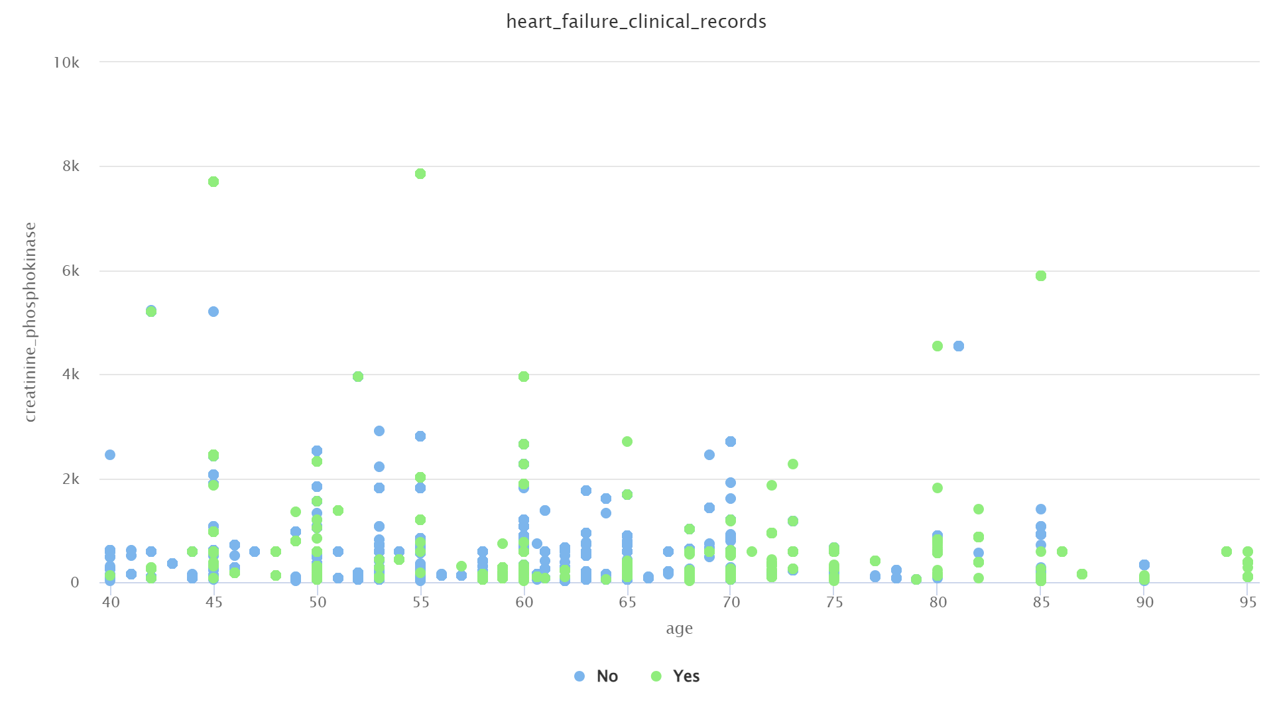
Age vs CPK

Slide 6
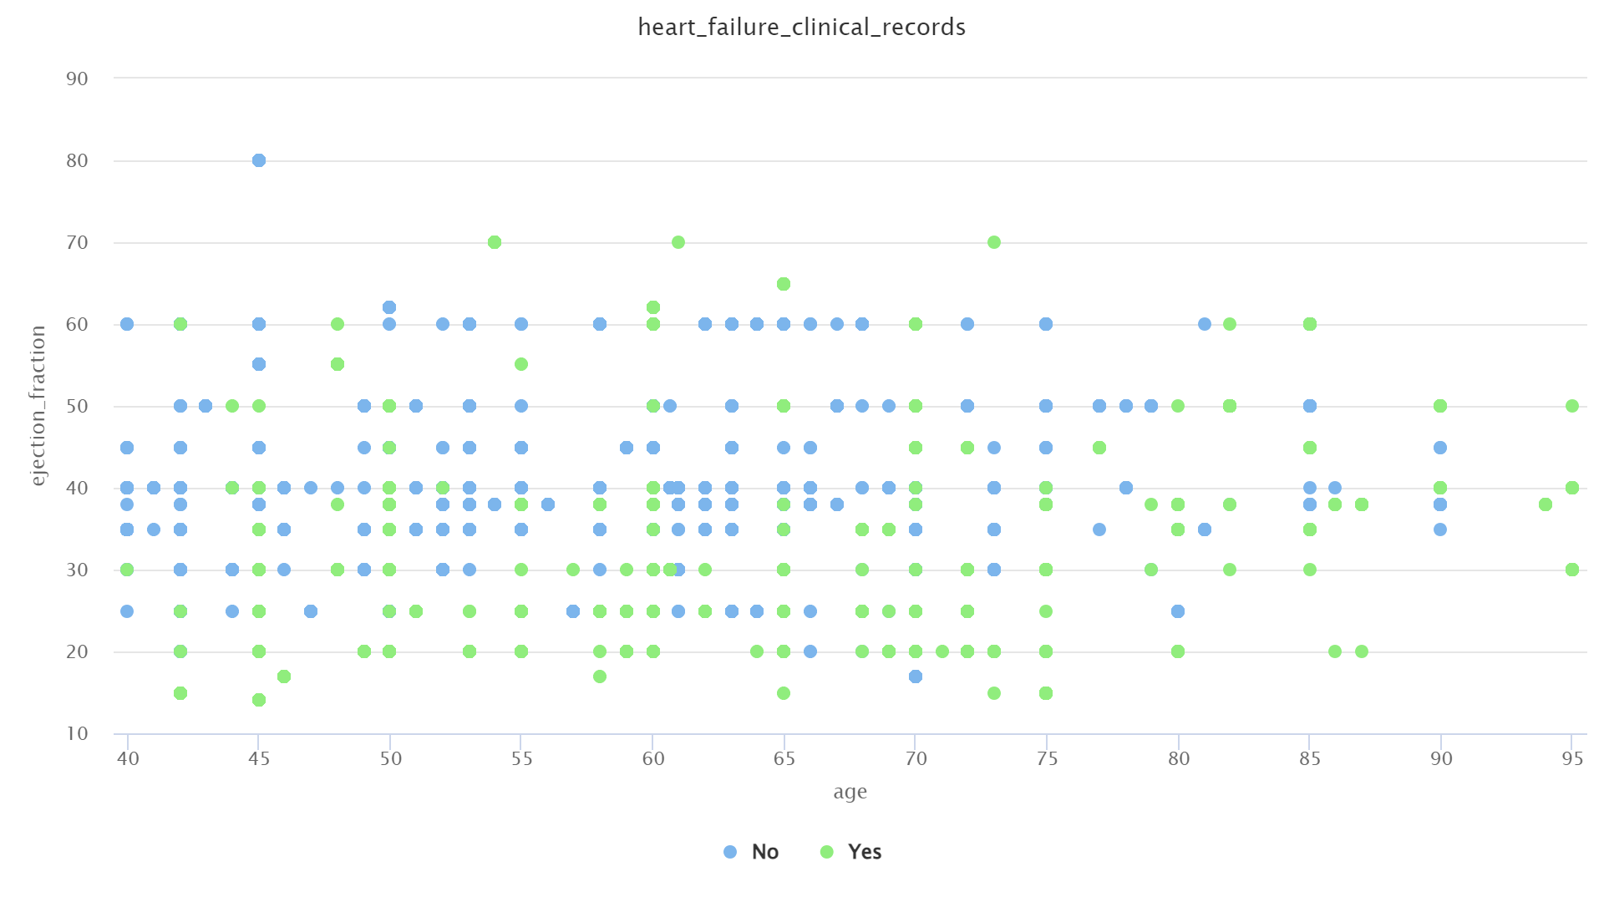
Age vs Ejection precentage

Slide 7
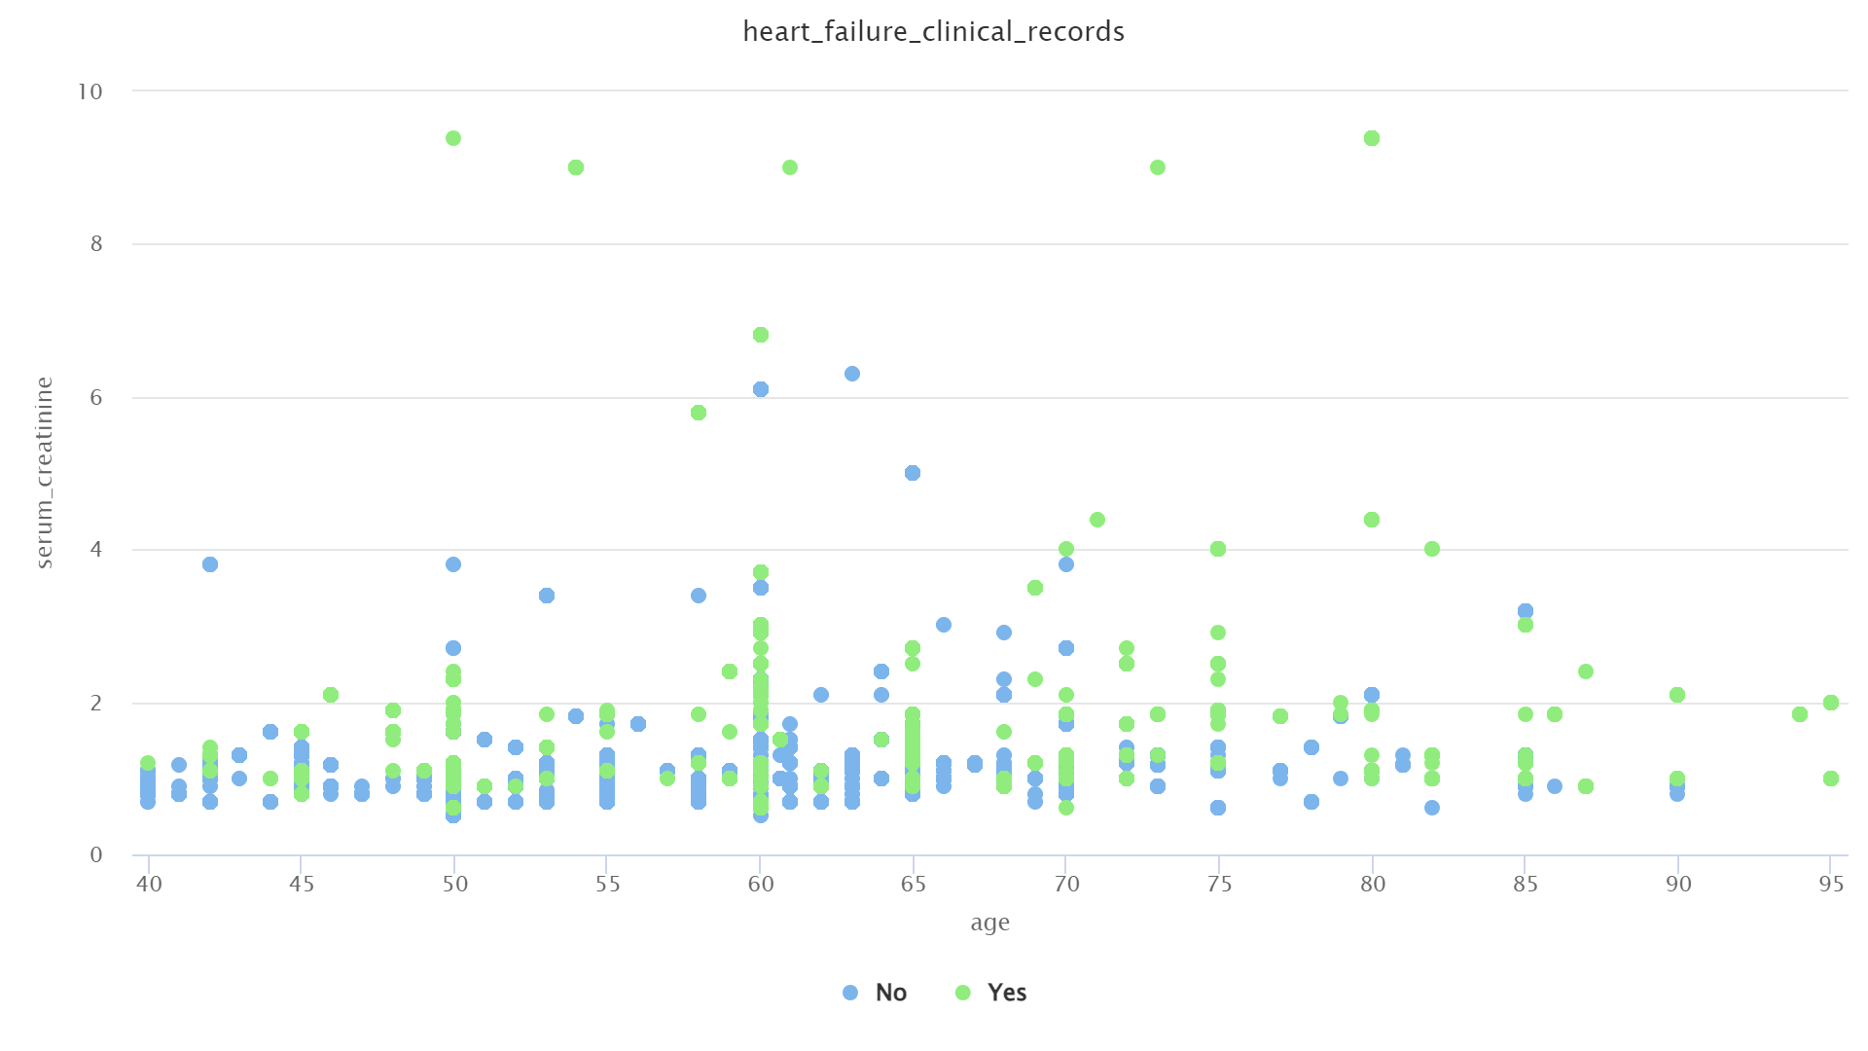
Age vs Creatinine

Slide 8
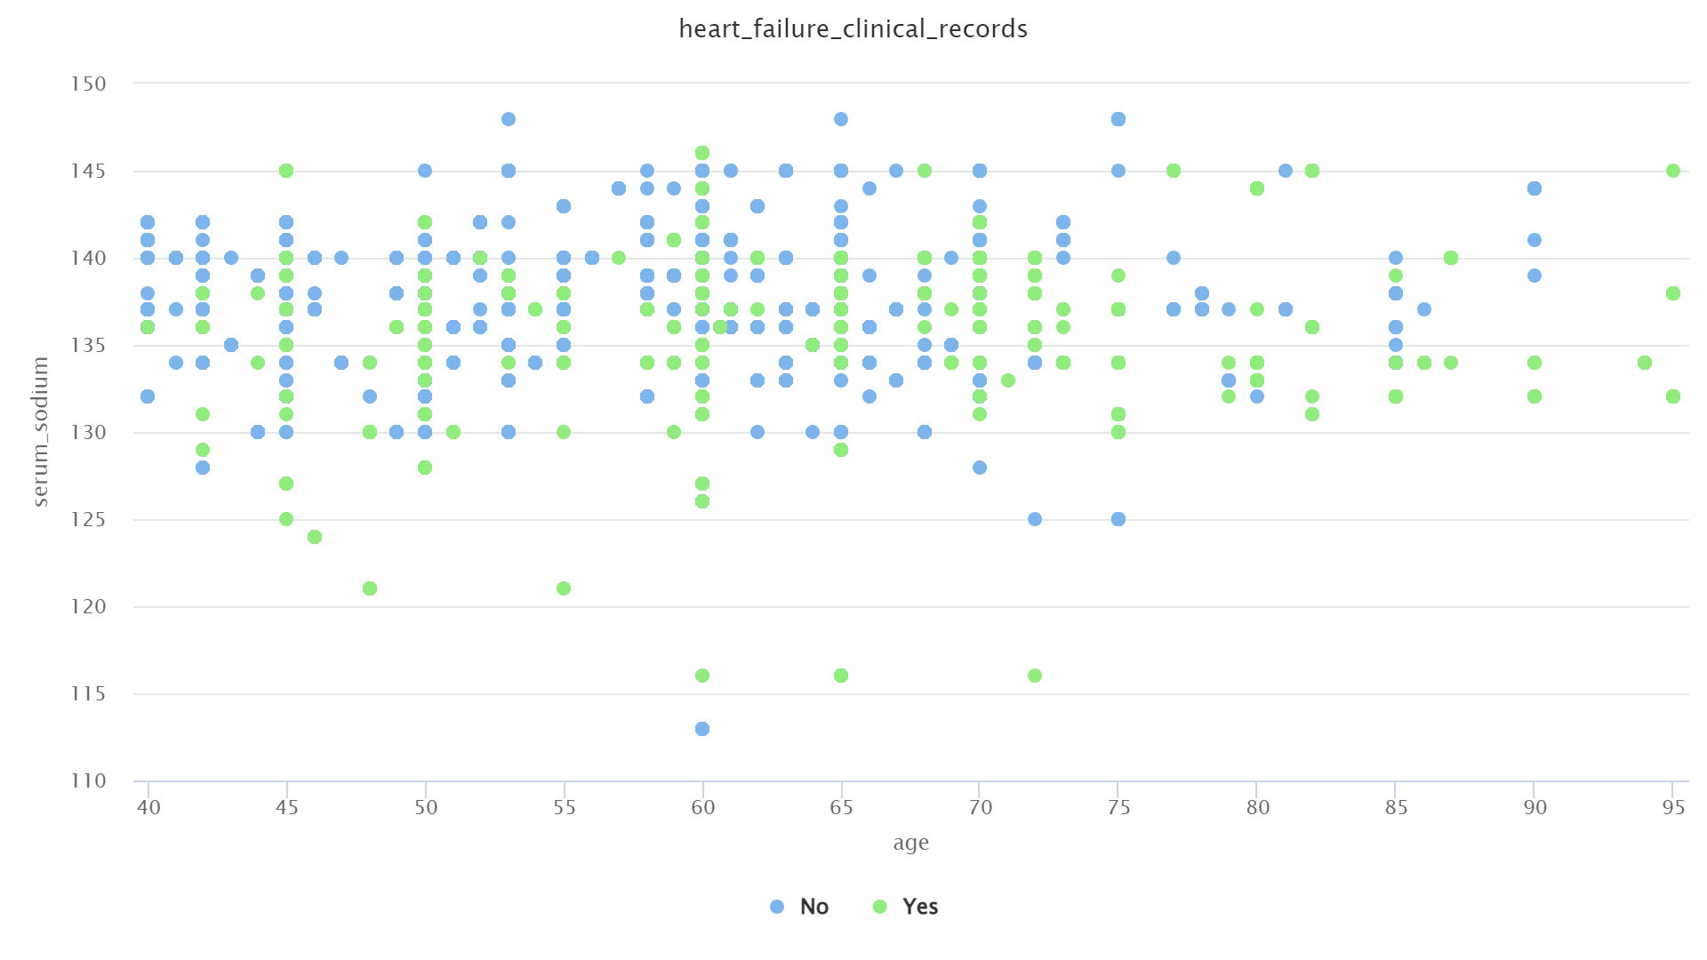
Age vs Sodium

Slide 9
Model Training
S.NO | MODEL | ACCURACY
1 | DecisionTreeClassifier | 1.00
2 | GaussianNB | 0.87
3 | GradientBoostingClassifier | 0.87
4 | RandomForestClassifier | 0.93
5 | SVC | 0.73
6 | KNeighborsClassifier | 0.27
7 | RidgeClassifier | 0.75
Even though DecisionTreeClassifier gave 100% accuracy , I took RandomForestClassifier model and trained it. Because DecisionTreeClassifier looks like it overfitted to the data.

Slide 10
Results
Confusion Matrix
 | true No | true Yes
pred. No | 986 | 61
pred. Yes | 44 | 409
Accuracy = 93%

Slide 11
Thank You
YouTube video link : https://youtu.be/lDuqos2fARA

